Slide 1
Introduction to Logic and Reasoning
if there is a storm, then the office is closed.
if the office is closed, then I don't go to work.
if there is a storm, then I don't go to work..

Slide 2
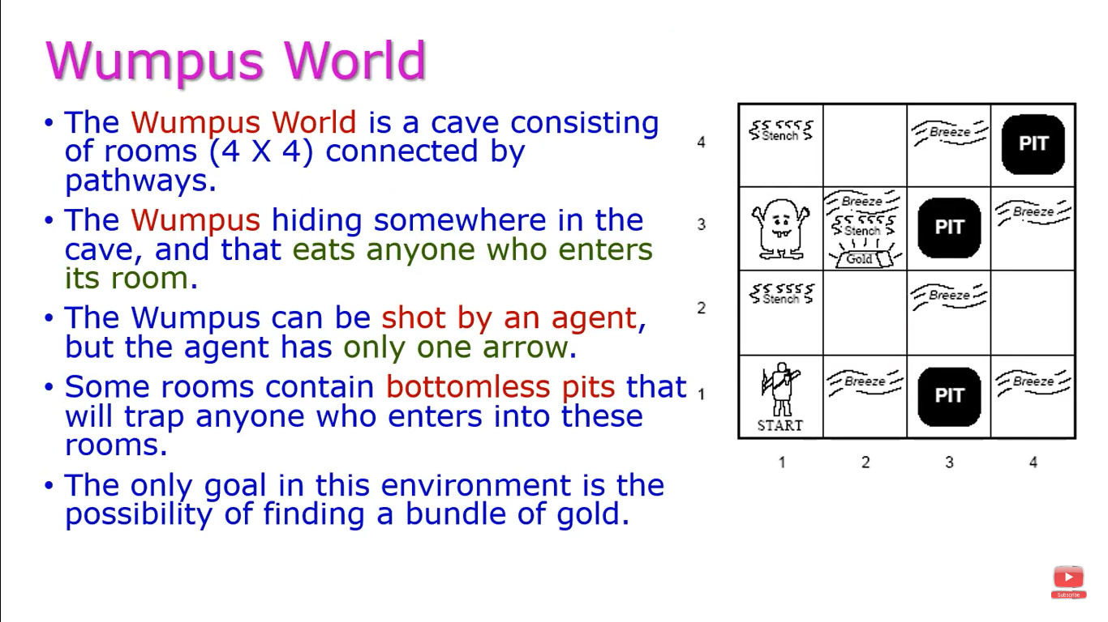
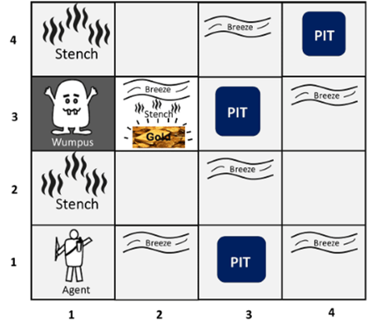


Slide 3
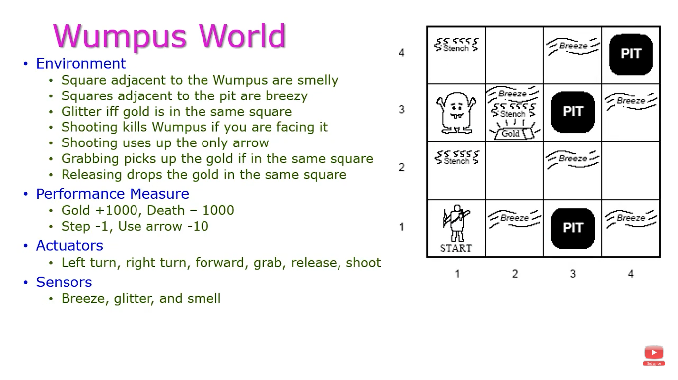

Slide 4
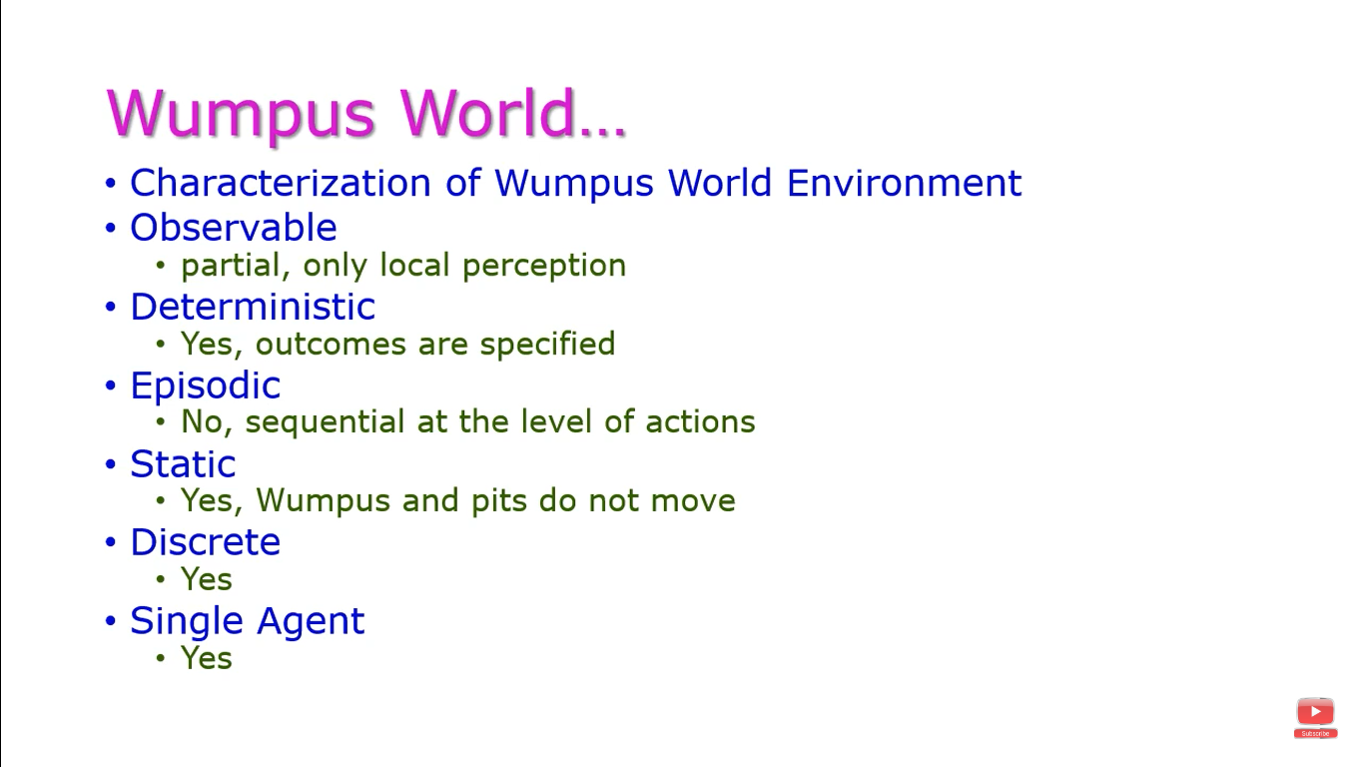

Slide 5
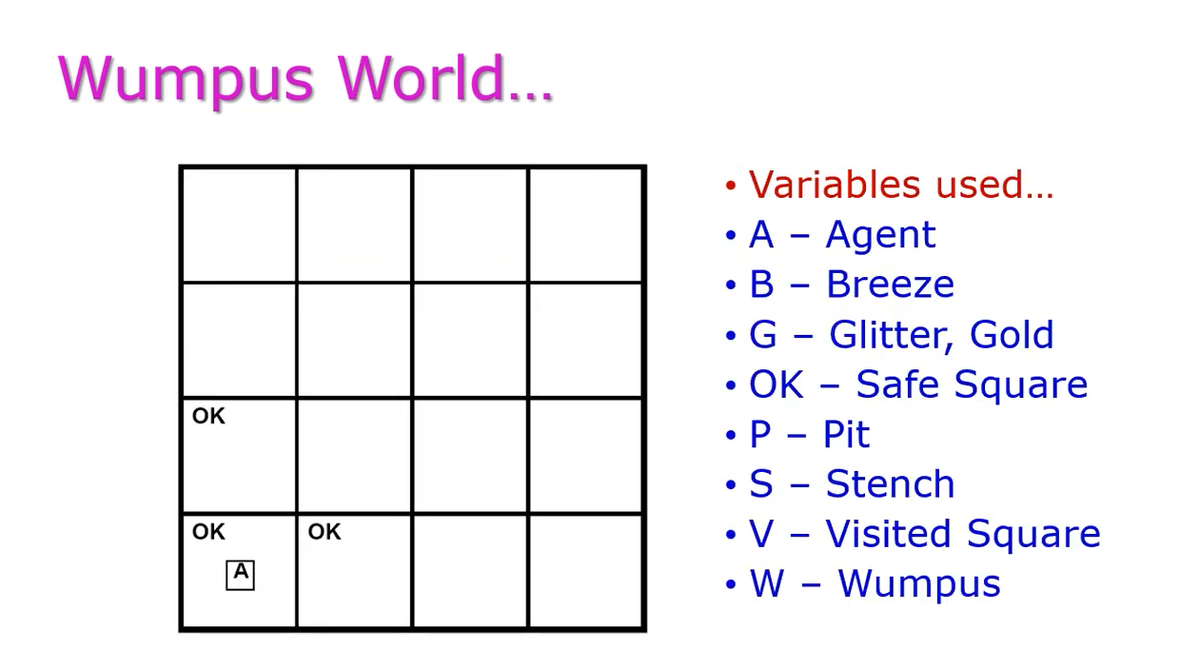

Slide 6
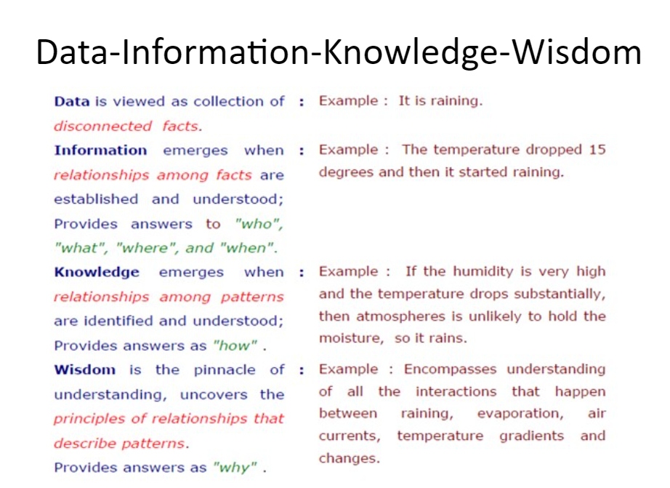

Slide 7
Definition
An intelligent agent needs knowledge about the real world for taking decisions and reasoning to act efficiently.
Knowledge-based agents are those agents who have the capability of maintaining an internal state of knowledge, reason over that knowledge, update their knowledge after observations and take actions. These agents can represent the world with some formal representation and act intelligently. Inference engine is a component of the system that applies logical rules to the knowledge base to deduce new information
Knowledge-based agents are composed of two main parts:
  Knowledge-base and
  Inference system.

Slide 8
Properties of Knowledge based Agent
An agent should be able to represent states, actions, etc.
An agent Should be able to incorporate new percepts
An agent can update the internal representation of the world
An agent can deduce the internal representation of the world
An agent can deduce appropriate actions.

Slide 9
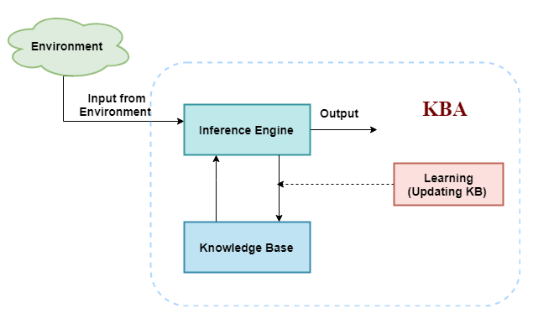
Architecture

Slide 10
Cont…
The above diagram is representing a generalized architecture for a knowledge-based agent.
The knowledge-based agent (KBA) take input from the environment by perceiving the environment.
The input is taken by the inference engine of the agent and which also communicate with KB to decide as per the knowledge store in KB.
The learning element of KBA regularly updates the KB by learning new knowledge.

Slide 11
Cont…
Knowledge-base is a central component of a knowledge-based agent, it is also known as KB.
It is a collection of sentences (here 'sentence' is a technical term and it is not identical to sentence in English).
These sentences are expressed in a language which is called a knowledge representation language.
The Knowledge-base of KBA stores fact about the world.

Slide 12
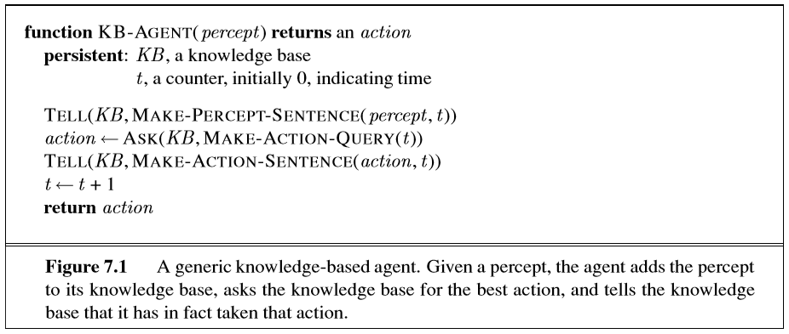
A generic knowledge-based agent

Slide 13
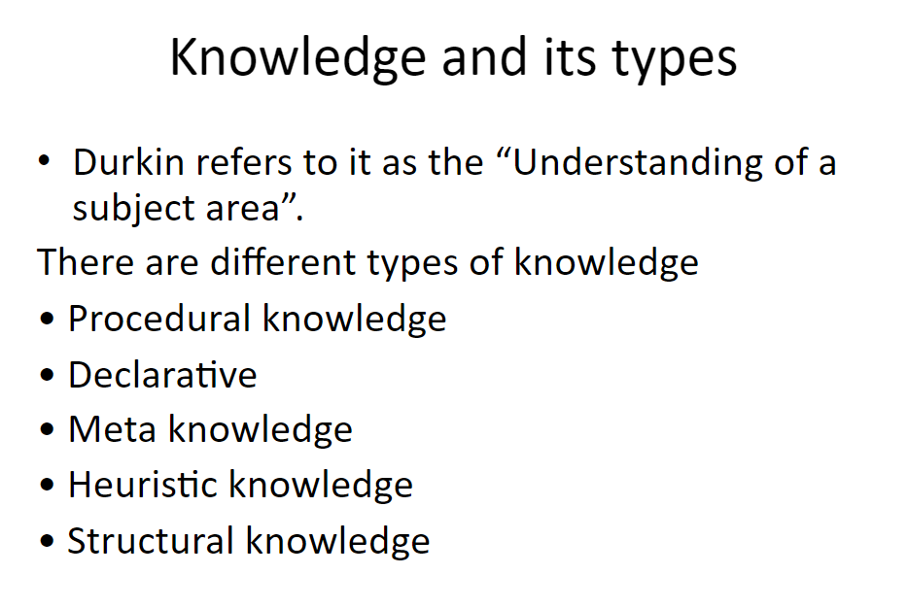

Slide 14
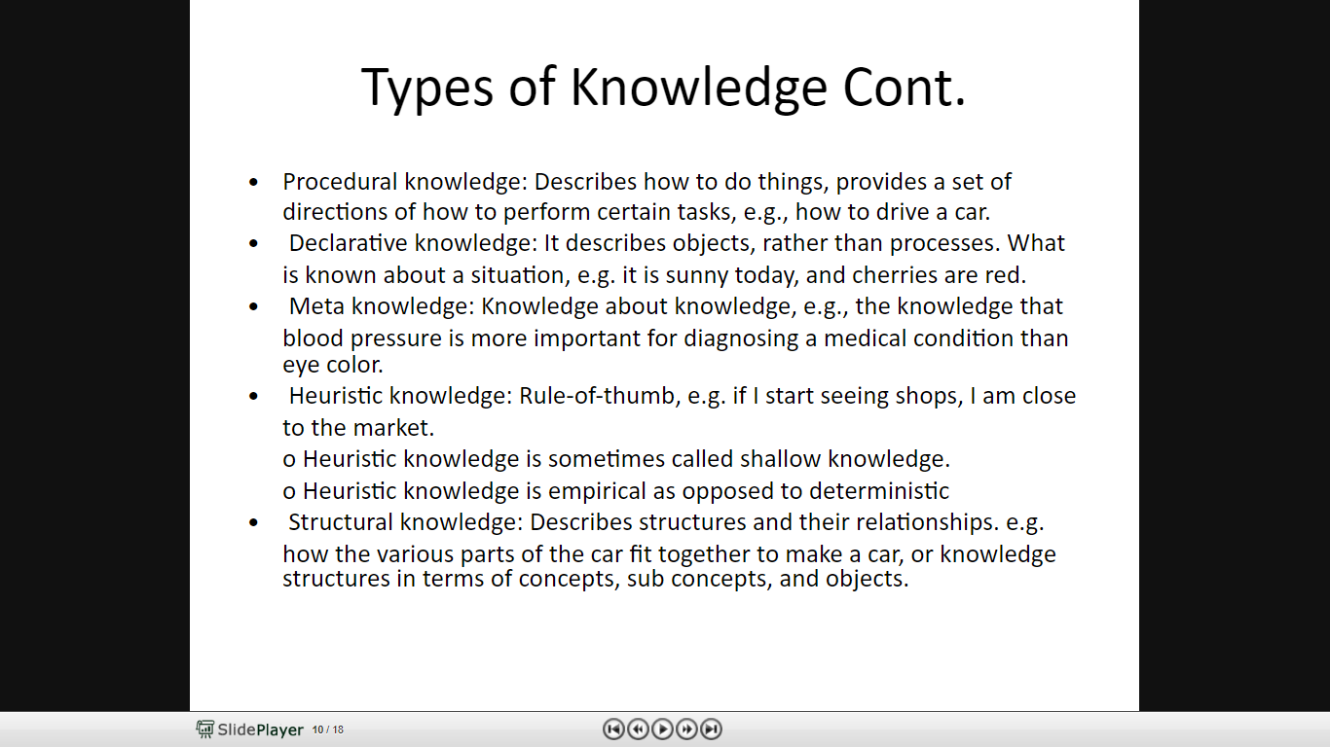

Slide 15
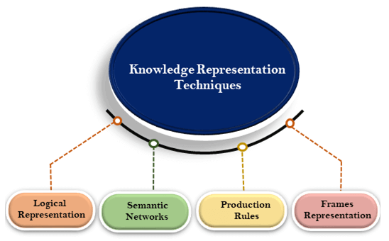
Knowledge Representation Techniques

Slide 16
Logical representation
Logical representation means drawing a conclusion based on various conditions.
This representation lays down some important communication rules.
It consists of precisely defined syntax and semantics which supports the sound inference.
Each sentence can be translated into logics using syntax and semantics.

Slide 17
Cont…
Syntax
Syntaxes are the rules which decide how we can construct legal sentences in the logic.
It determines which symbol we can use in knowledge representation.
How to write those symbols.
Semantics
Semantics are the rules by which we can interpret the sentence in the logic.
Semantic also involves assigning a meaning to each sentence.

Slide 18
Advantages & Disadvantages
Logical representation enables us to do logical reasoning.
Logical representation is the basis for the programming languages.
Logical representations have some restrictions and are challenging to work with.
Logical representation technique may not be very natural, and inference may not be so efficient.

Slide 19
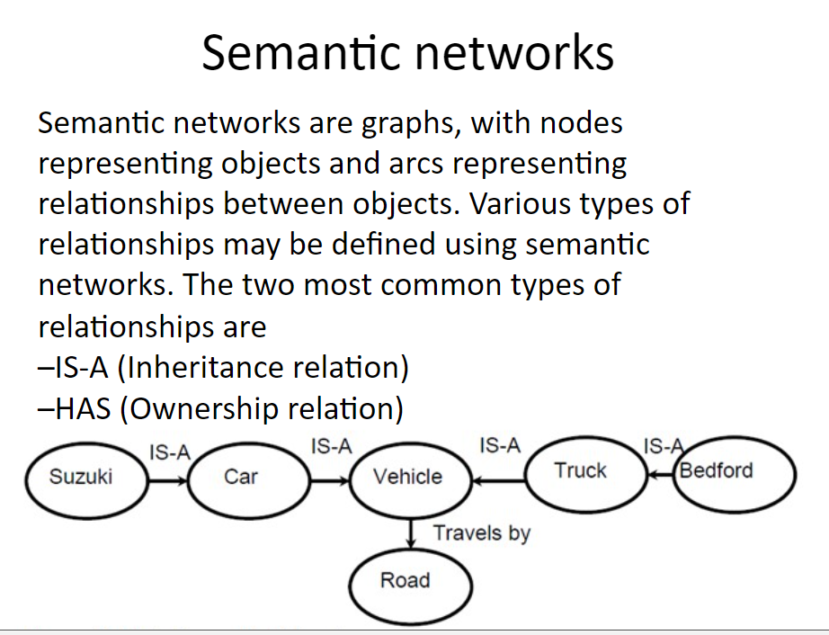

Slide 20
Semantic Network Representation
Semantic networks are alternative of predicate logic for knowledge representation.
In Semantic networks, we can represent our knowledge in the form of graphical networks.
This network consists of nodes representing objects and arcs which describe the relationship between those objects.
Semantic networks can categorize the object in different forms and can also link those objects.
Semantic networks are easy to understand and can be easily extended.
This representation consist of mainly two types of relations:
IS-A relation (Inheritance)
Kind-of-relation

Slide 21
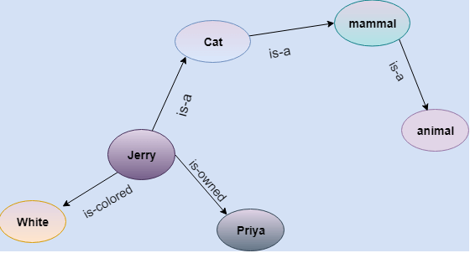
Cont…
Jerry is a cat.
Jerry is a mammal
Jerry is owned by Priya.
Jerry is brown colored.
All Mammals are animal.

Slide 22
Advantages of Semantic network
Semantic networks are a natural representation of knowledge.
Semantic networks convey meaning in a transparent manner.
These networks are simple and easily understandable.

Slide 23
Drawbacks in Semantic representation
Semantic networks take more computational time at runtime as we need to traverse the complete network tree to answer some questions. It might be possible in the worst case scenario that after traversing the entire tree, we find that the solution does not exist in this network.
Semantic networks do not have any standard definition for the link names.
These networks are not intelligent and depend on the creator of the system.

Slide 24
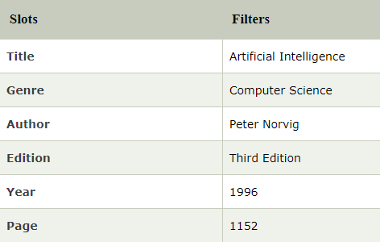
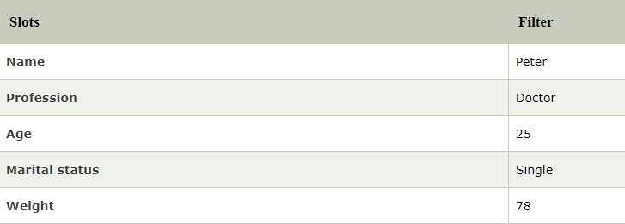
Frame Representation
A frame is a record like structure which consists of a collection of attributes and its values to describe an entity in the world.

Slide 25
Production Rules
Production rules system consist of (condition, action) pairs which mean, "If condition then action“.
Example:
IF (at bus stop AND bus arrives) THEN action (get into the bus)
IF (on the bus AND paid AND empty seat) THEN action (sit down).
IF (on bus AND unpaid) THEN action (pay charges).
IF (bus arrives at destination) THEN action (get down from the bus).

Slide 26
Advantages & Disadvantages
The production rules are expressed in natural language.
The production rules are highly modular, so we can easily remove, add or modify an individual rule.
Production rule system does not exhibit any learning capabilities, as it does not store the result of the problem for the future uses.
During the execution of the program, many rules may be active hence rule-based production systems are inefficient.

