Slide 1
Propositional Logic

Slide 2
Definition
Propositional logic (PL) is the simplest form of logic where all the statements are made by propositions.
A proposition is a declarative statement which is either true or false.
It is a technique of knowledge representation in logical and mathematical form.
Today is sunday.
The Sun rises from West (False proposition)
3+3= 7(False proposition)
5 is a prime number. (True Proposition)

Slide 3
Cont…
Propositional logic is also called Boolean logic as it works on 0 and 1.
In propositional logic, we use symbolic variables to represent the logic, and we can use any symbol for representing a proposition, such A, B, C, P, Q, R, etc.
Propositions can be either true or false, but it cannot be both.
Propositional logic consists of an object, relations or function, and logical connectives.
These connectives are also called logical operators.

Slide 4
Cont…
The propositions and connectives are the basic elements of the propositional logic.
Connectives can be said as a logical operator which connects two sentences.
A proposition formula which is always true is called tautology, and it is also called a valid sentence.
A proposition formula which is always false is called Contradiction.
Statements which are questions, commands, or opinions are not propositions such as "Where is Rohini", "How are you", "What is your name", are not propositions.

Slide 5
Cont…
There are two types of Propositions
Atomic Propositions
Compound propositions
Atomic Proposition
Atomic propositions are the simple propositions. It consists of a single proposition symbol. These are the sentences which must be either true or false.
Compound proposition
Compound propositions are constructed by combining simpler or atomic propositions, using parenthesis and logical connectives.

Slide 6


Example

Slide 7
Logical Connectives
Logical connectives are used to connect two simpler propositions or representing a sentence logically. We can create compound propositions with the help of logical connectives. There are mainly five connectives, which are given as follows:
Negation: A sentence such as ¬ P is called negation of P. A literal can be either Positive literal or negative literal.
Conjunction: A sentence which has ∧ connective such as, P ∧ Q is called a conjunction.
Example: ABC is intelligent and hardworking. It can be written as,
P= ABC is intelligent,
Q= ABC is hardworking. → P∧ Q

Slide 8
Cont…
Disjunction: A sentence which has ∨ connective, such as P ∨ Q. is called disjunction, where P and Q are the propositions.
Example: “DEF is a doctor or Engineer",
Here P= DEF is Doctor.
Q= DEF is Engineer, so we can write it as P ∨ Q.
Implication: A sentence such as P → Q, is called an implication. Implications are also known as if-then rules. It can be represented as
If it is raining, then the street is wet.
Let P= It is raining, and Q= Street is wet, so it is represented as P → Q
Biconditional: A sentence such as P⇔ Q is a Biconditional sentence,
example If I am breathing, then I am alive
P= I am breathing, Q= I am alive, it can be represented as P ⇔ Q.

Slide 9
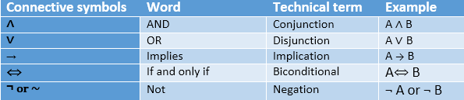
Propositional Logic Connectives

Slide 10
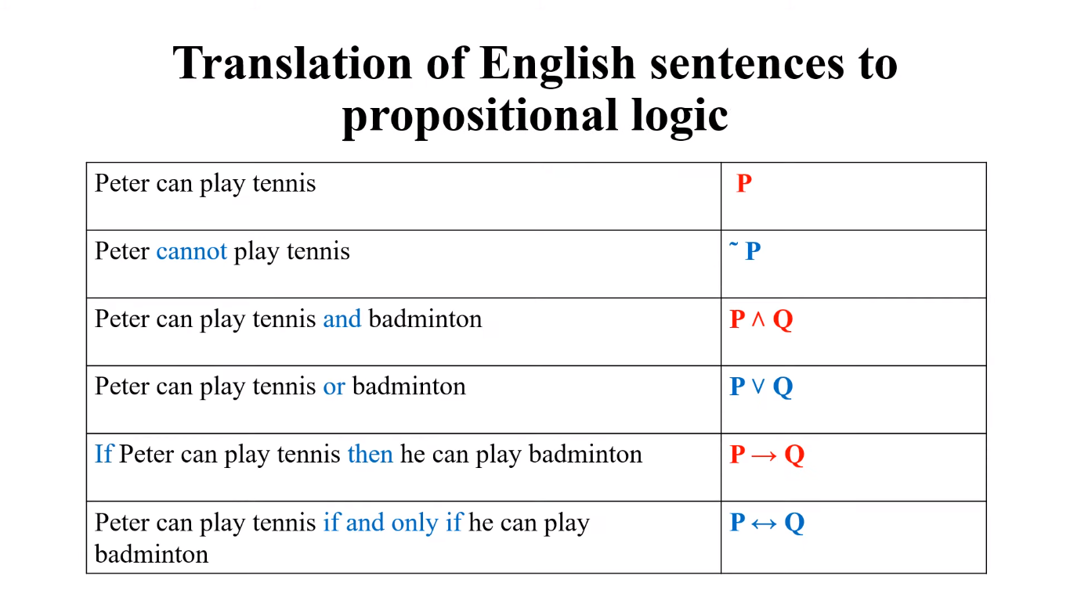


Slide 11
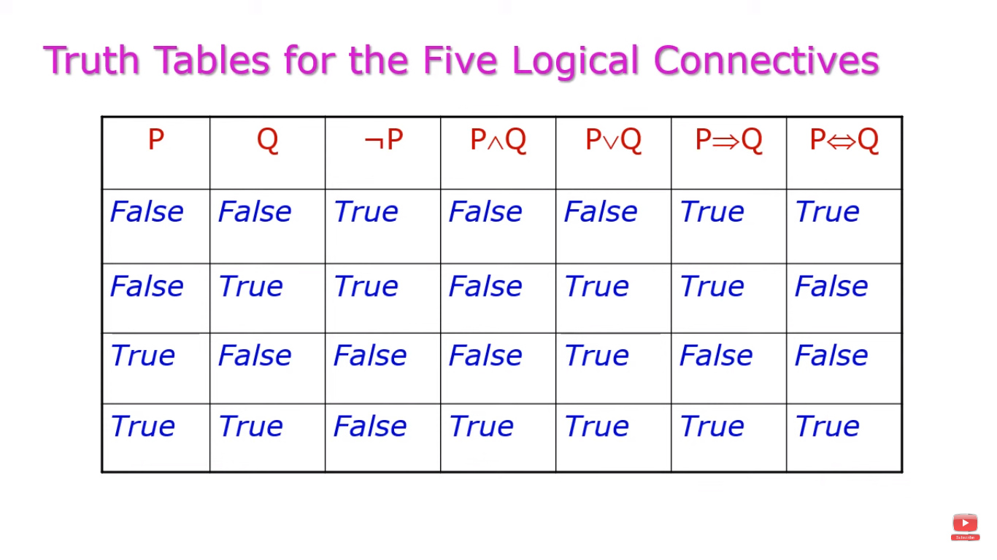

Slide 12
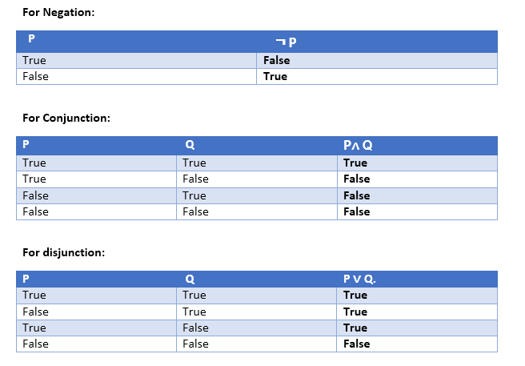
Truth Table

Slide 13
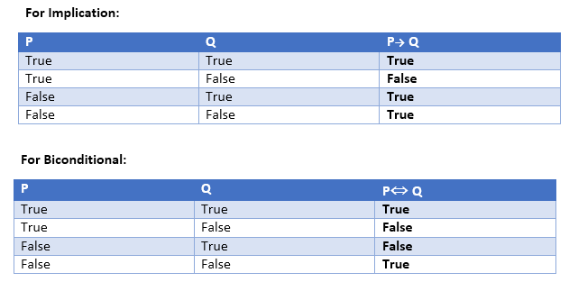
Cont…

Slide 14

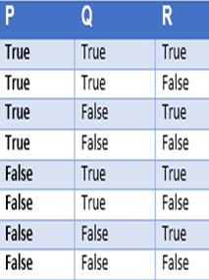
Cont…

Slide 15
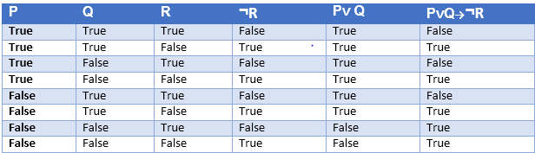
Truth table with three propositions

Slide 16

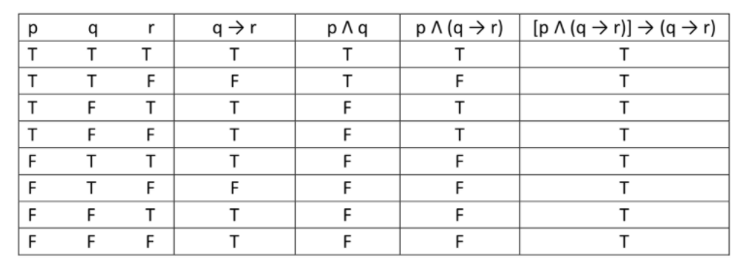
Examples

Slide 17

Examples

Slide 18
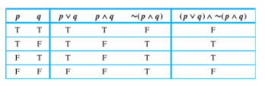
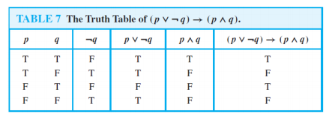
Cont…

Slide 19
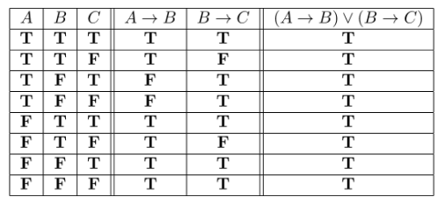
Cont…

Slide 20
Properties of Operators
Commutative:
  P∧ Q= Q ∧ P, or
  P ∨ Q = Q ∨ P.
Associative:
  (P ∧ Q) ∧ R= P ∧ (Q ∧ R),
  (P ∨ Q) ∨ R= P ∨ (Q ∨ R)
Identity element:
  P ∧ True = P,
  P ∨ True= True.

Slide 21
Cont…
Distributive:
  P∧ (Q ∨ R) = (P ∧ Q) ∨ (P ∧ R).
  P ∨ (Q ∧ R) = (P ∨ Q) ∧ (P ∨ R).
DE Morgan's Law:
  ¬ (P ∧ Q) = (¬P) ∨ (¬Q)
  ¬ (P ∨ Q) = (¬ P) ∧ (¬Q).
Double-negation elimination:
  ¬ (¬P) = P.

Slide 22
Inference Rules
Inference rules are the templates for generating valid arguments.
Inference rules are applied to derive proofs in artificial intelligence, and the proof is a sequence of the conclusion that leads to the desired goal.

Slide 23
Terminologies
Implication: It is one of the logical connectives which can be represented as P → Q. It is a Boolean expression.
Converse: The converse of implication, which means the right-hand side proposition goes to the left-hand side and vice-versa. It can be written as Q → P.
Contrapositive: The negation of converse is termed as contrapositive, and it can be represented as ¬ Q → ¬ P.
Inverse: The negation of implication is called inverse. It can be represented as ¬ P → ¬ Q.

Slide 24
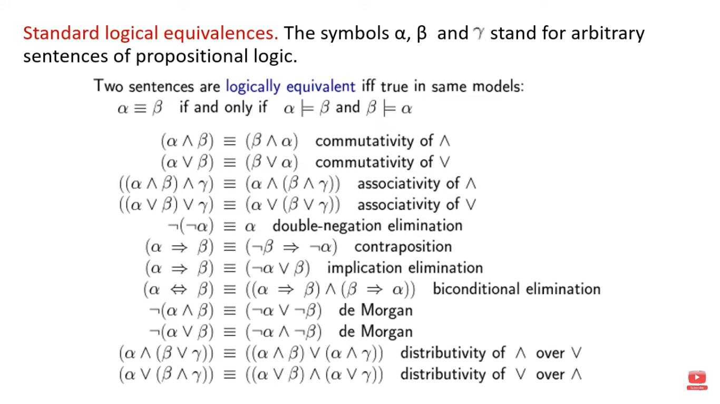

Slide 25
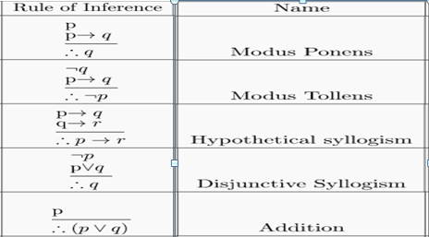
Inference Rules

Slide 26
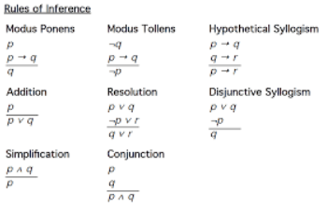
Cont…

Slide 27
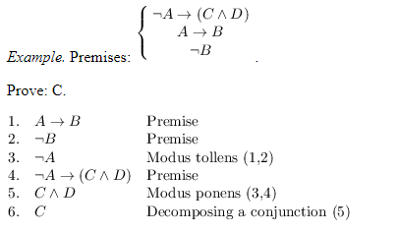
Example of Inference

Slide 28
Solve
Show that the following statements constitute a valid argument using the rule of inference.
“If there was rain, then traveling was difficult. If they had umbrella, then traveling was not difficult. They had umbrella. Therefore there was no rain.”

Slide 29
Solve
Show that the following statements constitute a valid argument using the rule of inference.
“If today is Tuesday, I have a test in English or Science. If my English Professor is absent, then I will not have a test in English. Today is Tuesday and my English Professor is absent. Therefore I have a test in Science.“

Slide 30
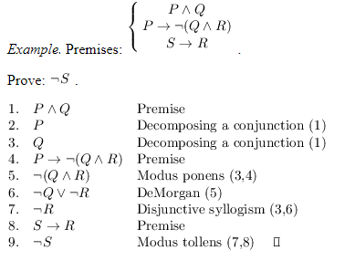
Cont…

Slide 31
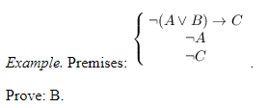
Cont…

Slide 32
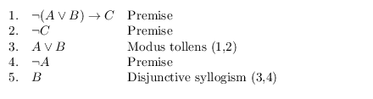
Cont…

Slide 33
Limitations of Propositional logic
We cannot represent relations like ALL, some, or none with propositional logic. Example:
  All the students are intelligent.
  Some apples are sweet.
Propositional logic has limited expressive power.
In propositional logic, we cannot describe statements in terms of their properties or logical relationships

Slide 34
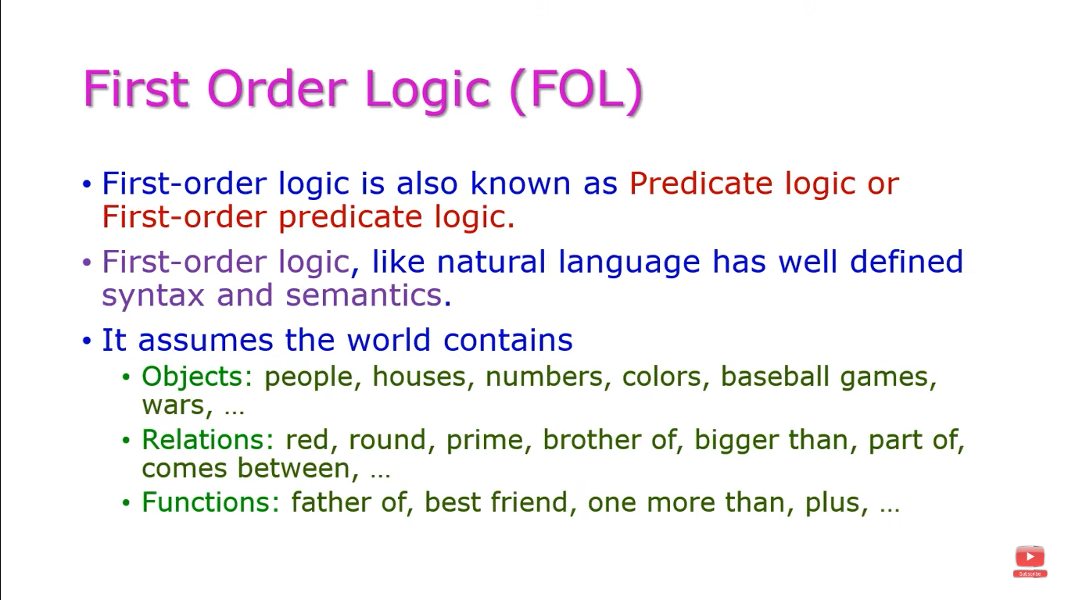

Slide 35
