Slide 1
Bayesian Belief Networks

Slide 2
Bayesian Networks
Probabilistic models are used to define a relationship between variables and can be used to calculate the probabilities of each variable.
They are a type of Probabilistic Graphical Model that uses the Bayesian inferences for probability computations.
It represents a set of variables and its conditional probabilities with a Directed Acyclic Graph (DAG).
Can obtain the Joint Probability Distribution (JPF) with the conditional probabilities.
Each node in the graph represents a random variable and the arc (or directed arrow) represents the relationship between the nodes.

Slide 3
Bayesian networks
A simple, graphical notation for conditional independence assertions and hence for compact specification of full joint distributions
Syntax:
  a set of nodes, one per variable
  a directed, acyclic graph (link ≈ "directly influences")
  a conditional distribution for each node given its parents:
    P (X_{i} | Parents (X_{i}))
In the simplest case, conditional distribution represented as a conditional probability table (CPT) giving the distribution over X_{i} for each combination of parent values
A node is independent of its nondescendents given its parents.

Slide 4
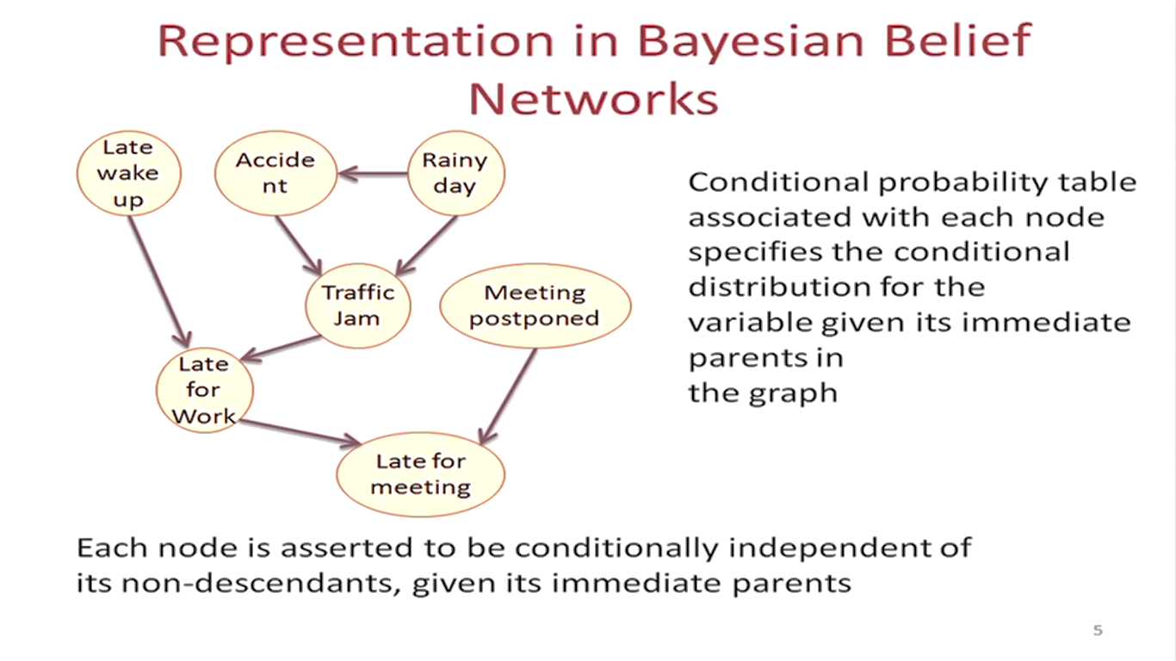


Slide 5
Compactness
A CPT for Boolean X_{i} with k Boolean parents has 2^{k} rows for the combinations of parent values
Each row requires one number p for X_{i} = true
(the number for X_{i} = false is just 1-p)
If each variable has no more than k parents, the complete network requires O(n · 2^{k}) numbers
I.e., grows linearly with n, vs. O(2^{n}) for the full joint distribution
For late meeting net, 1 + 1 + 2 + 4 + 4 + 1+ 4= 17 numbers (vs. 2⁷-1 = 127)

Slide 6

Example
Topology of network encodes conditional independence assertions:
Weather is independent of the other variables
Toothache and Catch are conditionally dependent given Cavity
If A and B are independent events, then the expression for conditional probability is given by, P(A| B) = P (A)
Given A and B are dependent events, the conditional probability is calculated as P (A| B) = P (A and B) / P (B)

Slide 7
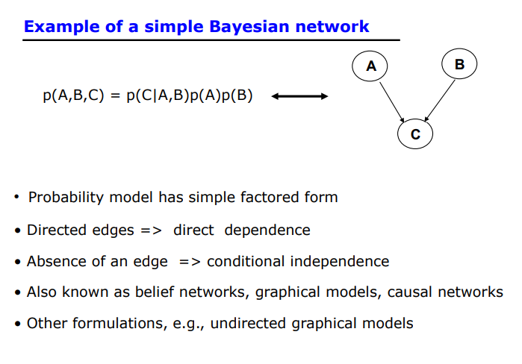

Slide 8
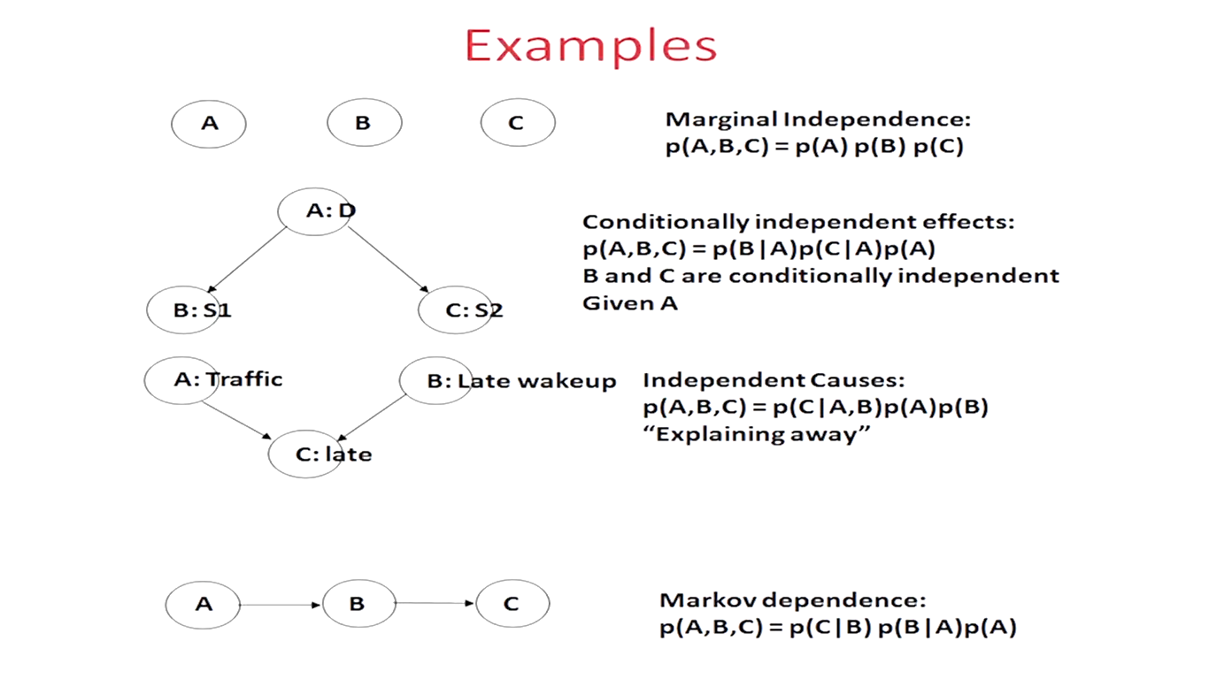

Slide 9
Some Applications of BN
Medical diagnosis
Troubleshooting of hardware/software systems
Fraud/uncollectible debt detection
Data mining
Analysis of genetic sequences
Data interpretation, computer vision, image understanding

Slide 10
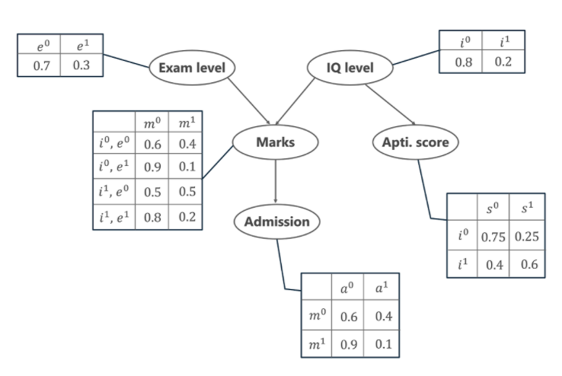
Example 1

Slide 11
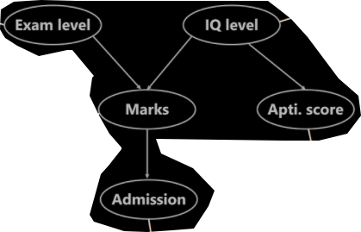
Example 1
Let us first list all the possible events that are occurring in the above-given table.
Exam Level (e)
IQ Level (i)
Aptitude Score (s)
Marks (m)
Admission (a)
These five variables are represented in the form of a Directed Acyclic Graph (DAG) in a Bayesian Network format with their Conditional Probability tables. Now, to calculate the Joint Probability Distribution of the 5 variables the formula is given by,
P[a, m, i, e, s]= P(a | m) . P(m | i, e) . P(i) . P(e) . P(s | i)

Slide 12
Calculation of Joint Probability Distribution
Calculate the probability that in spite of the exam level being difficult, the student having a low IQ level and a low Aptitude Score, manages to pass the exam and secure admission to the university.
From the above word problem statement, the Joint Probability Distribution can be written as below,
P[a=1, m=1, i=0, e=1, s=0]
From the above Conditional Probability tables, the values for the given conditions are fed to the formula and is calculated as below.
P[a=1, m=1, i=0, e=1, s=0] = P(a=1 | m=1) . P(m=1 | i=0, e=1) . P(i=0) . P(e=1) . P(s=0 | i=0)
= 0.1 * 0.1 * 0.8 * 0.3 * 0.75
= 0.0018

Slide 13
Example 1
P[a=1, m=1, i=0, e=1, s=0] =
P(a=1 | m=1) . P(m=1 | i=0, e=1) . P(i=0) . P(e=1) . P(s=0 | i=0)
= 0.1 * 0.1 * 0.8 * 0.3 * 0.75
= 0.0018

Slide 14
Calculation of Joint Probability Distribution
In another case, calculate the probability that the student has a High IQ level and Aptitude Score, the exam being easy yet fails to pass and does not secure admission to the university.
The formula for the JPD is given by
P[a=0, m=0, i=1, e=0, s=1]
Thus,
P[a=0, m=0, i=1, e=0, s=1]= P(a=0 | m=0) . P(m=0 | i=1, e=0) . P(i=1) . P(e=0) . P(s=1 | i=1)
= 0.6 * 0.5 * 0.2 * 0.7 * 0.6
= 0.0252

Slide 15
Example 1
P[a=0, m=0, i=1, e=0, s=1]= P(a=0 | m=0) . P(m=0 | i=1, e=0) . P(i=1) . P(e=0) . P(s=1 | i=1)
= 0.6 * 0.5 * 0.2 * 0.7 * 0.6
= 0.0252

Slide 16
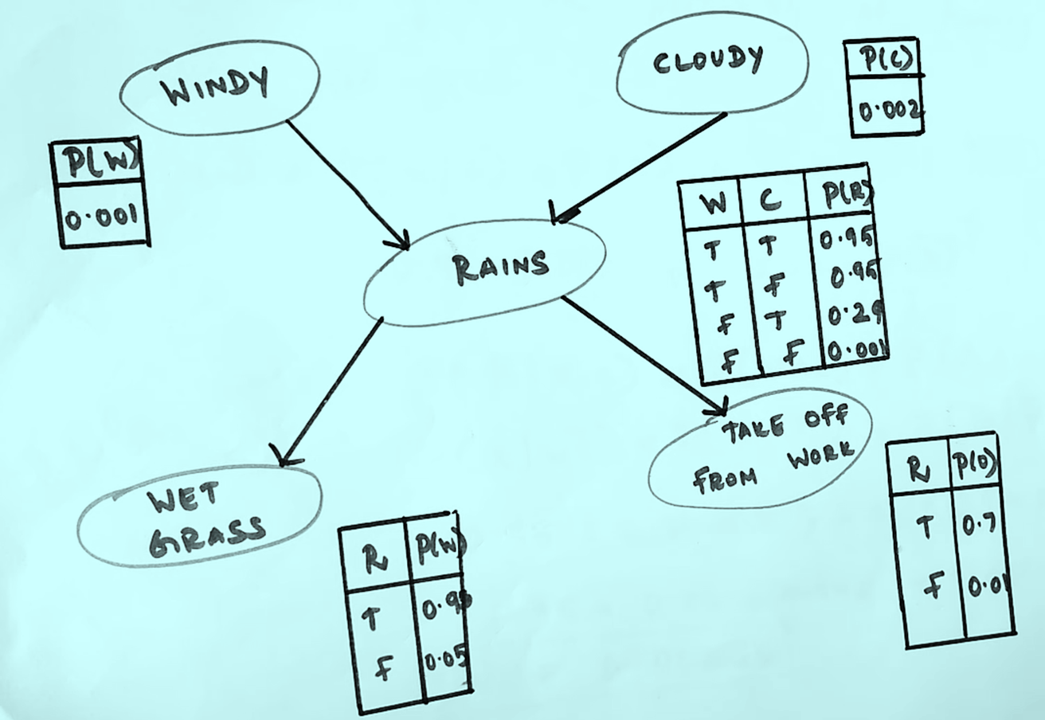
Example

Slide 17
Example
I'm at work, neighbor John calls to say my alarm is ringing, but neighbor Mary doesn't call. Sometimes it's set off by minor earthquakes. Is there a burglar?
Variables: Burglary, Earthquake, Alarm, JohnCalls, MaryCalls
Network topology reflects "causal" knowledge:
  A burglar can set the alarm off
  An earthquake can set the alarm off
  The alarm can cause Mary to call
  The alarm can cause John to call

Slide 18
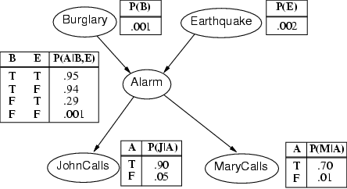
Example contd.

Slide 19
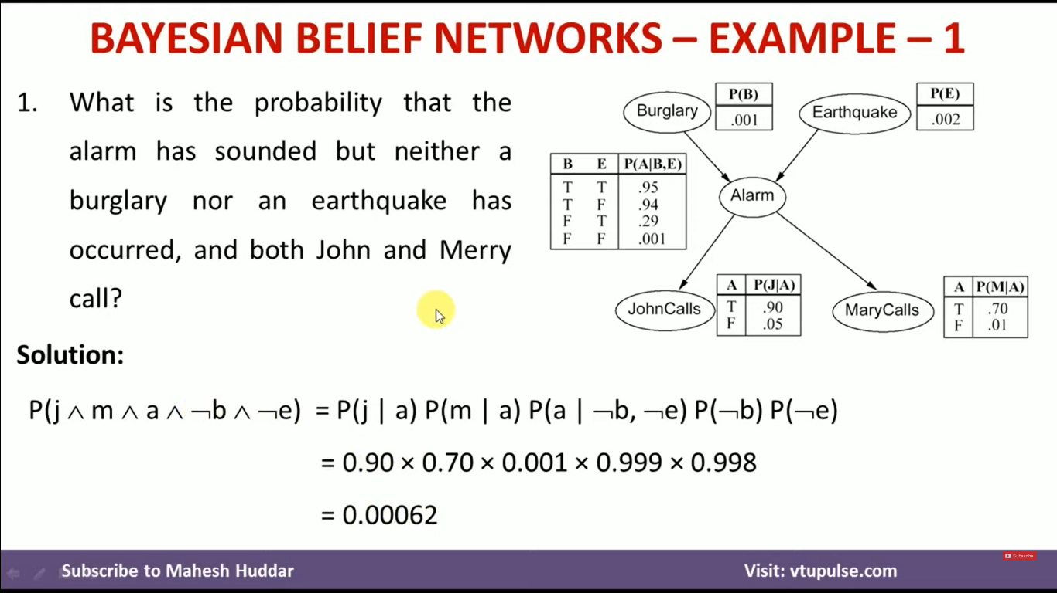

Slide 20
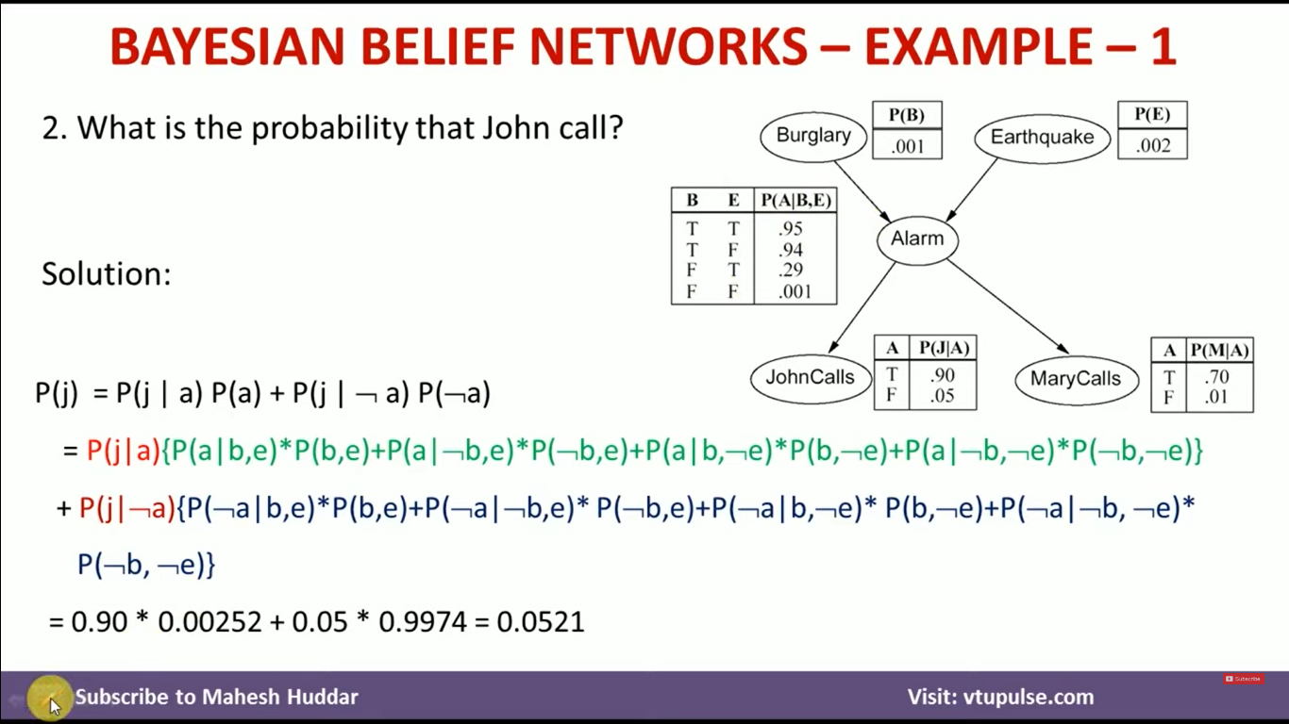

Slide 21
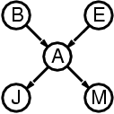
Semantics
The full joint distribution is defined as the product of the local conditional distributions:
P (X₁, … ,X_{n}) = Π_{i = 1} P (X_{i} | Parents(X_{i}))
e.g., P(j ∧ m ∧ a ∧ ¬b ∧ ¬e)
= P (j | a) P (m | a) P (a | ¬b, ¬e) P (¬b) P (¬e)
n
A node is independent of its non-descendents given its parents.

Slide 22
Constructing Bayesian networks
1. Choose an ordering of variables X₁, … ,X_{n}
2. For i = 1 to n
  add X_{i} to the network
  select parents from X₁, … ,X_{i-1} such that
  P (X_{i} | Parents(X_{i})) = P (X_{i} | X₁, ... X_{i-1})
This choice of parents guarantees:
P (X₁, … ,X_{n}) = π_{i =1} P (X_{i} | X₁, … , X_{i-1}) (chain rule)
= π_{i =1}P (X_{i} | Parents(X_{i})) (by construction)
n
n

Slide 23
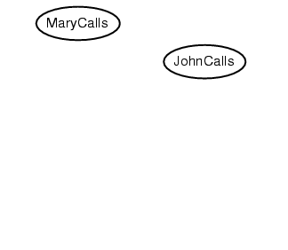
Example
Suppose we choose the ordering M, J, A, B, E
P(J | M) = P(J)?

Slide 24
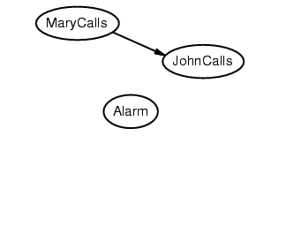
Example
Suppose we choose the ordering M, J, A, B, E
P(J | M) = P(J) No
P(A | J, M) = P(A | J)? P(A | J, M) = P(A)?

Slide 25
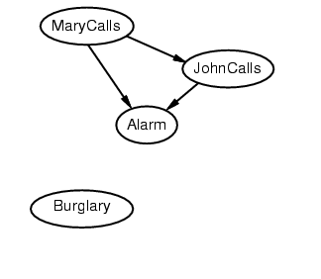
Example
Suppose we choose the ordering M, J, A, B, E
P(J | M) = P(J) No
P(A | J, M) = P(A | J)? P(A | J, M) = P(A)? No
P(B | A, J, M) = P(B | A)?
P(B | A, J, M) = P(B)?

Slide 26
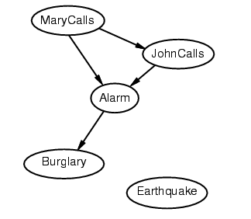
Example
Suppose we choose the ordering M, J, A, B, E
P(J | M) = P(J) No
P(A | J, M) = P(A | J)? P(A | J, M) = P(A)? No
P(B | A, J, M) = P(B | A)? Yes
P(B | A, J, M) = P(B)? No
P(E | B, A ,J, M) = P(E | A)?
P(E | B, A, J, M) = P(E | A, B)?

Slide 27
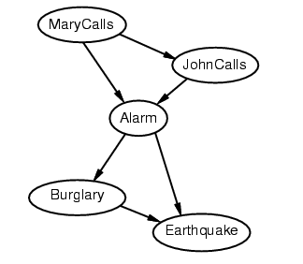
Example
Suppose we choose the ordering M, J, A, B, E
P(J | M) = P(J) No
P(A | J, M) = P(A | J)? P(A | J, M) = P(A)? No
P(B | A, J, M) = P(B | A)? Yes
P(B | A, J, M) = P(B)? No
P(E | B, A ,J, M) = P(E | A)? No
P(E | B, A, J, M) = P(E | A, B)? Yes

Slide 28
Example contd.
Deciding conditional independence is hard in noncausal directions
(Causal models and conditional independence seem hardwired for humans!)
Network is less compact: 1 + 2 + 4 + 2 + 4 = 13 numbers needed

Slide 29
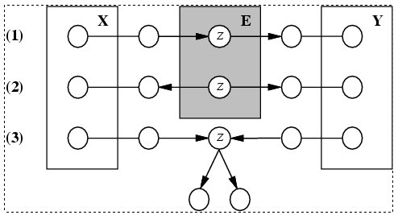
Conditional independence and
D-separation
Two sets of nodes, X and Y, are conditionally independent given an evidence set of nodes, E if every undirected path from a node in X to a node in Y is d-seperated by E.
A set of nodes, E d-separates to sets of nodes, X and Y, if every undirected path from a node in X to a node in Y is blocked by E
A path is blocked given E if there is a node Z on the path for which one of the following holds:

Slide 30
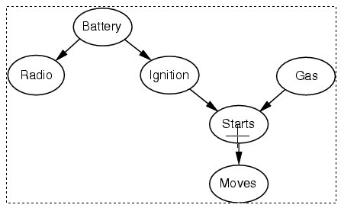
Conditional independence and
D-separation - example

