Slide 1
Planning Graphs

Slide 2
Planning Graphs
Planning graphs are an efficient way to create a representation of a planning problem that can be used to
🞑 Achieve better heuristic estimates
🞑 Directly construct plans
Planning graphs only work for propositional problems.

Slide 3
Planning Graphs
Planning graphs consists of a seq of levels that correspond to time steps in the plan.
🞑 Level 0 is the initial state.
🞑 Each level consists of a set of literals and a set of actions that represent what might bepossible at that step in the plan
🞑 Might beis the key to efficiency
🞑 Records only a restricted subset of possible negative interactions among actions.

Slide 4
Planning Graphs
Each level consists of
Literals= all those that couldbe true at that time step, depending upon the actions executed at preceding time steps.
Actions= all those actions that couldhave their preconditions satisfied at that time step, depending on which of the literals actually hold.

Slide 5
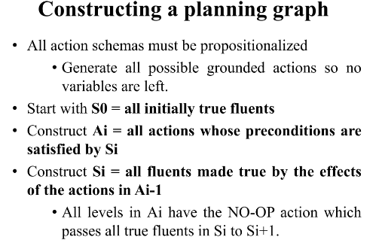

Slide 6
PG Example - The have cake and eat cake too
Init(Have(Cake))
Goal(Have(Cake) ∧Eaten(Cake))
Action(Eat(Cake),
PRECOND: Have(Cake)
EFFECT: ¬Have(Cake) ∧Eaten(Cake))
Action(Bake(Cake),
PRECOND: ¬ Have(Cake)
EFFECT: Have(Cake))

Slide 7
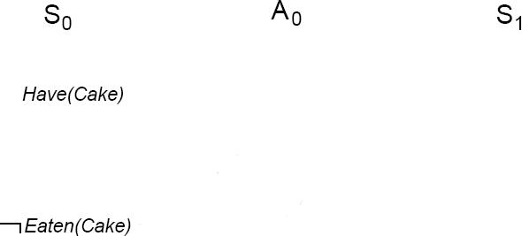
PG Example
Create level 0 from initial problem state.

Slide 8
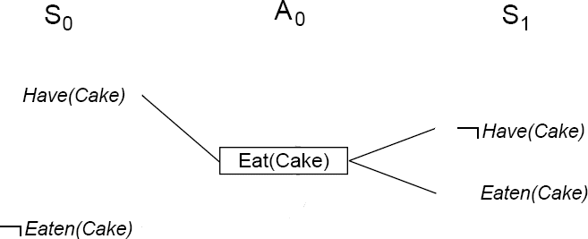
PG Example
Add all applicable actions.
Add all effects to the next state.

Slide 9
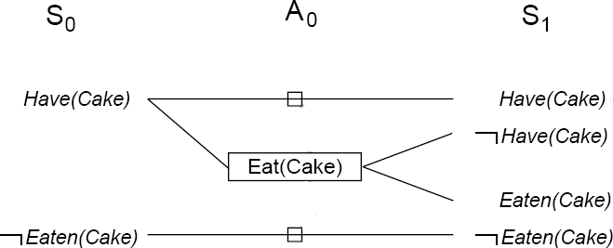
PG Example
Add persistence actions (inaction = no-ops) to map all literals in state S_{i} to state S_{i+1}.

Slide 10
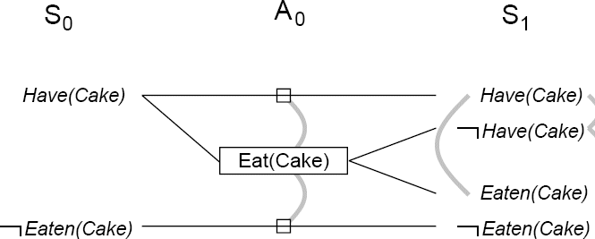
PG Example
Identify mutual exclusionsbetween actions and literals based on potential conflicts.

Slide 11
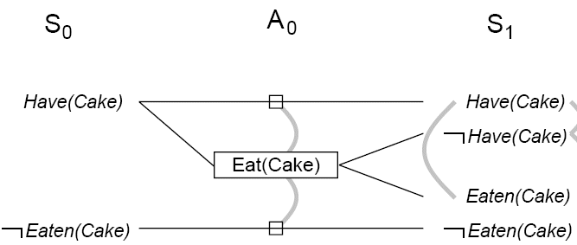
Cake example
Level S₁ contains all literals that could result from
picking any subset of actions in A₀
🞑 Conflicts between literals that can not occur together (as a consequence of the selection action) are represented by mutex links.
🞑 S1 defines multiple states and the mutex links are the constraints that define this set of states.

Slide 12
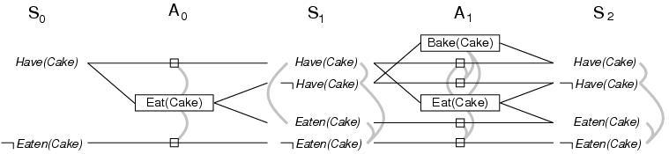
Cake example
Repeat process until graph levels off:
🞑 two consecutive levels are identical, or
🞑 contain the same amount of literals (explanation follows later)

Slide 13
The GRAPHPLAN Algorithm
Extract a solution directly from the PG
functionGRAPHPLAN(problem) returnsolutionor failure graph←INITIAL-PLANNING-GRAPH(problem) goals←GOALS[problem]
loop do
if goalsall non-mutex in last level of graph then do
solution←EXTRACT-SOLUTION(graph, goals, LENGTH(graph))
ifsolution≠failure then returnsolution
else ifNO-SOLUTION-POSSIBLE(graph) then returnfailure
graph←EXPAND-GRAPH(graph, problem)

Slide 14
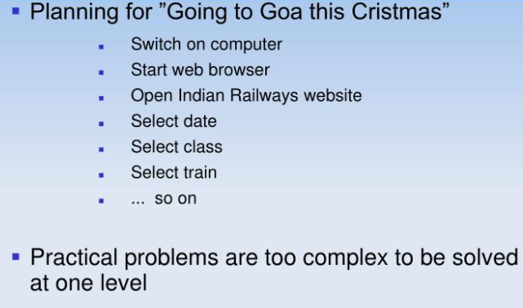
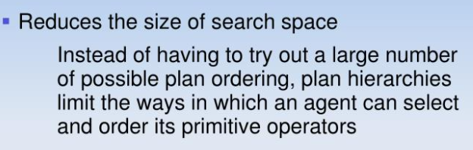
motivation

Slide 15
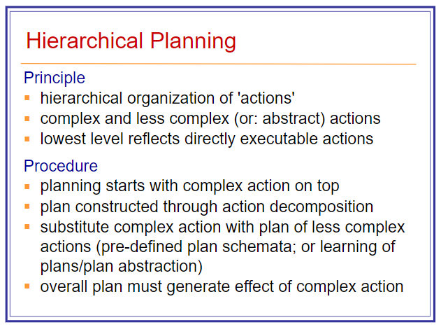

Slide 16
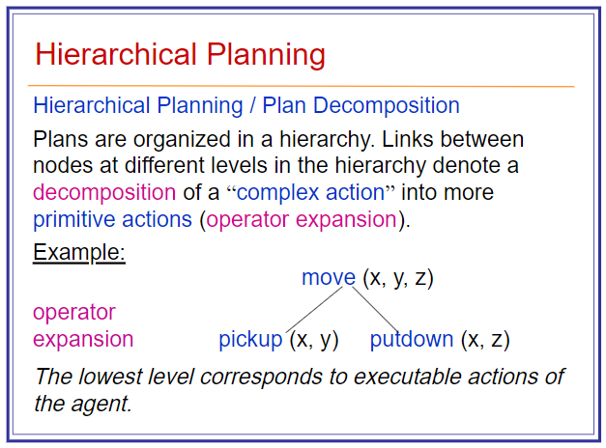

Slide 17
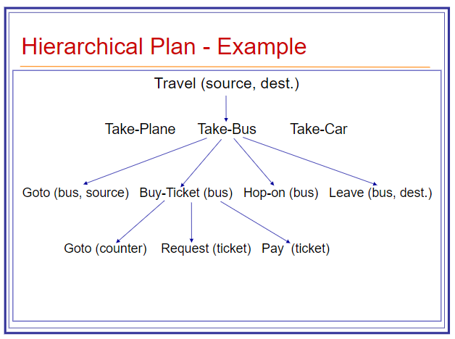

Slide 18
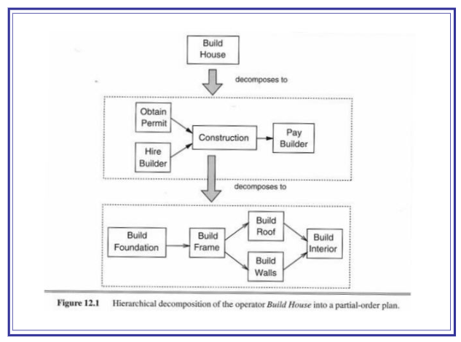

Slide 19
