Slide 1
Communication- Language Processing
Ref: Chapter 22.1 and 2
in
Russell, S. and Norvig, P. 2015. Artificial Intelligence - A Modern Approach, 3rd Edition, Prentice Hall.

Slide 2
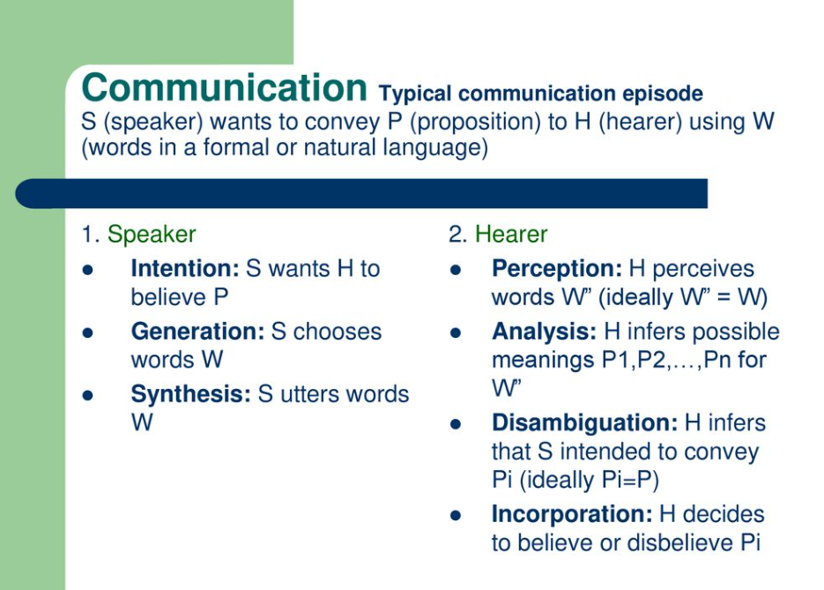

Slide 3
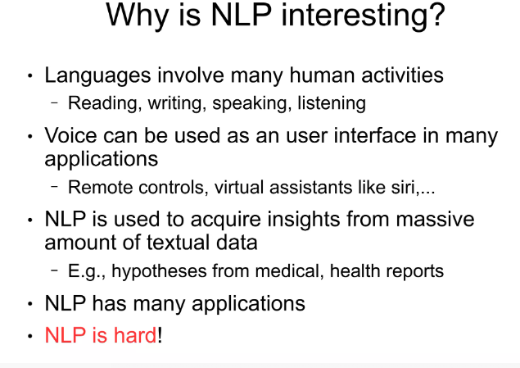

Slide 4
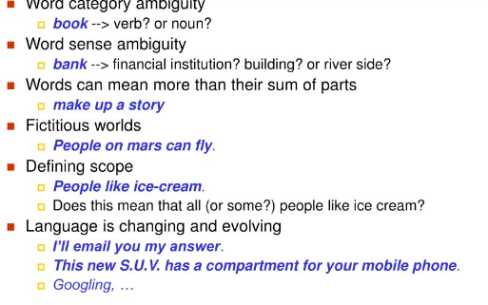
Why hard?

Slide 5
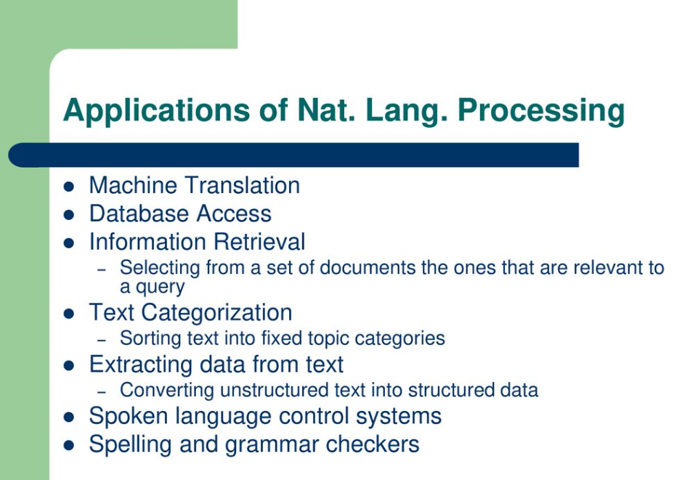

Slide 6
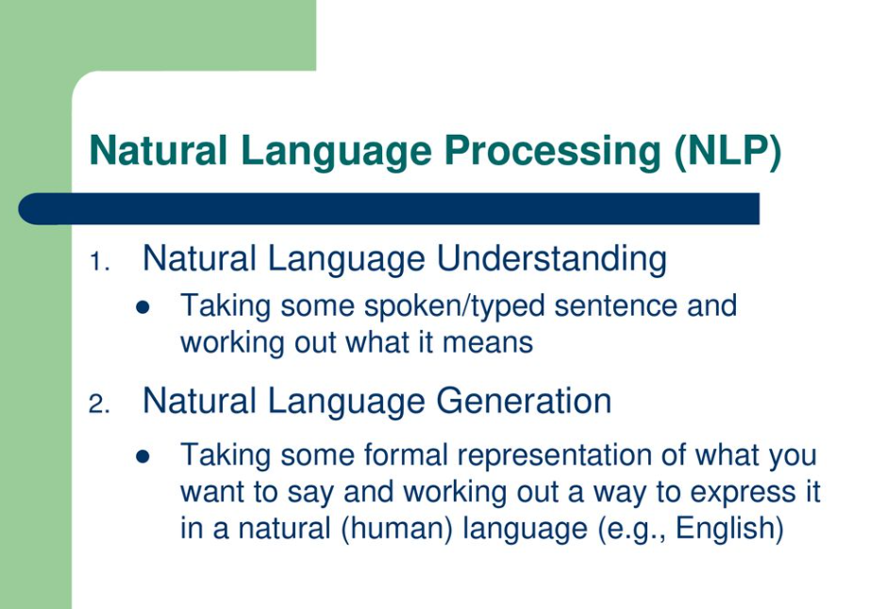

Slide 7
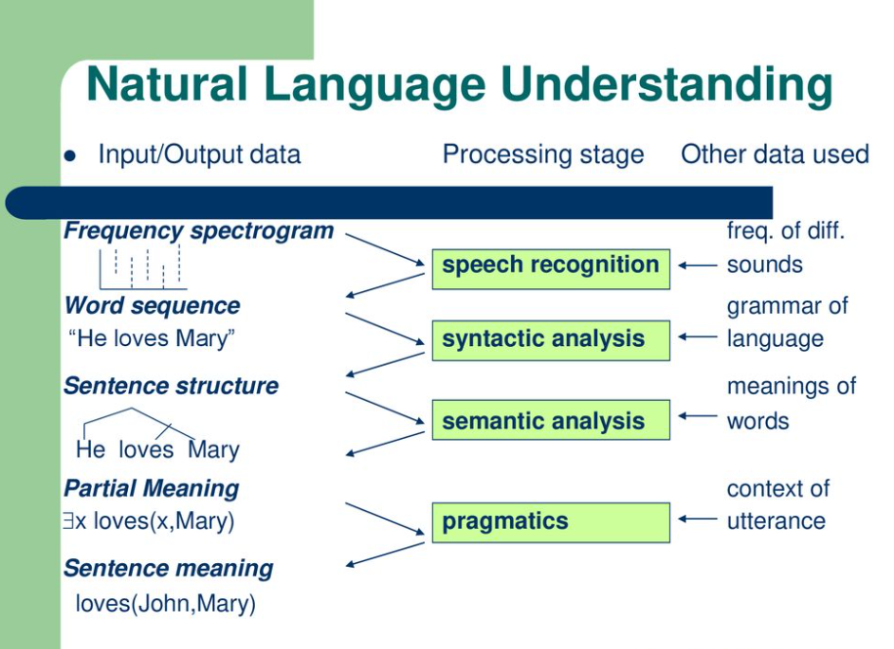

Slide 8
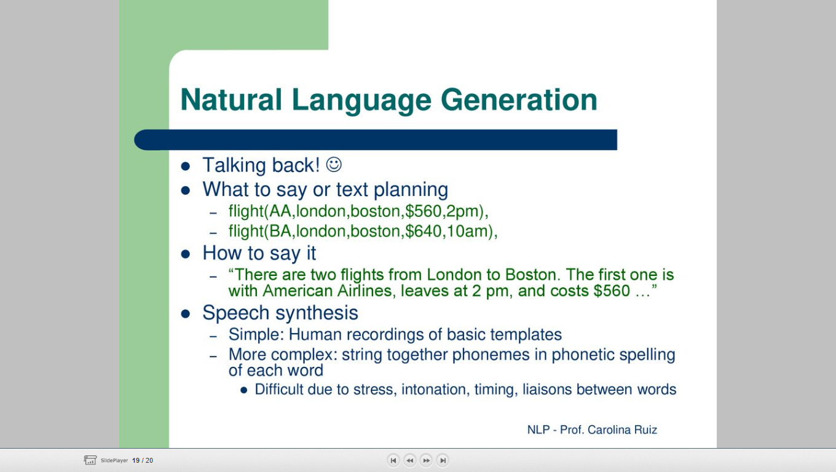

Slide 9
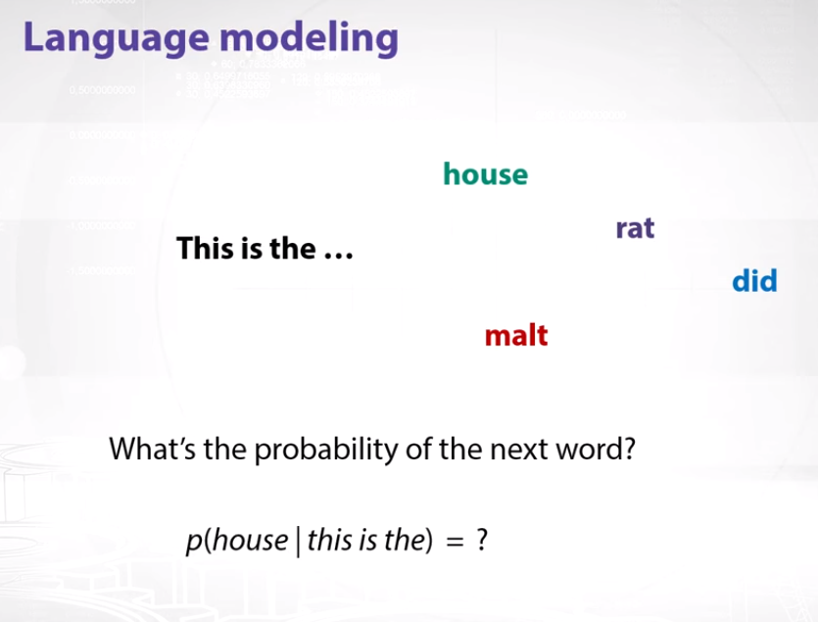

Slide 10
n-gram models
N-gram is a sequence of the N-words in the modeling of NLP.
Consider an example of the statement for modeling.
“I love reading history books and watching documentaries”.
In one-gram or unigram, there is a one-word sequence. As for the above statement, in one gram it can be “I”, “love”, “history”, “books”, “and”, “watching”, “documentaries”.
In two-gram or the bi-gram, there is the two-word sequence i.e. “I love”, “love reading”, or “history books”

Slide 11
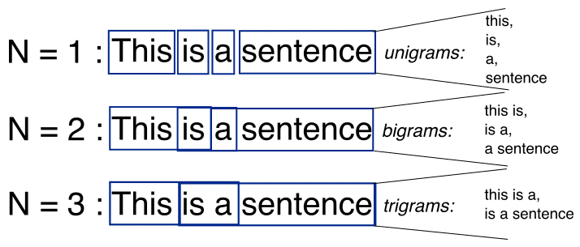
n-gram models

Slide 12
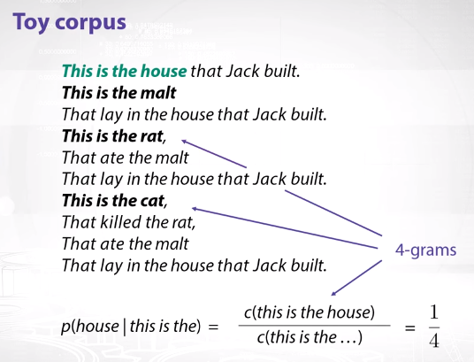

Slide 13
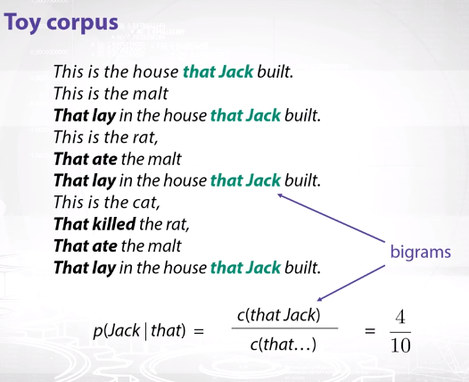

Slide 14
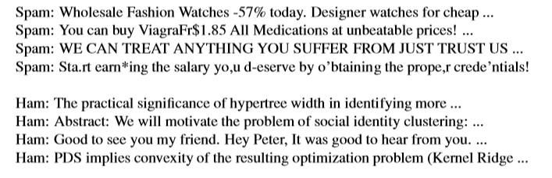
Text classiﬁcation
We can treat spam detection as a problem in supervised learning. A training set is readily available: the positive (spam) examples are in my spam folder, the negative (ham) examples are in my inbox. Here is an excerpt:

Slide 15
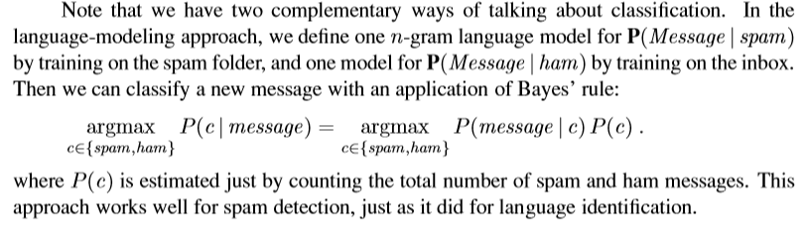
Text classiﬁcation
Word n-grams such as “for cheap” and “You can buy” seem to be indicators of spam.
they would have a nonzero probability in ham as well.
spam is more likely to be all uppercase and to have punctuation embedded in words.
“you deserve” would be too indicative of spam, and thus wrote “yo,u d-eserve” instead.

