Slide 1

Mathematics of Cryptography
Part I: Modular Arithmetic, Congruence,
and Matrices
2.<number>
Copyright © The McGraw-Hill Companies, Inc. Permission required for reproduction or display.

Slide 2
Chapter 2
Objectives
To review integer arithmetic, concentrating on divisibility
and finding the greatest common divisor using the Euclidean
algorithm
To understand how the extended Euclidean algorithm can be
used to solve linear Diophantine equations, to solve linear
congruent equations, and to find the multiplicative inverses
To emphasize the importance of modular arithmetic and
the modulo operator, because they are extensively used in
cryptography
To emphasize and review matrices and operations on residue
matrices that are extensively used in cryptography
To solve a set of congruent equations using residue matrices
2.<number>

Slide 3
2-1 INTEGER ARITHMETIC
In integer arithmetic, we use a set and a few operations. You are familiar with this set and the corresponding operations, but they are reviewed here to create a background for modular arithmetic.
Topics discussed in this section:
2.1.1 Set of Integers
2.1.2 Binary Operations
2.1.3 Integer Division
2.1.4 Divisibility
2.1.5 Linear Diophantine Equations
2.<number>

Slide 4

2.1.1 Set of Integers
The set of integers, denoted by Z, contains all integral numbers (with no fraction) from negative infinity to positive infinity (Figure 2.1).
Figure 2.1 The set of integers
2.<number>

Slide 5
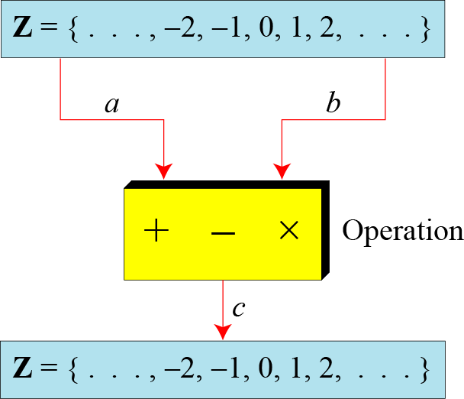
2.1.2 Binary Operations
In cryptography, we are interested in three binary operations applied to the set of integers. A binary operation takes two inputs and creates one output.
Figure 2.2 Three binary operations for the set of integers
2.<number>

Slide 6
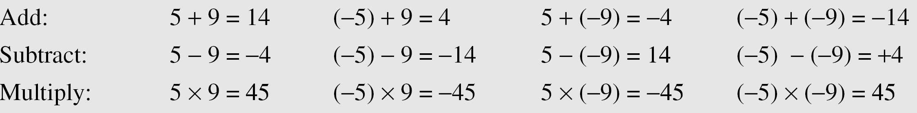
2.1.2 Continued
Example 2.1
The following shows the results of the three binary operations on two integers. Because each input can be either positive or negative, we can have four cases for each operation.
2.<number>

Slide 7
2.1.3 Integer Division
In integer arithmetic, if we divide a by n, we can get q
And r . The relationship between these four integers can be shown as
a = q × n + r
2.<number>

Slide 8
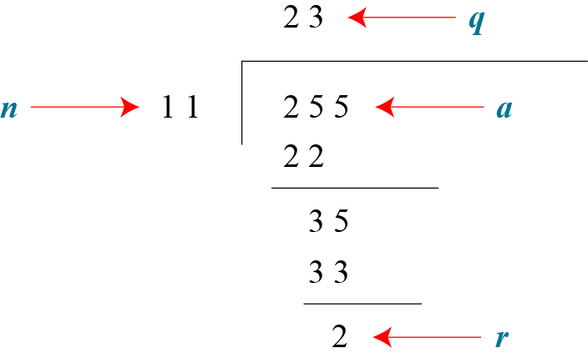
2.1.3 Continued
Example 2.2
Assume that a = 255 and n = 11. We can find q = 23 and R = 2 using the division algorithm.
Figure 2.3 Example 2.2, finding the quotient and the remainder
2.<number>

Slide 9
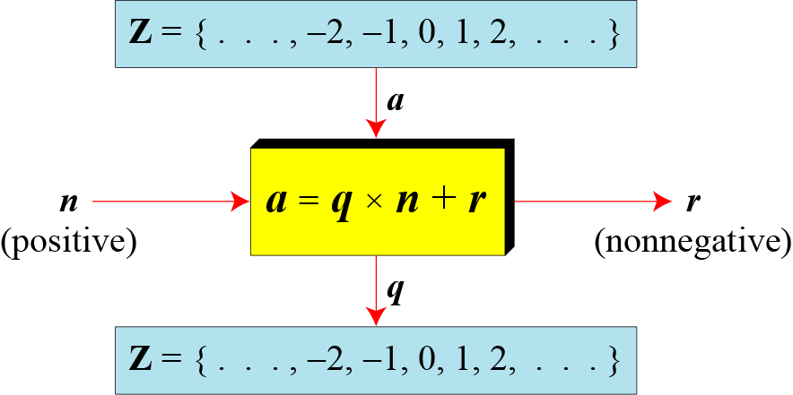
2.1.3 Continued
Figure 2.4 Division algorithm for integers
2.<number>

Slide 10
2.1.3 Continued
Example 2.3
When we use a computer or a calculator, r and q are negative when a is negative. How can we apply the restriction that r needs to be positive? The solution is simple, we decrement the value of q by 1 and we add the value of n to r to make it positive.
2.<number>

Slide 11
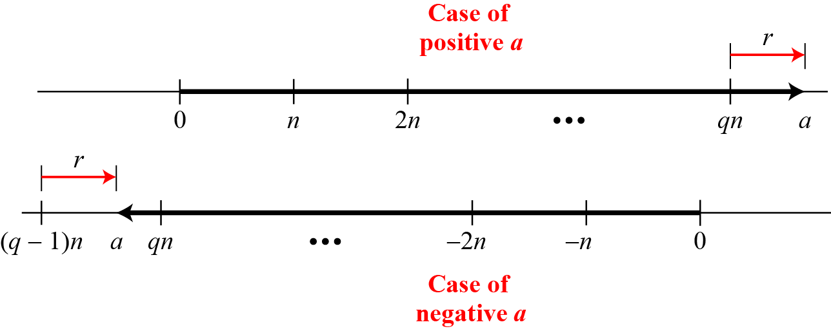
2.1.3 Continued
Figure 2.5 Graph of division alogorithm
2.<number>

Slide 12

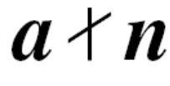
2.1.4 Divisbility
If a is not zero and we let r = 0 in the division relation, we get
a = q × n
If the remainder is zero,
If the remainder is not zero,
2.<number>

Slide 13
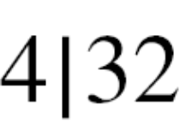
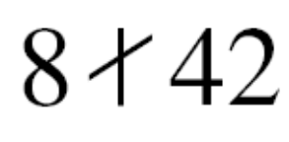
2.1.4 Continued
Example 2.4
The integer 4 divides the integer 32 because 32 = 8 × 4. We show this as
b. The number 8 does not divide the number 42 because
42 = 5 × 8 + 2. There is a remainder, the number 2, in the equation. We show this as
2.<number>

Slide 14
2.1.4 Continued
Properties
Property 1: if a|1, then a = ±1.
Property 2: if a|b and b|a, then a = ±b.
Property 3: if a|b and b|c, then a|c.
Property 4: if a|b and a|c, then
a|(m × b + n × c), where m
and n are arbitrary integers
2.<number>

Slide 15
2.1.4 Continued
Example 2.5
2.<number>

Slide 16

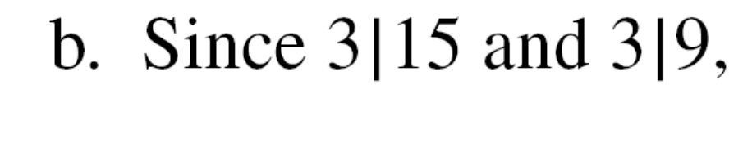
2.1.4 Continued
Example 2.6
2.<number>

Slide 17

2.1.4 Continued
Note
Fact 1: The integer 1 has only one
divisor, itself.
Fact 2: Any positive integer has at least
two divisors, 1 and itself (but it
can have more).
2.<number>

Slide 18
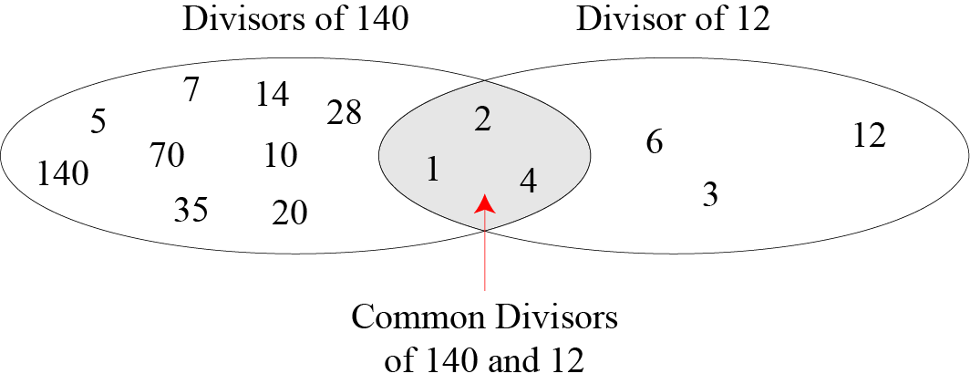
2.1.4 Continued
Figure 2.6 Common divisors of two integers
2.<number>

Slide 19
2.1.4 Continued
Note
Greatest Common Divisor
The greatest common divisor of two positive integers is the largest integer that can divide both integers.
Note
Euclidean Algorithm
Fact 1: gcd (a, 0) = a
Fact 2: gcd (a, b) = gcd (b, r), where r is
the remainder of dividing a by b
2.<number>

Slide 20
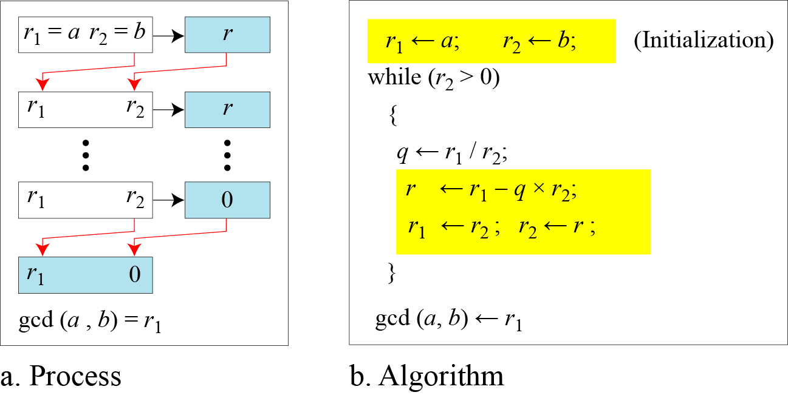
2.1.4 Continued
Figure 2.7 Euclidean Algorithm
Note
When gcd (a, b) = 1, we say that a and b are relatively prime.
2.<number>

Slide 21
2.1.4 Continued
Note
When gcd (a, b) = 1, we say that a and b are relatively prime.
2.<number>

Slide 22
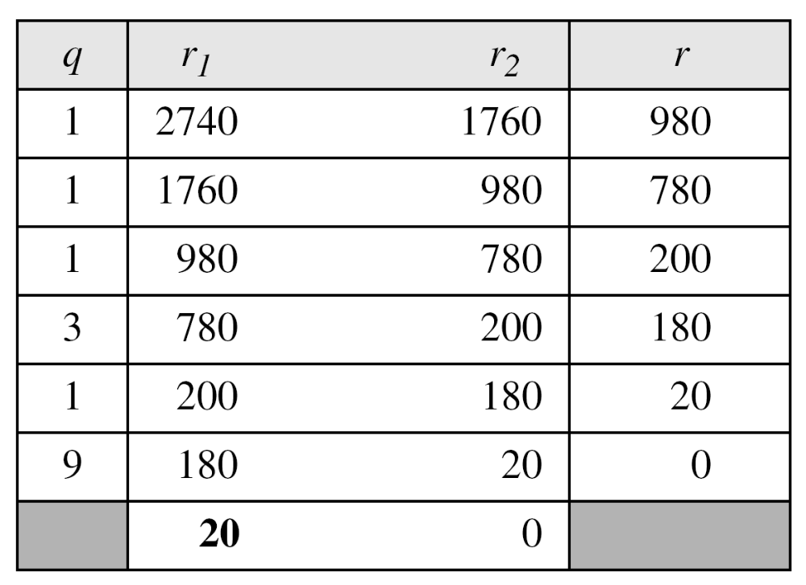
2.1.4 Continued
Example 2.7
Find the greatest common divisor of 2740 and 1760.
Solution
We have gcd (2740, 1760) = 20.
2.<number>

Slide 23
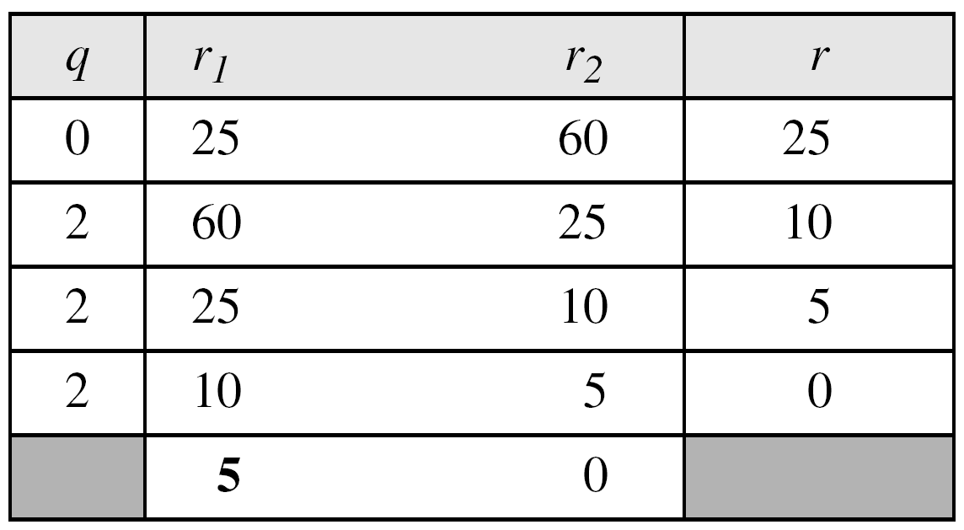
2.1.4 Continued
Example 2.8
Find the greatest common divisor of 25 and 60.
Solution
We have gcd (25, 65) = 5.
2.<number>

Slide 24

2.1.4 Continued
Extended Euclidean Algorithm
Given two integers a and b, we often need to find other two integers, s and t, such that
The extended Euclidean algorithm can calculate the gcd (a, b) and at the same time calculate the value of s and t.
2.<number>

Slide 25
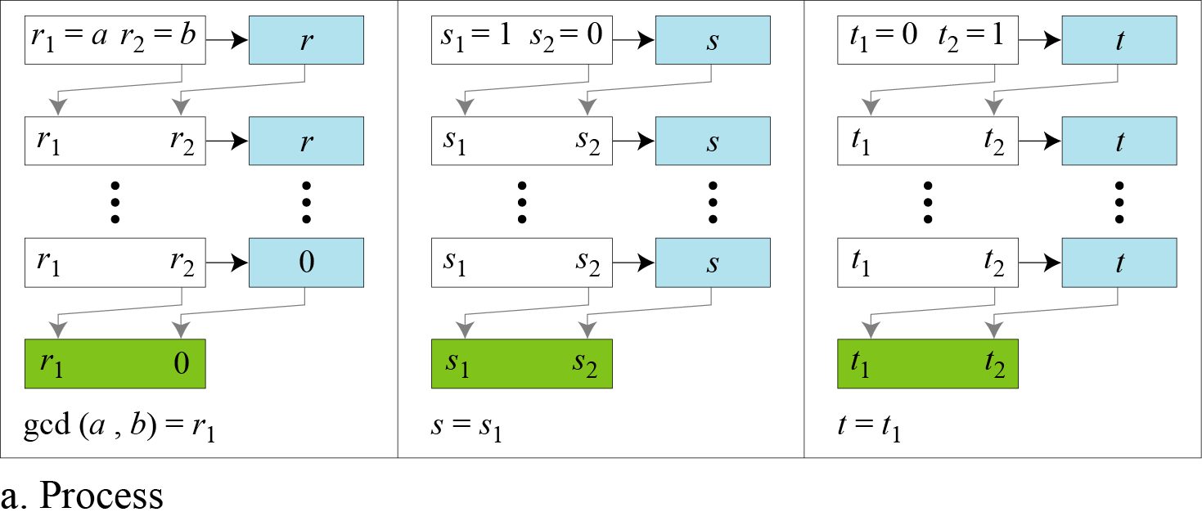
2.1.4 Continued
Figure 2.8.a Extended Euclidean algorithm, part a
2.<number>

Slide 26
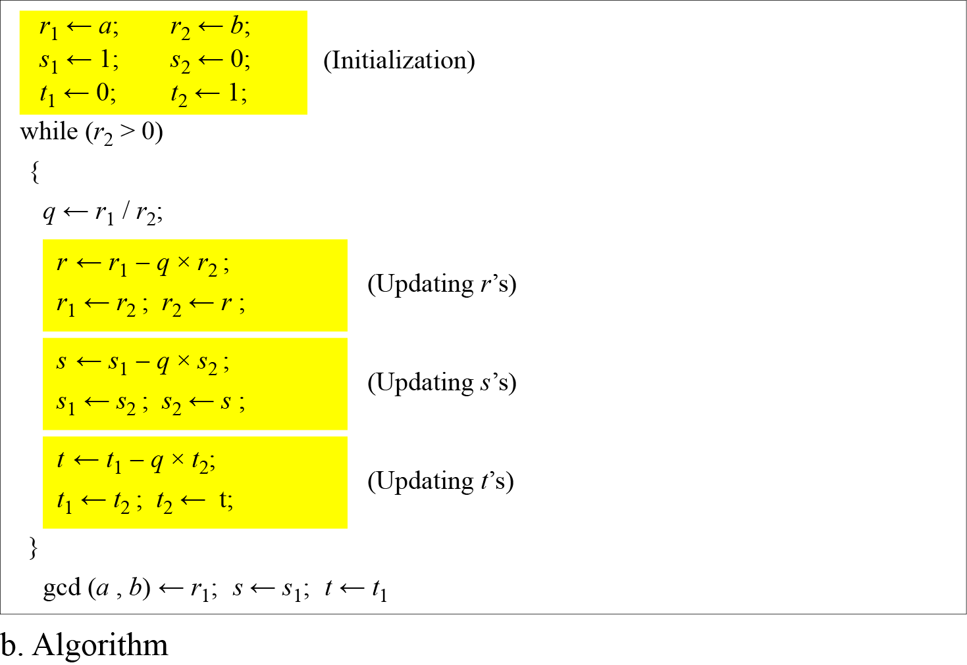
2.1.4 Continued
Figure 2.8.b Extended Euclidean algorithm, part b
2.<number>

Slide 27
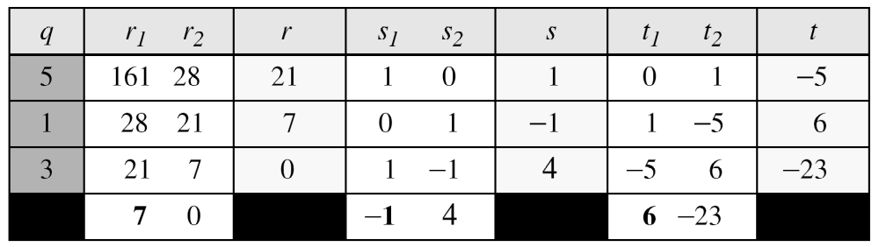
2.1.4 Continued
Example 2.9
Given a = 161 and b = 28, find gcd (a, b) and the values of s and t.
Solution
We get gcd (161, 28) = 7, s = −1 and t = 6.
2.<number>

Slide 28
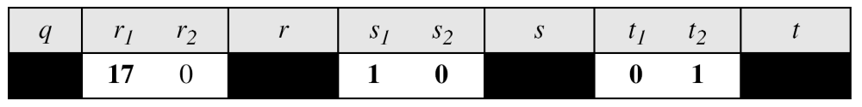
2.1.4 Continued
Example 2.10
Given a = 17 and b = 0, find gcd (a, b) and the values of s
and t.
Solution
We get gcd (17, 0) = 17, s = 1, and t = 0.
2.<number>

Slide 29
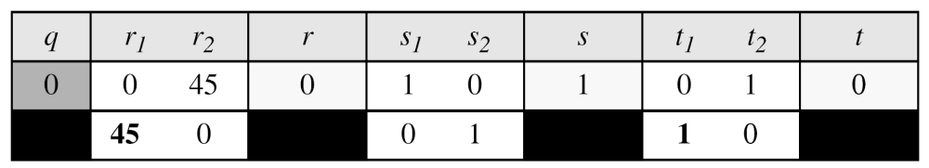
2.1.4 Continued
Example 2.11
Given a = 0 and b = 45, find gcd (a, b) and the values of s
and t.
Solution
We get gcd (0, 45) = 45, s = 0, and t = 1.
2.<number>

Slide 30
2.1.4 Continued
Linear Diophantine Equation
Note
A linear Diophantine equation of two variables is ax + by = c.
2.<number>

Slide 31

2.1.4 Continued
Linear Diophantine Equation
Note
Particular solution:
x₀ = (c/d)s and y₀ = (c/d)t
Note
General solutions:
x = x₀ + k (b/d) and y = y₀ − k(a/d)
where k is an integer
2.<number>

Slide 32
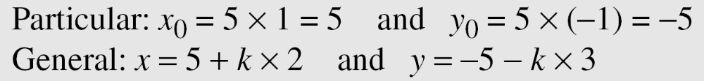
2.1.4 Continued
Example 2.12
Find the particular and general solutions to the equation
21x + 14y = 35.
Solution
2.<number>

Slide 33
2.1.4 Continued
Example 2.13
For example, imagine we want to cash a $100 check and get
some $20 and some $5 bills. We have many choices, which we can find by solving the corresponding Diophantine equation 20x + 5y = 100. Since d = gcd (20, 5) = 5 and 5 | 100, the equation has an infinite number of solutions, but only a few of them are acceptable in this case The general solutions
with x and y nonnegative are
(0, 20), (1, 16), (2, 12), (3, 8), (4, 4), (5, 0).
2.<number>

Slide 34
2-2 MODULAR ARITHMETIC
The division relationship (a = q × n + r) discussed in the previous section has two inputs (a and n) and two outputs (q and r). In modular arithmetic, we are interested in only one of the outputs, the remainder r.
Topics discussed in this section:
2.2.1 Modular Operator
2.2.2 Set of Residues
2.2.3 Congruence
2.2.4 Operations in Z_{n}
2.2.5 Addition and Multiplication Tables
2.2.6 Different Sets
2.<number>

Slide 35
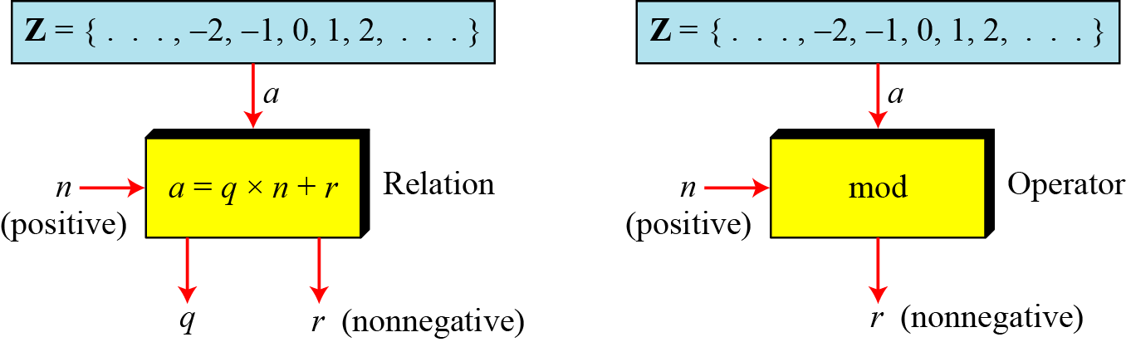
2.2.1 Modulo Operator
The modulo operator is shown as mod. The second input (n) is called the modulus. The output r is called the residue.
Figure 2.9 Division algorithm and modulo operator
2.<number>

Slide 36
2.1.4 Continued
Example 2.14
Find the result of the following operations:
a. 27 mod 5 b. 36 mod 12
c. −18 mod 14 d. −7 mod 10
Solution
Dividing 27 by 5 results in r = 2
Dividing 36 by 12 results in r = 0.
c. Dividing −18 by 14 results in r = −4. After adding the modulus r = 10
d. Dividing −7 by 10 results in r = −7. After adding the modulus to −7, r = 3.
2.<number>

Slide 37
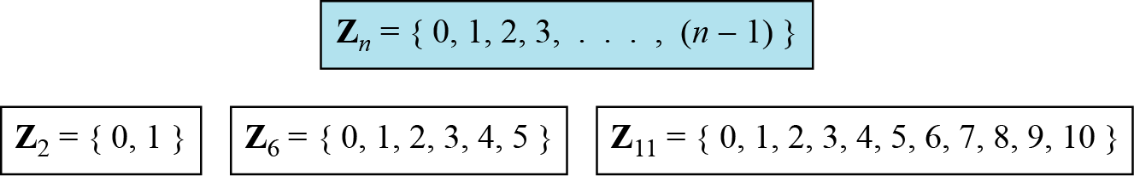
2.2.2 Set of Residues
The modulo operation creates a set, which in modular arithmetic is referred to as the set of least residues modulo n, or Z_{n}.
Figure 2.10 Some Z_{n} sets
2.<number>

Slide 38
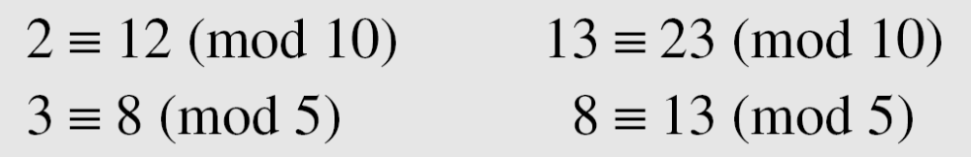
2.2.3 Congruence
To show that two integers are congruent, we use the congruence operator ( ≡ ). For example, we write:
2.<number>

Slide 39
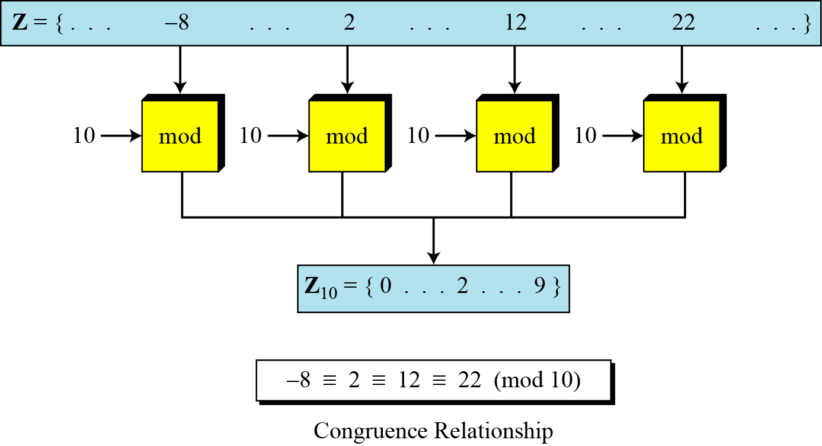
2.2.3 Continued
Figure 2.11 Concept of congruence
2.<number>

Slide 40
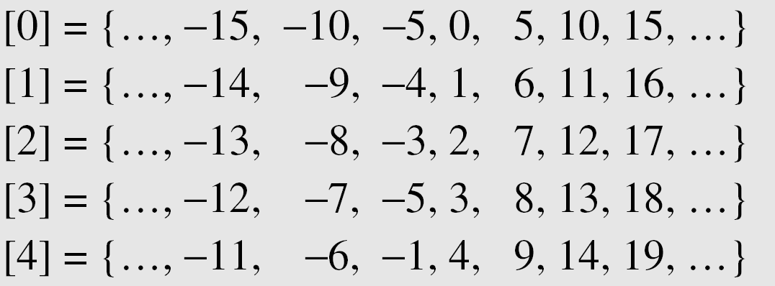
2.2.3 Continued
Residue Classes
A residue class [a] or [a]_{n} is the set of integers congruent modulo n.
2.<number>

Slide 41
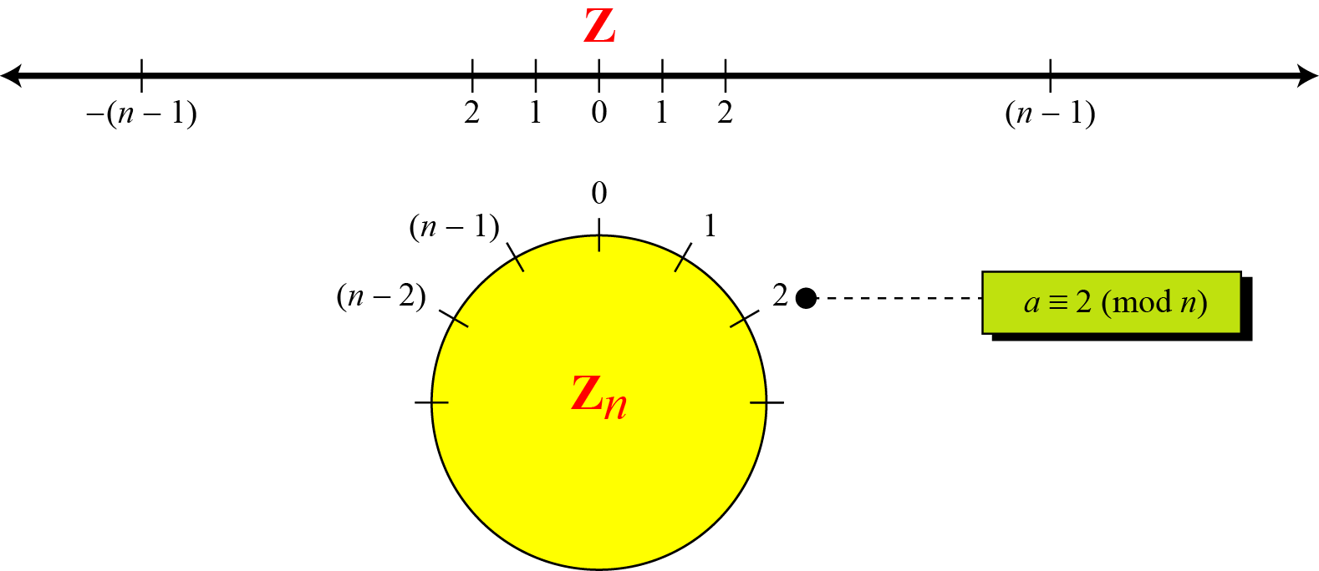
2.2.3 Continued
Figure 2.12 Comparison of Z and Z_{n} using graphs
2.<number>

Slide 42
2.2.3 Continued
Example 2.15
We use modular arithmetic in our daily life; for example, we use a clock to measure time. Our clock system uses modulo 12 arithmetic. However, instead of a 0 we use the number 12.
2.<number>

Slide 43
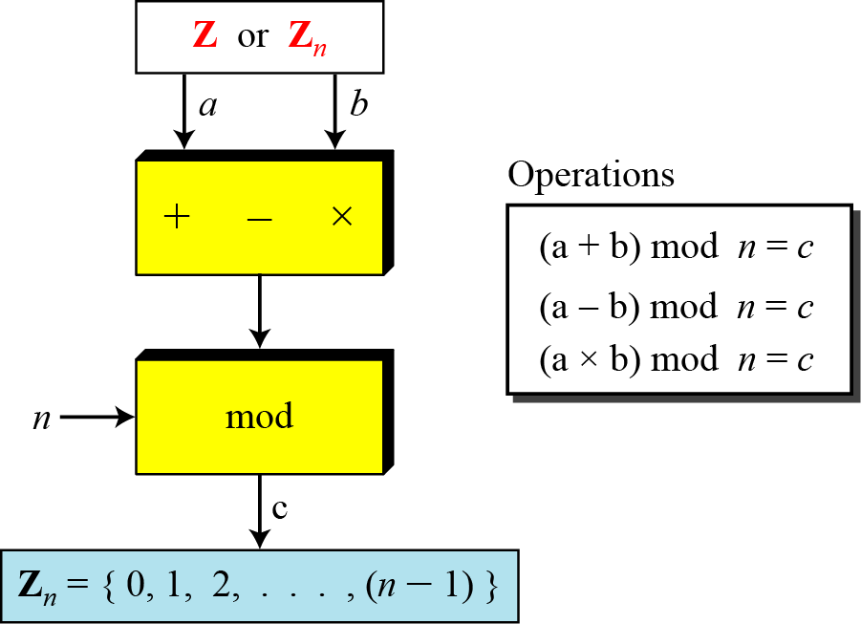
2.2.4 Operation in Z_{n}
The three binary operations that we discussed for the set Z can also be defined for the set Zn. The result may need to be mapped to Zn using the mod operator.
Figure 2.13 Binary operations in Z_{n}
2.<number>

Slide 44
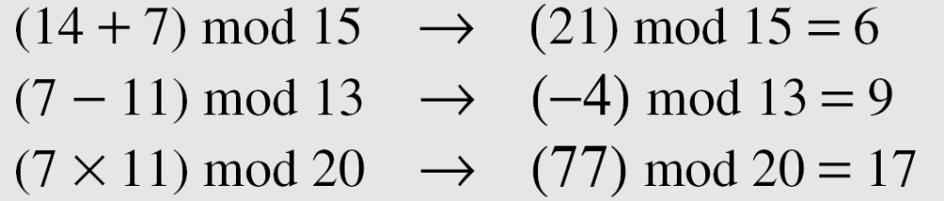
2.2.4 Continued
Example 2.16
Perform the following operations (the inputs come from Zn):
a. Add 7 to 14 in Z15.
b. Subtract 11 from 7 in Z13.
c. Multiply 11 by 7 in Z20.
Solution
2.<number>

Slide 45
2.2.4 Continued
Example 2.17
Perform the following operations (the inputs come from either Z or Z_{n}):
a. Add 17 to 27 in Z₁₄.
b. Subtract 43 from 12 in Z₁₃.
c. Multiply 123 by −10 in Z₁₉.
Solution
2.<number>

Slide 46
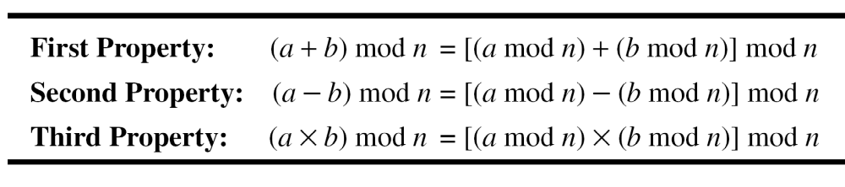
2.2.4 Continued
Properties
2.<number>

Slide 47
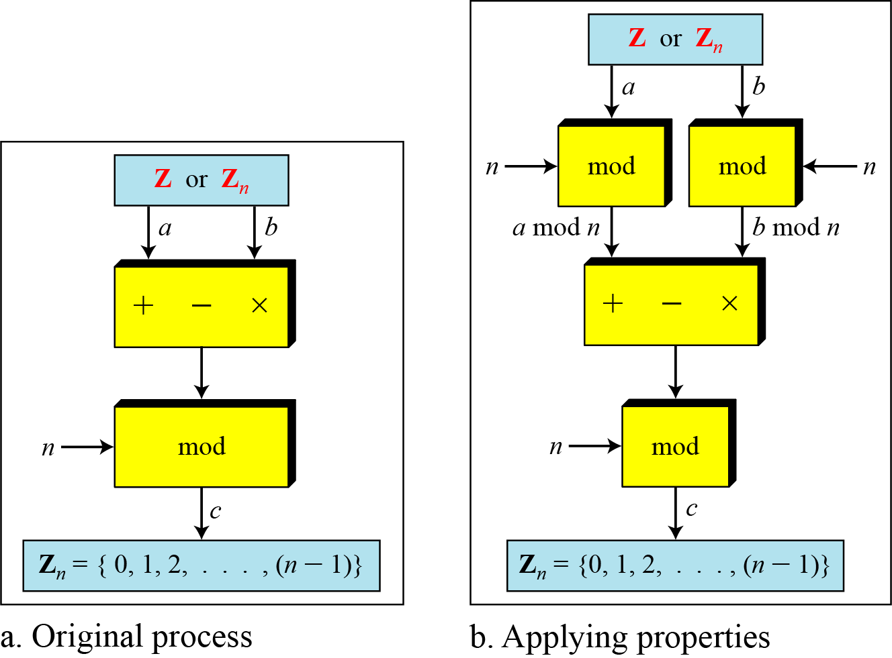
2.2.4 Continued
Figure 2.14 Properties of mode operator
2.<number>

Slide 48
2.2.4 Continued
Example 2.18
The following shows the application of the above properties:
1. (1,723,345 + 2,124,945) mod 11 = (8 + 9) mod 11 = 6
2. (1,723,345 − 2,124,945) mod 16 = (8 − 9) mod 11 = 10
3. (1,723,345 × 2,124,945) mod 16 = (8 × 9) mod 11 = 6
2.<number>

Slide 49
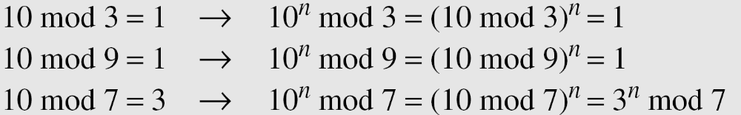
2.2.4 Continued
Example 2.19
In arithmetic, we often need to find the remainder of powers of 10 when divided by an integer.
2.<number>

Slide 50
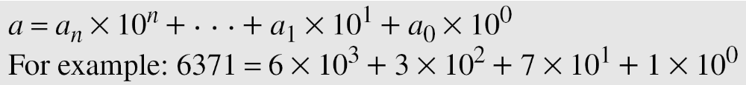
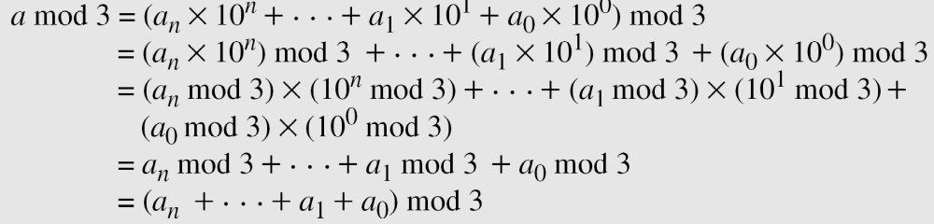
2.2.4 Continued
Example 2.20
We have been told in arithmetic that the remainder of an integer divided by 3 is the same as the remainder of the sum of its decimal digits. We write an integer as the sum of its digits multiplied by the powers of 10.
2.<number>

Slide 51
2.2.5 Inverses
When we are working in modular arithmetic, we often need to find the inverse of a number relative to an operation. We are normally looking for an additive inverse (relative to an addition operation) or a multiplicative inverse (relative to a multiplication operation).
2.<number>

Slide 52

2.2.5 Continue
Additive Inverse
In Z_{n}, two numbers a and b are additive inverses of each other if
Note
In modular arithmetic, each integer has an additive inverse. The sum of an integer and its additive inverse is congruent to 0 modulo n.
2.<number>

Slide 53
2.2.5 Continued
Example 2.21
Find all additive inverse pairs in Z10.
Solution
The six pairs of additive inverses are (0, 0), (1, 9), (2, 8), (3, 7), (4, 6), and (5, 5).
2.<number>

Slide 54

2.2.5 Continue
Multiplicative Inverse
In Z_{n}, two numbers a and b are the multiplicative inverse of each other if
Note
In modular arithmetic, an integer may or may not have a multiplicative inverse.
When it does, the product of the integer and its multiplicative inverse is congruent to 1 modulo n.
2.<number>

Slide 55
2.2.5 Continued
Example 2.22
Find the multiplicative inverse of 8 in Z₁₀.
Solution
There is no multiplicative inverse because gcd (10, 8) = 2 ≠ 1. In other words, we cannot find any number between 0 and 9 such that when multiplied by 8, the result is congruent to 1.
Example 2.23
Find all multiplicative inverses in Z₁₀.
Solution
There are only three pairs: (1, 1), (3, 7) and (9, 9). The numbers 0, 2, 4, 5, 6, and 8 do not have a multiplicative inverse.
2.<number>

Slide 56
2.2.5 Continued
Example 2.24
Find all multiplicative inverse pairs in Z₁₁.
Solution
We have seven pairs: (1, 1), (2, 6), (3, 4), (5, 9), (7, 8), (9, 9), and (10, 10).
2.<number>

Slide 57
2.2.5 Continued
Note
The extended Euclidean algorithm finds the multiplicative inverses of b in Z_{n} when n and b are given and
gcd (n, b) = 1.
The multiplicative inverse of b is the value of t after being mapped to Z_{n}.
2.<number>

Slide 58
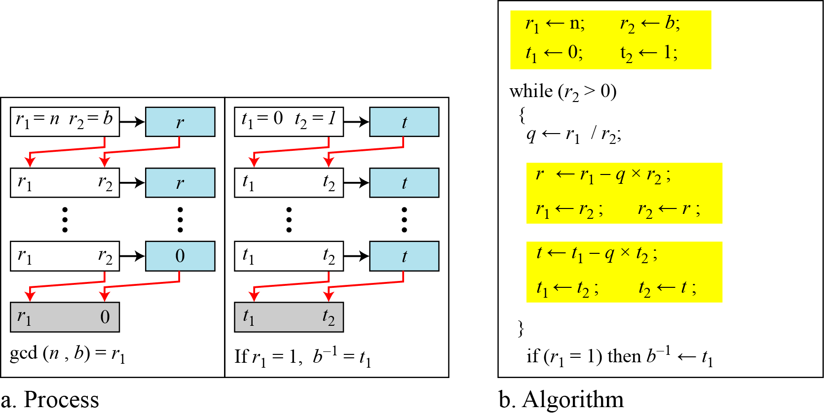
2.2.5 Continued
Figure 2.15 Using extended Euclidean algorithm to
find multiplicative inverse
2.<number>

Slide 59
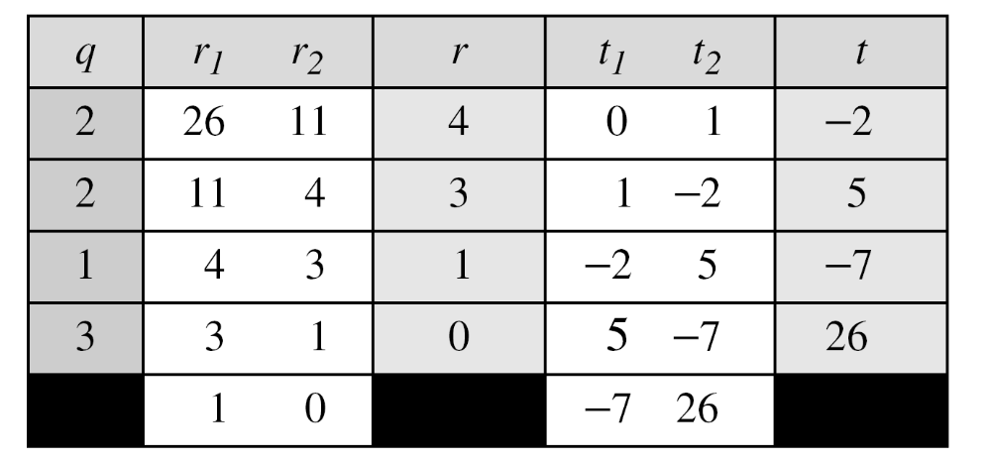
2.2.5 Continued
Example 2.25
Find the multiplicative inverse of 11 in Z₂₆.
Solution
The gcd (26, 11) is 1; the inverse of 11 is −7 or 19.
2.<number>

Slide 60
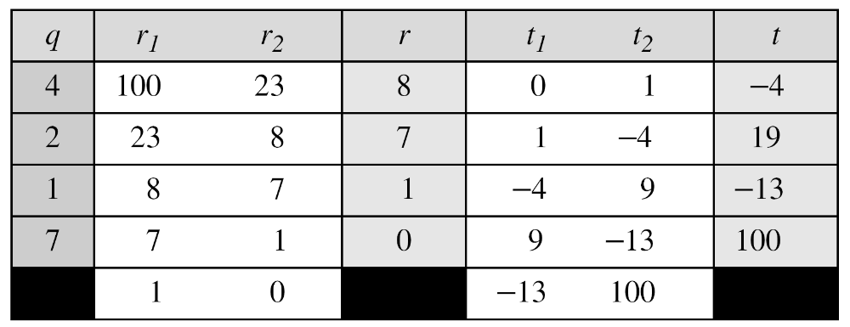
2.2.5 Continued
Example 2.26
Find the multiplicative inverse of 23 in Z₁₀₀.
Solution
The gcd (100, 23) is 1; the inverse of 23 is −13 or 87.
2.<number>

Slide 61
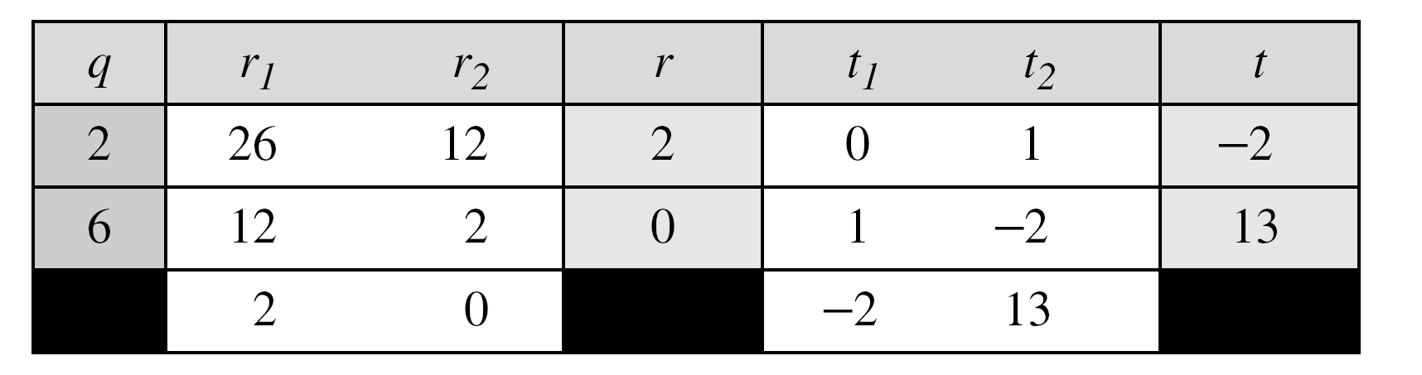
2.2.5 Continued
Example 2.27
Find the inverse of 12 in Z₂₆.
Solution
The gcd (26, 12) is 2; the inverse does not exist.
2.<number>

Slide 62
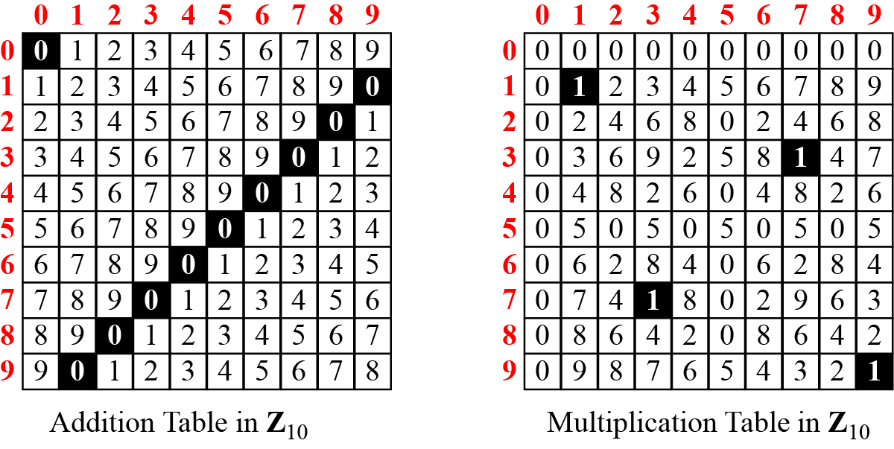
2.2.6 Addition and Multiplication Tables
Figure 2.16 Addition and multiplication table for Z₁₀
2.<number>

Slide 63
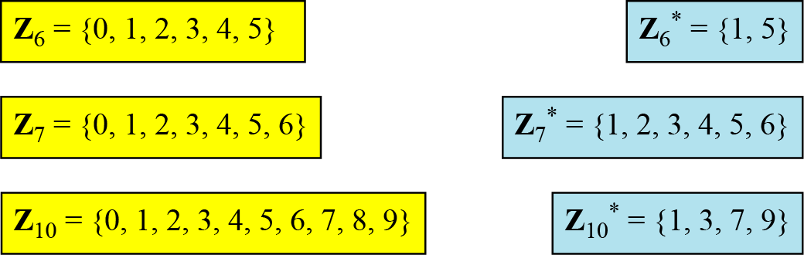
2.2.7 Different Sets
Figure 2.17 Some Z_{n} and Z_{n}* sets
Note
We need to use Zn when additive inverses are needed; we need to use Zn* when multiplicative inverses are needed.
2.<number>

Slide 64
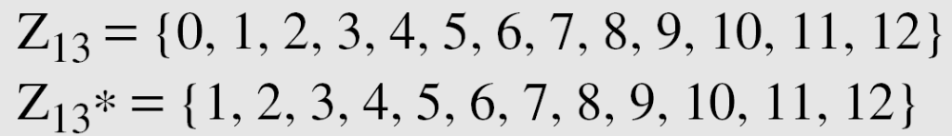
2.2.8 Two More Sets
Cryptography often uses two more sets: Z_{p} and Z_{p}*. The modulus in these two sets is a prime number.
2.<number>

Slide 65
2-3 MATRICES
In cryptography we need to handle matrices. Although this topic belongs to a special branch of algebra called linear algebra, the following brief review of matrices is necessary preparation for the study of cryptography.
Topics discussed in this section:
2.3.1 Definitions
2.3.2 Operations and Relations
2.3.3 Determinants
2.3.4 Residue Matrices
2.<number>

Slide 66
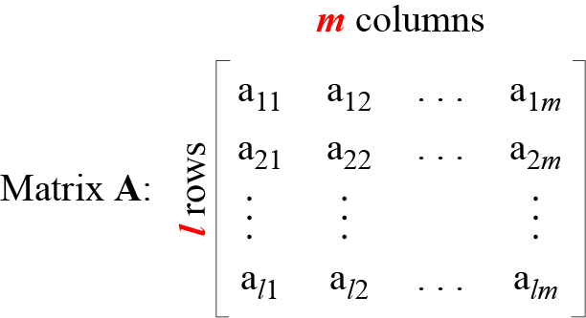
2.3.1 Definition
Figure 2.18 A matrix of size l × m
2.<number>

Slide 67
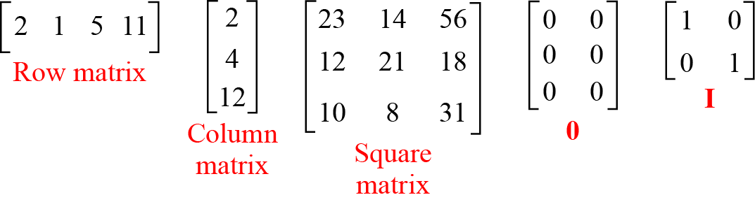
2.3.1 Continued
Figure 2.19 Examples of matrices
2.<number>

Slide 68
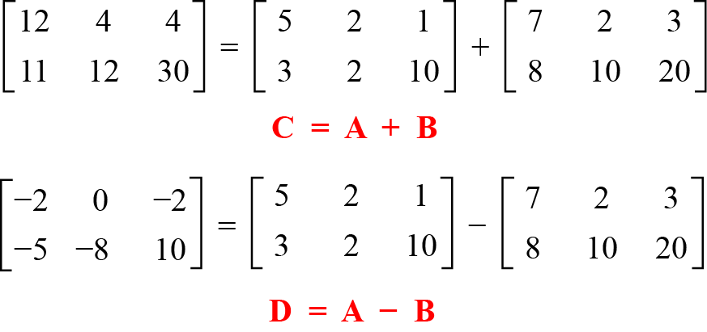
2.3.2 Operations and Relations
Example 2.28
Figure 2.20 shows an example of addition and subtraction.
Figure 2.20 Addition and subtraction of matrices
2.<number>

Slide 69
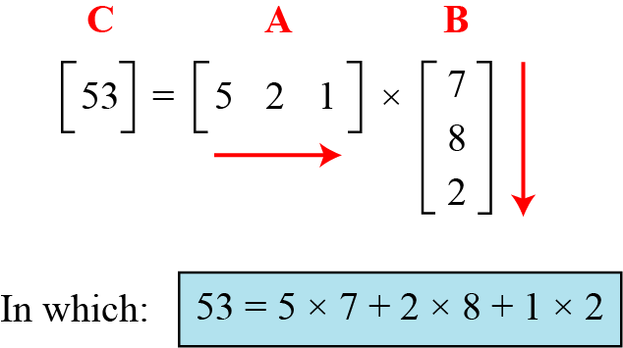
2.3.2 Continued
Example 2. 29
Figure 2.21 shows the product of a row matrix (1 × 3) by a column matrix (3 × 1). The result is a matrix of size 1 × 1.
Figure 2.21 Multiplication of a row matrix by a column matrix
2.<number>

Slide 70
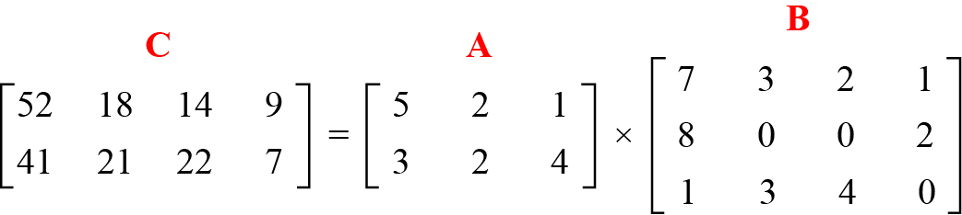
2.3.2 Continued
Example 2. 30
Figure 2.22 shows the product of a 2 × 3 matrix by a
3 × 4 matrix. The result is a 2 × 4 matrix.
Figure 2.22 Multiplication of a 2 × 3 matrix by a 3 × 4 matrix
2.<number>

Slide 71
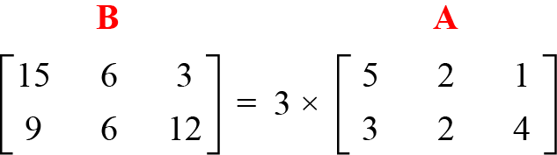
2.3.2 Continued
Example 2. 31
Figure 2.23 shows an example of scalar multiplication.
Figure 2.23 Scalar multiplication
2.<number>

Slide 72
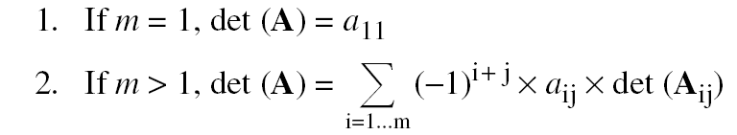
2.3.3 Determinant
The determinant of a square matrix A of size m × m denoted as det (A) is a scalar calculated recursively as shown below:
Note
The determinant is defined only for a square matrix.
2.<number>

Slide 73
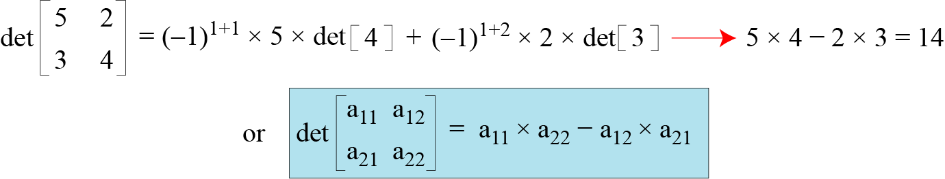
2.3.3 Continued
Example 2. 32
Figure 2.24 shows how we can calculate the determinant of a 2 × 2 matrix based on the determinant of a 1 × 1 matrix.
Figure 2.24 Calculating the determinant of a 2 × 2 matrix
2.<number>

Slide 74
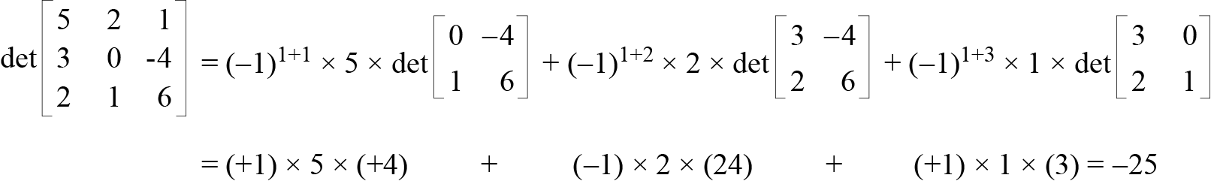
2.3.3 Continued
Example 2. 33
Figure 2.25 shows the calculation of the determinant of a 3 × 3 matrix.
Figure 2.25 Calculating the determinant of a 3 × 3 matrix
2.<number>

Slide 75
2.3.4 Inverses
Note
Multiplicative inverses are only defined for square matrices.
2.<number>

Slide 76
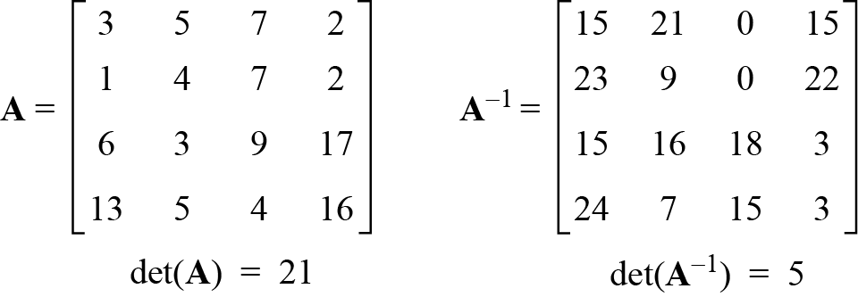
2.3.5 Residue Matrices
Cryptography uses residue matrices: matrices where all elements are in Z_{n}. A residue matrix has a multiplicative inverse if gcd (det(A), n) = 1.
Example 2. 34
Figure 2.26 A residue matrix and its multiplicative inverse
2.<number>

Slide 77
2-4 LINEAR CONGRUENCE
Cryptography often involves solving an equation or a set of equations of one or more variables with coefficient in Z_{n}. This section shows how to solve equations when the power of each variable is 1 (linear equation).
Topics discussed in this section:
2.4.1 Single-Variable Linear Equations
2.4.2 Set of Linear Equations
2.<number>

Slide 78



2.4.1 Single-Variable Linear Equations
Equations of the form ax ≡ b (mod n ) might have no solution or a limited number of solutions.
2.<number>

Slide 79
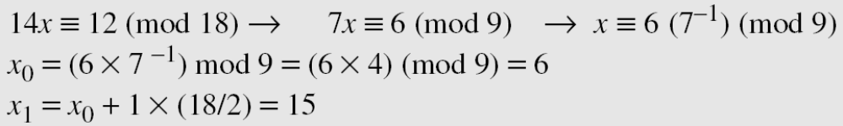
2.4.1 Continued
Example 2.35
Solve the equation 10 x ≡ 2(mod 15).
Solution
First we find the gcd (10 and 15) = 5. Since 5 does not divide 2, we have no solution.
Example 2.36
Solve the equation 14 x ≡ 12 (mod 18).
Solution
2.<number>

Slide 80
2.4.1 Continued
Example 2.37
Solve the equation 3x + 4 ≡ 6 (mod 13).
Solution
First we change the equation to the form ax ≡ b (mod n). We add −4 (the additive inverse of 4) to both sides, which give
3x ≡ 2 (mod 13). Because gcd (3, 13) = 1, the equation has only one solution, which is x₀ = (2 × 3⁻¹) mod 13 = 18 mod 13 = 5. We can see that the answer satisfies the original equation:
3 × 5 + 4 ≡ 6 (mod 13).
2.<number>

Slide 81

2.4.2 Single-Variable Linear Equations
We can also solve a set of linear equations with the same modulus if the matrix formed from the coefficients of the variables is invertible.
Figure 2.27 Set of linear equations
2.<number>

Slide 82

2.4.2 Continued
Example 2.38
Solve the set of following three equations:
Solution
The result is x ≡ 15 (mod 16), y ≡ 4 (mod 16), and z ≡ 14 (mod 16). We can check the answer by inserting these values into the equations.
2.<number>

