Slide 1
Advanced Encryption Standard
(AES)
(Symmetric key Algorithm)
7.<number>
Copyright © The McGraw-Hill Companies, Inc. Permission required for reproduction or display.

Slide 2
INTRODUCTION
The Advanced Encryption Standard (AES) is a
symmetric-key block cipher published by the National
Institute of Standards and Technology (NIST) in
December 2001.
In February 2001, NIST announced that a draft of
the Federal Information Processing Standard (FIPS)
was available for public review and comment.
Finally, AES was published as FIPS 197 in the
Federal Register in December 2001.
7.<number>

Slide 3
AES was designed for following characteristics:
1. Resistance against all known attacks.
2. Speed and code compactness on a wide range of
platform
3. Design Simplicity, work with smart cards.
7.<number>

Slide 4

Rounds.
AES is a non-Feistel cipher that encrypts and decrypts a data block of 128 bits. It uses 10, 12, or 14 rounds. The key size, which can be 128, 192, or 256 bits, depends on the number of rounds.
Note
AES has defined three versions, with 10, 12, and 14 rounds.
Each version uses a different cipher key size (128, 192, or 256), but the round keys are always 128 bits.
7.<number>

Slide 5
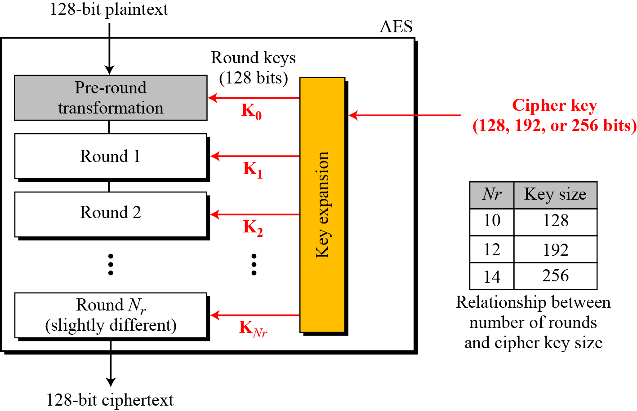
Continue
Three different AES version: AES128,AES192 and AES256
Figure: General design of AES encryption cipher
The no. of round keys generated by the key-expansion algorithm is always one more
Than the no. of rounds. Number of round keys= Nr + 1
7.<number>

Slide 6
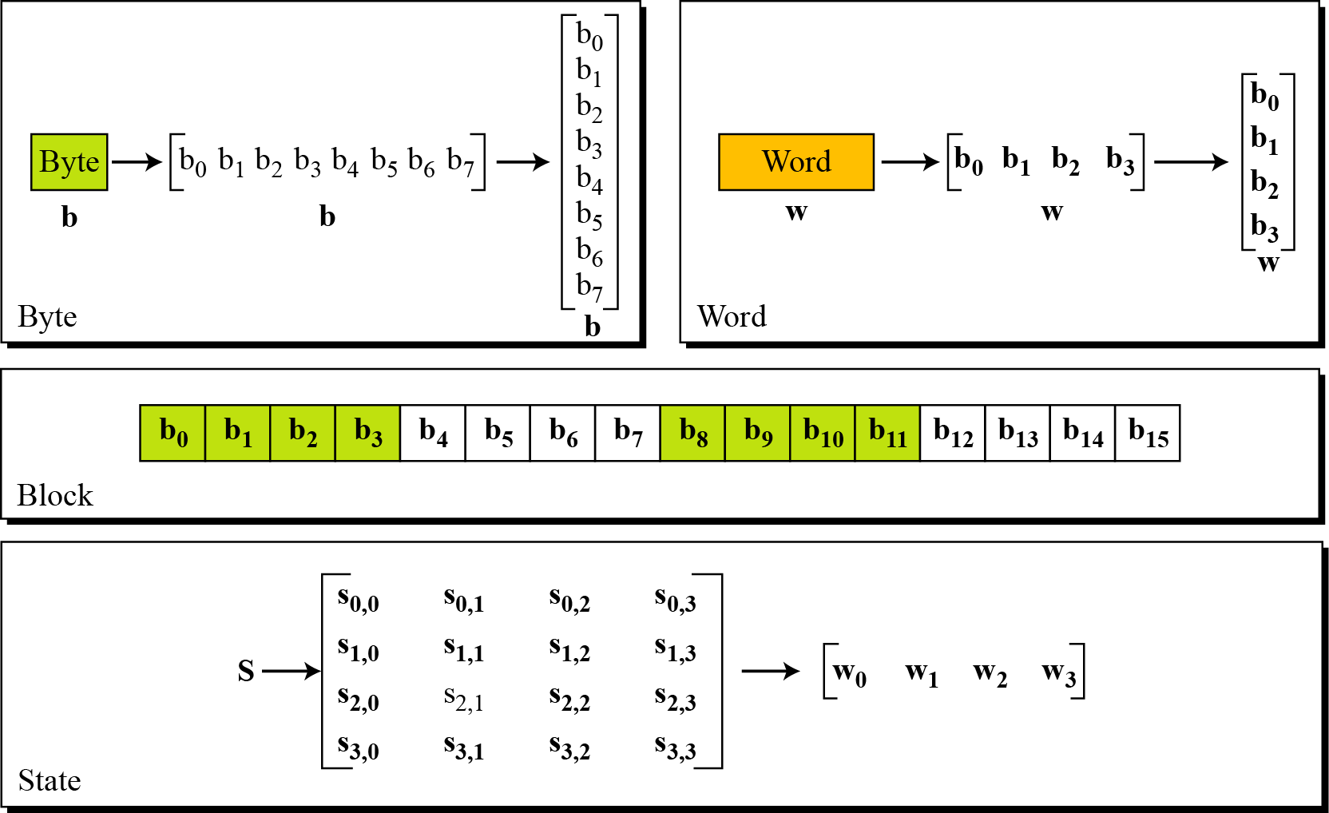
Data Units(AES uses Five units of measurement to refer to data)
(Bit, Byte, Word, Block, State)
7.<number>
Data units used in AES

Slide 7
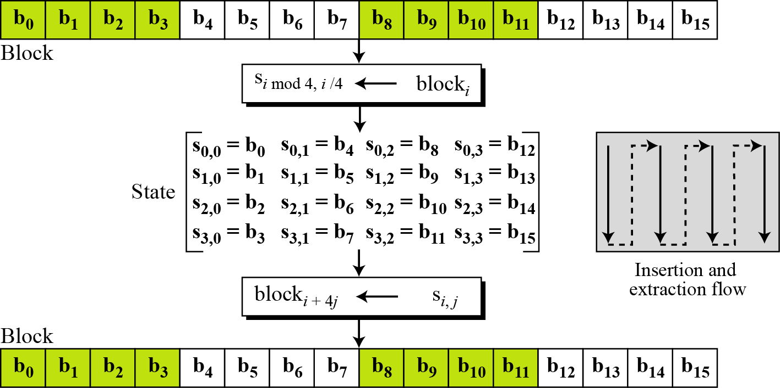
State
AES uses several rounds in which each round is made of several stages.
Data block is transformed from one stage to another.
Block-to-state and state-to-block transformation
7.<number>

Slide 8
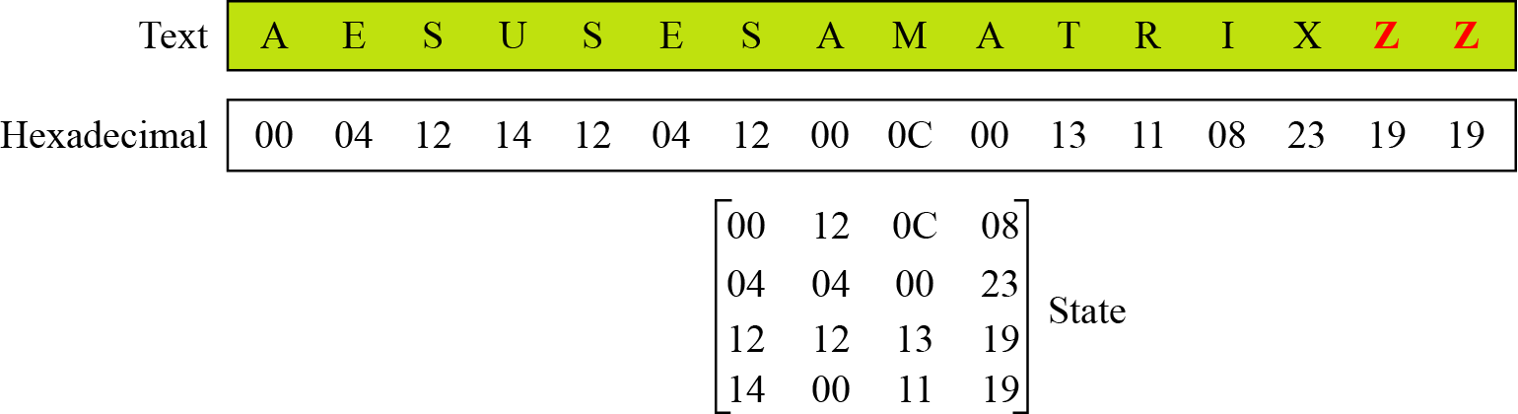
Continue
Changing plaintext to state
Example
7.<number>

Slide 9
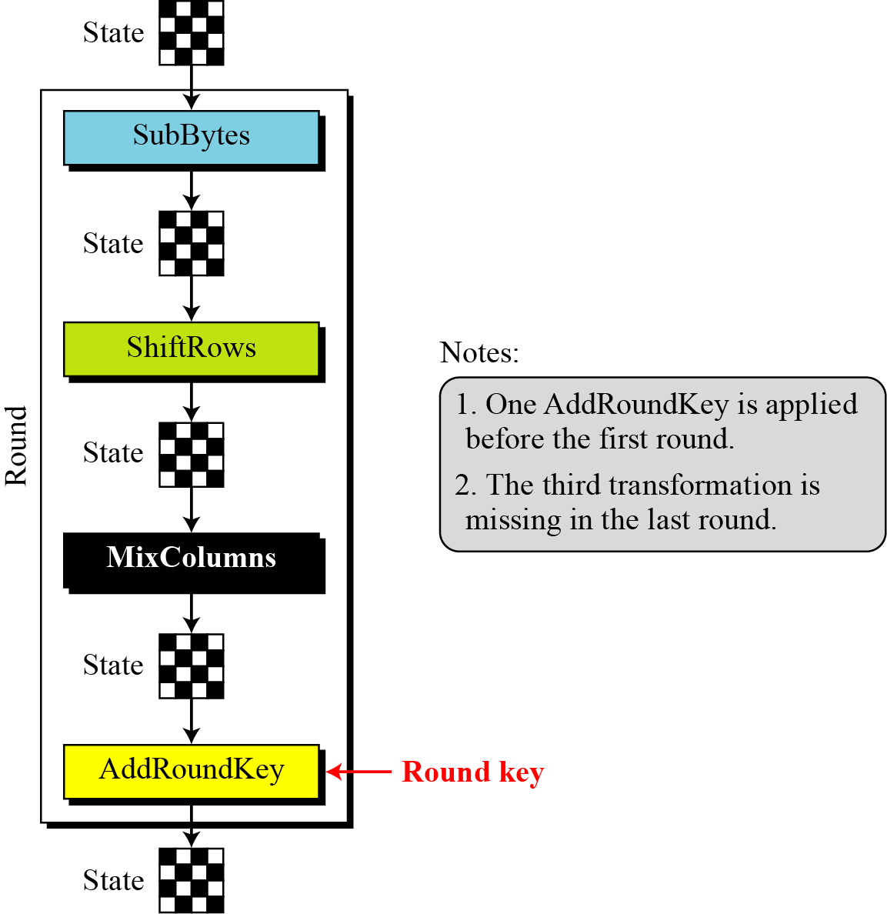
Structure of Each Round
Note:
The pre-round section uses only one transformation (AddRoundKey)
MixColumns transformation is missing in last round
Figure: Structure of each round at the encryption site
7.<number>

Slide 10
TRANSFORMATIONS
To provide security, AES uses four types of transformations:
Substitution, Permutation, Mixing, and Key-adding.
7.<number>

Slide 11
Substitution
AES, like DES, uses substitution. AES uses two invertible transformations.
SubBytes
The first transformation, SubBytes, is used at the encryption site. To substitute a byte, we interpret the byte as two hexadecimal digits.
Note
The SubBytes operation involves 16 independent byte-to-byte transformations.
7.<number>

Slide 12
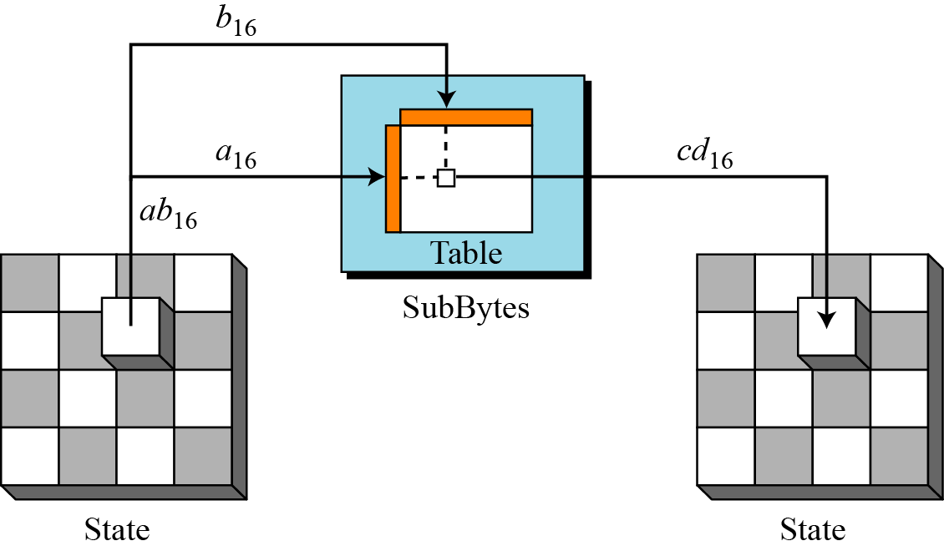
Continue
Figure: SubBytes transformation
7.<number>

Slide 13
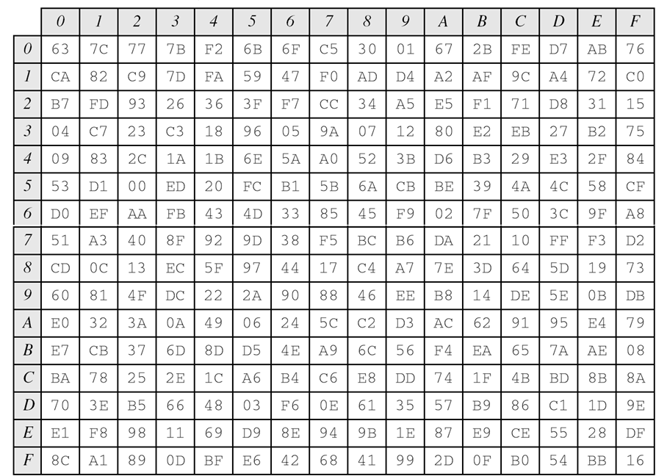
Continue
7.<number>
SubBytes transformation table (S-Boxes)

Slide 14
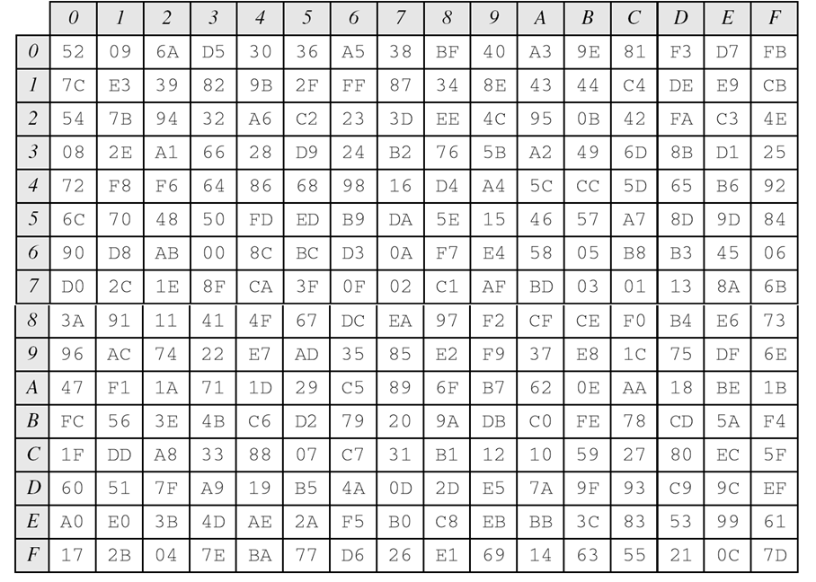
Continue
7.<number>
InvSubBytes transformation table (S-Boxes)

Slide 15
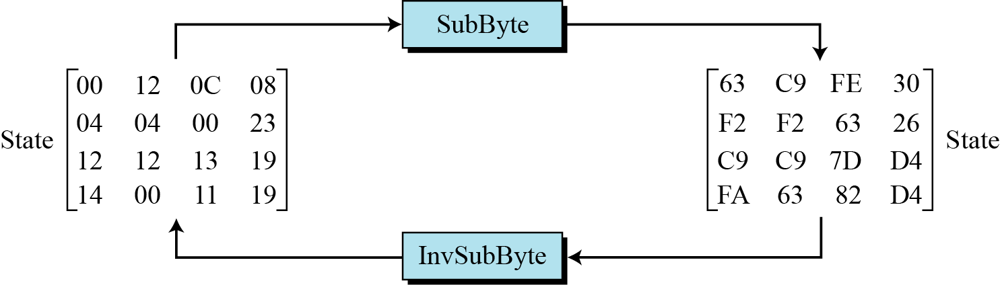
Continue
Example
Figure shows how a state is transformed using the SubBytes transformation. The figure also shows that the InvSubBytes transformation creates the original one. Note that if the two bytes have the same values, their transformation is also the same.
Figure: SubBytes transformation for Example 7.2
7.<number>

Slide 16
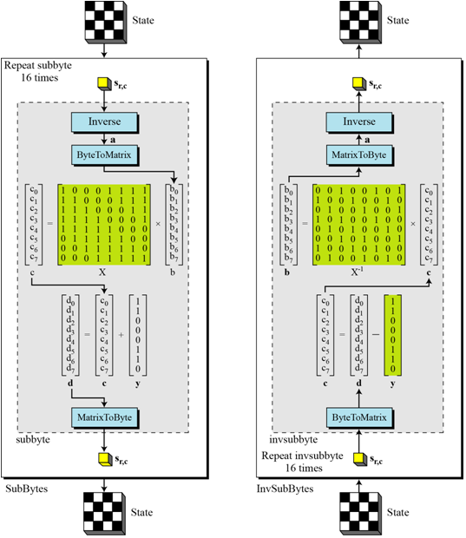
Continue
7.<number>
Figure: SubBytes and InvSubBytes processes

Slide 17
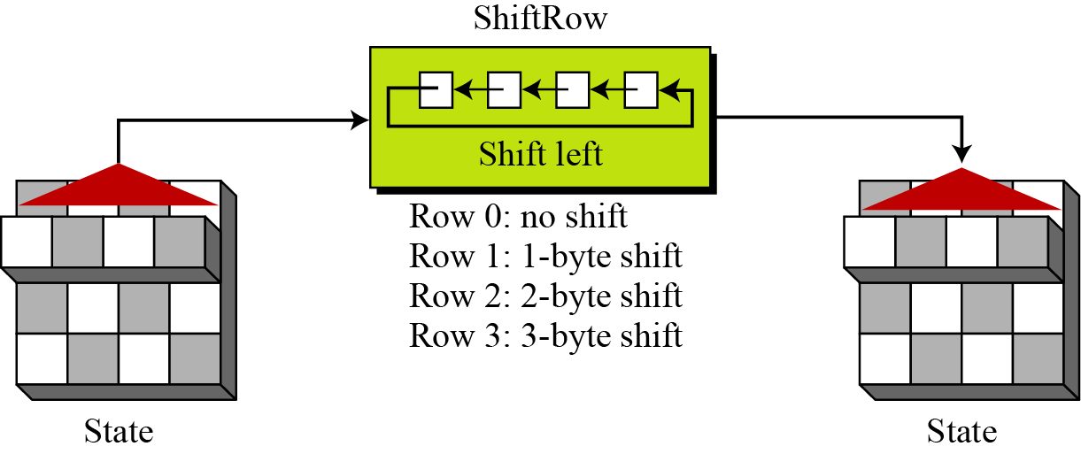
Permutation
Another transformation found in a round is shifting, which permutes the bytes.
ShiftRows
In the encryption, the transformation is called ShiftRows.
Figure 7.9 ShiftRows transformation
7.<number>

Slide 18
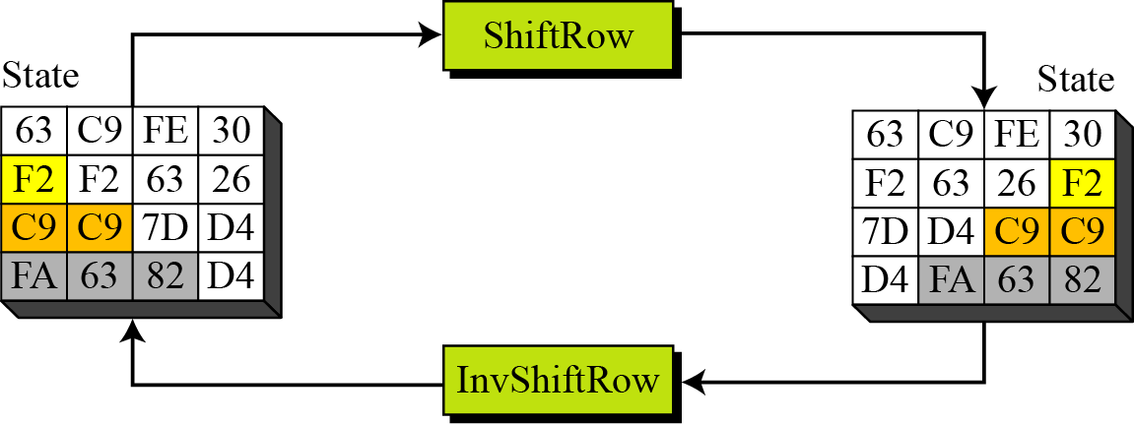
Continue
Example
Figure shows how a state is transformed using ShiftRows transformation. The figure also shows that InvShiftRows transformation creates the original state.
Figure: ShiftRows transformation in Example
7.<number>

Slide 19
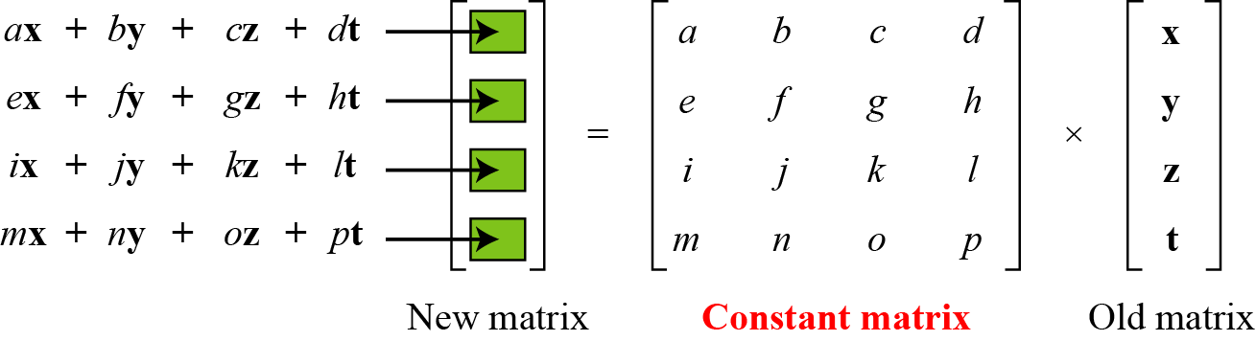
Mixing
We need an interbyte transformation that changes the bits inside a byte, based on the bits inside the neighboring bytes. We need to mix bytes to provide diffusion at the bit level.
Figure: Mixing bytes using matrix multiplication
7.<number>

Slide 20
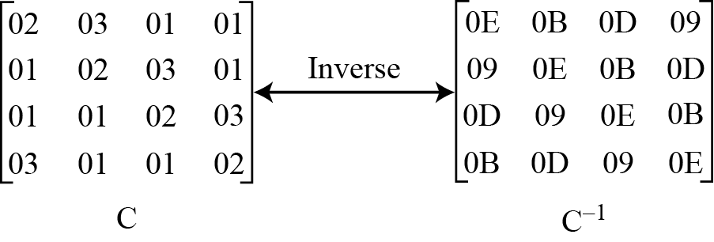
Continue
Figure: Constant matrices used by MixColumns and InvMixColumns
7.<number>

Slide 21
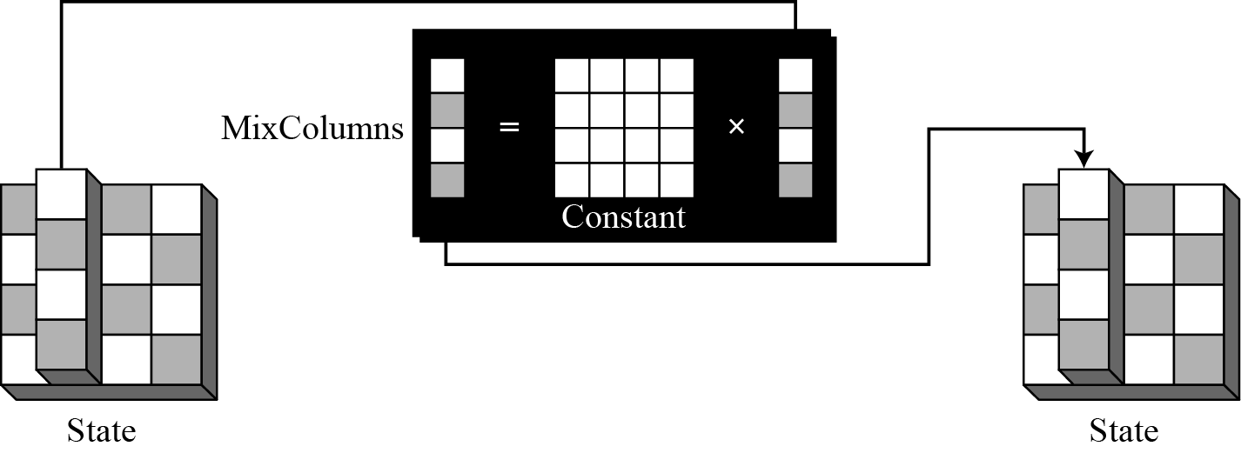
Continue
MixColumns
The MixColumns transformation operates at the column level; it transforms each column of the state to a new column.
Figure: MixColumns transformation
7.<number>

Slide 22
Continue
InvMixColumns
The InvMixColumns transformation is basically the same as the MixColumns transformation.
Note
The MixColumns and InvMixColumns transformations are inverses of each other.
7.<number>

Slide 23
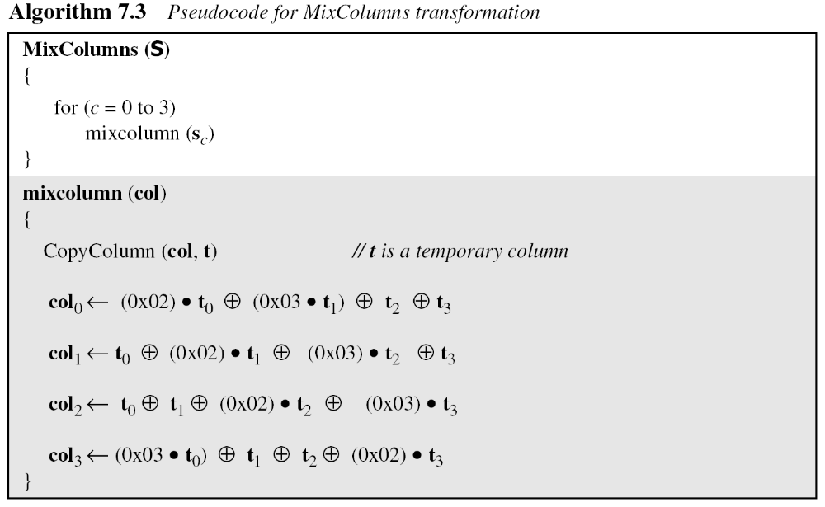
Continue
7.<number>

Slide 24
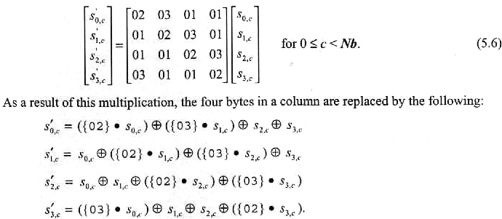


Continue
Example
In GF(2⁸), irreducible polynomial mod(x⁴+x³+x+1)
({02} · {87}) ⊕ ({03} · {6E}) ⊕ {46} ⊕ {A6} = {47}
{87} ⊕ ({02} · {6E}) ⊕ ({03}· {46}) ⊕ {A6} = {37}
{87} ⊕ {6E} ⊕ ({02} · {46} ⊕ ({03} · {A6}) = {94}
({03} · {87}) ⊕ {6E} ⊕ {46} ⊕ ({02} · {A6} = {ED}
For the first equation,
  {02} · {87} = x*(x⁷ + x²+x+1) = (1 0000 1110) l because of the most left 1, (0000 1110) ⊕ (0001 1011) = (0001 0101);
and
  {03} · {6E} = (x+1)*(x⁶ +x⁵ + x³+ x²+x)
  = (x⁶ +x⁵ + x³+ x²+x) ⊕ (x)*(x⁶ +x⁵ + x³+ x²+x), the same statement for the second side.
  = {6E} ⊕ ({02} · {6E}) = (0110 1110) ⊕ (1101 1100)
  = (1011 0010).
{02} · {87} = 0001 0101
{03} · {6E} = 1011 0010
{46} = 0100 0110
{A6} = 1010 0110 Answer:Total 0100 0111 = {47}
7.<number>

Slide 25
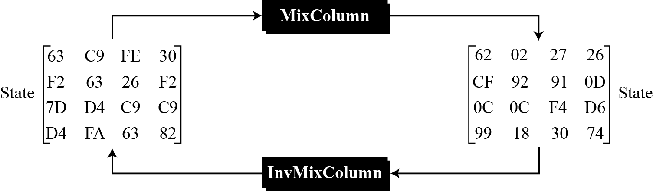
Continue
Example
Figure shows how a state is transformed using the MixColumns transformation. The figure also shows that the InvMixColumns transformation creates the original one.
Figure: The MixColumns transformation in Example 7.5
7.<number>

Slide 26
Key Adding
AddRoundKey
AddRoundKey proceeds one column at a time. AddRoundKey adds a round key word with each state column matrix; the operation in AddRoundKey is matrix addition.
Note
The AddRoundKey transformation is the inverse of itself.
7.<number>

Slide 27
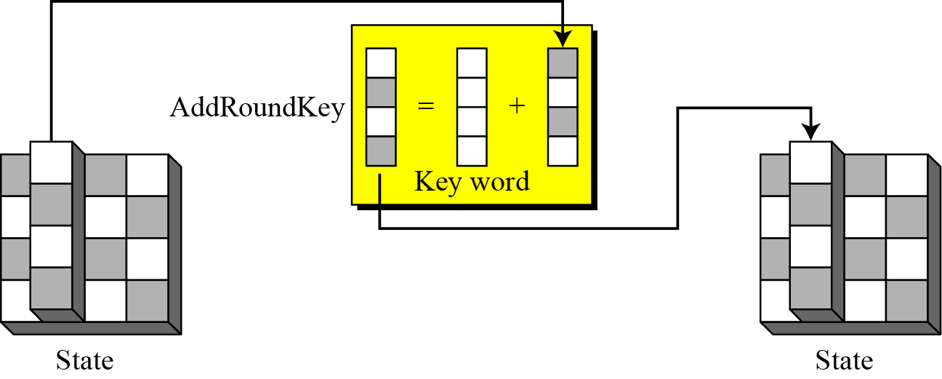
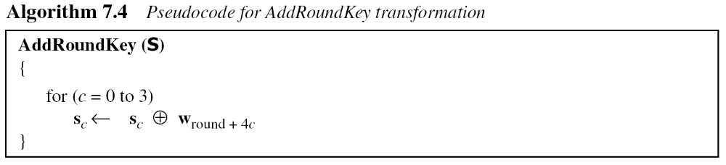
Continue
Figure: AddRoundKey transformation
7.<number>

Slide 28
KEY EXPANSION
To create round keys for each round, AES uses a key-expansion process. If the number of rounds is N_{r} , the key-expansion routine creates N_{r} + 1 128-bit round keys from one single 128-bit cipher key.
7.<number>

Slide 29
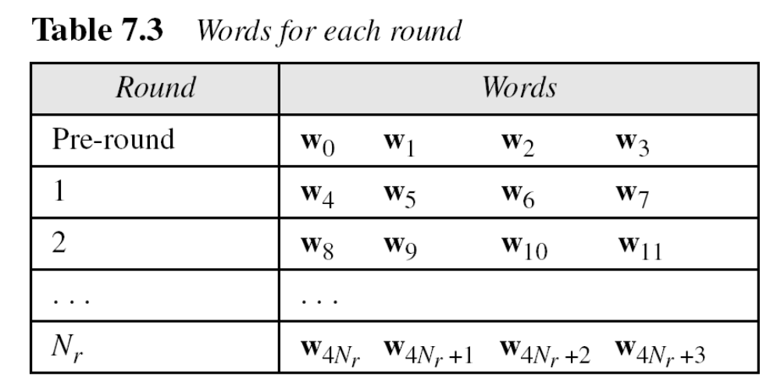
Continued
7.<number>

Slide 30
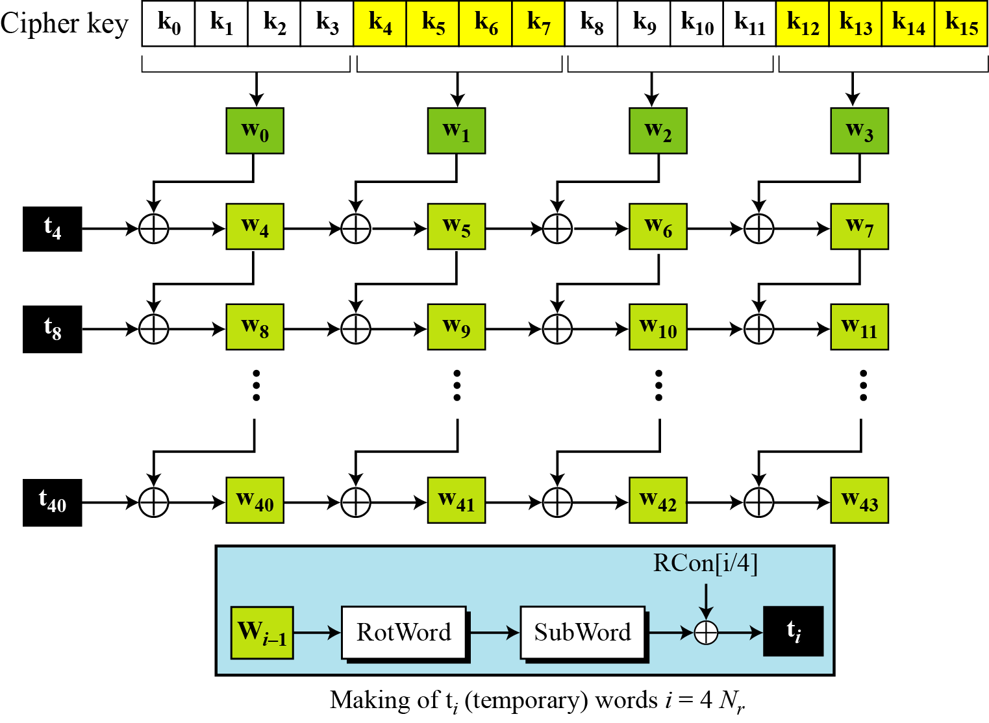
Key Expansion in AES-128
Figure: Key expansion in AES
7.<number>

Slide 31
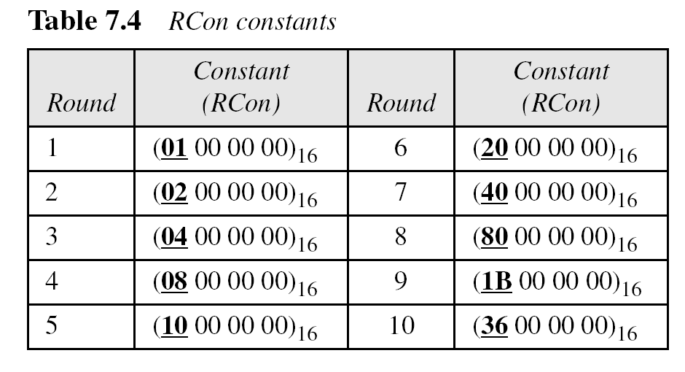
Continue
7.<number>

Slide 32
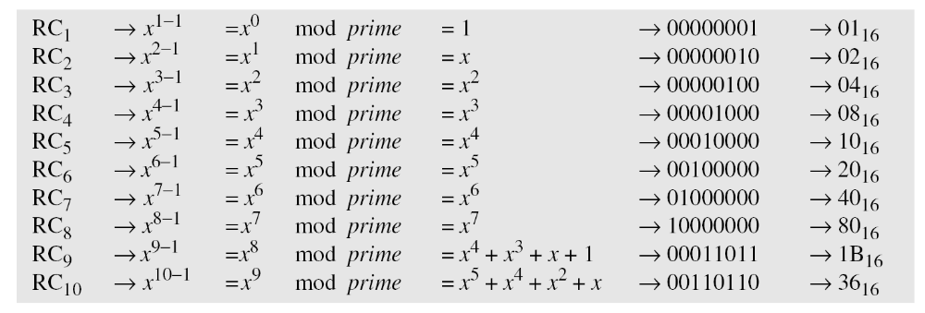
Continue
The key-expansion routine can either use the above table when calculating the words or use the GF(2⁸) field to calculate the leftmost byte dynamically, as shown below (prime is the irreducible polynomial):
7.<number>

Slide 33
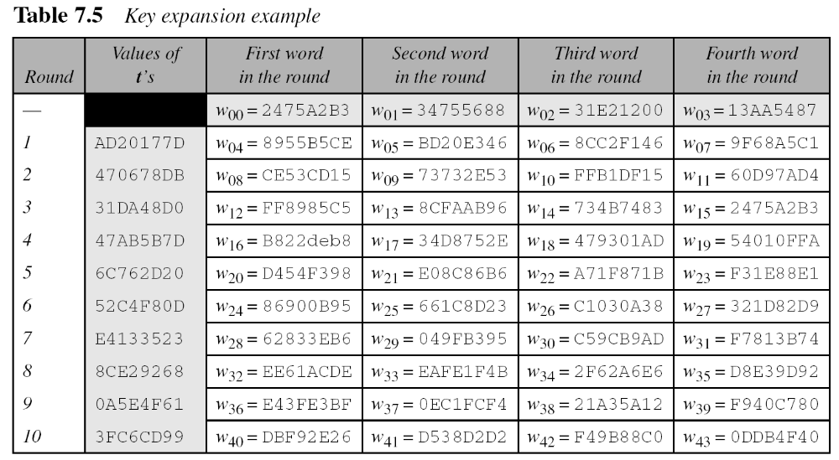
Continue
Example 7.6
Table shows how the keys for each round are calculated assuming that the 128-bit cipher key agreed upon by Alice and Bob is (24 75 A2 B3 34 75 56 88 31 E2 12 00 13 AA 54 87)₁₆.
7.<number>

Slide 34
Continue
Example
Each round key in AES depends on the previous round key. The dependency, however, is nonlinear because of SubWord transformation. The addition of the round constants also guarantees that each round key will be different from the previous one.
Example
The two sets of round keys can be created from two cipher keys that are different only in one bit.
7.<number>

Slide 35
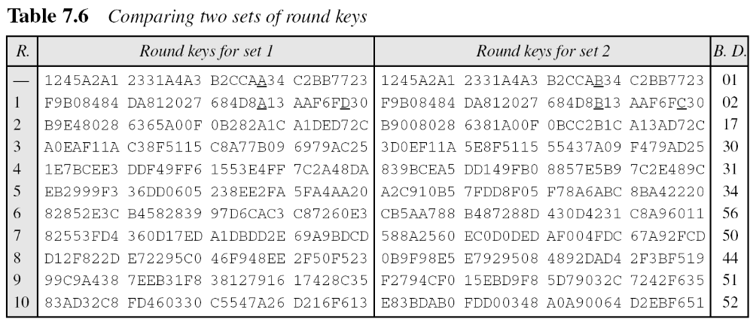
Continue
Example
Continue
7.<number>

Slide 36
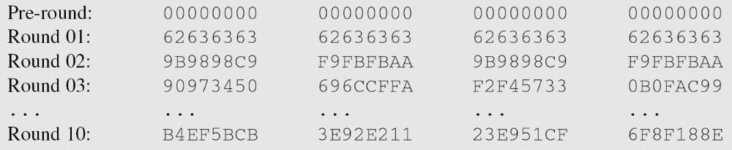
Continue
Example
The concept of weak keys, as we discussed for DES, does not apply to AES. Assume that all bits in the cipher key are 0s. The following shows the words for some rounds:
The words in the pre-round and the first round are all the same. In the second round, the first word matches with the third; the second word matches with the fourth. However, after the second round the pattern disappears; every word is different.
7.<number>

Slide 37
Key Expansion in AES-192 and AES-256
Key-expansion algorithms in the AES-192 and AES-256 versions are very similar to the key expansion algorithm in AES-128, with the following differences:
7.<number>

Slide 38
Key-Expansion Analysis
The key-expansion mechanism in AES has been designed to provide several features that thwart the cryptanalyst.
7.<number>

Slide 39
CIPHERS
AES uses four types of transformations for encryption and decryption. In the standard, the encryption algorithm is referred to as the cipher and the decryption algorithm as the inverse cipher.
7.<number>

Slide 40
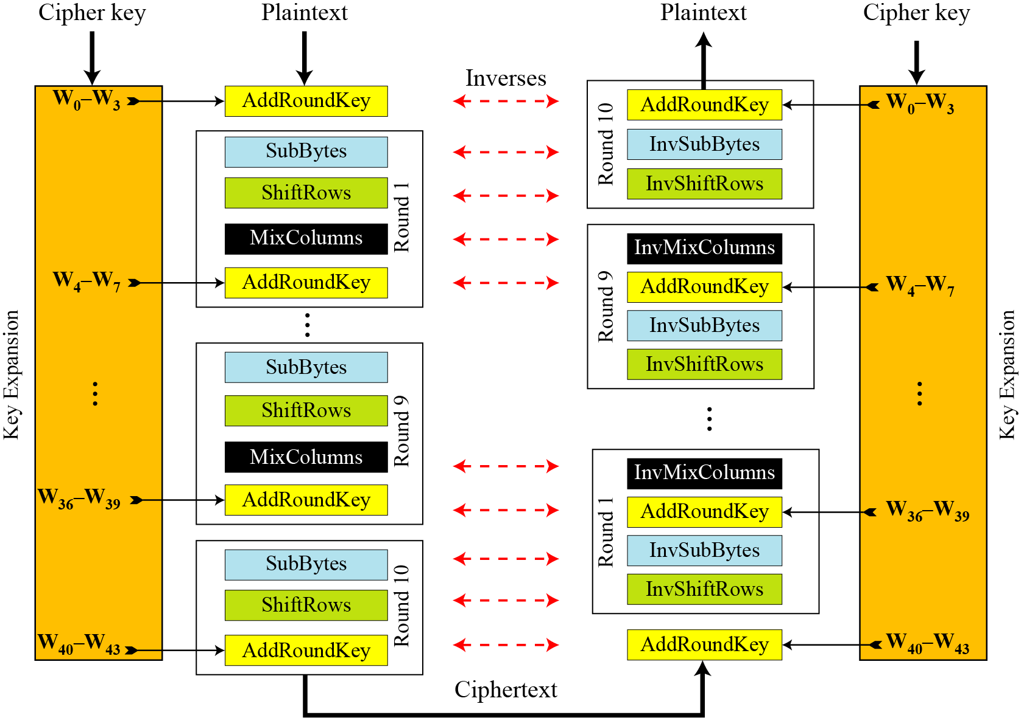
Original Design
Figure: Ciphers and inverse ciphers of the original design
7.<number>

Slide 41
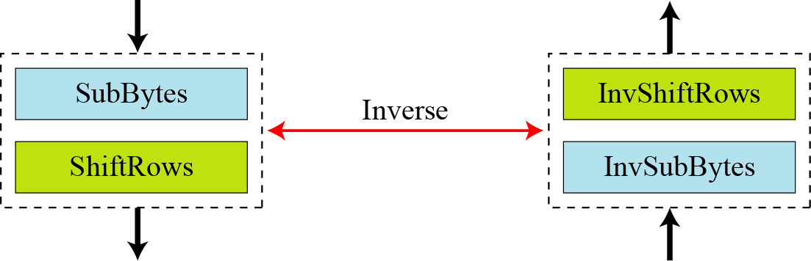
Alternative Design
Figure: Invertibility of SubBytes and ShiftRows combinations
7.<number>

Slide 42
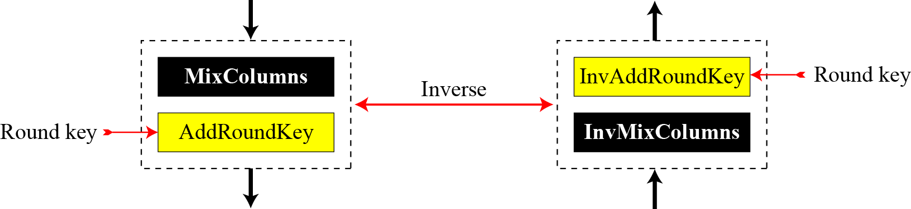
Continue
Figure: Invertibility of MixColumns and AddRoundKey combination
7.<number>

Slide 43
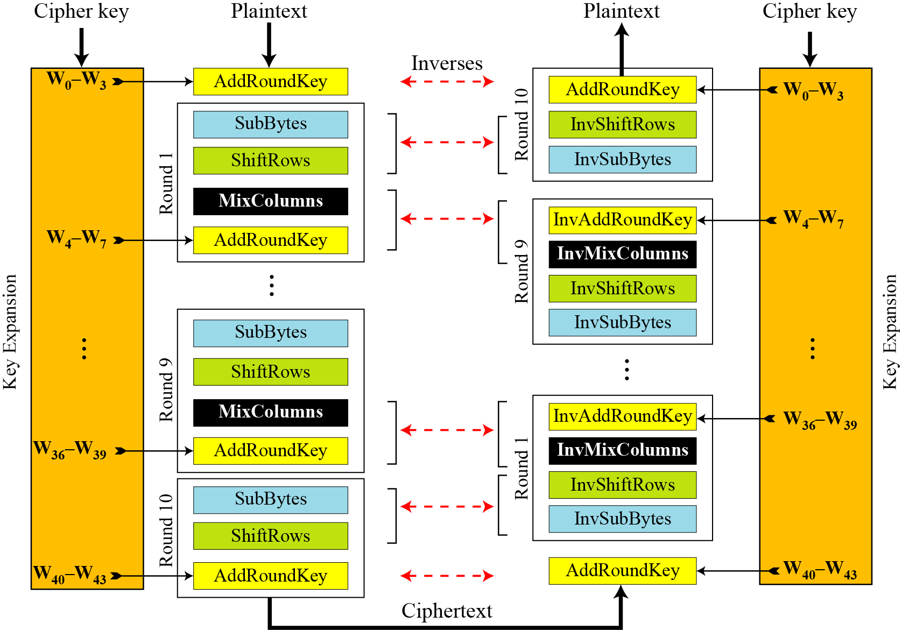
7.4.2 Continue
Figure: Cipher and reverse cipher in alternate design
7.<number>

Slide 44
Continue
Changing Key-Expansion Algorithm
Instead of using InvRoundKey transformation in the reverse cipher, the key-expansion algorithm can be changed to create a different set of round keys for the inverse cipher.
7.<number>

