Slide 1

Symmetric Block Ciphers
Dr.K.MURUGAN

Slide 2
Symmetric Ciphers
A Symmetric Cipher has five constituents:
  Plaintext
  An Encryption Algorithm
  A single Secret Key
  Ciphertext
  A Decryption Algorithm

Slide 3
Symmetric Ciphers
Given:
  Plaintext P
  Secret Key K
  Encryption Algorithm E_{K}
  Ciphertext C
  Decryption Algorithm D_{K}
We have, as requirements:
  For encryption:
C = E_{K}(P)
  and for decryption:
P = D_{K}(C)
so that the process is reversible.
When the same key is used for encryption and decryption, the cipher is said to be a Symmetric Cipher.
By necessity, this single key must be kept secret from all but the sender and recipient, so the cipher is also said to be a Secret Key Cipher.

Slide 4
Stream Ciphers & Block Ciphers
A Stream Cipher is a cipher that encrypts a data stream one bit or one byte (octet) at a time.
  Examples:
    The autokeyed Vigenère cipher
    The Vernam cipher
A Block Cipher is a cipher which treats a fixed-sized block of plaintext as a whole, and from it creates a ciphertext block of equal length.
  Typically, the block size is 64 bits (now considered small) or 128 bits
  Using Modes of Operation (described later), a block cipher can be used to achieve the same effect as a stream cipher

Slide 5
Block Ciphers
A block cipher operates on a plaintext block of n bits to produce a ciphertext of n bits.
There are 2^{n} possible different plaintext blocks
For the encryption to be reversible, each plaintext block must produce a unique ciphertext block
However, if the block size is too small (e.g. n = 4), then the cipher is equivalent to a classical substitution cipher.

Slide 6
Shannon's Diffusion and Confusion
Claude E. Shannon, in his seminal paper on cryptography*, suggested two methods for frustrating statistical cryptanalysis:
  Diffusion
    Spreads the influence of individual plaintext or key bits over as much of the ciphertext as possible.
    Hides statistical relationships and makes cryptanalysis more difficult
  Confusion
    Hides any relationship between the plaintext, the ciphertext, and the key.
    Good confusion makes the relationship statistics so complicated that even the most powerful cryptographic tools won't work.
C. E. Shannon, Communication theory of secrecy systems, Bell System Technical Journal, 1949

Slide 7
The Feistel Cipher
The modern block cipher was invented by Horst Feistel, around 1973. At the time, he was working for IBM.
  Based on the concept of a product cipher, which uses two or more basic ciphers in sequence in such a way that the combined result is cryptographically stronger than any of the component ciphers.
  In particular, Feistel proposed a cipher that alternates substitutions and permutations. This is a practical implementation of Shannon's confusion and diffusion principles.
  So successful are diffusion and confusion, that they have become the cornerstone of modern block cipher design.

Slide 8
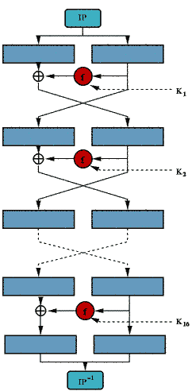
The Feistel Network
The inputs to a Feistel Network are:
  A plaintext block of length n bits (n is even)
  A key K of m bits
The plaintext is divided into 2 parts, L and R
  The two halves pass through n rounds of processing, and finally combine to produce the ciphertext.
The key, K, is used to generate n subkeys, K_{i}, each of which is used in a round
  The subkeys are distinct from each other and from the original key, K.
http://www.freesoft.org/CIE/Topics/143.htm

Slide 9
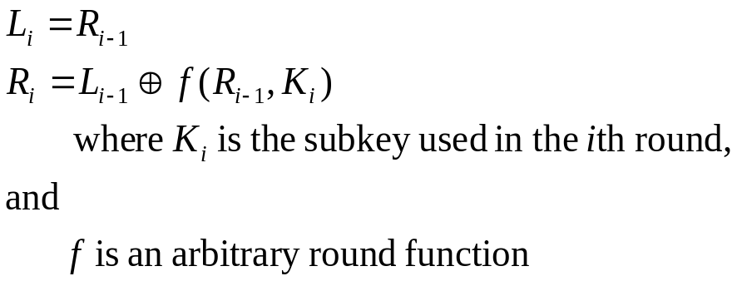
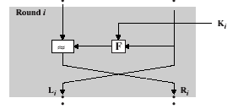

The Feistel Network
A Feistel Network is an iterated block cipher, where the output of the ith round is determined from the output of the (i-1)th round:
Because XOR is used to combine the left half with the output of the round function, the operation is reversible:

Slide 10
The Feistel Network
Implementations of a Feistel Network depend on a number of parameters:
  Block size
    Larger block sizes provide greater security, but reduced performance.
    Block sizes of 64 bits or, more recently, 128 bits are reasonable
  Key size
    Larger key sizes provide greater security, but may reduce performance
    Key sizes of 64 bits are now considered to be inadequate;
    128 bits is now more common; 256 bits is better.
  Number of rounds
    The more rounds, the more security
    16 rounds is typical
  Subkey generation
    More complexity in how subkeys are generated from the input key provides greater security
  Round function
    Greater complexity yields greater resistance to cryptanalysis

Slide 11
The Feistel Network
Interestingly:
  A Feistel Network is guaranteed to be invertible as long as the inputs to f in each round can be reconstructed.
  It doesn't matter what f is; f need not be invertible!
  So we can design f to be as complicated as we wish.
  Thus, we don't have to implement one algorithm for encryption and a different algorithm for decryption.

Slide 12
The Data Encryption Standard (DES)
DES (also called the Data Encryption Algorithm, DEA) is the most widely used encryption scheme
  In 1973, the National Bureau of Standards (NBS) -- now called the National Institute of Standards and Techology (NIST) -- issued a request for proposals for a national cipher standard.
  IBM submitted a proposal based on Horst Feistel's work, known as Lucifer. It was adopted, with some modifications influenced by the NSA.
  DES is a Feistel block cipher which operates on 64 bit blocks.
  Lucifer originally used a key size of 128 bits, but DES reduced this to 56 bits* (causing lots of controversy and suspicion of NSA's involvement)
*Actually, the function expects 64 bits, but only 56 bits are used.

Slide 13
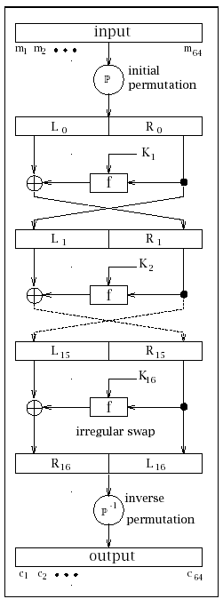
The Data Encryption Standard (DES)
There are 3 phases:
  An initial permutation (IP)
  16 rounds of the same function, involving permutation and substitution functions
  A final permutation (IP⁻¹), which is the inverse of the initial permutation function
http://www.itl.nist.gov/fipspubs/fip46-2.htm

Slide 14
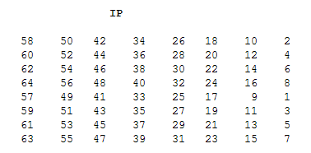
The Data Encryption Standard (DES)
The 64 bits of the input block to be enciphered are first subjected to the following permutation, called the initial permutation IP:
  That is, the permuted input has bit 58 of the input as its first bit, bit 50 as its second bit, and so on with bit 7 as its last bit.

Slide 15
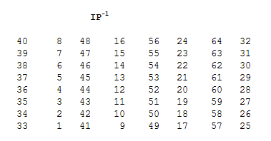
The Data Encryption Standard (DES)
The permuted input block is then supplied as input to several rounds of complex key-dependent computation.
The output of that computation, called the preoutput, is then subjected to the following permutation which is the inverse of the initial permutation:

Slide 16
The Data Encryption Standard (DES)
According to our textbook:
  "Since the permutation appears to have no security value, it seems nearly certain that there is no security significance to this particular permutation." (Kaufman, Perlman, & Speciner, p. 67)
and:
  "We hope you appreciate the time we spent staring at the numbers and discovering this completely useless structure." (p. 66)

Slide 17
The Data Encryption Standard (DES)
Per-Round Key Generation
  The input key, K, is 64 bits -- however...
  Every 8th bit of K is considered to be a parity bit, which makes the effective key length 64 - 8 = 56 bits.
  This caused great controversy at the time of DES' adoption, with suspicions raised about the NSA intentionally weakening the design of DES because they already knew how to break it.
DES performs a function on these bits to generate sixteen 48-bit subkeys, K₁, K₂, ... K₁₆, one for each round ...

Slide 18
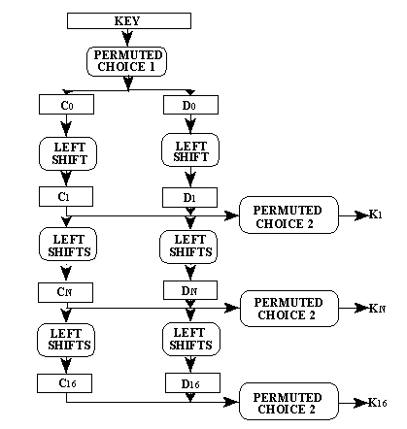
The Data Encryption Standard (DES)
First, an initial permutation* is performed on the useful 56 bits of K, to generate a 56-bit output. This is then divided into two 28-bit values, C₀ & D₀
The two values are then fed through 16 rounds.
  Rounds 1, 2, 9, and 16 perform a 1-bit rotate left with carry around to the right.
  All other rounds use a 2-bit rotate left.
  The output of each round is a subkey, K_{i}, permuted from the two values C_{i} (with 4 bits discarded) and D_{i} (with 4 bits discarded), producing a subkey of 48 bits.
*For details of the permutation, see the textbook.

Slide 19
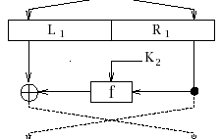
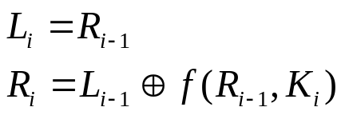
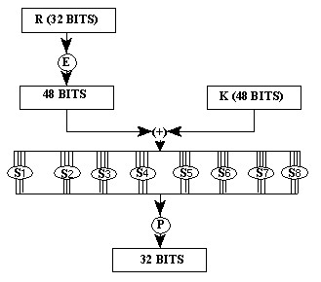
A DES Round
For each round, i :
where the function f:
  Expands the 32-bit input to 48 bits, using an expansion permutation
  XORs (mod 2) the result with K_{i}, producing a 48 bit value
  Passes the result through a set of eight S-boxes (substitution boxes)
  Then performs a permutation on the result, using a P-box
  The final result of f is XORed (mod 2) with L_{i} and the result of that passes into the next round as R_{i+1}
  The original R_{i} passes unchanged into the next round as L_{i+1}

Slide 20
DES Decryption
As with any Feistel block cipher, decryption uses the same algorithm as encryption, but with the application of the subkeys reversed.
  The various component operations of DES were chosen to make this work.

Slide 21
The Avalanche Effect
We would like to ensure a particular behavior, called an Avalanche Effect, in any good encryption algorithm:
  A small change in either the plaintext or the key should produce a significant change in the ciphertext.
  In particular, a change in one bit of the plaintext or one bit of the key should change many bits in the ciphertext
If this were not the case, it could provide a way to reduce the size of the plaintext or keyspace to be searched by an attacker.
DES exhibits a strong avalanche effect.

Slide 22
Weak and Semi-Weak Keys in DES
It turns out that there are 16 keys that should not be used with DES:
  4 Weak Keys, where C₀ and D₀ are all ones or all zeroes
    Weak keys are their own inverses (encrypting with one is the same as decrypting with the other)
  12 Semi-Weak Keys, where C₀ and D₀ are alternating ones and zeros or alternating zeros and ones
    Each semi-weak key is the inverse of one of the other semi-weak keys

Slide 23
The Data Encryption Standard (DES)
When DES was adopted, there was much controversy over the 56-bit key size.
  In 1977, Diffie and Hellman postulated that the technology existed to build a parallel machine with 1 million encryption devices, each of which could perform one encryption per microsecond. They estimated that a machine costing about $20M in 1977 could crack DES in about 10 hours.
DES was finally cracked in 1998 by the Electronic Frontier Foundation, which built special hardware, using custom chips. The EFF DES Cracker, built for less than $250,000, took less than 3 days to crack DES.
DES is now known to be insufficient for today's environment.
See the Electronic Frontier Foundation's web site documenting this.

Slide 24
Block Cipher Modes of Operation
A block cipher can encrypt a single block of a fixed size (n bits)
So, how do we encrypt long messages?
  First, if the plaintext is not an exact multiple of the block cipher's block size, we have to perform some form of padding
    Such padding must be reversible, in order to allow decryption
    The most obvious scheme -- appending zero bytes to P until the length is suitable -- is not reversible.
  Once we have suitably padded the plaintext, we then must use some mechanism to create concatenated blocks of ciphertext from the concatenated plaintext blocks. These are called Block Cipher Modes of Operation, and are specified in a FIPS standard (see FIPS PUB 81, DES MODES OF OPERATION*) . Note that they can be used with any block cipher.
*http://www.itl.nist.gov/fipspubs/fip81.htm

Slide 25
Block Cipher Modes of Operation
Ferguson and Schneier* suggest the following:
  Let P be the plaintext, l(P) be the length of P in bytes, and b be the block size of the block cipher in bytes
  Using one of the following padding schemes:
    Append to P a single byte with a value of 128, and then as many zero bytes as necessary to make the overall size a multiple of b.
    Determine the number, n, of padding bytes needed.
    Pad P by appending n bytes, each with value n.
*Practical Cryptography, by Niels Ferguson & Bruce Schneier, Wiley

Slide 26
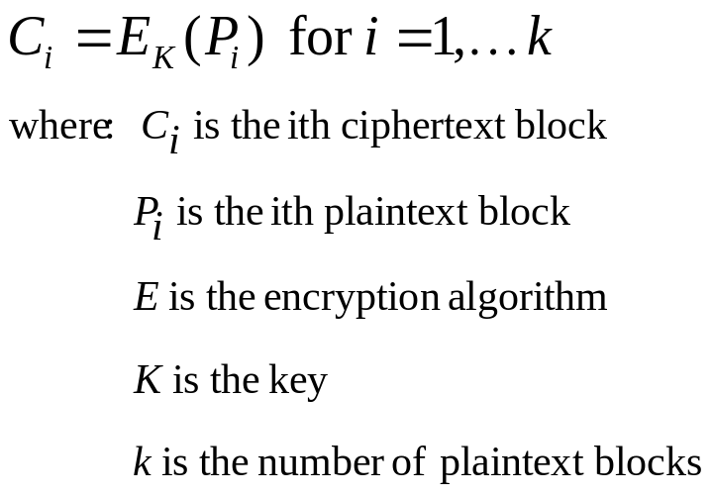
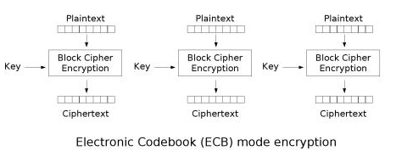
Electronic Codebook Mode (ECB)
The most straightforward way of encrypting a longer plaintext is to use Electronic Codebook mode, or ECB.
http://en.wikipedia.org/wiki/Electronic_codebook

Slide 27
Electronic Codebook Mode (ECB)
Unfortunately, ECB has serious shortcomings:
  If two plaintext blocks are the same, then the corresponding ciphertext blocks will be the same, which is visible to an attacker. Depending on the structure of the message, this can leak a lot of information.
  It is strongly recommended that ECB not be used for message encryption.
To see a particularly striking example of how weak ECB can be, go to http://en.wikipedia.org/wiki/Electronic_codebook

Slide 28
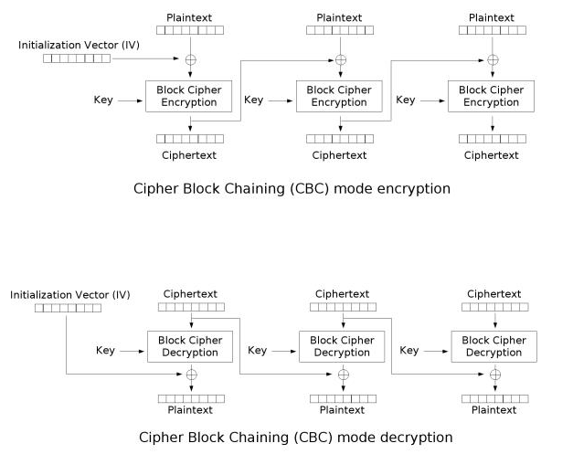
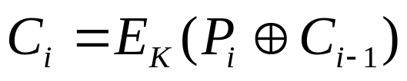
Cipher Block Chaining Mode (CBC)
Cipher Block Chaining mode (CBC) avoids the problems with ECB by XORing each plaintext block with the previous ciphertext block:

Slide 29
Cipher Block Chaining Mode (CBC)
This raises the issue of what to do for the first plaintext block, which does not have a previous ciphertext block.
We use an Initialization Vector (IV)
  What should we use for an IV?
    A Fixed IV is not a good idea, since it reintroduces the ECB problem for the first plaintext block. Messages often start with similar or identical blocks, so this is to be discouraged.
    A Counter IV (e.g. 0, 1, ...) is not a good idea, either, because it can open up the block to easier attack

Slide 30
Cipher Block Chaining Mode (CBC)
What should we use for an IV?
  A Random IV is better, but how will the recipient of the message know the random number used?
    One solution is to generate a random IV and prepend it as the first block of the plaintext.
    To do this, we need a cryptographic strength random number generator, which is not easy to implement
    Also, this adds one ciphertext block to the size of every message, which is never a good idea, especially for short messages.

Slide 31
Cipher Block Chaining Mode (CBC)
What should we use for an IV?
  A Nonce*-Generated IV is a better solution.
    Each message to be encrypted is given a unique number called a nonce.
    In security, nonce is a contraction of "number used once", and its value must be unique; that is, the value should never be used again.
*nonce
1 : the one, particular, or present occasion, purpose, or use <for the nonce>
2 : the time being

Slide 32
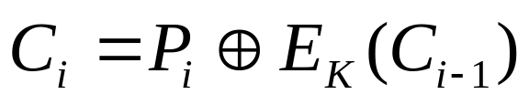
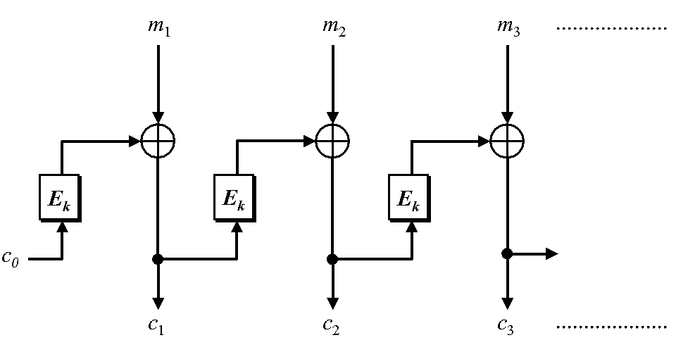
Cipher Feedback Mode (CFB)
In CFB mode, the previous ciphertext block is encrypted and the output produced is combined with the plaintext block using XOR to produce the current ciphertext block.
An initialization vector c₀ is used as a seed for the process.

Slide 33
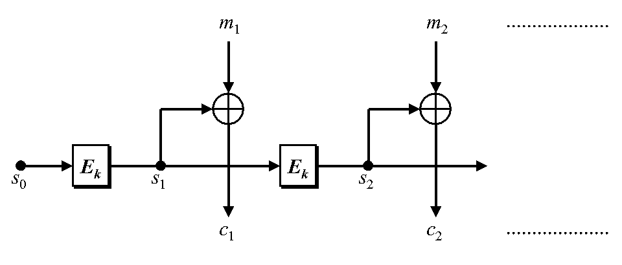
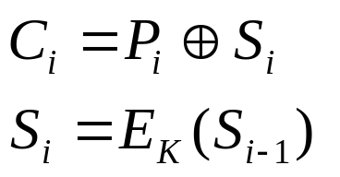
Output Feedback Mode (OFB)
OFB mode is similar to CFB mode except that the quantity XORed with each plaintext block is generated independently of both the plaintext and ciphertext.
An initialization vector s₀ is used as a seed for a sequence of data blocks s_{i}, and each data block s_{i} is derived from the encryption of the previous data block s_{i-1}.

Slide 34
CFB and OFB Modes
The CFB and OFB modes make the block cipher into a stream cipher
  They generate keystream blocks, which are then XORed with the plaintext blocks to get the ciphertext.
  Just as with other stream ciphers, flipping a bit in the ciphertext produces a flipped bit in the plaintext at the same location.
With CFB, a keystream block is computed by encrypting the previous ciphertext block.
OFB generates the next keystream block by encrypting the last one.

Slide 35
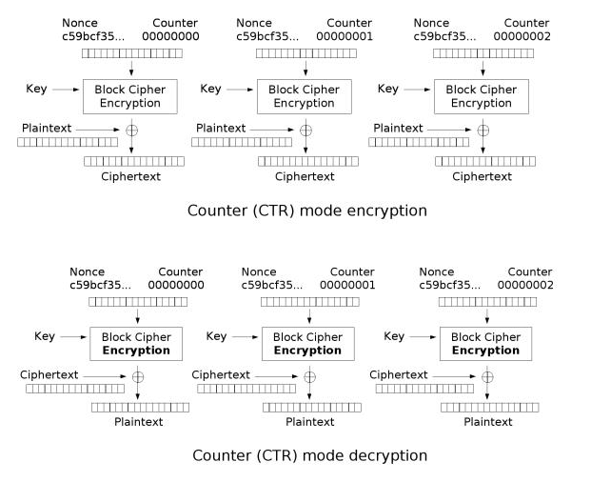
Counter Mode (CTR)

Slide 36
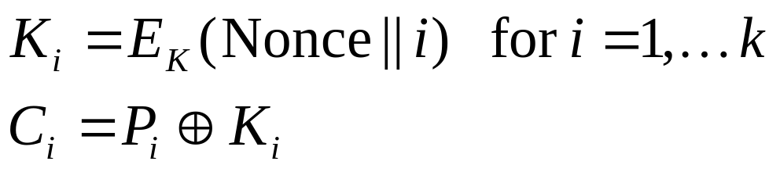
Counter Mode (CTR)
Counter Mode (CTR) block ciphers use
sequence numbers as the input to the
algorithm.
CTR mode has existed for a long time.
It was not standardized as an official
DES mode, but has recently been
standardized by NIST.
Like OFB, it is a stream cipher.

Slide 37
What Mode to Use?
Schneier* suggests:
  For encrypting random data, such as other keys, ECB is a good choice
  For normal plaintext, use CBC, CFB or OFB
  To encrypt files, use CBC
Ferguson & Schneier (published later):
  Only recommend use of CBC or CTR
  Compare CBC and CTR, with CTR coming out on top in most respects.
*Applied Cryptography (2nd Edition) by Bruce Schneier, Wiley

Slide 38
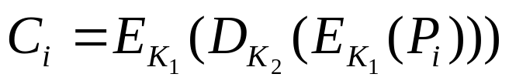
Triple DES (3DES)
DES was cracked, and is now considered to be too weak for today's world.
  Triple DES (3DES) was an attempt to increase the strength of encryption without having to move to an entirely different algorithm.
  Two keys are used, K₁ and K₂
  Each plaintext block P_{i} is subjected to the following:
  3DES was adopted as the encrypt-decrypt-encrypt EDE mode of the DES cipher algorithm. The choice of EDE with the keys was deliberate to avoid cryptanalysis problems.
  The problem with 3DES is that it is slow.

Slide 39
International Data Encryption Algorithm (IDEA)
Introduced in 1990, by Xuejia Lai and James Massey of ETH Zurich*, under the name Proposed Encryption Standard (PES)
The algorithm was subjected to cryptanalysis, and some shortcomings were identified. The authors published a strengthened algorithm called Improved Proposed Encryption Standard (IPES) in 1991.
In 1992, they renamed it International Data Encryption Algorithm (IDEA)
IDEA is part of PGP (Pretty Good Privacy)
*Eidgenössische Technische Hochschule Zürich,
The Swiss Federal Institute of Technology, Zurich

Slide 40
International Data Encryption Algorithm (IDEA)
IDEA is similar to DES in some ways:
  Both have rounds
  Both have a complicated "mangler" function which does not have to be reversible for decryption to work.
With DES, the same keys are used in reverse for decryption
With IDEA, the encryption and decryption keys are related in a more complex manner.
IDEA is a block cipher with a:
  Block size of 64 bits
  Key size of 128 bits

Slide 41
International Data Encryption Algorithm (IDEA)
IDEA is patented by the Swiss company Ascom, but they have been generous in allowing free non-commercial use of their algorithm.
IDEA avoids the use of any lookup tables or S-boxes (no bit-level permutations)
Each primitive operation in IDEA maps two 16-bit quantities into a 16-bit quantity
  By comparison, each DES S-box maps a 6-bit quantity into a 4-bit quantity
The primitive operations in IDEA are efficient in computers -- even in 16-bit processors

Slide 42
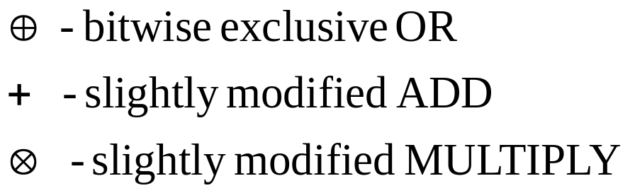
International Data Encryption Algorithm (IDEA)
IDEA uses 3 operations to create a mapping:
  The addition is done mod 2¹⁶

Slide 43
International Data Encryption Algorithm (IDEA)
The multiplication is done by first calculating the 32-bit result from the two 16-bit inputs, and then taking the remainder mod (2¹⁶ + 1)
  Multiplication mod (2¹⁶ + 1) is reversible, in that every number between 1 and 2¹⁶ has an inverse in the range 1 to 2¹⁶ because 2¹⁶ + 1 (65,537) is prime
  0 would not have a multiplicative inverse, and 2¹⁶ (a valid remainder in mod 2¹⁶ + 1 arithmetic) cannot be expressed in 16 bits, so in IDEA a 16-bit number containing all zeros is treated as an encoding for 2¹⁶
  Note that:
    (2⁴ + 1 = 17) and (2⁸ + 1 = 257) are both prime, but
    (2³² + 1) is not prime, so IDEA cannot easily be extended to a 128-bit block size

Slide 44
International Data Encryption Algorithm (IDEA)
The 64-bit plaintext block is divided into 4 16-bit sub-blocks, X_{a}, X_{b}, X_{c}, X_{d}, which become the inputs to the first round.
The 128-bit key is expanded into 52 16-bit subkeys, K_{i}
There are 17 rounds, even and odd:
  Odd rounds use four of the keys, K_{a}, K_{b}, K_{c}, K_{d}
    For example, round 1 uses K₁, K₂, K₃, K₄
  Even rounds use two keys, K_{e} and K_{f}
    For example, round 2 uses K₅ and K₆
(Some explanations talk about 8 rounds, where each of those rounds combines the work of two of the above rounds. It can get confusing if you mix different explanations!)

Slide 45
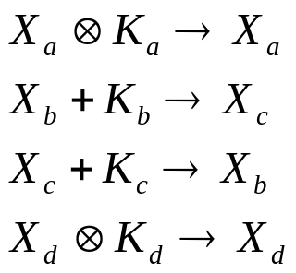
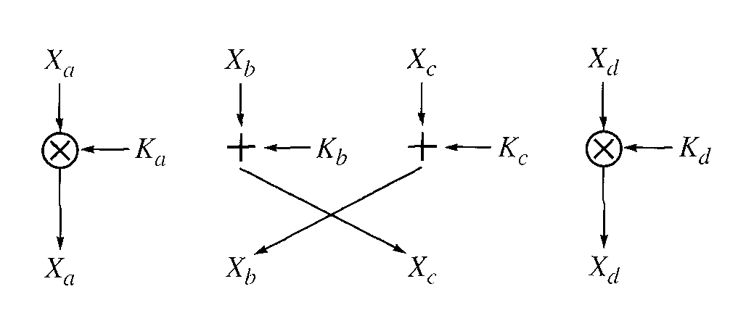
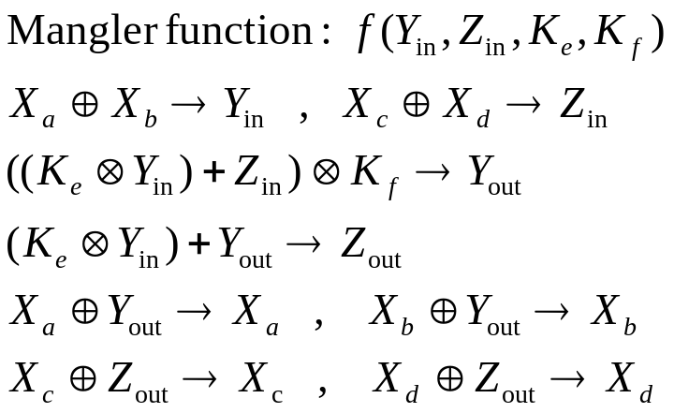
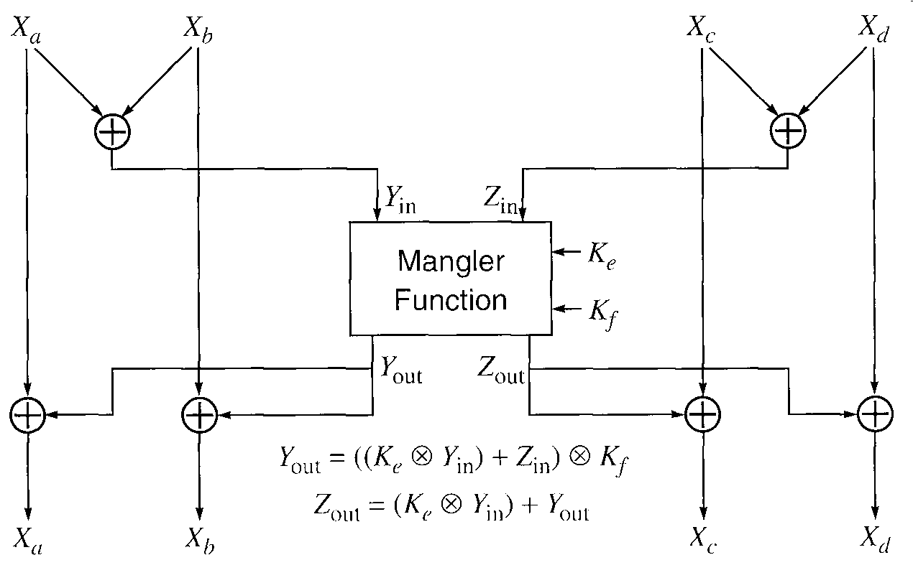
IDEA Rounds
Odd round:
Even round:

Slide 46
IDEA Rounds
For decryption:
  For odd rounds, we perform the multiplications with the inverses of the K_{i} keys, mod 2¹⁶ + 1
  An even round is its own inverse -- use the same keys
Key schedule for decryption:
    K_{D}(1) = K_{E}⁻¹(49) , K_{D}(2) = -K_{E}(50) , K_{D}(3) = -K_{E}(51) , K_{D}(4) = K_{E}⁻¹(52)
    K_{D}(5) = K_{E}(47) , K_{D}(6) = K_{E}(48)
    etc ...
Multiplicative Inverse
Additive Inverse
Same value

Slide 47
International Data Encryption Algorithm (IDEA)
IDEA has been thoroughly cryptanalyzed, and is considered to be a secure cipher -- much better than DES
However, it has not caught on as much as did DES, and perhaps it is now overshadowed by...

Slide 48
The Advanced Encryption Standard (AES)
In January, 1997, NIST announced a contest to select a new encryption standard to be used for protecting sensitive, non-classified, U.S. government information.
  Proposals were accepted from anyone, anywhere in the world
  5 finalists were chosen from 15 submissions:
    MARS, RC6, Rijndael, Serpent, and Twofish

Slide 49
The Advanced Encryption Standard (AES)
Proposals had to meet a number of specific evaluation criteria.
The initial criteria were:
  Security:
    High effort required to cryptanalyze the algorithm
  Cost:
    Practical in a wide range of applications
  Algorithm and Implementation Characteristics:
    Flexibility, suitability for a variety of hardware and software implementations, simplicity (to make the analysis of security easier)

Slide 50
The Advanced Encryption Standard (AES)
The final criteria used to pick from the 5 finalists were:
  General Security: Public worldwide security analyses were published
  Software Implementations
  Restricted-Space Implementations
  Hardware Implementations
  Attacks on Implementations
  Encryption vs Decryption
  Key Agility
  Other Versatility and Flexibility
  Potential for Instruction-level Parallelism

Slide 51
The Advanced Encryption Standard (AES)
The DES selection process:
  Was done in relative secrecy
  The details and motivation for the algorithm was secret
  Led to lots of suspicion about the role of NSA and whether DES was truly secure
In contrast, the AES selection process:
  Was open
  NSA was specifically excluded from proposing, although they could provide advice
  A detailed explanation and analysis of the algorithms was part of the process.
  This resulted in more confidence about AES

Slide 52
The Advanced Encryption Standard (AES) "Rijndael"
NIST chose a submission called "Rijndael" by two Belgian cryptographers -- Joan Daemen & Vincent Rijmen
In 2001, they published this as the new Advanced Encryption Standard (AES)*, ultimately replacing DES.
*http://csrc.nist.gov/CryptoToolkit/aes/rijndael/ http://csrc.nist.gov/publications/fips/fips197/fips-197.pdf http://www.esat.kuleuven.ac.be/~rijmen/rijndael/

Slide 53
The Advanced Encryption Standard (AES) "Rijndael"
From the authors of Rijndael:
(http://www.esat.kuleuven.ac.be/~rijmen/rijndael/)
  How is that pronounced ?
    If you're Dutch, Flemish, Indonesian, Surinamer or South-African, it's pronounced like you think it should be. Otherwise, you could pronounce it like "Reign Dahl", "Rain Doll", "Rhine Dahl". We're not picky. As long as you make it sound different from "Region Deal".
  Why did you choose this name ?
    Because we were both fed up with people mutilating the pronunciation of the names "Daemen" and "Rijmen". (There are two messages in this answer.)
  Can't you give it another name ? (Propose it as a tweak !)
    Dutch is a wonderful language. Currently we are debating about the names "Herfstvrucht", "Angstschreeuw" and "Koeieuier". Other suggestions are welcome of course. Derek Brown, Toronto, Ontario, Canada, proposes "bob".

Slide 54
The Mathematics of Rijndael
Rijndael uses arithmetic in the Galois Field GF(2⁸), a.k.a. GF(256) (the finite field of order 256)
  Recall that:
    It can be shown that the order of a finite field (number of elements in the field) must be a power of a prime, p^{n}, where n is a positive integer.
  A nice property of GF(2⁸) is that each element of the field can be represented by an octet.

Slide 55
The Mathematics of Rijndael
The bits in the octet are the coefficients of a polynomial over Z₂ modulo the irreducible* Z₂ polynomial:
      m(x) = x⁸ + x⁴ + x³ + x + 1
*A polynomial is called irreducible if its only divisors are one and itself. By analogy to integers, an irreducible polynomial is also called a prime polynomial.

Slide 56
The Mathematics of Rijndael
Byte values are represented as polynomials with the least significant bit being the the coefficient of x⁰, and the most significant bit the coefficient of x⁷.
  For example, {01100011} identifies the specific field element:
    x⁶ + x⁵ + x + 1
Some finite field operations involve one additional bit to the left of an 8-bit byte. When this extra bit is present, it appears as {01} to the left of the other 8 bits:
    {01} {00011011}

Slide 57

The Mathematics of Rijndael
Addition in a finite field is achieved by "adding" the coefficients for the corresponding powers in the polynomials for the two elements.
Addition is s performed using an XOR operation, denoted by (recall that addition modulo 2 is equivalent to XOR)
Subtraction of polynomials is identical to addition of polynomials (recall that, too?)

Slide 58
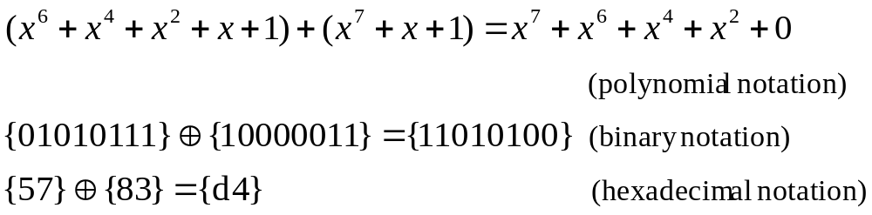
The Mathematics of Rijndael
For example:
are all equivalent.

Slide 59
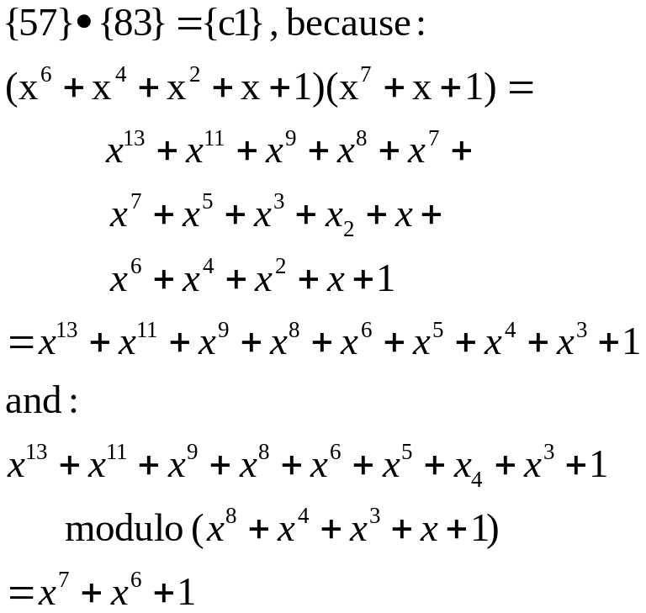
The Mathematics of Rijndael
Multiplication in Rijndael is the multiplication of polynomials modulo the irreducible polynomial:
  m(x) = x⁸ + x⁴ + x³ + x + 1
or {01}{1b} in hexadecimal notation.
For example:

Slide 60
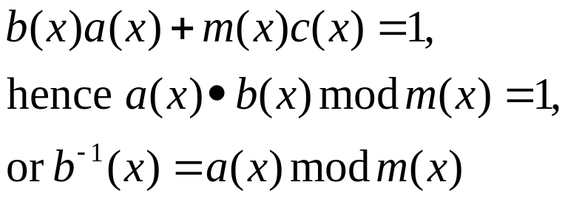
The Mathematics of Rijndael
The modular reduction by m(x) ensures that the result will be a binary polynomial of degree less than 8, and thus can be represented in a byte.
This multiplication is associative
The element {01} is the multiplicative identity.
For any non-zero binary polynomial b(x) of degree less than 8, the multiplicative inverse of b(x), denoted by b⁻¹(x) can be found using the Extended Euclidean algorithm. This computes polynomials a(x) and c(x) such that:

Slide 61
The Mathematics of Rijndael
It follows from the above that the set of 256 possible byte values, with XOR used as addition, and the multiplication defined as above, has the structure of the finite field GF(2⁸)

Slide 62
The Mathematics of Rijndael
Rijndael also uses polynomials over GF(2⁸), taken modulo the GF(2⁸) non-irreducible polynomial x⁴ + 1.
  These polynomials are represented as 4-vectors of octets, with the coefficient of 1 being the first octet in the 4-vector.
  With this representation, multiplication is simply a rotation.
Finally, for one of its operations composing its "S-box", Rijndael treats octets as polynomials over Z₂ modulo the non-irreducible polynomial x⁸ + 1

Slide 63
The Advanced Encryption Standard (AES) "Rijndael"
Originally, Rijndael defined a symmetric block cipher in which the block length and the key length can be independently specified to be 128, 192, or 256 bits
The accepted AES allows key sizes of 128, 192, or 256 bits, but restricts the block size to 128 bits
AES is not a Feistel cipher.

Slide 64
The Advanced Encryption Standard (AES) "Rijndael"
The basic structure provides flexibility with the use of 3 parameters:
  N_{b} , the block size (the number of 32-bit words, or 4-octet columns, in a plaintext block). For AES, N_{b} = 4, since the block size is 128 bits
  N_{k} , the key size (the number of 32-bit words in an encryption key)
    128 bits => N_{k} = 4; 192 bits => N_{k} = 6; 256 bits => N_{k} = 8
  N_{r} , the number of rounds
    Needs to be larger for longer keys
    Needs to be larger for larger block sizes
    Rijndael specifies N_{r} = 6 + max(N_{b}, N_{k})
      128-bit key => 10 rounds
      192-bit key => 12 rounds
      256-bit key => 14 rounds

Slide 65
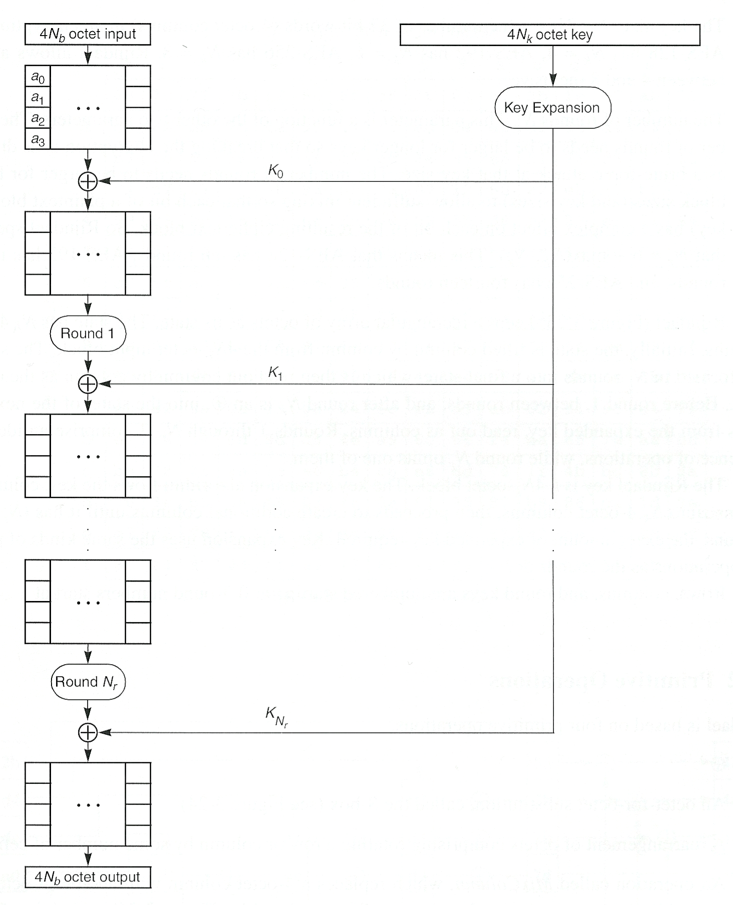
The Basic Rijndael Structure
Internally, the algorithm's operations are performed on a 2-dimensional array of bytes called the State.
The State consists of 4 rows of bytes, each containing N_{b} bytes, where N_{b} is the block length/32.
  In AES, N_{b} = 128/32 = 4 so the State is a 4x4 array of bytes.

Slide 66
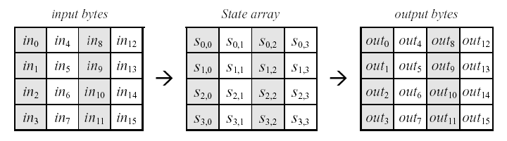
The Rijndael State
At the start of the cipher and inverse cipher, the array of input bytes (plaintext) is copied into the State array.
The cipher or inverse cipher operations are then conducted on this State array.
Finally, the State's final value is copied to the output array.

Slide 67
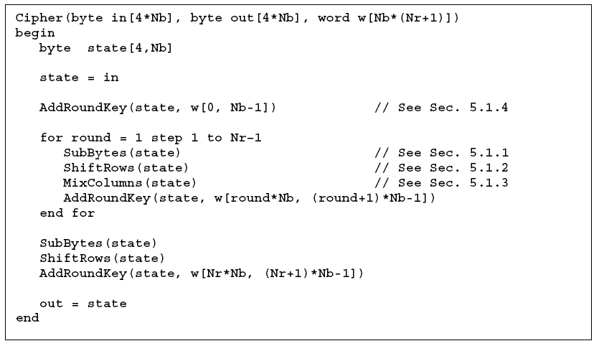
The Rijndael Cipher Algorithm

Slide 68
The Rijndael Cipher Algorithm
AddRoundKey()
  A Round Key is added to the state using XOR
SubBytes()
  uses S-box to perform a non-linear byte-by-byte substitution of State
ShiftRows()
  processes the State by cyclically shifting the last three rows of the State by different offsets
MixColumns()
  takes all the columns of the State and mixes their data, independently of one another, making use of arithmetic over GF(2⁸)

Slide 69
The Rijndael Cipher Algorithm
Only AddRoundKey() makes use of the key
The other three functions are used to produce diffusion and confusion
The final round omits MixColumns transformation.

Slide 70
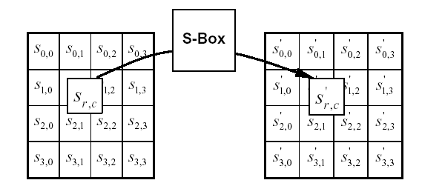
SubBytes()
The SubBytes() transformation is a non-linear substitution that operates independently on each byte of the State using a substitution table ("S-box").
The S-box is invertible

Slide 71
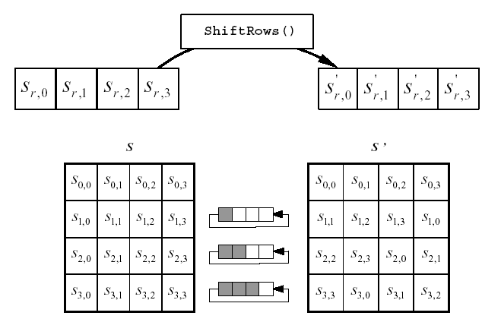
ShiftRows()
ShiftRows() cyclically shifts the last three rows in the State

Slide 72
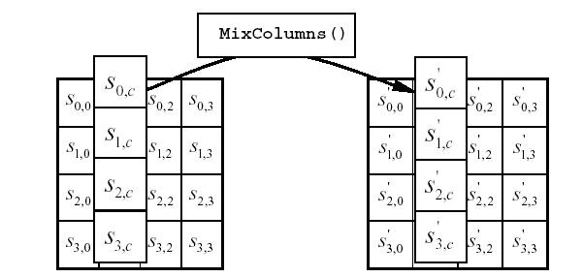
MixColumns()
MixColumns() operates on the State column-by-column

Slide 73
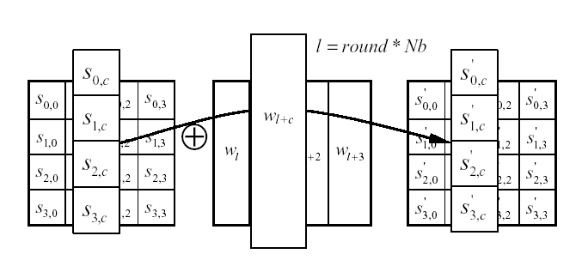
AddRoundKey()
AddRoundKey() XORS each column of the State with a word from the key schedule.

Slide 74
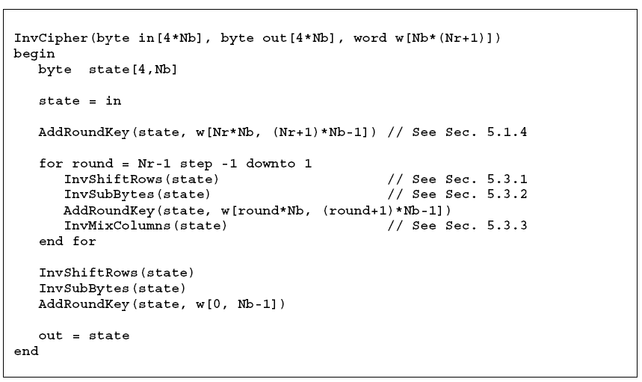
Inverse Cipher Algorithm

Slide 75
The AES Inverse Cipher
Decryption algorithm uses the expanded key in reverse order
All the functions are easily reversible and their inverse form is used in decryption
The decryption algorithm is not identical to the encryption algorithm
The final round again omits a stage.

Slide 76
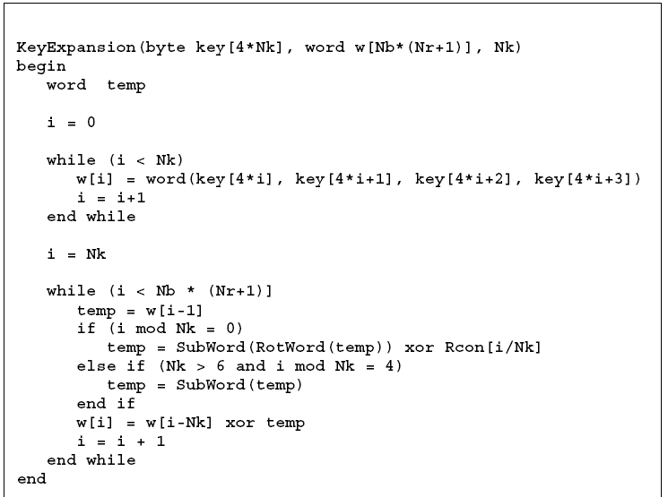
Rijndael Key Expansion

Slide 77
Rijndael Key Expansion
Starts with the key arranged as N_{k} 4-octet columns and iteratively generates the next N_{k} columns of the expanded key.
SubWord() takes a 4-byte input and applies the S-box to each of the 4 bytes to produce an output word.
RotWord() takes a word [a₀a₁a₂a₃] as input and performs a cyclic permutation on it, returning [a₁a₂a₃a₀]

Slide 78
Some Other Symmetric Block Ciphers
Serpent
  An AES finalist – conservative; slower than Rijndael
Blowfish
  Designed by Bruce Schneier; unpatented algorithm; C code in the public domain; fast; compact; simple; variable key length up to 448 bits.
Twofish
  AES finalist; Designed by Bruce Schneier et. al. from Counterpane Systems; 128-bit block; 128-, 192-, or 256-bit key; 16 rounds
RC5
  Designed by Ron Rivest (of RSA fame); variable block size, variable key size, and variable number of rounds

Slide 79
Summary
Whew!
We've "done" symmetric block ciphers in a fair amount of detail.
Bruce Schneier, in his book Applied Cryptography, Second Edition, Wiley documents a lot more of them, and about them, including C code that is available either for free, or for a nominal charge.

