Slide 1
Cryptography and Network Security
Chapter 7
Fifth Edition
by William Stallings
Lecture slides by Lawrie Brown
Notes:
Lecture slides by Lawrie Brown for “Cryptography and Network Security”, 5/e, by William Stallings, Chapter 7 – “Stream Ciphers and Random Number Generation”.

Slide 2
Chapter 7 – Stream Ciphers and Random Number Generation
The comparatively late rise of the theory of probability shows how hard it is to grasp, and the many paradoxes show clearly that we, as humans, lack a well grounded intuition in this matter.
In probability theory there is a great deal of art in setting up the model, in solving the problem, and in applying the results back to the real world actions that will follow.
— The Art of Probability, Richard Hamming
Notes:
Opening quote.

Slide 3
Random Numbers
many uses of random numbers in cryptography
  nonces in authentication protocols to prevent replay
  session keys
  public key generation
  keystream for a one-time pad
in all cases its critical that these values be
  statistically random, uniform distribution, independent
  unpredictability of future values from previous values
true random numbers provide this
care needed with generated random numbers
Notes:
Random numbers play an important role in the use of encryption for various network security applications. In this section, we provide a brief overview of the use of random numbers in cryptography and network security and then focus on the principles of pseudorandom number generation. Getting good random numbers is important, but difficult. You don't want someone guessing the key you're using to protect your communications because your "random numbers" weren't (as happened in an early release of Netscape SSL). Traditionally, the concern in the generation of a sequence of allegedly random numbers has been that the sequence of numbers be random in some well-defined statistical sense (with uniform distribution & independent). In applications such as reciprocal authentication, session key generation, and stream ciphers, the requirement is not just that the sequence of numbers be statistically random but that the successive members of the sequence are unpredictable (so that it is not possible to predict future values having observed previous values). With "true" random sequences, each number is statistically independent of other numbers in the sequence and therefore unpredictable. However, as is discussed shortly, true random numbers are seldom used; rather, sequences of numbers that appear to be random are generated by some algorithm.

Slide 4
Pseudorandom Number Generators (PRNGs)
often use deterministic algorithmic techniques to create “random numbers”
  although are not truly random
  can pass many tests of “randomness”
known as “pseudorandom numbers”
created by “Pseudorandom Number Generators (PRNGs)”
Notes:
Cryptographic applications typically make use of deterministic algorithmic techniques for random number generation, producing sequences of numbers that are not statistically random, but if the algorithm is good, the resulting sequences will pass many reasonable tests of randomness. Such numbers are referred to as pseudorandom numbers, created by “Pseudorandom Number Generators (PRNGs)”.

Slide 5
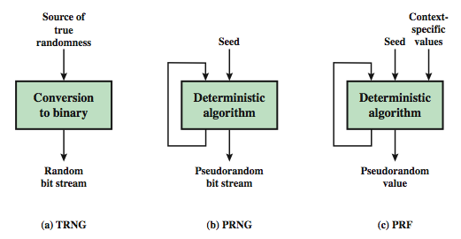
Random & Pseudorandom Number Generators
Notes:
Stallings Figure 7.1 contrasts a true random number generator (TRNG) with two forms of pseudorandom number generators. A TRNG takes as input a source that is effectively random; the source is often referred to as an entropy source. In contrast, a PRNG takes as input a fixed value, called the seed, and produces a sequence of output bits using a deterministic algorithm. Typically, as shown, there is some feedback path by which some of the results of the algorithm are fed back as input as additional output bits are produced. The important thing to note is that the output bit stream is determined solely by the input value or values, so that an adversary who knows the algorithm and the seed can reproduce the entire bit stream.
Figure 7.1 shows two different forms of PRNGs, based on application;
• Pseudorandom number generator: An algorithm that is used to produce an open-ended sequence of bits is referred to as a PRNG. A common application for an open-ended sequence of bits is as input to a symmetric stream cipher, as discussed in Section 7.4. Also, see Figure 3.1a.
• Pseudorandom function (PRF): A PRF is used to produced a pseudorandom string of bits of some fixed length. Examples are the symmetric encryption keys and nonces. Typically, the PRF takes as input a seed plus some context specific values, such as a user ID or an application ID.

Slide 6
PRNG Requirements
randomness
  uniformity, scalability, consistency
unpredictability
  forward & backward unpredictability
  use same tests to check
characteristics of the seed
  secure
  if known adversary can determine output
  so must be random or pseudorandom number
Notes:
When a PRNG or PRF is used for a cryptographic application, then the basic requirement is that an adversary who does not know the seed is unable to determine the pseudorandom string. This general requirement for secrecy of the output of a PRNG or PRF leads to specific requirements in the areas of randomness, unpredictability, and the characteristics of the seed.
In terms of randomness, the requirement for a PRNG is that the generated bit stream appear random even though it is deterministic. NIST SP 800-22 (A Statistical Test Suite for Random and Pseudorandom Number Generators for Cryptographic Applications) specifies that the tests should seek to establish the following three characteristics: uniformity, scalability, consistency. SP 800-22 lists 15 separate tests of randomness.
A stream of pseudorandom numbers should exhibit two forms of unpredictability: forward unpredictability, backward unpredictability. The same set of tests for randomness also provide a test of unpredictability. If the generated bit stream appears random, then it is not possible to predict some bit or bit sequence from knowledge of any previous bits. Similarly, if the bit sequence appears random, then there is no feasible way to deduce the seed based on the bit sequence. That is, a random sequence will have no correlation with a fixed value (the seed).
For cryptographic applications, the seed that serves as input to the PRNG must be secure. Because the PRNG is a deterministic algorithm, if the adversary can deduce the seed, then the output can also be determined. Therefore, the seed must be unpredictable. In fact, the seed itself must be a random or pseudorandom number.

Slide 7
PRNG Requirements
Randomness
  Uniformity – at any point in the generation of the PRN sequence, the occurrence of a zero or a one is equally likely (i.e., p = 0.5)
  Scalability – any test for randomness applicable to a sequence can also be applied to any random subsequence (it should pass)
  Consistency – the characteristics of the PRN sequence of the PRNG must not depend on the seed used
Notes:
When a PRNG or PRF is used for a cryptographic application, then the basic requirement is that an adversary who does not know the seed is unable to determine the pseudorandom string. This general requirement for secrecy of the output of a PRNG or PRF leads to specific requirements in the areas of randomness, unpredictability, and the characteristics of the seed.
In terms of randomness, the requirement for a PRNG is that the generated bit stream appear random even though it is deterministic. NIST SP 800-22 (A Statistical Test Suite for Random and Pseudorandom Number Generators for Cryptographic Applications) specifies that the tests should seek to establish the following three characteristics: uniformity, scalability, consistency. SP 800-22 lists 15 separate tests of randomness.
A stream of pseudorandom numbers should exhibit two forms of unpredictability: forward unpredictability, backward unpredictability. The same set of tests for randomness also provide a test of unpredictability. If the generated bit stream appears random, then it is not possible to predict some bit or bit sequence from knowledge of any previous bits. Similarly, if the bit sequence appears random, then there is no feasible way to deduce the seed based on the bit sequence. That is, a random sequence will have no correlation with a fixed value (the seed).
For cryptographic applications, the seed that serves as input to the PRNG must be secure. Because the PRNG is a deterministic algorithm, if the adversary can deduce the seed, then the output can also be determined. Therefore, the seed must be unpredictable. In fact, the seed itself must be a random or pseudorandom number.

Slide 8
Linear Congruential
Generator
common iterative technique using:
  X_{n+1} = (aX_{n} + c) mod m
given suitable values of parameters can produce a long random-like sequence
suitable criteria to have are:
  function generates a full-period
  generated sequence should appear random
  efficient implementation with 32-bit arithmetic
note that an attacker can reconstruct sequence given a small number of values
have possibilities for making this harder
Notes:
By far the most widely used technique for pseudorandom number generation is the “Linear Congruential Generator”, first proposed by Lehmer. It uses successive values from an iterative equation. Given suitable values of parameters can produce a long random-like sequence, but there are only a small number of such good choices. Note that the sequence, whilst looking random, is highly predictable, and an attacker can reconstruct the sequence knowing only a small number of values. There are some approaches to making this harder to do in practice by modifying the numbers in some way, see text.

Slide 9
Blum Blum Shub Generator
based on public key algorithms
use least significant bit from iterative equation:
  x_{i} = x_{i-1}² mod n
  where n=p.q, and primes p,q=3 mod 4
unpredictable, passes next-bit test
security rests on difficulty of factoring N
is unpredictable given any run of bits
slow, since very large numbers must be used
too slow for cipher use, good for key generation
Notes:
A popular approach to generating secure pseudorandom number is known as the Blum, Blum, Shub (BBS) generator, after its developers [BLUM86]. It has perhaps the strongest public proof of its cryptographic strength of any PRNG. It is based on public key algorithms, and hence is very slow, but has a very high level of security. It is referred to as a cryptographically secure pseudorandom bit generator (CSPRBG), being in practice unpredictable.

Slide 10
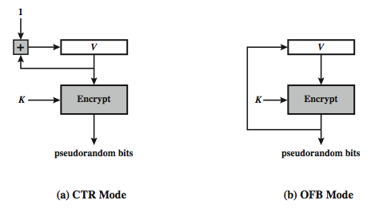
Using Block Ciphers as PRNGs
for cryptographic applications, can use a block cipher to generate random numbers
often for creating session keys from master key
CTR
  X_{i} = E_{K}[V_{i}]
OFB
  X_{i} = E_{K}[X_{i-1}]
Notes:
A popular approach to PRNG construction is to use a symmetric block cipher as the heart of the PRNG mechanism. For any block of plaintext, a symmetric block cipher produces an output block that is apparently random. That is, there are no patterns or regularities in the ciphertext that provide information that can be used to deduce the plaintext. Thus, a symmetric block cipher is a good candidate for building a pseudorandom number generator. If an established, standardized block cipher is used, such as DES or AES, then the security characteristics of the PRNG can be established. Further, many applications already make use of DES or AES, so the inclusion of the block cipher as part of the PRNG algorithm is straightforward. Two approaches that use a block cipher to build a PNRG have gained widespread acceptance: the CTR mode and the OFB mode. The CTR mode is recommended in SP 800-90, in the ANSI standard X9.82 (Random Number Generation), and RFC 4086. The OFB mode is recommended in X9.82 and RFC 4086. Stallings Figure 7.3 illustrates the two methods. In each case, the seed consists of two parts: the encryption key value and a value V that will be updated after each block of pseudorandom numbers is generated. In the CTR case, the value of V is incremented by 1 after each encryption. In the case of OFV, the value of V is updated to equal the value of the preceding PRNG block. In both cases, pseudorandom bits are produced on block at a time.

Slide 11
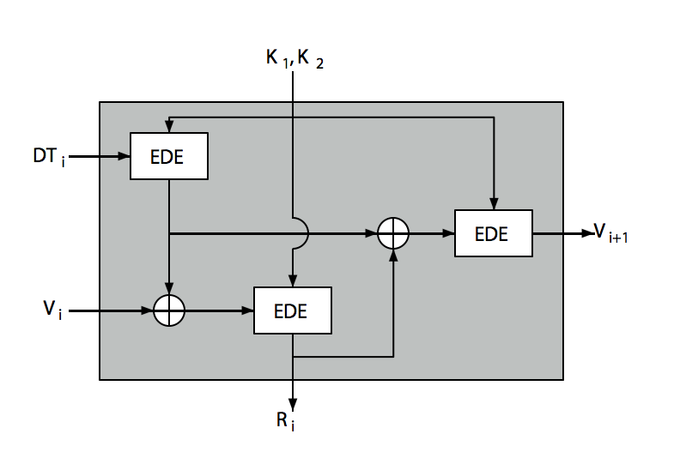
ANSI X9.17 PRG
Dti = date and time
Notes:
One of the strongest (cryptographically speaking) PRNGs is specified in ANSI X9.17. It uses date/time & seed inputs and 3 triple-DES encryptions to generate a new seed & random value. See discussion & illustration in Stallings section 7.3 & Figure 7.4 where:
DTi - Date/time value at the beginning of ith generation stage
Vi - Seed value at the beginning of ith generation stage
Ri - Pseudorandom number produced by the ith generation stage
K1, K2 - DES keys used for each stage
Then compute successive values as:
Ri = EDE([K1, K2], [Vi XOR EDE([K1, K2], DTi)])
Vi+1 = EDE([K1, K2], [Ri XOR EDE([K1, K2], DTi)])
Several factors contribute to the cryptographic strength of this method. The technique involves a 112-bit key and three EDE encryptions for a total of nine DES encryptions. The scheme is driven by two pseudorandom inputs, the date and time value, and a seed produced by the generator that is distinct from the pseudo-random number produced by the generator. Thus the amount of material that must be compromised by an opponent is overwhelming.

Slide 12
Stream Ciphers
process message bit by bit (as a stream)
have a pseudo random keystream
combined (XOR) with plaintext bit by bit
randomness of stream key completely destroys statistically properties in message
  C_{i} = M_{i} XOR StreamKey_{i}
but must never reuse stream key
  otherwise can recover messages (cf book cipher)
Notes:
A typical stream cipher encrypts plaintext one byte at a time, although a stream cipher may be designed to operate on one bit at a time or on units larger than a byte at a time. In a stream cipher, a key is input to a pseudorandom bit generator that produces a stream of 8-bit numbers that are apparently random. The output of the generator, called a keystream, is combined one byte at a time with the plaintext stream using the bitwise exclusive-OR (XOR) operation. The stream cipher is similar to the one-time pad discussed in Chapter 2. The difference is that a one-time pad uses a genuine random number stream, whereas a stream cipher uses a pseudorandom number stream. But rely on the randomness of stream key completely destroys statistically properties in message. However, you must never reuse a stream key since otherwise you can recover messages (as with a book cipher).

Slide 13

Stream Cipher Structure
Notes:
Stallings Figure 7.5 illustrates the general structure of a stream cipher, where a key is input to a pseudorandom bit generator that produces an apparently random keystream of bits, and which are XOR’d with message to encrypt it, and XOR’d again to decrypt it by the receiver.

Slide 14
Stream Cipher Properties
some design considerations are:
  long period with no repetitions
  statistically random
  depends on large enough key
  large linear complexity
properly designed, can be as secure as a block cipher with same size key
but usually simpler & faster
Notes:
[KUMA97] lists the following important design considerations for a stream cipher:
The encryption sequence should have a large period, the longer the period of repeat the more difficult it will be to do cryptanalysis.
The keystream should approximate the properties of a true random number stream as close as possible, the more random-appearing the keystream is, the more randomized the ciphertext is, making cryptanalysis more difficult.
To guard against brute-force attacks, the key needs to be sufficiently long. The same considerations as apply for block ciphers are valid here .Thus, with current technology, a key length of at least 128 bits is desirable.
With a properly designed pseudorandom number generator, a stream cipher can be as secure as block cipher of comparable key length. The primary advantage of a stream cipher is that stream ciphers are almost always faster and use far less code than do block ciphers. A stream cipher can be constructed with any cryptographically strong PRNG.

Slide 15
RC4
a proprietary cipher owned by RSA DSI
another Ron Rivest design, simple but effective
variable key size, byte-oriented stream cipher
widely used (web SSL/TLS, wireless WEP/WPA)
key forms random permutation of all 8-bit values
uses that permutation to scramble input info processed a byte at a time
Notes:
RC4 is a stream cipher designed in 1987 by Ron Rivest for RSA Security. It is a variable key-size stream cipher with byte-oriented operations. The algorithm is based on the use of a random permutation. Analysis shows that the period of the cipher is overwhelmingly likely to be greater than 10^100. Eight to sixteen machine operations are required per output byte, and the cipher can be expected to run very quickly in software. RC4 is probably the most widely used stream cipher. It is used in the SSL/TLS secure web protocol, & in the WEP & WPA wireless LAN security protocols. RC4 was kept as a trade secret by RSA Security, but in September 1994 was anonymously posted on the Internet on the Cypherpunks anonymous remailers list. In brief, the RC4 key is ued to form a random permutation of all 8-bit values, it then uses that permutation to scramble input info processed a byte at a time.

Slide 16
RC4 Key Schedule
starts with an array S of numbers: 0..255
use key to well and truly shuffle
S forms internal state of the cipher
  for i = 0 to 255 do
    S[i] = i // init S to identity
    T[i] = K[i mod keylen]) // extend key
  j = 0 // location of swap
  for i = 0 to 255 do // for each element
        // update location of swap
    j = (j + S[i] + T[i]) (mod 256)
    swap (S[i], S[j]) // permute
Notes:
The RC4 algorithm is remarkably simple and quite easy to explain. It uses a variable-length key of from 1 to 256 bytes. The RC4 key schedule initialises the state S to the numbers 0..255, and then walks through each entry in turn, using its current value plus the next byte of key to pick another entry in the array, and swaps their values over. After doing this 256 times, the result is a well and truly shuffled array. The total number of possible states is 256! - a truly enormous number, much larger even than the 2048-bit (256*8) max key allowed can select.

Slide 17
RC4 Encryption
encryption continues shuffling array values
sum of shuffled pair selects "stream key" value from permutation
XOR S[t] with next byte of message to en/decrypt
  i = j = 0
  for each message byte M_{i}
    i = (i + 1) (mod 256) // rotate thru S
    j = (j + S[i]) (mod 256) // update swap location
    swap(S[i], S[j]) // update permutation S
    t = (S[i] + S[j]) (mod 256) // pick key index
    C_{i} = M_{i} XOR S[t] // encrypt
Notes:
To form the stream key for en/decryption (which are identical), RC4 continues to shuffle the permutation array S by continuing to swap each element in turn with some other entry, and using the sum of these two entry values to select another value from the permutation to use as the stream key, which is then XOR’d with the current message byte.

Slide 18
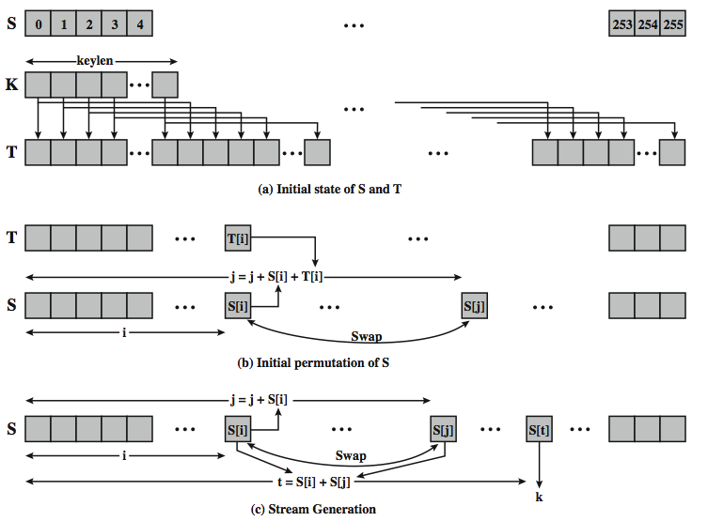
RC4 Overview
initialize
permutation
extend key
shuffle
permutation
update
permutation
Notes:
Stallings Figure 7.6 illustrates the general structure of RC4.

Slide 19
RC4 Security
claimed secure against known attacks
  However, have some analyses, some on the verge of practical
  first 256 bytes have bias
  multiple keys/same plaintext attack
result is very non-linear
since RC4 is a stream cipher, must never reuse a key
have a concern with WEP, but due to key handling rather than RC4 itself
Notes:
A number of papers have been published analyzing methods of attacking RC4, but none of these approaches is practical against RC4 with a reasonable key length, such as 128 bits.
A more serious problem occurs in its use in the WEP protocol, not with RC4 itself but the way in which keys are generated for use as input to RC4.
Currently RC4 its regarded as quite secure, if used correctly, with a sufficiently large key.

Slide 20
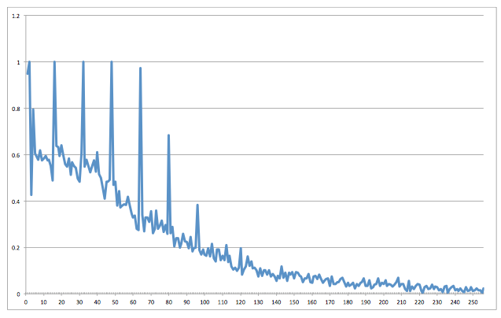
RC4 Security
Probability of recovery of plaintext from 2²⁴ ciphertexts vs. byte position
Notes:
A number of papers have been published analyzing methods of attacking RC4, but none of these approaches is practical against RC4 with a reasonable key length, such as 128 bits.
A more serious problem occurs in its use in the WEP protocol, not with RC4 itself but the way in which keys are generated for use as input to RC4.
Currently RC4 its regarded as quite secure, if used correctly, with a sufficiently large key.

Slide 21
Natural Random Noise
best source is natural randomness in real world
find a regular but random event and monitor
do generally need special h/w to do this
  eg. radiation counters, radio noise, audio noise, thermal noise in diodes, leaky capacitors, mercury discharge tubes etc
starting to see such h/w in new CPUs
  Intel Ivy Bridge, Via Padlock
problems of bias or uneven distribution in signal
  have to compensate for this when sample, often by passing bits through a hash function
  best to only use a few noisiest bits from each sample
  RFC4086 recommends using multiple sources + hash
Notes:
A true random number generator (TRNG) uses a nondeterministic source to produce randomness. Most operate by measuring unpredictable natural processes, such as pulse detectors of ionizing radiation events, gas discharge tubes, and leaky capacitors. Special hardware is usually needed for this. A true random number generator may produce an output that is biased in some way. Various methods of modifying a bit stream to reduce or eliminate the bias have been developed. These are referred to as deskewing algorithms. One approach to deskew is to pass the bit stream through a hash function such as MD5 or SHA-1. RFC 4086 recommends collecting input from multiple hardware sources and then mixing these using a hash function to produce random output.

Slide 22
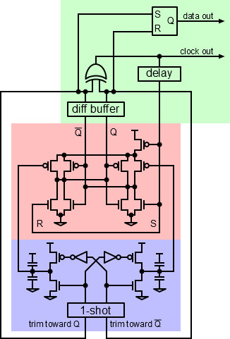
Intel Ivy Bridge TRNG
Entropy Source
- shared by all cores
- RS-NOR latch
becomes metastable
when input
De-asserted
- Output settles to 0 or 1,
depending on thermal
Noise
- Feedback helps reach
Metastable state
- Output detects when
settled, stores result,
reasserts input
Detect when
settled, and
store output
RS-NOR
latch
Negative
feedback
Entropy Source
http://electronicdesign.com/learning-resources/understanding-intels-ivy-bridge-random-number-generator
Notes:
A true random number generator (TRNG) uses a nondeterministic source to produce randomness. Most operate by measuring unpredictable natural processes, such as pulse detectors of ionizing radiation events, gas discharge tubes, and leaky capacitors. Special hardware is usually needed for this. A true random number generator may produce an output that is biased in some way. Various methods of modifying a bit stream to reduce or eliminate the bias have been developed. These are referred to as deskewing algorithms. One approach to deskew is to pass the bit stream through a hash function such as MD5 or SHA-1. RFC 4086 recommends collecting input from multiple hardware sources and then mixing these using a hash function to produce random output.

Slide 23
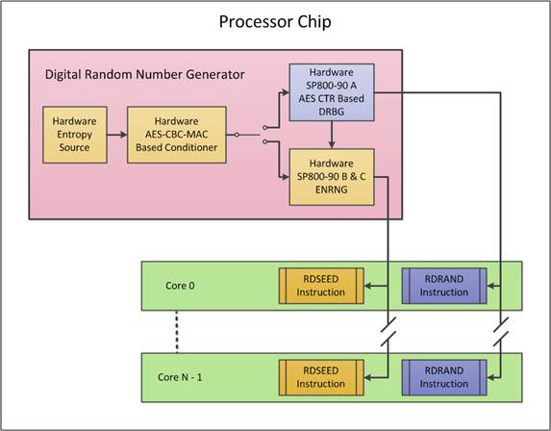
Intel Ivy Bridge TRNG
DRNG output fed to all processors
hardware instruction-level access
https://software.intel.com/en-us/articles/intel-digital-random-number-generator-drng-software-implementation-guide
Notes:
A true random number generator (TRNG) uses a nondeterministic source to produce randomness. Most operate by measuring unpredictable natural processes, such as pulse detectors of ionizing radiation events, gas discharge tubes, and leaky capacitors. Special hardware is usually needed for this. A true random number generator may produce an output that is biased in some way. Various methods of modifying a bit stream to reduce or eliminate the bias have been developed. These are referred to as deskewing algorithms. One approach to deskew is to pass the bit stream through a hash function such as MD5 or SHA-1. RFC 4086 recommends collecting input from multiple hardware sources and then mixing these using a hash function to produce random output.

Slide 24
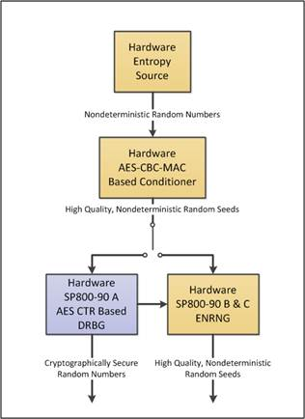
Intel Ivy Bridge TRNG
- Output is biased
due to feedback
- 800 MHz clock
Conditioner
outputs 256 bits
every few
microseconds
Expand rate using
NIST SP800-90
PRNG to rate of
800 MBps
Notes:
A true random number generator (TRNG) uses a nondeterministic source to produce randomness. Most operate by measuring unpredictable natural processes, such as pulse detectors of ionizing radiation events, gas discharge tubes, and leaky capacitors. Special hardware is usually needed for this. A true random number generator may produce an output that is biased in some way. Various methods of modifying a bit stream to reduce or eliminate the bias have been developed. These are referred to as deskewing algorithms. One approach to deskew is to pass the bit stream through a hash function such as MD5 or SHA-1. RFC 4086 recommends collecting input from multiple hardware sources and then mixing these using a hash function to produce random output.

Slide 25
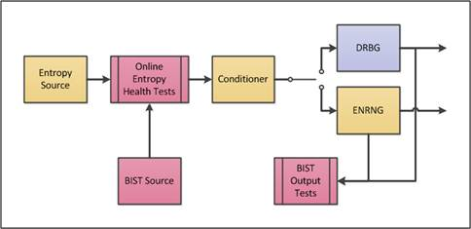
Intel Ivy Bridge TRNG
Built-In
Self Test
Health tests are basic, ad hoc, but detect RNG failure
Output zero with carry zero on failure (can't read a 0)
Notes:
A true random number generator (TRNG) uses a nondeterministic source to produce randomness. Most operate by measuring unpredictable natural processes, such as pulse detectors of ionizing radiation events, gas discharge tubes, and leaky capacitors. Special hardware is usually needed for this. A true random number generator may produce an output that is biased in some way. Various methods of modifying a bit stream to reduce or eliminate the bias have been developed. These are referred to as deskewing algorithms. One approach to deskew is to pass the bit stream through a hash function such as MD5 or SHA-1. RFC 4086 recommends collecting input from multiple hardware sources and then mixing these using a hash function to produce random output.

Slide 26
Trustworthiness of TRNGs
Design appears to be very sound
Possible back doors
  Snowden leaks show NSA coerced hardware and software manufacturers to introduce back doors
  Intel and Via hardware considered suspect
Approach by FreeBSD
  Use hardware PRNG as a source
  Pass through Yarrow PRNG algorithm when producing cryptographically significant random numbers
See: https://www.schneier.com/paper-yarrow.pdf
Notes:
Another alternative is to dip into a published collection of good-quality random numbers (e.g., [RAND55], [TIPP27]). However, these collections provide a very limited source of numbers compared to the potential requirements of a sizable network security application. But they can be of use in the design of random tables for cryptographic functions (cf. Khafre). Furthermore, although the numbers in these books do indeed exhibit statistical randomness, they are predictable because an opponent who knows that the book is in use can obtain a copy.

Slide 27
Published Sources
a few published collections of random numbers
Rand Co, in 1955, published 1 million numbers
  generated using an electronic roulette wheel
  has been used in some cipher designs cf Khafre
earlier Tippett in 1927 published a collection
issues are that:
  these are limited
  too well-known for most uses
Notes:
Another alternative is to dip into a published collection of good-quality random numbers (e.g., [RAND55], [TIPP27]). However, these collections provide a very limited source of numbers compared to the potential requirements of a sizable network security application. But they can be of use in the design of random tables for cryptographic functions (cf. Khafre). Furthermore, although the numbers in these books do indeed exhibit statistical randomness, they are predictable because an opponent who knows that the book is in use can obtain a copy.

Slide 28
Summary
pseudorandom number generation
stream ciphers
RC4
true random numbers
Notes:
Chapter 7 summary.

