Slide 1
Module-1
Information Security Devices

Slide 2
Module-1: Information Security Devices
Identity and Access Management (IdAM)
Networks (Wired & Wireless) Devices
Endpoints/Edge Devices
Storage Devices
Infrastructure Devices (e.g. Routers, Firewall Services)
Computer Assets, Servers and Storage Networks
Content management
IDS/IPS

Slide 3
Identity and Access Management (IdAM)
Identity and access management (IAM or IdAM for short) is a way to tell who a user is and what they are allowed to do.
IAM is like the bouncer at the door of a nightclub with a list of who is allowed in, who isn't allowed in, and who is able to access the VIP area.
IAM is also called identity management (IdM).

Slide 4
Identity and Access Management (IdAM)
In more technical terms, IAM is a means of managing a given set of users' digital identities, and the privileges associated with each identity.
Within an organization, IAM may be a single product, or it may be a combination of processes, software products, cloud services, and hardware that give administrators visibility and control over the organizational data that individual users can access.

Slide 5
Identity and Access Management (IdAM)
Identity in the context of computing
A person's entire identity cannot be uploaded and stored in a computer, so "identity" in a computing context means a certain set of properties that can be conveniently measured and recorded digitally.
Think of an ID card or a passport: not every fact about a person is recorded in an ID card, but it contains enough personal characteristics that a person's identity can quickly be matched to the ID card.

Slide 6
Identity and Access Management (IdAM)
Identity in the context of computing
To verify identity, a computer system will assess a user for characteristics that are specific to them.
If they match, the user's identity is confirmed. These characteristics are also known as "authentication factors,“.
The three most widely used authentication factors are:
Something the user knows
Something the user has
Something the user is

Slide 7
Identity and Access Management (IdAM)
Identity in the context of computing
Something the user has:
This factor refers to possession of a physical token that is issued to authorized users.
The most basic example of this authentication factor is the use of a physical house key to enter one's home. The assumption is that only someone who owns, rents, or otherwise is allowed into the house will have a key.

Slide 8
Identity and Access Management (IdAM)
Identity in the context of computing
Something the user is:
This refers to a physical property of one's body.
A common example of this authentication factor in action is Face ID, the feature offered by many modern smartphones. Fingerprint scanning is another example.
Less common methods used by some high-security organizations include retina scans and blood tests.

Slide 9
Identity and Access Management (IdAM)
Access management
"Access" refers to what data a user can see and what actions they can perform once they log in.
Once John logs into his email, he can see all the emails he has sent and received.
However, he should not be able to see the emails sent and received by Tracy, his coworker.

Slide 10
What is a network device?
Components used to connect computers as well as other electrical devices together in order to share resources such as printers and fax machines.

Slide 11
Devices used in Networking
Hubs
Switches
Routers
Network bridges
Gateways
Firewalls
Wireless AP (Access Points)

Slide 12
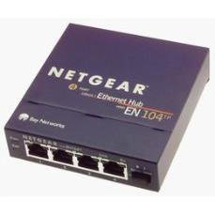
What is a Hub?
A small rectangular box that joins computers together through ports on the back of the hub.
J
Ethernet hub – Wikipedia. [online image]. Available en.wikipedia.org/wiki/Ethernet hub

Slide 13
How does a Hub work?
A hub receives data packets and passes on all the Information it receives to all the other computers connected to the hub.
Information is also sent to the computer that sent the information
Example:
if computer 1 wants to communicate with computer 3, the data will be sent to all the computers on the network since hubs do not know the destination of the information it receives.

Slide 14
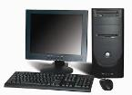


Diagram of a hub network
Main PC
Hub
Ethernet
PC 1
PC 2

Slide 15
Additional Information about Hubs
Most hubs contain 4 ports some have 5 or more ports.
Hubs can be used for a smaller network such as a home network or a small office network.
Hubs are not that expensive most range for less than $30.
Hubs may not be the best option for sophisticated or complex networks.

Slide 16
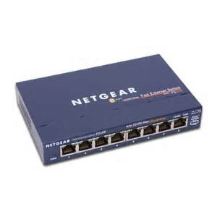
What is a Switch?
Switches look similar to hubs in that they are rectangular in shape.
Manageable switches are usually a little bigger than unmanageable switches.
A switch also has ports on the back.
Network switch – net gear.[online image]. Available http://www.senasum.blogspot.com, July 9, 2013

Slide 17
How does a Switch work?
Switches work about the same way as hubs. Unlike hubs, switches can identify the destination of a packet.
Switches send information only to the computer that is suppose to receive the information.
Switches can also send and retrieve information at the same time which makes sending information faster to retrieve than hubs.

Slide 18
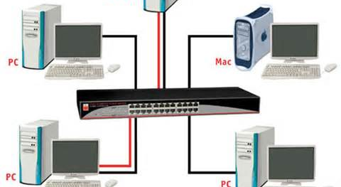
Diagram of a Switch Network
Switch Diagram. LindyConnectionPerfection.[online image]. Available http://www.lindy-international.com, July 9, 2013

Slide 19
Additional Information about Switches
Switches are a better option than hubs for larger networks or home networks with 4 or more connected computers.
Switches can range in price from $30 up to $100 or more depending on if the switch is manageable or unmanageable, usually unmanageable switches are less in price versus managed switches.

Slide 20
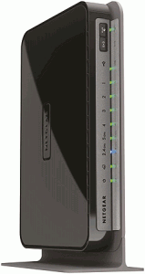
What is a Router?
A specialized computer programmed to interface between different networks.
Netgear-wndr4000-ddwrt-450 – Most Popular VPN Service Providers & DD-WRT Routers. [online image]. www.flashrouters.com, July 12, 2013.

Slide 21
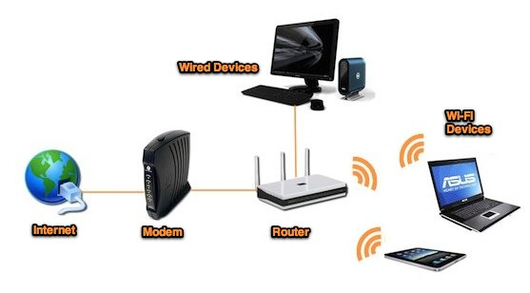
Diagram of a Router

Slide 22
Additional Information about Routers
Routers make sure data sent over the Internet goes where it needs to go and not where it is not needed.
Acts like a traffic controller, working to cut down congestion throughout the network and keeps everything flowing smoothly along the best path.
Routers are the only type of equipment that looks at every single packet passing by on the network.
Home network router including wireless routers can cost anywhere from $40 to $150 or higher.

Slide 23
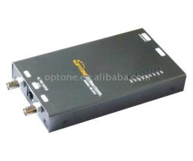
What is a Bridge?
A hardware device used to create a connection between two separate computer networks or to divide one network into two.
Filters data traffic at a network boundary and reduces the amount of traffic on a LAN dividing it into two segments.
I -4E to Ethernet (10/100M) Network Bridge. [online image]. Network Bridge. Available at www.freewtc.com. July 12, 2013.

Slide 24
How does a Bridge work?
Each bridge consist of a MAC address and operates at layer 2 of the OSI model
When a packet is received on the bridge ports the forwarding table including the MAC address is automatically updated to map the source MAC address to the network port from which the packet originated
The gateway then process the received packet according to the packet’s type.

Slide 25
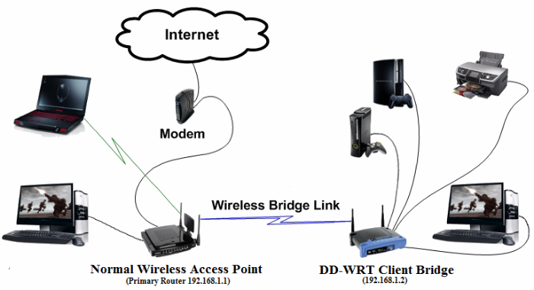
Diagram of a Bridge

Slide 26
Additional Information about Bridges
A bridge examines each message on a LAN and passes the ones known to be within the same LAN.
Computer addresses have no relationship to location in a bridging network.
A bridge is sometimes referred to as a brouter.
Wireless network bridges can costs anywhere from $100 to $1000 or more depending on the type of bridge purchased.

Slide 27
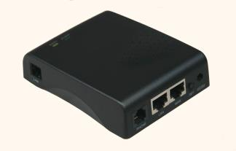
What is a Gateway?
A communication device that provides a remote network with connectivity to the host network.
Gateway Network Communications [online image]. Available www.hiwtc.com

Slide 28
How a Gateway Works?
The gateway node acts like a proxy server and firewall
The gateway uses forwarding tables to determine where packet are to be sent

Slide 29
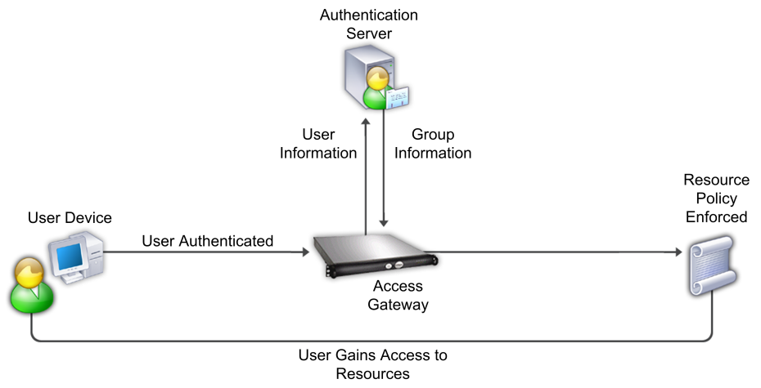
Gateway Diagram

Slide 30
Additional Information about Gateways
On the Internet a node or stopping point can be a gateway.
The computers controlling traffic within a network are gateway nodes.
A gateway is also associated with a router.

Slide 31
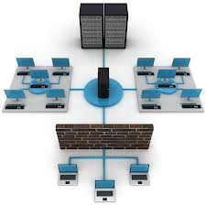
What is a Firewall?
Hardware or software device that protects a computer network from unauthorized access.
Firewall Sling Secure Smartphone. [online image]. Available www.slingsecure.com

Slide 32
How a Firewall works
Firewalls filters the information coming through the Internet connection into a user private network.
To control traffic in and out of the network firewalls one or more of the three methods are used including:
Packet filtering
Proxy service
Stateful inspection

Slide 33
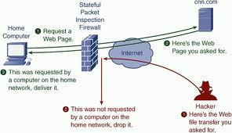
Diagram of Firewall

Slide 34
Additional Information about Firewalls
Most home network routers have built in firewall.
The term “firewall” originated from firefighting, where a firewall is a barrier established to prevent the spread of a fire.
A firewall works with the proxy server making request on behalf of workstation users.
There are a number of features firewalls can include from logging and reporting to setting alarms of an attack.
Costs for host based firewalls usually costs around $100 or less. Some may costs more depending on different things such as features included or if its an enterprise based system.

Slide 35
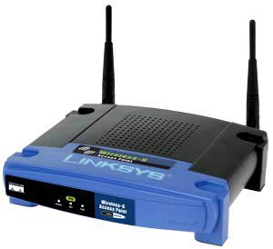
What is a Wireless Access Point?
A small hardware device featuring built-in network adapter, antenna, and radio signals.
Configured nodes on a WLAN.
Wireless Access Points, Page 2. [online image]. Available compnetworking.about.com

Slide 36
How a Wireless Access Point works?
Operates using radio frequency technology
Broadcast wireless signals computers can detect and use
A wireless network adapter is implemented while using a wireless access point, most computers today already have network adapters built into the computer.

Slide 37
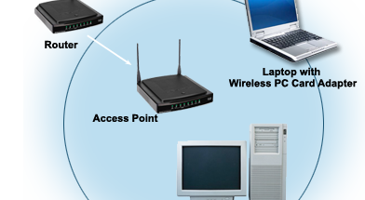
Diagram of Wireless Access Point
RxNT – The eprescribing System. [online image]. Available www.rxnt.com

Slide 38
Additional Information about Access Points
The access point usually connects to the router
A hotspot is a application wireless users can connect to the Internet.
Aps are used throughout a home network, usually through only one AP.
Wireless access points can cost anywhere from $30 and up depending on the type purchased.

Slide 39
Endpoint/Edge Devices
Endpoint point devices (PCs, laptops, mobile devices and servers)
An edge device is any piece of hardware that controls data flow at the boundary between two networks.
Examples include routers, routing switches, integrated access devices, multiplexers, and a variety of metropolitan area network and wide area network access devices

