Slide 1
Module-6
Managing Health and Safety

Slide 2
Need for Health and Safety at Work
The main focus in occupational health is on three different objectives:
(i) the maintenance and promotion of workers’ health and working capacity;
(ii) the improvement of working environment and work to become conducive to safety and health, and
(iii) development of work organisations and working cultures in a direction which supports health and safety at work, and in doing so also promotes a positive social climate and smooth operation, and may enhance productivity of the undertakings.

Slide 3
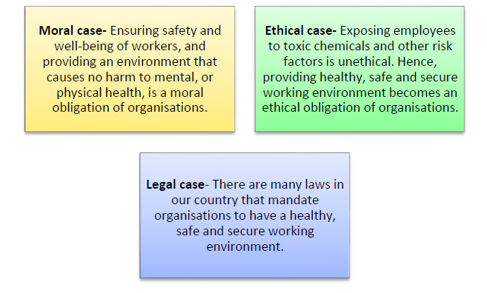
Need for Health and Safety at Work
Having a healthy, safe and secure working environment is important for the following reasons:

Slide 4
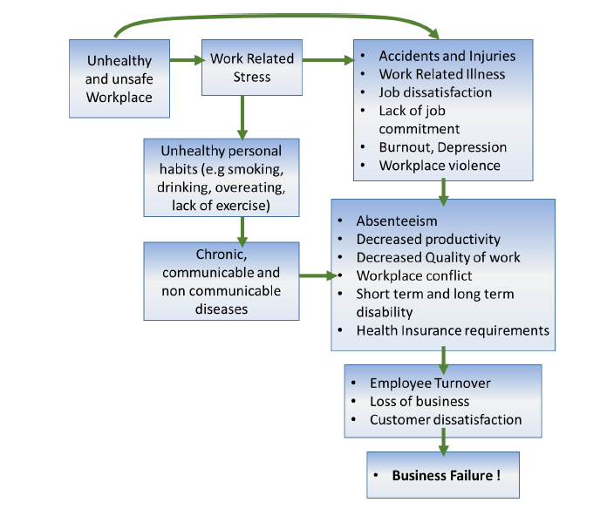
Need for Health and Safety at Work

Slide 5
Need for Health and Safety at Work
Different types of breaches in health, safety and security
1. Physical hazards
are the most common hazards and are present in most workplaces at some time.
For example, frayed electrical cords, unguarded machinery, exposed moving parts, constant loud noise, vibrations, working from ladders, scaffolding or heights, spills, tripping hazards.
2. Ergonomic hazards
occur when the type of work you do, your body position and/or your working conditions put a strain on your body. They are difficult to identify because you don’t immediately recognize the harm they are doing to your health.
For example, poor lighting, improperly adjusted workstations and chairs, frequent lifting, repetitive or awkward movements.

Slide 6
Need for Health and Safety at Work
Different types of breaches in health, safety and security
3. Chemical hazards
are present when you are exposed to any chemical preparation (solid, liquid, or gas) in the workplace.
For example, cleaning products and solvents, vapours and fumes, carbon monoxide or other gases, gasoline or other flammable materials.
4. Biological hazards
come from working with people, animals, or infectious plant material.
For example, blood or other bodily fluids, bacteria and viruses, insect bites, animal and bird droppings.
5. Electrical Hazards
as there are many equipment in the workplace that are run by electricity, which if due precautions are not taken can cause fire, electric shock, electrocution.

Slide 7
Need for Health and Safety at Work
Types of health and safety hazards at a workplace
Safety hazards
that cause accidents that physically injure workers. For example, many tall buildings that have glass windows, require cleaners to hang from the rooftop to clean the glasses. If the rope snaps, or if there is some other mistake, it can get fatal for the cleaner.
Health hazards that result in the development of some disease.

Slide 8
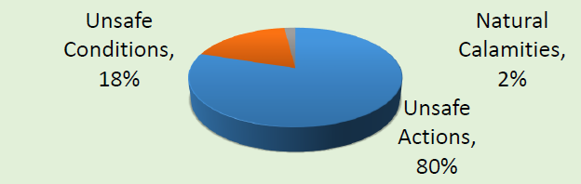
Need for Health and Safety at Work
Understanding ‘Safety’
Accident is an unplanned and undesired occurrence, which may or may not result in injury, or damage to self, others and/or property. Main causes of accidents are:

Slide 9
Need for Health and Safety at Work
Understanding ‘Safety’
Safety is freedom from accidents, injury or damage; it is a pro-active means to give protection from known dangers. A safe workplace is free of risks and hazards.

Slide 10
Need for Health and Safety at Work
Understanding ‘Safety’
Hazards are the potential to cause harm (accidents, injury or damage) e.g.
Naked wires
Heavy equipment and machines
Heat being generated in the computers, Servers, etc.
Sharp edges on furniture
Risks are the likelihood of harm (accidents, injury or damage) e.g.
Plugging equipment with naked wires
Lifting heavy equipment in a wrong posture
Working in a non-temperature regulated environment with Technology that heats up
Using duplicate parts in IT equipment that could pose a safety threat

Slide 11
Need for Health and Safety at Work
Common Safety Hazards
Some safety and health related hazards and how they can be controlled are as follows:
Surfaces/Places related Hazards & Risks
Equipment/items related Hazards & Risk
Materials & Chemical Hazards & Risks
Physical Hazards & Risks
Electrical Risks

Slide 12
Need for Health and Safety at Work
1. Surfaces/Places related Hazards & Risks:
Dirty, dusty and littered areas can lead to infections as well as accidents from slipping, tripping, etc.
Wet/oily/soapy surfaces are can lead to accidents by slipping or falling and breaking of glassware.
Working with wooden tables that have nails protruding on the surface.
How to Control?
Keep the work area neat and tidy
Wet areas should be mopped and kept dry
Handling glassware properly
Precautions should be taken while dealing with surfaces with sharp or pointed edges or object protruding

Slide 13
Need for Health and Safety at Work
2. Equipment/items related Hazards & Risk:
Certain equipment used in the workplace like staplers, heavy laptops and computers, etc. which if not used carefully can cause physical hurt.
How to Control?
Never use a tool to do a job for which it was not designed
Handling the equipment properly as required

Slide 14
Need for Health and Safety at Work
3. Materials & Chemical Hazards & Risks:
Cleaning chemicals used by housekeeping, kept in the washroom and housekeeping cabinets
Solutions for cleaning IT equipment
Pest control sprays, etc.
How to Control?
While using hazardous materials & chemicals ensure the following
Wear gloves, avoid skin coming into contact with the chemical
Keep the chemical away from eyes and nose
Never mix chemicals unless particularly advised by the product manufacturer
Do not ingest any chemical, if by mistake someone swallows some chemical see a doctor immediately.

Slide 15
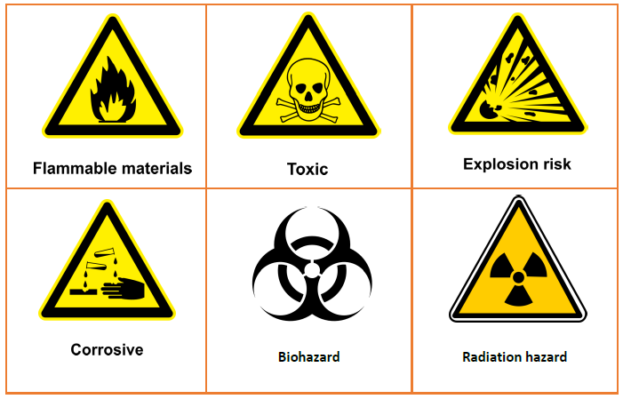
Need for Health and Safety at Work
3. Materials & Chemical Hazards & Risks:
How to Control?
Identify common warning signs associated with different types of hazardous materials

Slide 16
Need for Health and Safety at Work
4. Physical Hazards & Risks:
Any obstruction at the entry/exits/blind turns could be dangerous in a time of emergency when people have to run in or out.
Overstocked cupboards or shelves can be hazards as they can topple over anytime.
Work may require lifting or moving heavy objects, which if not done properly can cause injury or aches.

Slide 17
Need for Health and Safety at Work
4. Physical Hazards & Risks:
How to control?
Entry/exits/blind turns should be clear of obstructions/faults at all times.
Cupboards and shelves should be neatly arranged, preferably supported by the wall or fixed on the floor.
Warning signs should be placed if a physical hazard cannot be removed.
Always try to use a machine or tool if required to lift a heavy object.
If it is not possible then try to split the load and lift it in more than one turns. Can also take help.
If one has to lift a heavy object, then follow right lifting practices while lifting or moving heavy objects.

Slide 18
Need for Health and Safety at Work
4. Physical Hazards & Risks:
How to control?
Entry/exits/blind turns should be clear of obstructions/faults at all times.
Cupboards and shelves should be neatly arranged, preferably supported by the wall or fixed on the floor.
Warning signs should be placed if a physical hazard cannot be removed.
Always try to use a machine or tool if required to lift a heavy object.
If it is not possible then try to split the load and lift it in more than one turns. Can also take help.
If one has to lift a heavy object, then follow right lifting practices while lifting or moving heavy objects.

Slide 19
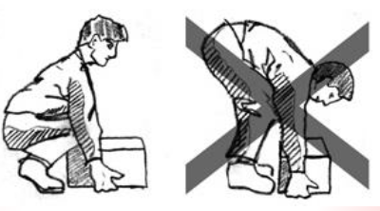
Need for Health and Safety at Work
4. Physical Hazards & Risks:

Slide 20
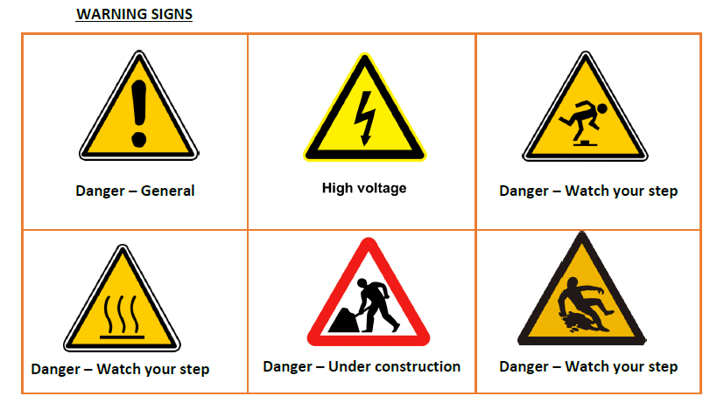
Need for Health and Safety at Work
4. Physical Hazards & Risks:

Slide 21
Need for Health and Safety at Work
5. Electrical Risks
Electricity is an amazing thing when used properly, but can very easily hurt, harm and even fatally injury a person that comes in contact with it.
Whenever one works with power tools or electrical circuits there is a risk of electrical hazards, especially electrical shock.
Electric Shock: An electrical shock is received when electrical current passes through the body. One gets an electrical shock if:
• touching a live wire and an electrical earth, or
• touching a live wire and another wire at a different voltage.

Slide 22
Need for Health and Safety at Work
5. Electrical Risks
Freeing a victim from electrocution
The first person to reach a shocked worker should cut off the current if this can be done quickly.
If this is not possible, the victim should be removed from contact with the charged equipment. Either the equipment/wire should be pulled away or the victim.
Bare hands should not be used, use a dry board, dry rope, leather belt, coat, overalls or some other non-conductor.
Be sure to stand on a non-conducting surface when pulling – dry rubber slippers, dry wooden board, etc..

Slide 23
How to identify job hazards
The following are the major steps to identifying and analyzing job hazards:
Step 1- Decide whether a job is to be analyzed
Step 2- Break the job down into a sequence of steps
Step 3- Identify the potential hazards
Step 4- Hazard Mitigation

Slide 24
How to identify job hazards
Step 1- Decide whether a job is to be analyzed, based on the following criteria:
Incident frequency and severity-
Jobs where incidents occur frequently, or where they occur infrequently but result in disabling injuries.
Potential for severe injuries or illness-
The consequences of the incident, hazardous conditions, or exposure to harmful substances are potentially severe.
Newly established jobs-
Due to lack of experience in these jobs, hazards may not be evident or anticipated.
Modified jobs-
New hazards may be associated with changes in job procedures.
Infrequently performed jobs-
Employees may be at greater risk when undertaking nonroutine jobs, and an analysis provides a means of reviewing hazards.

Slide 25
How to identify job hazards
Step 2- Break the job down into a sequence of steps.
Ensure that each step is not too specific, or too general.
Steps should be kept in the correct sequence. Document using the company template.
Make notes on what is done, rather than how it is done.

Slide 26
How to identify job hazards
Step 3- Identify the potential hazards. Based on observations of the job, knowledge of incident and injury causes, and personal experience, list the things that could go wrong at each step.
The following is a list of questions that may be used to help identify potential hazards:
Can any body part get caught in or between objects?
Do tools, machines, or equipment present any hazards?

Slide 27
How to identify job hazards
The following is a list of questions that may be used to help identify potential hazards:
Can the worker make harmful contact with moving objects?
Can the worker slip, trip, or fall?
Can the worker suffer strain from lifting, pushing, or pulling?
Is the worker exposed to extreme heat, or cold?
Is excessive noise, or vibration a problem?
Is there a danger from falling objects?

Slide 28
How to identify job hazards
The following is a list of questions that may be used to help identify potential hazards:
Is lighting a problem?
Can weather conditions affect safety?
Is harmful radiation a possibility?
Can contact be made with hot, toxic, or caustic substances?
Are there dusts, fumes, mists, or vapors in the air?

Slide 29
How to identify job hazards
Step 4- Hazard Mitigation- Upon completion of the first three steps of the job hazard analysis, determine the appropriate controls to overcome the hazards.
Elimination, substitution, isolation, engineering controls, administrative controls, and personal protective clothing and equipment.

Slide 30
Responsibilities w.r.t Health and Safety at Work
Complies with his organisation’s current health, safety and security policies and procedures.
Reports any identified breaches in health, safety and security policies and procedures to the designated person.
Identifies and corrects any hazards that he can deal with safely, competently and within the limits of your authority.

Slide 31
Responsibilities w.r.t Health and Safety at Work
Reports any hazards that he is not competent to deal with to the relevant people in line with organisational procedures.
o Warns others who may be affected.
Follows the emergency procedures promptly, calmly and efficiently.
Identifies and recommends opportunities for improving health, safety and security to the designated person.
Completes any health and safety records legibly and accurately.

Slide 32
Responsibilities w.r.t Health and Safety at Work
Coordinates with the appropriate people for his information needs.
Is reliable; gets information from reliable sources
Communicates with colleagues clearly, concisely and accurately.
Integrates his work effectively with others.
Shares essential information on time.
Takes help from the appropriate people when there are any problems in the information.
Follows the company rules while analysing data.

Slide 33
Responsibilities w.r.t Health and Safety at Work
Honours his commitments.
If for some reason, he is unable to carry out his promises, he informs in advance and suggests alternatives.
Maintains good relationships with colleagues.
o Sorts out problems with them, if any.
o Shows respect for others.

Slide 34
Responsibilities w.r.t Health and Safety at Work
Follows the policies, procedures and culture of the organisation.
Keeps abreast with the technological developments.
Takes care of quality issues.
Maintains the data in the required formats
Keeps data up-to-date
Provides accurate information
Provides complete information
Gives importance to the needs of the colleagues and responds to their feedback.

Slide 35
How and when to report hazards
After developing the ability to identify hazards, the Information Security Analyst should report them to his line manager, or the person assigned the responsibility in the company policy.
This should be done immediately without any delay.

Slide 36
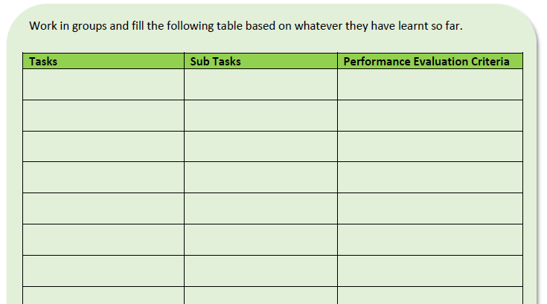
How and when to report hazards

