Slide 1
Module-2
Security Device Management

Slide 2
Module-2: Security Device Management
Different types of information security devices and their functions,
Technical and configuration specifications, architecture concepts
Design patterns and how these contribute to the security of design and devices.

Slide 3
Information Security Management
Access control
Antivirus and anti-malware software
Application security
Behavioral analytics
Data loss prevention
Distributed denial of service prevention
Email security
Firewalls
Mobile device security
Network segmentation
Security information and event management
Web security

Slide 4
Types of information security devices
Access control
  This refers to controlling which users have access to the network or especially sensitive sections of the network. Using security policies, you can restrict network access to only recognized users and devices or grant limited access to noncompliant devices or guest users.

Slide 5
Types of information security devices
Antivirus and anti-malware software
  Malware, or “malicious software,” is a common form of cyber attack that comes in many different shapes and sizes.
  Some variations work quickly to delete files or corrupt data, while others can lie dormant for long periods of time and quietly allow hackers a back door into your systems.
  The best antivirus software will monitor network traffic in real time for malware, scan activity log files for signs of suspicious behavior or long-term patterns, and offer threat remediation capabilities.

Slide 6
Types of information security devices
Application security.
  Each device and software product used within your networking environment offers a potential way in for hackers.
  For this reason, it is important that all programs be kept up-to-date and patched to prevent cyber attackers from exploiting vulnerabilities to access sensitive data.
  Application security refers to the combination of hardware, software, and best practices you use to monitor issues and close gaps in your security coverage.

Slide 7
Types of information security devices
Behavioral analytics
  In order to identify abnormal behavior, security support personnel need to establish a baseline of what constitutes normal behavior for a given customer’s users, applications, and network.
  Behavioral analytics software is designed to help identify common indicators of abnormal behavior, which can often be a sign that a security breach has occurred.
  By having a better sense of each customer’s baselines, MSPs can more quickly spot problems and isolate threats.

Slide 8
Types of information security devices
Data loss prevention
  Data loss prevention (DLP) technologies are those that prevent an organization’s employees from sharing valuable company information or sensitive data—whether unwittingly or with ill intent—outside the network.
  DLP technologies can prevent actions that could potentially expose data to bad actors outside the networking environment, such as uploading and downloading files, forwarding messages, or printing.

Slide 9
Types of information security devices
Distributed denial of service prevention
  Distributed denial of service (DDoS) attacks are becoming increasingly common.
  They function by overloading a network with one-sided connection requests that eventually cause the network to crash.
  A DDoS prevention tool scrubs incoming traffic to remove nonlegitimate traffic that could threaten your network, and may consist of a hardware appliance that works to filter out traffic before it reaches your firewalls.

Slide 10
Types of information security devices
Email security
  Email is an especially important factor to consider when implementing networking security tools.
  Numerous threat vectors, like scams, phishing, malware, and suspicious links, can be attached to or incorporated into emails.
  Because so many of these threats will often use elements of personal information in order to appear more convincing, it is important to ensure an organization’s employees undergo sufficient security awareness training to detect when an email is suspicious.
  Email security software works to filter out incoming threats and can also be configured to prevent outgoing messages from sharing certain forms of data.

Slide 11
Types of information security devices
Firewalls
  Firewalls are another common element of a network security model.
  They essentially function as a gatekeeper between a network and the wider internet.
  Firewalls filter incoming and, in some cases, outgoing traffic by comparing data packets against predefined rules and policies, thereby preventing threats from accessing the network.

Slide 12
Types of information security devices
Mobile device security
  The vast majority of us have mobile devices that carry some form of personal or sensitive data we would like to keep protected.
  This is a fact that hackers are aware of and can easily take advantage of. Implementing mobile device security measures can limit device access to a network, which is a necessary step to ensuring network traffic stays private and doesn’t leak out through vulnerable mobile connections.

Slide 13
Types of information security devices
Network segmentation
  Dividing and sorting network traffic based on certain classifications streamlines the job for security support personnel when it comes to applying policies.
  Segmented networks also make it easier to assign or deny authorization credentials for employees, ensuring no one is accessing information they should not be.
  Segmentation also helps to sequester potentially compromised devices or intrusions.

Slide 14
Types of information security devices
Security information and event management
  These security systems (called SIEMs) combine host-based and network-based intrusion detection systems that combine real-time network traffic monitoring with historical data log file scanning to provide administrators with a comprehensive picture of all activity across the network.

Slide 15
Types of information security devices
Security information and event management
  An IPS can also log security events and send notifications to the necessary players in the interest of keeping network administrators informed.

Slide 16
Types of information security devices
Web security
  Web security software serves a few purposes.
  First, it limits internet access for employees, with the intention of preventing them from accessing sites that could contain malware.
  It also blocks other web-based threats and works to protect a customer’s web gateway.

Slide 17
Configuring Firewall
What firewall software does?
  A firewall is simply a program or hardware device that filters the information coming through the internet connection into your private network or computer system.
  If an incoming packet of information is flagged by the filters, it is not allowed through.

Slide 18
Configuring Firewall
Firewalls use one or more of three methods to control traffic flowing in and out of the network:
  Packet filtering
  Proxy service
  Stateful inspection

Slide 19
Configuring Firewall
Packet Filtering
  Packets (small chunks of data) are analyzed against a set of filters. Packets that make it through the filters are sent to the requesting system and all others are discarded.

Slide 20
Configuring Firewall
Proxy service
  Information from the internet is retrieved by the firewall and then sent to the requestingsystem and vice versa.

Slide 21
Configuring Firewall
Stateful Inspection
  A newer method that doesn't examine the contents of each packet but instead compares certain key parts of the packet to a database of trusted information.
  Information traveling from inside the firewall to the outside is monitored for specific defining characteristics, then incoming information is compared to these characteristics.
  If the comparison yields a reasonable match, the information is allowed through. Otherwise it is discarded.

Slide 22
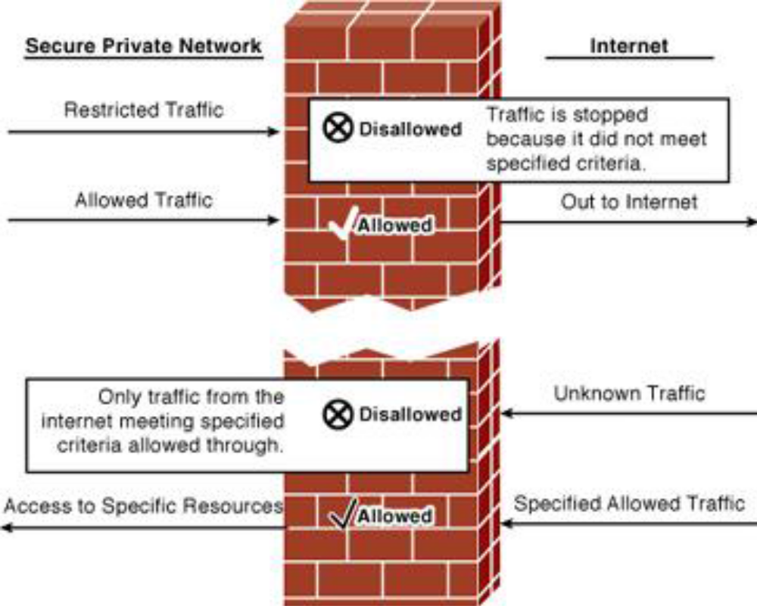
Working of firewall

Slide 23
Firewall SOFTWARE CONFIGURATION
Firewalls are customizable. This means that you can add or remove filters based on several conditions. Some of these are:
  IP addresses
  Domain names
  Protocols

Slide 24
Firewall SOFTWARE CONFIGURATION
IP addresses
  Each machine on the Internet is assigned a unique address called an IP address.
  IP addresses are 32- bit numbers, normally expressed as four "octets" in a "dotted decimal number."
  A typical IP address looks like this: 216.27.61.137. For example, if a certain IP address outside the company is reading too many files from a server, the firewall can block all traffic to or from that IP address.

Slide 25
Firewall SOFTWARE CONFIGURATION
Domain names
  As it is hard to remember the string of numbers that make up an IP address, and because IP addresses sometimes need to change, all servers on the Internet also have human-readable names, called domain names
  For example, it is easier for most of us to remember www.howstuffworks.com than it is to remember 216.27.61.137.
  A company might block all access to certain domain names, or allow access only to specific domain names.

Slide 26
Firewall SOFTWARE CONFIGURATION
Protocols
  The protocol is the pre-defined way that someone who wants to use a service talks with that service.
  The "someone" could be a person, but more often it is a computer program like a Web browser.
  Protocols are often text, and simply describe how the client and server will have their conversation.
  Eg: http in the Web's protocol.
  A company might set up only one or two machines to handle a specific protocol and ban that protocol on all other machines.

Slide 27
Firewall SOFTWARE CONFIGURATION
Protocols
  Some common protocols that you can set firewall filters for include:
    IP (Internet Protocol)
    TCP (Transmission Control Protocol)
    HTTP (Hyper Text Transfer Protocol)
    FTP (File Transfer Protocol)
    UDP (User Datagram Protocol) teletype network
    ICMP (Internet Control Message Protocol)
    SMTP (Simple Mail Transport Protocol)
    SNMP (Simple Network Management Protocol)
    Telnet (Teletype Network)

Slide 28
Why Firewall Security?
Access or abuse of unprotected computers
  There are many creative ways that unscrupulous people use to access or abuse unprotected computers:
    Remote login
    Application backdoors
    SMTP session hijacking
    Operating system bugs
    Denial of service
    E-mail bombs
    Macros
    Viruses
    Spam
    Redirect bombs
    Source routing

Slide 29
Why Firewall Security?
Remote Login
  When someone is able to connect to your computer and control it in some form.
  This can range from being able to view or access your files to actually running programs on your computer.

Slide 30
Why Firewall Security?
Application backdoors
  Some programs have special features that allow for remote access.
  Others contain bugs that provide a backdoor, or hidden access that provides some level of control of the program.

Slide 31
Why Firewall Security?
SMTP session hijacking
  SMTP is the most common method of sending e-mail over the Internet.
  By gaining access to a list of e-mail addresses, a person can send unsolicited junk e-mail (spam) to thousands of users.
  This is done quite often by redirecting the e-mail through the SMTP server of an unsuspecting host, making the actual sender of the spam difficult to trace.

Slide 32
Why Firewall Security?
Operating system bugs
  Like applications, some operating systems have backdoors.
  Others provide remote access with insufficient security controls or have bugs that an experienced hacker can take advantage of.

Slide 33
Why Firewall Security?
Denial of service
  What happens is that the hacker sends a request to the server to connect to it.
  When the server responds with an acknowledgement and tries to establish a session, it cannot find the system that made the request. By inundating a server with these unanswerable session requests, a hacker causes the server to slow to a crawl or eventually crash.

Slide 34
Why Firewall Security?
E-mail bombs
  An e-mail bomb is usually a personal attack.
  Someone sends you the same e-mail hundreds or thousands of times until your e-mail system cannot accept any more messages.

Slide 35
Why Firewall Security?
Macros
  To simplify complicated procedures, many applications allow you to create a script of commands that the application can run. This script is known as a macro.
  Hackers have taken advantage of this to create their own macros that, depending on the application, can destroy your data or crash your computer.

Slide 36
Why Firewall Security?
Viruses
  Probably the most well-known threat is computer viruses.
  A virus is a small program that can copy itself to other computers. This way it can spread quickly from one system to the next. Viruses range from harmless messages to erasing all of your data.

Slide 37
Why Firewall Security?
Spam
  Typically, harmless but always annoying, spam is the electronic equivalent of junk mail.
  Spam can be dangerous though.
  Quite often it contains links to Web sites.
  Be careful of clicking on these because you may accidentally accept a cookie that provides a backdoor to your computer.

Slide 38
Why Firewall Security?
Redirect bombs
  Hackers can use ICMP to change (redirect) the path information takes by sending it to a different router.
  This is one of the ways that a denial of service attack is set up.

Slide 39
Why Firewall Security?
Source routing
  In most cases, the path a packet travels over the Internet (or any other network) is determined by the routers along that path.
  But the source providing the packet can arbitrarily specify the route that the packet should travel.
  Hackers sometimes take advantage of this to make information appear to come from a trusted source or even from inside the network! Most firewall products disable source routing by default.

Slide 40
Why Firewall Security?
Security against unauthorized access or abuse
  Some of the items in the list above are hard, if not impossible, to filter using a firewall.
  While some firewalls offer virus protection, it is worth the investment to install anti-virus software on each computer.
  The level of security you establish will determine how many of these threats can be stopped by your firewall.
  You can also restrict traffic that travels through the firewall so that only certain types of information, such as e-mail, can get through.
  This is a good rule for businesses that have an experienced network administrator that understands what the needs are and knows exactly what traffic to allow through.
  One of the best things about a firewall from a security standpoint is that it stops anyone on the outside from logging onto a computer in your private network.

Slide 41
Proxy Servers and DMZ
There are times that you may want remote users to have access to items on your network. Some examples are:
  Web site
  Online business
  FTP download and upload area

Slide 42
Proxy Servers and DMZ
DMZ is just an area that is outside the firewall.
Think of DMZ as the front yard of a house.
It belongs to the owner, who may put some things there, but would put anything valuable inside the house where it can be properly secured.
Setting up a DMZ is very easy.
If you have multiple computers, you can choose to simply place one of the computers between the Internet connection and the firewall. Most of the software firewalls available will allow you to designate a directory on the gateway computer as a DMZ.

Slide 43
Configuring a Simple Firewall
Basic traffic filtering is limited to configured access list implementations that examine packets at the network layer or, at most, the transport layer, permitting or denying the passage of each packet through the firewall.
However, the use of inspection rules in CBAC allows the creation and use of dynamic temporary access lists.

Slide 44
Configuring a Simple Firewall
These dynamic lists allow temporary openings in the configured access lists at firewall interfaces.
These openings are created when traffic for a specified user session exits the internal network through the firewall.
The openings allow returning traffic for the specified session (that would normally be blocked) back through the firewall.

Slide 45
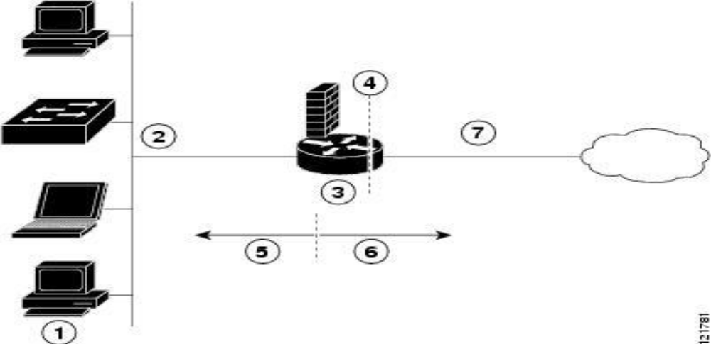
Configuring a Simple Firewall
The following Figure shows a network deployment using PPPoE or PPPoA with NAT and a firewall.

Slide 46
Configuring a Simple Firewall
Multiple networked devices—Desktops, laptop PCs, switches
Fast Ethernet LAN interface (the inside interface for NAT)
PPPoE or PPPoA client and firewall implementation—Cisco 1811/1812 or Cisco 1801/1802/1803 series integrated services router, respectively
Point at which NAT occurs
Protected network
Unprotected network
Fast Ethernet or ATM WAN interface (the outside interface for NAT)

Slide 47
Configuration Tasks
Configure Access Lists
Configure Inspection Rules
Apply Access Lists and Inspection Rules to Interfaces

Slide 48
Configure Access Lists
Perform these steps to create access lists for use by the firewall, beginning in global configuration mode:
Step 1
Command
access-list access-list-number {deny | permit} protocol
source source-wildcard [ operator [port]] destination
Example
Router(config)# access-list 103 permit host 200.1.1.1 eq
isakmp any
Router(config)#
Purpose
Creates an access list which prevents Internet- initiated traffic from reaching the local (inside) network of the router, and which compares source and destination ports.

Slide 49
Configure Access Lists
Step 2
Command
access-list access-list-number {deny | permit} protocol
source source-wildcard destination destination-wildcard
Example
Router(config)# access-list 105 permit ip 10.1.1.0 0.
0.0.255 192.168.0.0 0.0.255.255
Router(config)#
Purpose
Creates an access list that allows network traffic to pass freely between the corporate network and the local networks through the configured VPN tunnel.

Slide 50
Configure Inspection Rules
Perform these steps to configure firewall inspection rules for all TCP and UDP traffic, as well as specific application protocols as defined by the security policy, beginning in global configuration mode:
Step 1
Command
ip inspect name inspection-name protocol
Example
Router(config)# ip inspect
name firewall tcp
Router(config)#
Purpose
Defines an inspection rule for a particular protocol.

Slide 51
Apply Access Lists and Inspection Rules to Interfaces
Perform these steps to apply the ACLs and inspection rules to the network interfaces, beginning in global configuration mode:
Step 1
Command
interface type number
Example
Router(config)# interface vlan 1
Router(config-if)#
Purpose
Enters interface configuration mode for the inside network interface on your router.

Slide 52
Apply Access Lists and Inspection Rules to Interfaces
Step 2
Command
ip inspect inspection-name { in | out }
Example
Router(config-if)# ip inspect firewall in
Router(config-if)#
Purpose
Assigns the set of firewall inspection rules to the inside interface on the router.

Slide 53
Apply Access Lists and Inspection Rules to Interfaces
Step 3
Command
Exit
Example
Router(config-if)# exit
Router(config)#
Purpose
Returns to global configuration mode.

Slide 54
Apply Access Lists and Inspection Rules to Interfaces
Step 4
Command
interface type number
Example
Router(config)# interface fastethernet 0
Router(config-if)#
Purpose
Enters interface configuration mode for the outside network interface on your router.

Slide 55
Apply Access Lists and Inspection Rules to Interfaces
Step 5
Command
ip access-group { access-list-number
| access-list-name } { in | out }
Example
Router(config-if)# ip access-group 103
in
Router(config-if)#
Purpose
Assigns the defined ACLs to the outside interface on the router..

Slide 56
Apply Access Lists and Inspection Rules to Interfaces
Step 6
Command
exit
Example
Router(config-if)# exit
Router(config)#
Purpose
Returns to global configuration mode.

Slide 57
Configure Inspection Rules
Step 2
Command
ip inspect name inspection-name protocol
Example
Router(config)# ip inspect
name firewall rtsp
Router(config)# ip inspect
name firewall h323
Router(config)# ip inspect
name firewall netshow
Router(config)# ip inspect
name firewall ftp
Router(config)# ip inspect
name firewall sqlnet
Router(config)#
Purpose
Repeat this command for each inspection rule that you wish to use.

Slide 58
Firewall Limitations
A firewall cannot prevent users or attackers with modems from dialing into or out of the internal network, thus bypassing the firewall and its protection completely.
Firewalls cannot enforce your password policy or prevent misuse of passwords. Your password policy is crucial in this area because it outlines acceptable conduct and sets the ramifications of noncompliance.
Firewalls are ineffective against nontechnical security risks such as social engineering.
Firewalls cannot stop internal users from accessing websites with malicious code, making user education critical.
Firewalls cannot protect you from poor decisions.
Firewalls cannot protect you when your security policy is too lax.

