Slide 1
IPS CONFIGURATION

Slide 2
IPS Network Sensing
Network sensing - accomplished using Cisco IPS sensors and Cisco IOS IPS devices.
Cisco IPS sensors and Cisco IOS IPS devices - IPS devices or sensors.

Slide 3
Capturing Network Traffic
sensor can operate in either promiscuous or inline mode.

Slide 4
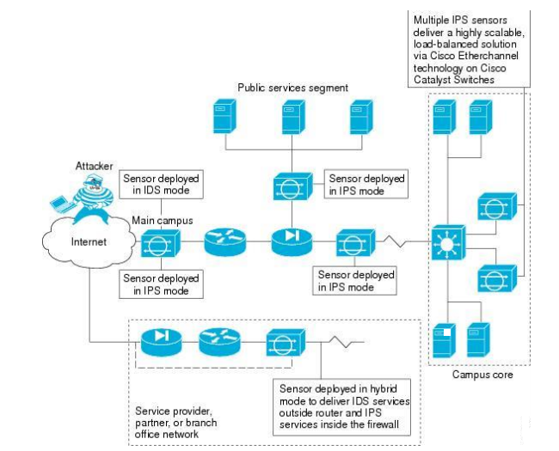
IPS DEPLOYMENT

Slide 5
Capturing Network Traffic
When responding to attacks, the sensor can do the following:
  Insert TCP resets via the sensing interface.
  Make ACL changes on switches, routers, and firewalls that the sensor manages.
  Generate IP session logs, session replay, and trigger packets display.

Slide 6
Capturing Network Traffic
  IP session logs are used to gather information about unauthorized use.
  Implement multiple packet drop actions to stop worms and viruses.

Slide 7
Correctly Deploying the Sensor
Before deploy and configure the sensors, check:
  The size and complexity of your network.
  Connections between your network and other networks, including the Internet.
  The amount and type of traffic on your network.
  Always position the IPS sensor behind a perimeter-filtering device.
    Correct placement significantly reduces the number of alerts, which increases the amount of actionable data you can use to investigate security violations.

Slide 8
Tuning the IPS
Ensures that the alerts you see, reflect true actionable information.
Tips:
  Place your sensor on your network behind a perimeter-filtering device.
  Deploy the sensor with the default signatures in place.
  Make sure that the event action override is set to drop packets with a risk rating greater than 90.

Slide 9

Tuning the IPS
  Filter out known false positives caused by specialized software, such as vulnerability scanner and load balancers
  Filter the Informational alerts.
  Analyse the remaining actionable alerts:
    Research the alert.
    Fix the attack source.
    Fix the destination host.
    Modify the IPS policy to provide more information

Slide 10
IPS Configuration
Procedure
Step 1: Install and connect the device to your network. Install the device software and perform basic device configuration. Install the licenses required for all of the services running on the device.
Step 2: Add the device to the Security Manager device inventory.
Step 3: Configure the interfaces as described in Configuring Interfaces.
Step 4: Use the Virtual Sensors policy to assign interfaces to the virtual sensors.
Step 5: Configure basic device access platform policies.
Step 6: Configure basic server access platform policies.
Step 7: Configure the Logging policy if you want non-default logging.

Slide 11
Procedure
Step8 : Configure IPS signatures and event actions.
Step 9: Configure blocking or rate limiting hosts.
Step 10: Configure other desired advanced IPS services.
Step 11: Maintain the device
Step 12: Monitor the device

Slide 12
CONFIGURE BASIC DEVICE ACCESS PLATFORM POLICIES

Slide 13
BASIC DEVICE ACCESS PLATFORM POLICIES (Step 5)
AAA —Configure this policy if you want to use a RADIUS server to control access to the device.
Allowed Hosts —The addresses of hosts who are allowed access. Ensure that the Security Manager server is included as an allowed host, or you cannot configure the device using Security Manager.
SNMP —Configure this policy if you want to use an SNMP application to manage the device.
Password Requirements —You can define the acceptable characteristics of a user password.
User Accounts —The user accounts defined on the device.

Slide 14
Identifying Allowed Hosts
Step 1: Do one of the following to open the Allowed Hosts policy:
- (Device view) Select Platform > Device Admin > Device Access > Allowed Hosts from the Policy selector.
- (Policy view) Select IPS > Platform > Device Admin > Allowed Hosts, then select an existing policy or create a new one.

Slide 15
Identifying Allowed Hosts
Step 2: Do one of the following:
- To add an entry, click the Add Row button and fill in the Access List dialog box.
- You can add up to 512 entries.
- To edit an entry, select it and click the Edit Row button.
- To delete an entry, select it and click the Delete Row button.

Slide 16
Identifying Allowed Hosts
Step 3: When adding or editing an entry, specify the host or network address in the Add or Modify Access List dialog box, then click OK. You can enter addresses using the following formats:
- Host address—A simple IP address, such as 10.100.10.10.
- Network address—A network address and mask, such as 10.100.10.0/24 or 10.100.10.0/255.255.255.0.

Slide 17
Identifying Allowed Hosts
- A network/host policy object—Click Select to select an existing object or to create a new one. To use the object in this policy, it must have a single value, either a single network or a single host.

Slide 18
Configuring SNMP
Step 1: Do one of the following to open the SNMP policy:
- (Device view) Select Platform > Device Admin > Device Access > SNMP from the Policy selector.
- (Policy view) Select IPS > Platform > Device Admin > Device Access > SNMP, then select an existing policy or create a new one.

Slide 19
Configuring SNMP
Step 2: On the General Configuration tab, configure at least the following options.
  Enable SNMP Gets/Sets
  Read-Only Community String
  Read-Write Community String
  Step 3: If you want to configure SNMP traps, click the SNMP Trap Configuration tab and configure at least the following options.
  - Enable Notifications
  - Trap Destinations

Slide 20
Configuring SNMP
Step 4: If you configure trap destinations, you must also ensure that the desired alerts include the Request SNMP Trap action. You have the following options for adding this action:
- Easy way
- Precise way
Step 5: Add the SNMP management stations to the Allowed Hosts policy. The management stations must be allowed hosts to access the sensor.

Slide 21
IPS user accounts, and Security Manager discovery and deployment considerations

Slide 22
Understanding IPS User Roles
Understanding Managed and Unmanaged IPS Passwords
Understanding How IPS Passwords are Discovered and Deployed
Configuring IPS User Accounts
Configuring User Password Requirements
Configuring AAA Access Control for IPS Devices

Slide 23
Understanding IPS User Roles
Four User Roles
Viewer: Users can view the device configuration and events, but they cannot modify any configuration data except their user passwords.
Operator: Users can view everything and they can modify the following options:
– Signature tuning (priority, disable or enable).
– Virtual sensor definition.
– Managed routers.
– Their user passwords.

Slide 24
IPS User Roles
Administrator: Users can view everything and they can modify all options that Operators can modify in addition to the following:
  Sensor addressing configuration.
  List of hosts allowed to connect as configuration or viewing agents.
  Assignment of physical sensing interfaces.
  Enable or disable control of physical interfaces.
  Add and delete users and passwords.
  Generate new SSH host keys and server certificates.
Service: Only one user with service privileges can exist on a sensor. The service user cannot log in to IDM or IME. The service user logs in to a bash shell rather than the CLI. The service role is a special role that allows you to bypass the CLI if needed.

Slide 25
Understanding Managed and Unmanaged IPS Passwords
The status of a password is indicated in the Is Password Managed? column of the Platform > Device Admin > Device Access > User Accounts policy:
- No - the password for this account is not configured in Security Manager.
- Yes - the password for this account was configured or updated in Security Manager.

Slide 26
Understanding How IPS Passwords are Discovered and Deployed
Discovery : Security Manager determines the current status of each user account, updates the User Account policy with each discovered username and associated role, and marks the user password as unmanaged.
Active: account is available for use. Active accounts can be accessed using an authentication token if one has been assigned to the account.
Expired: account’s authentication token has expired and the account cannot be accessed using a token until the token has been updated.

Slide 27
Discovered and Deployed
  Locked: logins to the account have been disabled due to too many failed authentication attempts. You should update the password for these accounts.
Deployment: You are warned if any deployed user accounts are in the Expired or Locked state. Any unmanaged passwords are not deployed to the device.

Slide 28
Configuring IPS User Accounts
The user accounts policy should have at least these accounts:
  Cisco
  An administrator account: Security Manager
  Cisco IOS IPS devices use the same user accounts that are defined for the router

Slide 29
Configuring IPS User Accounts
Step 1 Do one of the following to open the User Accounts policy:
  (Device view) Select Platform > Device Admin > Device Access > User Accounts from the Policy selector.
  (Policy view) Select IPS > Platform > Device Admin > Device Access > User Accounts, then select an existing policy or create a new one.

Slide 30
Configuring IPS User Accounts
Step 2: Do one of the following:
  To add a user account, click the Add Row (+) button. This opens the Add User dialog box. Enter the information required to define the account.
  To edit a user account, select it and click the Edit Row (pencil) button and make the required changes in the Edit User dialog box.
  To delete a user account, select it and click the Delete Row (trash can) button. You cannot delete the account named cisco.

Slide 31
Configuring User Password Requirements
Step 1: To configure IPS password requirements, select one of the following policies:
  Device view
  Select Platform > Device Admin > Device Access > Password Requirements from the Policy selector.
  Policy view
Select IPS > Platform > Device Admin > Password Requirements from the Policy Type selector, then select an existing policy or create a new one.

Slide 32
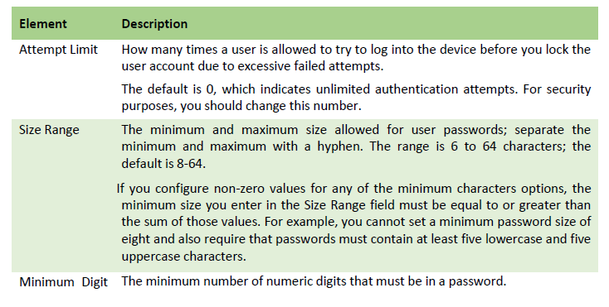
PASSWORD REQUIREMENTS - SAMPLE

Slide 33
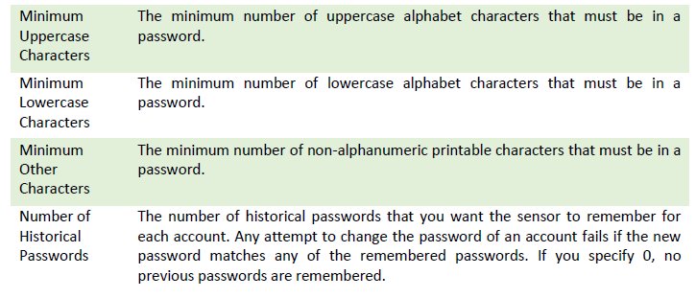
PASSWORD REQUIREMENTS - SAMPLE

Slide 34
Configuring AAA Access Control
AAA - Authentication, Authorization, and Accounting
When you configure the AAA server object, you must adhere to the following restrictions:
  Host: specify the IP address; you cannot use a DNS name
  Timeout: it must be from 1 to 512 seconds. The default is 3
  Protocol: RADIUS (Remote Access Dialup User Service )
  Key: specify the shared secret key that is defined on the RADIUS server
  Port:Ensure that the RADIUS Authentication/Authorization port is correct (Default: 1812)

Slide 35
Configuring AAA Access Control
Step 1 Do one of the following:
  (Device view) Select Platform > Device Admin > Device Access > AAA from the Policy selector.
  (Policy view) Select IPS > Platform > Device Admin > AAA, then select an existing policy or create a new one.
Step 2 Configure the following basic properties:
  Authentication Mode —Whether to use Local or AAA mode.
  Primary RADIUS Server, Secondary RADIUS Server —The main (primary) AAA server and a backup server, if any.

Slide 36
Configuring AAA Access Control
Step 3 Configure the following optional properties if you want non-default values:
  Console Authentication —How you want to authenticate users who access the IPS device through the console:
    Local—Users connected through the console port are authenticated through local user accounts.
    Local and RADIUS—Users connected through the console port are authenticated through RADIUS first. If RADIUS fails, local authentication is attempted.
    RADIUS—Users connected through the console port are authenticated by RADIUS. If you also select Enable Local Fallback, then users can also be authenticated through the local user accounts.

Slide 37
Configuring AAA Access Control (Step 3)
RADIUS NAS ID —The Network Access ID, which identifies the service requesting authentication. The value can be:
  no NAS-ID,
  cisco-ips, or
  a NAS-ID already configured on the RADIUS server. The default is cisco-ips.
Enable Local Fallback —Whether you want to fall back to local user account authentication if all RADIUS servers are unavailable. This option is selected by default.
Default User Role —The role to assign to users who do not have a role assigned in the RADIUS server.

Slide 38
Configure basic server access platform policies (Step 6)
These policies identify the servers to which the device can connect:
External Product Interface —If you use Management Centre for Cisco Security Agents, configure this policy to allow the sensor to download host postures from the application.
NTP —Configure this policy if you want to use a Network Time Protocol server to control the device time.
DNS, HTTP Proxy —The DNS and HTTP Proxy policies are required only if you configure global correlation. They identify a server that can resolve DNS names to IP addresses. Use the HTTP Proxy policy if your network requires the use of a proxy to make Internet connections; otherwise, use the DNS policy.

Slide 39
Identifying an NTP Server
Use the NTP policy to configure a Network Time Protocol (NTP) server as the time source for the IPS device.
Using NTP helps ensure synchronized time among your network devices, which can aid event analysis.

Slide 40
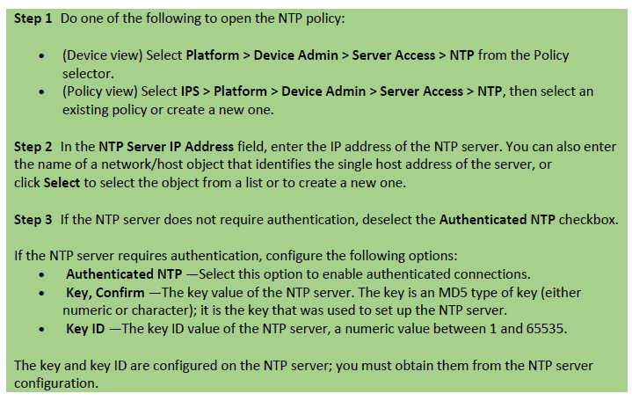
NTP

Slide 41
Identifying DNS Servers
For global correlation - the sensor must be able to resolve domain names to successfully connect to update the server when downloading global correlation updates.
Use the DNS policy to identify the Domain Name System (DNS) servers that the sensor can use to resolve domain names to IP addresses.

Slide 42
Identifying DNS Servers
Step 1 Do one of the following to open the HTTP Proxy policy:
(Device view) Select Platform > Device Admin > Server Access > DNS from the Policy selector.
(Policy view) Select IPS > Platform > Device Admin > Server Access > DNS, then select an existing policy or create a new one.
Step 2 Specify the IP addresses of up to three DNS servers in the Primary, Secondary, and Tertiary Address fields.
- The sensor uses the servers in the order listed ; if one server does not respond, the next server is contacted.

Slide 43
Identifying an HTTP Proxy Server
For configuring global correlation - network requires the use of HTTP proxies to connect to the Internet., you need to configure the HTTP Proxy policy to identify a proxy that the IPS sensor can use. When downloading global correlation updates, the IPS sensor connects to the update server using this proxy. The proxy must be able to resolve DNS names.

Slide 44

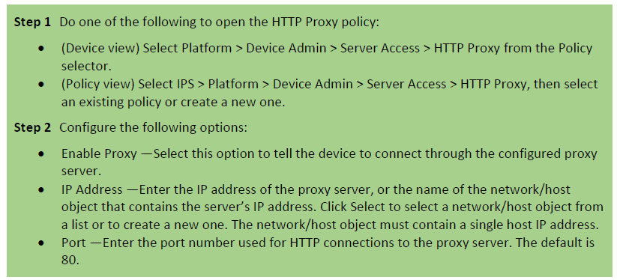
Identifying an HTTP Proxy Server

Slide 45
Configuring the External Product Interface
Use the External Product Interface policy to configure the way that Security Manager works with Management Centre for Cisco Security Agents (CSA MC).
Management Centre for Cisco Security Agents enforces a security policy on network hosts. It has two components:
  Agents that reside on and protect network hosts.
  A management console, which is an application that manages agents. It downloads security policy updates to agents and uploads operational information from agents.

Slide 46
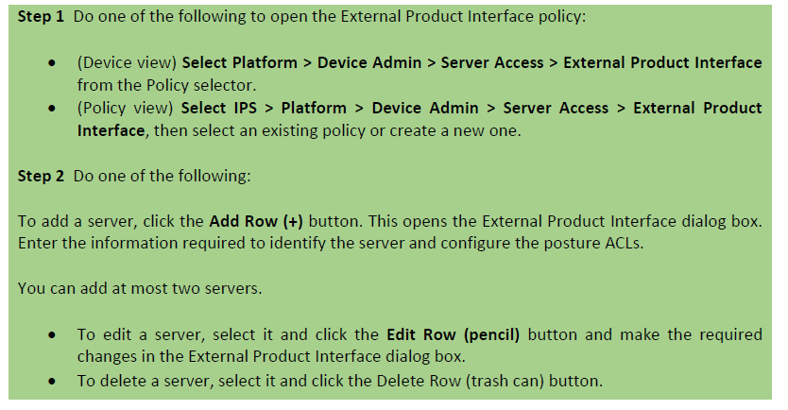
Configuring the External Product Interface

