Slide 1
MODULE 7
Learning and Self Development

Slide 2
The benefits of continual learning and self-development
It helps to stay relevant and up to date of the changing trends and directions in one’s profession.
It helps in becoming more effective in the workplace
Builds a knowledge base that helps identify different types of problems and generate solutions.
This assists in advancing one’s career and move into new positions

Slide 3
The benefits of continual learning and self-development
Can deliver a deeper understanding of what it means to be a professional, along with a greater appreciation of the implications and impacts of your work.
Leads to increased self confidence
Helps to stay interested and interesting by stimulating the mind to stay inspired and excited.
Opens you up to new possibilities, new knowledge and new skill areas.

Slide 4
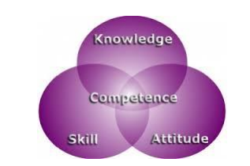
What is Competence?
Competence can be defined as the application of knowledge and skills to perform to the standards required.
In other words, it is the ability of a person to do a job properly.

Slide 5
Types of Competencies
Competencies can be broadly classified into two categories:
Behavioural Competencies- These refer to the soft skills that affect a person’s performance.
For example, customer focus is a very popular behavioural competency expected of an Information Security Analyst.
He is expected to keeps the needs of his customers in mind and ensure their satisfaction.

Slide 6
Types of Competencies
Technical Competencies- These refer to technical skills that help a person complete his job.
For example, project management is a very popular technical competency expected of an Information Security Analyst.

Slide 7
Being responsible for own development
In a challenging business environment change is a fact of life.
These new challenges, and rapid changes, require new skills, knowledge and attitudes, that is why personal development is so important.
Most organisations recognize this and encourage their employees to continuously develop themselves by providing various opportunities for learning as well as time out from work to avail of the same.
However, whether the organisation provides an encouraging atmosphere or not, one’s own personal development, growth, and continuing learning is not the organisation’s responsibility; it is one’s own responsibility.

Slide 8
Being responsible for own development
Each person is best equipped, more than anyone else, to identify
what skills and attributes he or she needs to develop?
where one’s interests lie?
what one wants in the future and one’s vision of a bigger self?

Slide 9
Being responsible for own development
Personal performance depends on you and your motivation to succeed; no one can make it happen for you, but you. You must have:
Self-awareness
Setting objectives
Gaining support
Most importantly, continually reviewing how you are performing.

Slide 10
Knowledge and Skills Required for the Job
Knowledge refers to information, or concepts learned through books, or training, or other sources of learning.
It is the awareness, or understanding of facts and information, which are acquired through education, or learning.
Knowledge of the Organisation
A person needs to know about the organisation he is working with.
This includes knowledge about the company’s policies, procedures, structure, culture, your role and responsibilities, overview of other departments, information needs of other departments, key contact points, etc

Slide 11
Knowledge and Skills Required for the Job
Technical Knowledge
Technical knowledge helps a person understand a field of work.
If the Information Security Analyst does not know what a gateway is, or what a multiplexer is, or what a hub is, or how they function; how can he be expected to install them?

Slide 12
Knowledge and Skills Required for the Job
Skills required to perform the job of an Information Security Analyst effectively
Skills is the ability to use information, or knowledge acquired through education, or experience, to accomplish a given task.
Human Skills- The ability to work with people
Conceptual Skills- The ability to work with ideas, or concepts.

Slide 13
Knowledge and Skills Required for the Job
Core/ Generic Skills- These are generic in nature that are common to most white collar jobs like reading, writing, listening and speaking.
  As an Information Security Analyst, you should be able to communicate well with colleagues, in writing. For example, making plans for the department for upgrading the security systems required writing skills.
  You should also be able to read instructions, guidelines and procedures laid down by your organisation. For example, each organisation has certain guidelines for data security.
  Other than reading and writing, an Information Security Analyst should also have oral skills like listening and speaking.

Slide 14
Knowledge and Skills Required for the Job
Professional Skills- These skills make a person more employable by giving the person the ability to make logical decisions and the ability to solve problems judiciously.
Decision Making- you would need to take decisions, and you should have the skills to be able to take the appropriate decisions.
Planning and Organising-To be able to accomplish any task, one needs to first plan and then organise the sub-tasks.

Slide 15
Knowledge and Skills Required for the Job
Customer Centricity or focus- The term, ‘customer’ refers to not only external but internal customers, i.e., colleagues.
  When designing and installing the security systems, you will have to make sure that they meet the requirements of their colleagues
Problem Solving- You will have to develop problem solving skills to be able to handle them.
Analytical Thinking- He/she will have to analyse data across the organisation and also monitor the activities of all, before coming up with a data security plan

Slide 16
Knowledge and Skills Required for the Job
Critical Thinking-you may have to apply your judgment in a balanced manner in various situations.
  For example, you may suggest a particular data security template, but the senior management may not agree due it being too complex. Thus, you may have to apply your judgement to come up with a plan that keeps the user friendliness in mind while not compromising on the security.
Attention to Detail : One aspect of it is to pay attention to detail.
  For example, data usage policy of an organisation may be different for the senior management as compared to that of the others. you need to ensure that the data is error-free and complete.

Slide 17
Knowledge and Skills Required for the Job
Team Work- No job can be completed without interacting with others, within and outside the organisation.
Technical Skills- The ability to do a specific type of activity or work. Just like technical knowledge, technical skills too are equally important for any Information Security Analyst to perform his job.

Slide 18
Avenues for Self-Development
Formal avenues of self-development in an organisation
Knowledge, skills and attitudes can be developed through a range of methodologies
1) Education or professional qualifications,
2) Training by employers,
3) On-the-job experience,
4) Informal learning from peers, seniors and others.
5) Self-study and practice

Slide 19
Avenues for Self-Development
Many employers invest large amount of resources (time, effort and money) to make employees work ready and for them to grow in their jobs and improve their knowledge, skills and attitudes.
A professional should think of career development not just in the short term but also from a longer term perspective.
Life-long learning is very important for developing a successful and sustainable career.
There are many professionals who got comfortable with their current level of performance and stopped learning and in some time found themselves without a job, or stuck at a particular level without any growth.

Slide 20
Avenues for Self-Development
Some more Avenues for Learning
Develop Your Own Pet Projects:
Learn from Online Courses: Today there is a great diversity of free online courses. Sites such as Coursera, Udacity and edX
Go to Technical Meetings: Programmers like to meet to discuss new technologies and share their experiences
Participate in Online Forums
Read Technical Blogs: follow software development gurus on Twitter,
See Presentation Slides
Watch Videos: : It is easy to find videos on YouTube or Vimeo on most popular subjects.
Use Question-and-Answer Communities: If you have a technical problem, then it’s very probable that someone before you already had the same problem

Slide 21
Different types of learning styles and methods
Three main cognitive learning styles:
- visual
- auditory
- kinesthetic.

Slide 22
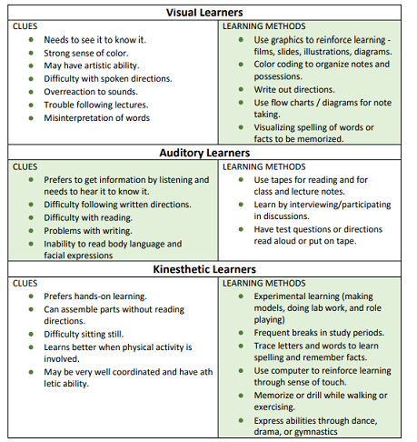

Slide 23
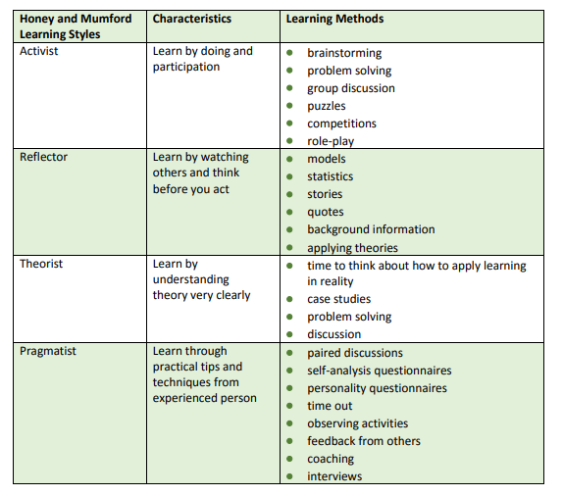

learning styles

Slide 24
Planning for self-development
Steps to be taken to upgrade your current level of knowledge, skills and competence.
Each organisation has a set of guidelines for developing the skill-sets of its employees.
He can follow the following 10 steps to ascertain his current level of knowledge, skills and competence
1) Understand your organisation’s procedures and guidelines for developing your knowledge, skills and competence, and your role and responsibilities in relationship to this.
2) Understand why you need to develop your knowledge, skills and competence and how it will help your organisation

Slide 25
Planning for self-development
3) Apprise yourself of the different methods used by your organisation to review skills and knowledge.
4) Training Need Analysis- This is a process to discover the development needs of employees so that they can perform their job effectively.
The following tools are used frequently for assessing the training needs: Questionnaires Direct observation, Review of relevant, literature, Interviews
5) Skills Need Analysis- This process is similar to the Training Need Analysis with a focus on the development needs of skills like the following: o Planning o Analytical skills o Action orientation o Business knowledge

Slide 26
Planning for self-development
6) Understand the different types of learning and development activities available for your role and the process of availing those.
7) Making a plan
8) Understand how and what future avenues would open up post the training.
9) Implement the plan, apply your new knowledge and skills in the workplace and take feedback.
10) You need to make sure that you make this a process continuous

