Slide 1
AI TA2 PROJECT
Objectives
Optical Character Recognition System
Image
01
Develop an automated OCR system to extract text from scanned documents and images
02
Transform unstructured image data into structured, machine-readable textual information
Preprocess
03
Implement a deep learning CRNN architecture combining CNN and Bidirectional LSTM layers
Recognize
04
Enable efficient, real-world processing of receipt documents and printed text
Output
05
Support downstream tasks including data analysis, digitization, and structured CSV export
01 / 06

Slide 2
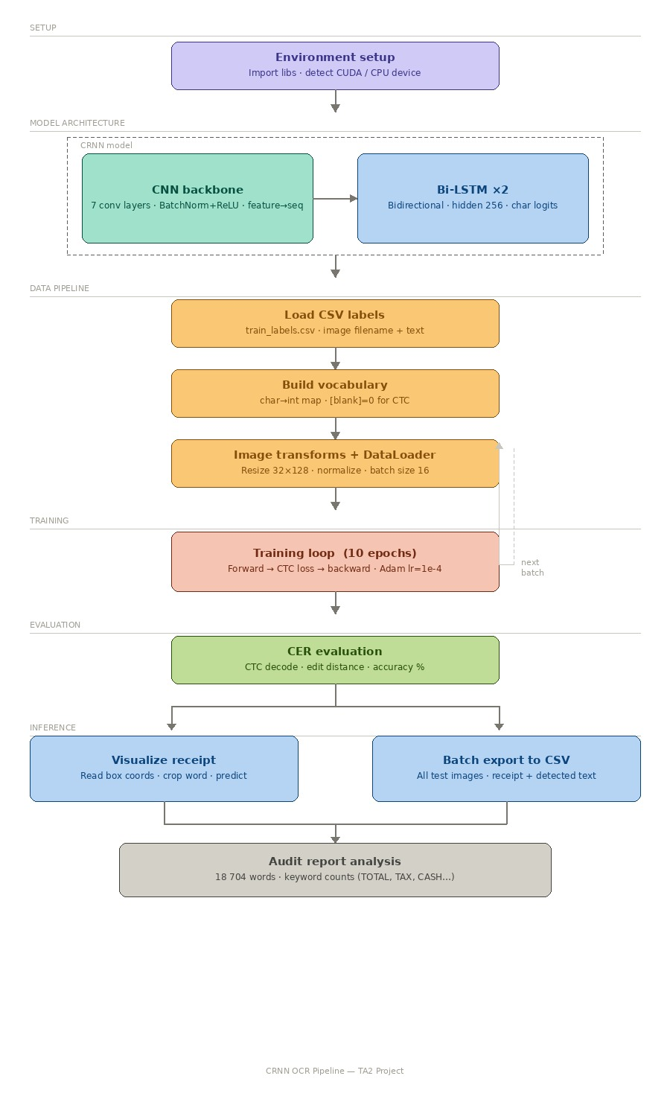
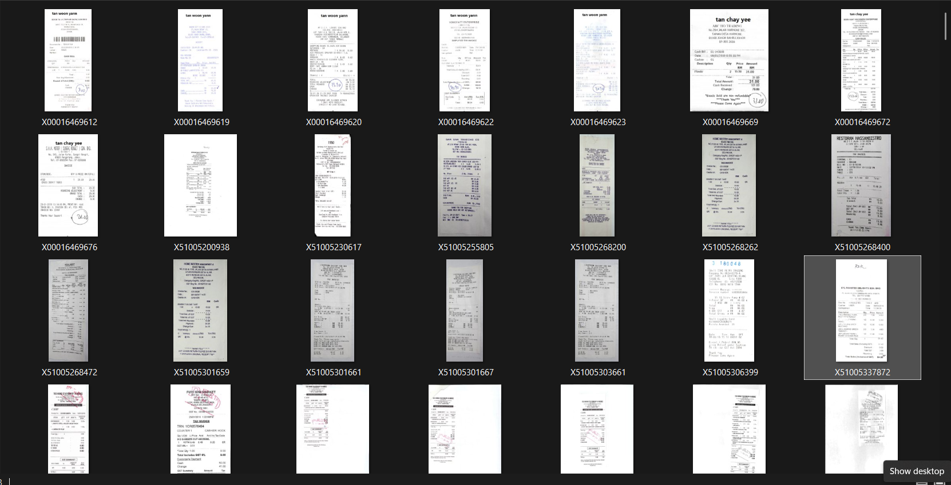
System Methodology
CRNN Pipeline Architecture
02 / 06
Dataset
https://www.kaggle.com/datasets/urbikn/sroie-datasetv2

Slide 3
Dataset & Implementation
SROIE Benchmark · PyTorch Framework
03 / 06
📂 SROIE Dataset
⚙️ Implementation Stack
Scanned Receipts OCR & IE Challenge dataset
Language
Python 3.x
Real-world receipt images with annotated ground truth
Framework
PyTorch
Covers font variation, layout diversity, and noise
Image Processing
OpenCV, PIL
Widely adopted OCR benchmark for document analysis
Numerics
NumPy
Supports text detection, recognition, and IE tasks
Architecture
CRNN (CNN + BiLSTM + CTC)

Slide 4
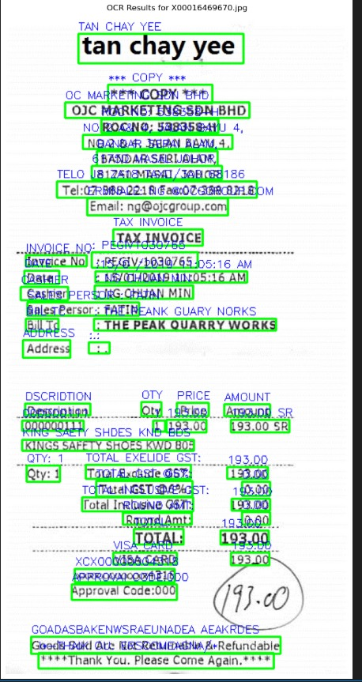
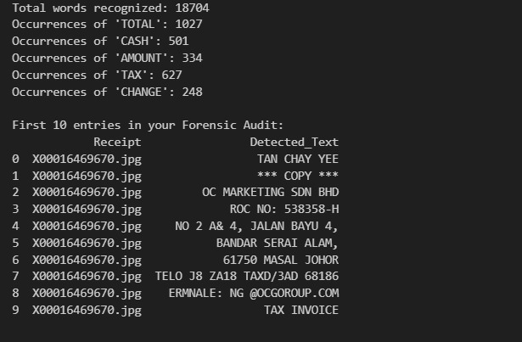
Results & Outputs
https://github.com/ANJITHAABHI/OCR.git
Empirical performance on SROIE benchmark
04 / 06
Result
Structured CSV Export
Extracted text organized into structured CSV rows
Fields: item name, quantity, price, total
Demonstrates practical document digitization
Enables downstream data analytics pipelines

Slide 5
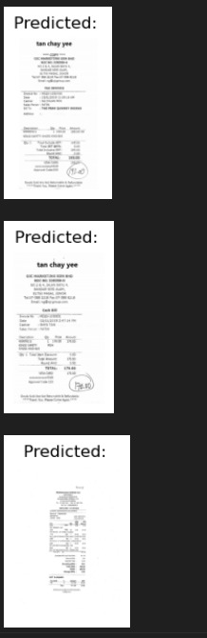
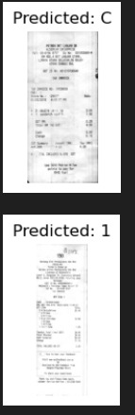
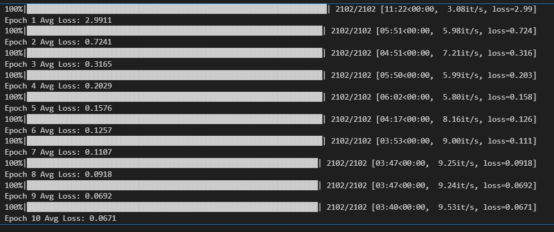
Performance Evaluation - outputs
CER Metric · Identified Constraints · Future Directions
05 / 06
Performance
Metric: Character Error Rate (CER)- 4.03%
Reliable accuracy on structured receipt data – 95.97%
Fig: Epoch
Fig : Output predictions

Slide 6
Team Contributions
Roles & Responsibilities — AI TA2 · April 2026
06 / 06
Adithiyan R S
Miracle Elliot Tettevi
AI engineering and launching
Data collection, selection and management; topic selection
Anjitha B
All Members
PPT, integration and
github management
Integration & Presentation

