Slide 1
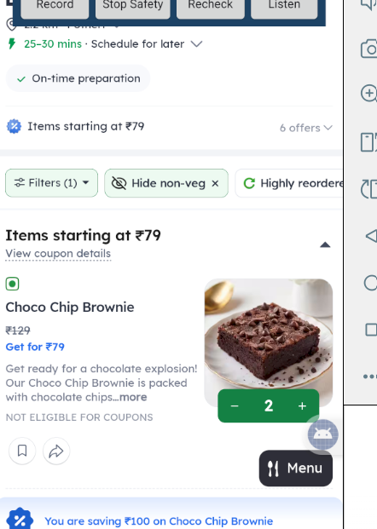
PRISM GENAI HACKATHON · 2026
VOICE
MACRO
STUDIO
Teach once. Speak naturally. Replay safely.
A local, accessibility-first Android prototype for verified voice macros in native apps.
TEAM STRAWHATS
Soumya Ranjan Sahoo · Sandesh Anand
G Vivek · Ankit Kumar Yadav
LIVE VERIFIED · QUANTITY 2
STRAWHATS • VOICE MACRO STUDIO
01
Notes:
Open with the outcome: Voice Macro Studio learns a demonstrated action and replays it only when the current screen is safe and the target is confidently matched.

Slide 2
01 · PROBLEM
Voice control breaks where people need it most
Native apps change, repeated controls look alike, and sensitive screens demand a human handoff.
01
02
03
Fragile automation
Ambiguous targets
Sensitive states
Coordinates drift when layout, offers, or scrolling changes.
A menu can expose many identical ADD buttons to accessibility.
Login, OTP, password and payment screens must stop automation.
DESIGN QUESTION
Can a user teach one action by demonstration, replay it by voice, and still prove that the correct UI state changed?
STRAWHATS • WHY IT MATTERS
02
Notes:
Frame the challenge around trust. The system must identify the intended control, block sensitive states, and verify an observed result rather than assuming a dispatched click succeeded.

Slide 3
02 · PRODUCT
A three-part loop: teach, speak, verify
The user owns the demonstration; the app stores a selector-based flow and replays only inside a bounded safety envelope.
1
2
3
TEACH
SPEAK
VERIFY
Say a unique command, then tap the target once.
Use the saved name or a supported paraphrase and quantity.
Recheck safety, act, then confirm a structural UI change.
User demonstrates intent
English + Hinglish
Fail closed on doubt
Observed outcome
Complete · Blocked · Failed — always stated visibly and aloud
STRAWHATS • PRODUCT LOOP
03
Notes:
The core interaction is teach once, speak later, and verify every action. The overlay and text-to-speech communicate the result without claiming success prematurely.

Slide 4
03 · PIPELINE
Deterministic orchestration around Android Accessibility
Every action passes through matching, a fresh safety gate, target resolution and a postcondition.
01
02
03
04
SpeechRecognizer
Intent + Quantity
Room
Safety Gate
up to 5 alternatives
flow name · 1–5
flows + ordered steps
fresh screen check
continue only when clear
BLOCK
08
07
06
05
Overlay + TTS
Postcondition
Accessibility Action
Selector Resolver
complete / stop / explain
local structure changed?
single verified dispatch
text · context · position
STRAWHATS • ARCHITECTURE
04
Notes:
Walk left to right on the top row, then back across the bottom. Room supplies the saved flow; every dispatch gets a fresh safety check. Success requires a changed structural fingerprint.

Slide 5
04 · BUILD
Android-native, local-first, zero paid API cost
The prototype uses platform speech and accessibility services; matching, quantity parsing and safety policy stay deterministic.
APP
PLATFORM
DATA
TOOLING
Kotlin 2.0.21
AccessibilityService
Room 2.7.2
Gradle 8.13
Android SDK 36
SpeechRecognizer
Private local storage
AGP 8.11.1
Min SDK 26
Text-to-Speech
Schema migrations
JDK 17
Single app module
Foreground overlay
No cloud database
Android Studio
₹0 API budget
No API key · No paid LLM · No target-app SDK · Runtime actions stay on-device
STRAWHATS • TECH STACK
05
Notes:
Emphasize that the runtime does not depend on a paid generative AI service. Android platform services handle speech and TTS; intent matching and quantities are local code.

Slide 6
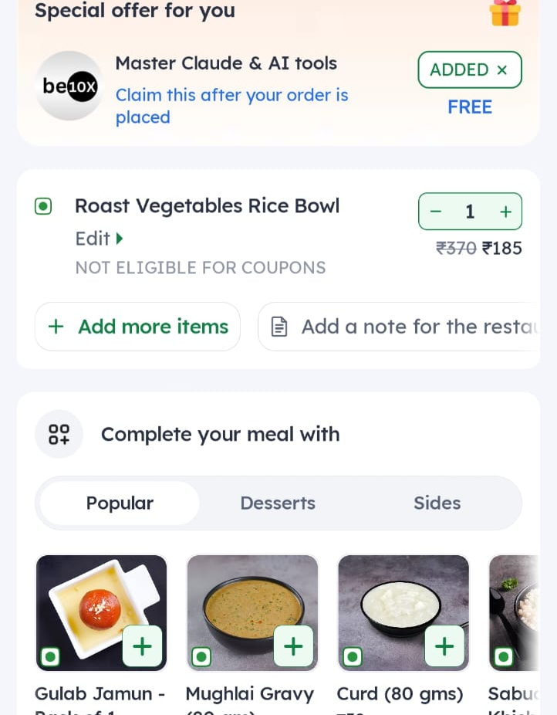
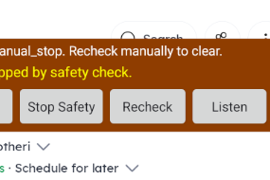
05 · TRUST
Fail closed before credentials, payment or uncertainty
A manual stop latches the system; unreadable trees and sensitive markers block replay.
SAFETY GATES
01
Target app + readable tree
02
No login / password / OTP
03
No payment screen
04
Unique selector match
Manual Stop stays orange and blocks the matched flow until a fresh safe-screen Recheck.
05
Fresh check before every action
06
Structural change after action
PAYMENT → HUMAN
STOP → LATCHED
STRAWHATS • SAFETY BY DESIGN
06
Notes:
The app never enters payment or credential data. On payment it says 'Your turn' and blocks. Manual stop persists until the user returns to a safe screen and taps Recheck.

Slide 7
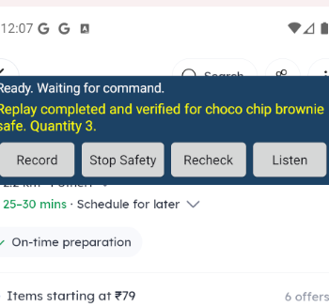
06 · LANGUAGE
English and Hinglish quantities from 1 to 5
A supported number is parsed locally, then replay advances through verified ADD / plus transitions.
“choco chip brownie safe”
ONE
TARGET 1
“do choco chip brownie safe”
TWO
TARGET 2
“add three choco chip brownie safe”
THREE
TARGET 3
“digits or English number words”
FOUR / FIVE
TARGET 4–5
Verified quantity 3
Out-of-range or conflicting quantities are rejected before replay.
STRAWHATS • VOICE EXPERIENCE
07
Notes:
Live tests passed for English quantity three and Hinglish 'do' for quantity two. Supported range is one to five. Requests such as six are rejected.

Slide 8
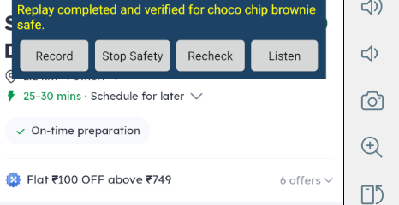
07 · EVIDENCE
Measured outcomes from the tested v0.4.0 build
The claims below are tied to emulator or physical-device checks and the repository test suite.
30
0
1–5
16
JVM TESTS
TEST FAILURES
QUANTITY RANGE
ANDROID VERSION
LIVE SCENARIOS
✓
Correct item · exact command · wrapper paraphrase
✓
Unknown command rejected · manual Stop latched
✓
Payment screen blocked · unreadable Swiggy tree blocked
✓
Quantity 3 English · quantity 2 Hinglish
✓
Success means the UI changed
Existing cart and quantity 6 refused without action
A dispatched click alone never counts.
STRAWHATS • VALIDATION
08
Notes:
Keep the evidence bounded. Thirty JVM tests passed. Live tests cover the listed cases on Android 16 with Zomato. This is not a general reliability claim.

Slide 9
08 · DEMO
A four-minute story judges can follow
Begin from a safe Zomato menu and an empty item state. End before payment.
0:00
SETUP
Show accessibility connected + blue Ready banner
DO
Use one item
Keep the screen stable
Wait for yellow result
Narrate the safety stop
0:30
TEACH
Record one ADD tap as “choco chip brownie safe”
1:30
REPLAY
Say the exact command; show verified quantity 1
2:15
Remove item; say “do…”; show verified quantity 2
DON’T
HINGLISH
Confirm an order
Show credentials
Claim Swiggy replay
3:00
SAFETY
Unknown command, manual Stop, or payment handoff
STRAWHATS • LIVE DEMO
09
Notes:
This sequence fits the submission limit. Pause after each command for the persistent yellow status. Do not proceed beyond the cart/payment handoff.

Slide 10
09 · HONEST SCOPE
A strong prototype with explicit boundaries
The current build proves a safe one-item replay pattern; the next steps broaden compatibility and generalization.
WORKS NOW
NEXT
✓
Teach a one-tap Zomato item
01
Parameterize item identity, not only quantity
✓
Exact + wrapper paraphrase matching
02
Teach address selection with user confirmation
✓
English / Hinglish quantity 1–5
03
Expand safe selectors across more layouts
✓
Fresh safety check per action
04
Add a second app once its tree is readable
✓
Verified structural postcondition
05
Run the full multi-utterance reliability matrix
✓
Local Room persistence + deletion
06
Polish onboarding and production signing
STRAWHATS • SCOPE + ROADMAP
10
Notes:
State the boundary clearly: Zomato is validated. Swiggy exposed an empty accessibility tree on the tested device, so the app blocks safely instead of bypassing the platform.

Slide 11
10 · DELIVERY
Everything a reviewer needs lives in one repository
Source, evaluation APK, docs, video, disclosure and this presentation are linked from the README.
✓
SOURCE CODE
✓
PRESENTATION
Android/Kotlin project
This deck in /docs
✓
DEMO VIDEO
✓
AI DISCLOSURE
YouTube link in README
Explicit tools + runtime note
✓
README
✓
APK
Setup · architecture · limits
v0.4.0 debug evaluation build
✓
TAG
✓
CHECKSUM
PRISM_GENAI_HACKATHON_Y2026
SHA-256 in /dist
AI disclosure: runtime uses no generative-AI API; Copilot and Codex assisted development, testing and documentation under human review.
STRAWHATS • SUBMISSION READY
11
Notes:
The GitHub tag already exists. The README now links the deck and dedicated AI disclosure. The APK checksum lets judges verify the evaluation artifact.

Slide 12
A safer way for native
apps to listen.
EXPLORE THE PROJECT
VOICE MACRO STUDIO
GitHub repository
github.com/ANKIEMUNKIE/voice_macro_Studio
1
Soumya Ranjan Sahoo
2
Sandesh Anand
Demo video
youtu.be/HedNCph6ZhA
3
G Vivek
4
Ankit Kumar Yadav
THANK YOU
Questions?
Repository and demo URLs are clickable in the README.
Verified on Android 16 · Zomato · v0.4.0-quantity · local-first · zero paid API budget
STRAWHATS • TEAM STRAWHATS
12
Notes:
Close by inviting questions about the safety pipeline, selector confidence, quantity handling, or the live demo evidence.

