Slide 1

A new way to explore New York

Slide 2

Objective and questions
Our one and only objective is to :
Optimize daily bike trips by deciding the initial allocation of bikes at each station.
Questions :
Is there any trend that demand follows ?
What is the optimal quantity of the bike that we should allocate at the selected stations ?

Slide 3
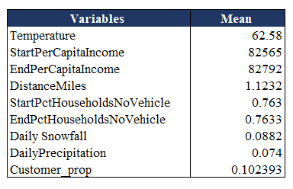

Descriptive Statistics Overview
Univariate :
The mean value of the various variables in the dataset is summarized in the table below.

Slide 4
Descriptive Statistics Overview
Bivariate :
The correlation between the demand and a number of variables, such as temperature, distance miles, start and end per capital income, and trip duration is outlined below.
The variables provided and demand are found to be positively correlated

Slide 5
Trends that demand follow
Demand is high on Thursdays especially during evening hours
Demand and income have positive relationship
Demand is high during summertime (May to October)

Slide 6
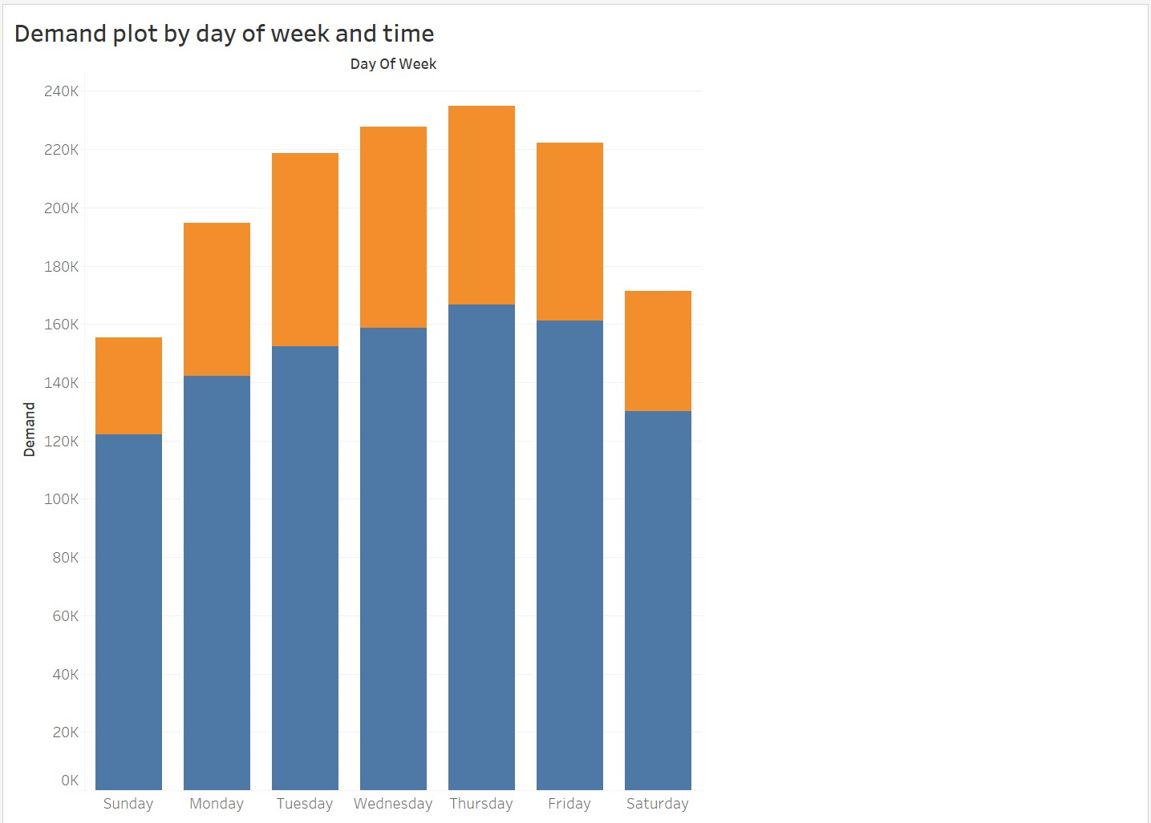
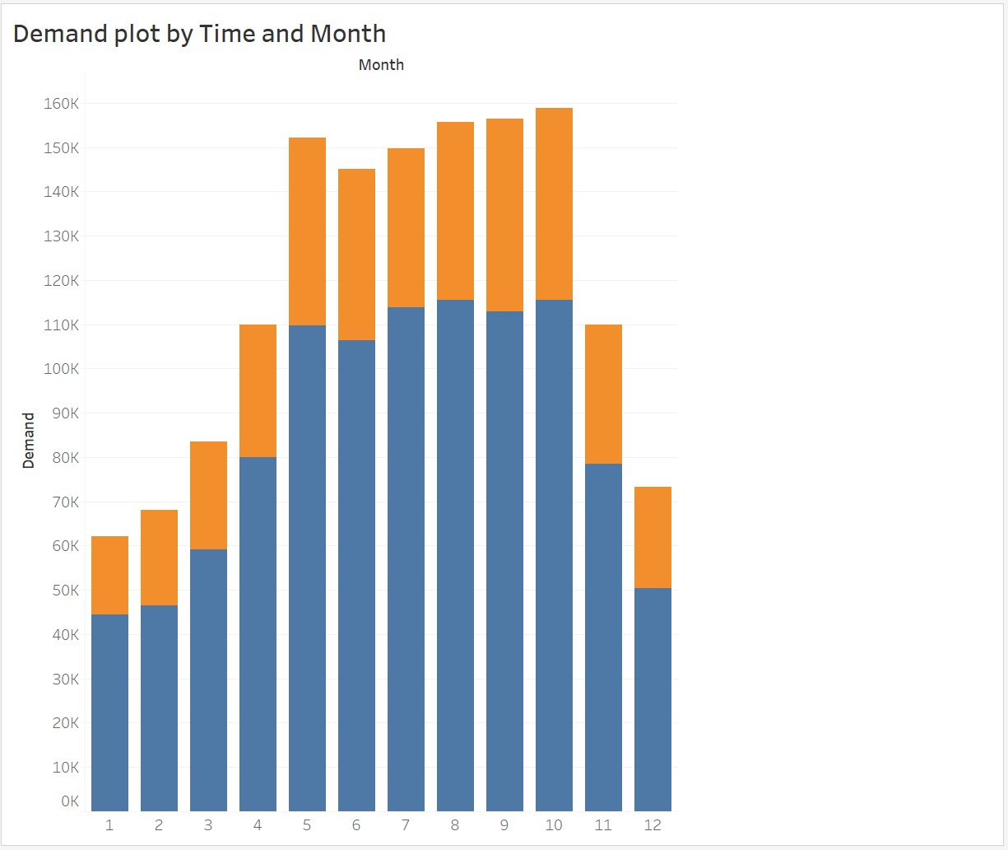

Demand Trends

Slide 7
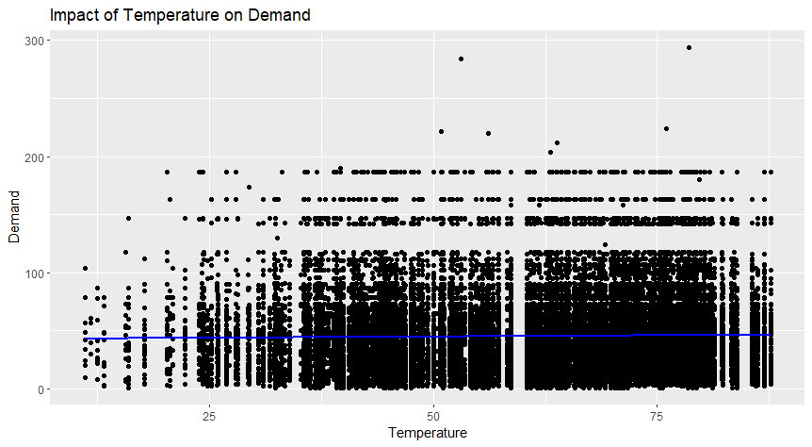
Does Temperature have any impact on Demand ?
This graph indicates that temperature does not have any major impact on demand of citi bikes.

Slide 8
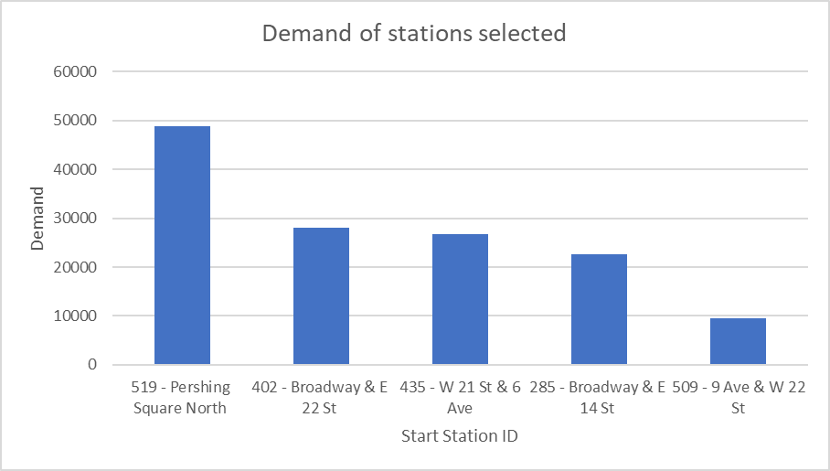
Stations for which we are predicting demand for are ….

Slide 9
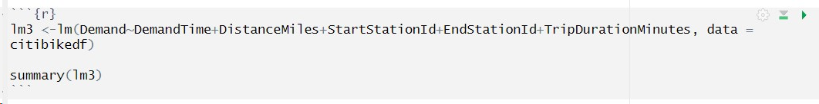

Using the power of ML
This is our optimal model, where all the predictors are significant, and this model explains 89.54% of variance in our data

Slide 10
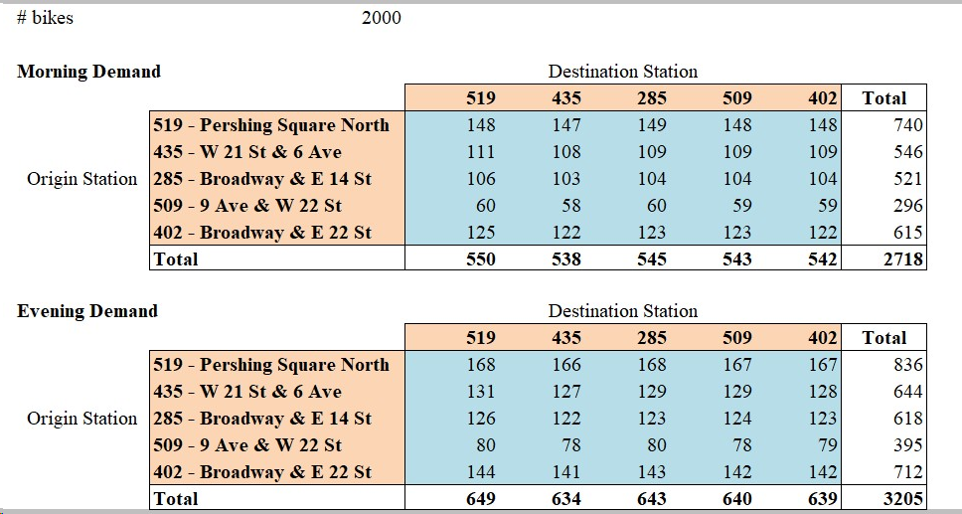
Demand Predictions for Thursday,12th July 2018.
Notes:
Explain why these 5 station are selected

Slide 11
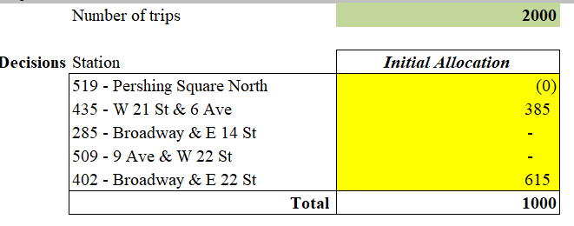
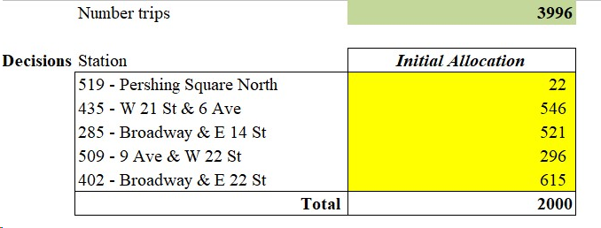
Optimizing Initial Bike Allocation

Slide 12

So, at the start of the day allocate…..
519 - Pershing Square North
22 Bikes
435 - W 21 St & 6 Ave
546 Bikes
285 - Broadway & E 14 St
521 Bikes
509 - 9 Ave & W 22 St
296 Bikes
402 - Broadway & E 22 St
615 Bikes

Slide 13
What did we meant to say ?
Allocate 2000 bikes at the start of the day.
Specially during Thursday’s and Summer season.
It will meet all the demands
And will also increase the profits

Slide 14
Questions are always welcome in our journey

