Slide 1
Travel Explorer – Weather & Destination Guide
CAPSTONE PROJECT
Presented By:
1. Ankit Singh-Graphic Era Hill university-CSE

Slide 2
OUTLINE
Problem Statement (Should not include solution)
System Development Approach (Technology Used)
Algorithm & Deployment (Step by Step Procedure)
Result
Conclusion
Future Scope(Optional)
References

Slide 3
Problem Statement
Many travelers struggle to quickly find reliable information about destinations.
Existing travel websites often require multiple steps to check weather and view photos.
There is a need for a lightweight, interactive, and visually appealing platform..

Slide 4
System Approach
Frontend Technologies:
HTML5 – Structure of the webpage
CSS3 – Styling and responsive layouts
JavaScript – Handles dynamic interactivity such as fetching weather data, displaying photos, and updating the UI.
Design Approach:
Clean and user-friendly interface
Mobile-responsive design
Modular separation of HTML, CSS, and JS files

Slide 5
Algorithm & Deployment
Product Catalog Creation
Define destination details (name, country, description).
Frontend Design
Layout using HTML5 and CSS3 (grid & cards).
Clean, animated, and responsive interface.
Interactive Features
Real-time weather display..
Search bar to find destinations.
Destination photo gallery.
Error handling for invalid inputs.
Testing
Cross-browser compatibility
Mobile responsiveness
Deployment
Host using GitHub Pages / Netlify for free and easy access.

Slide 6

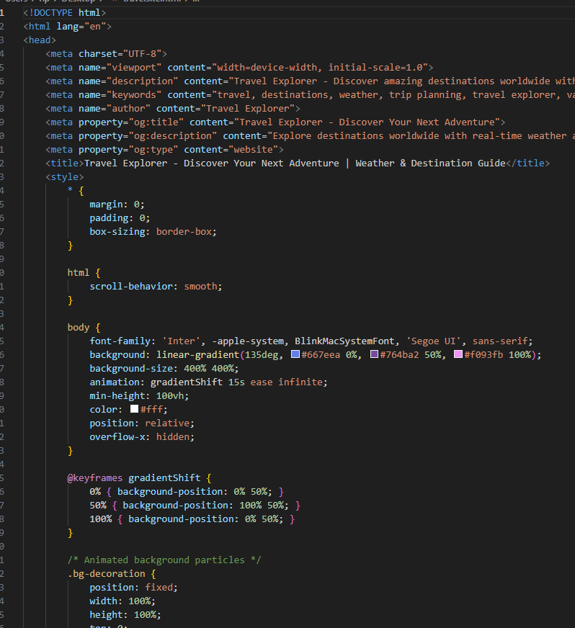
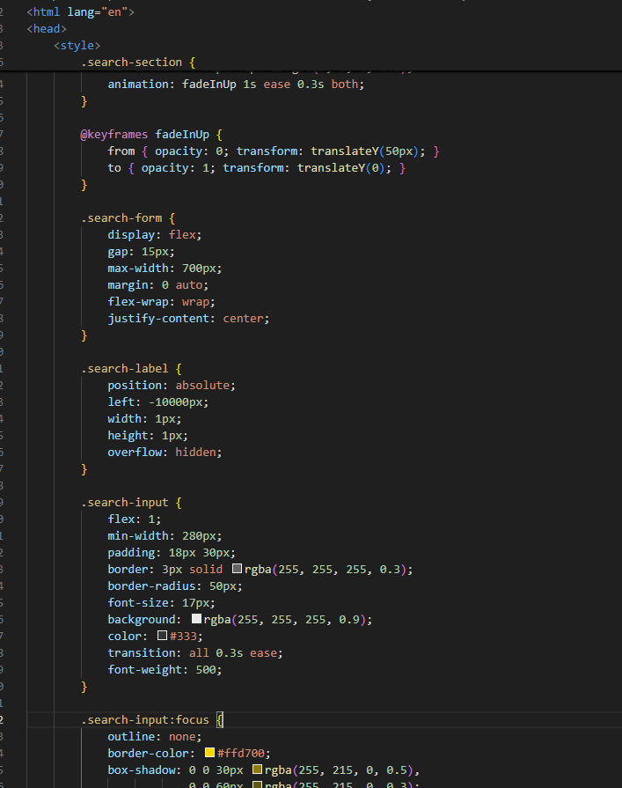
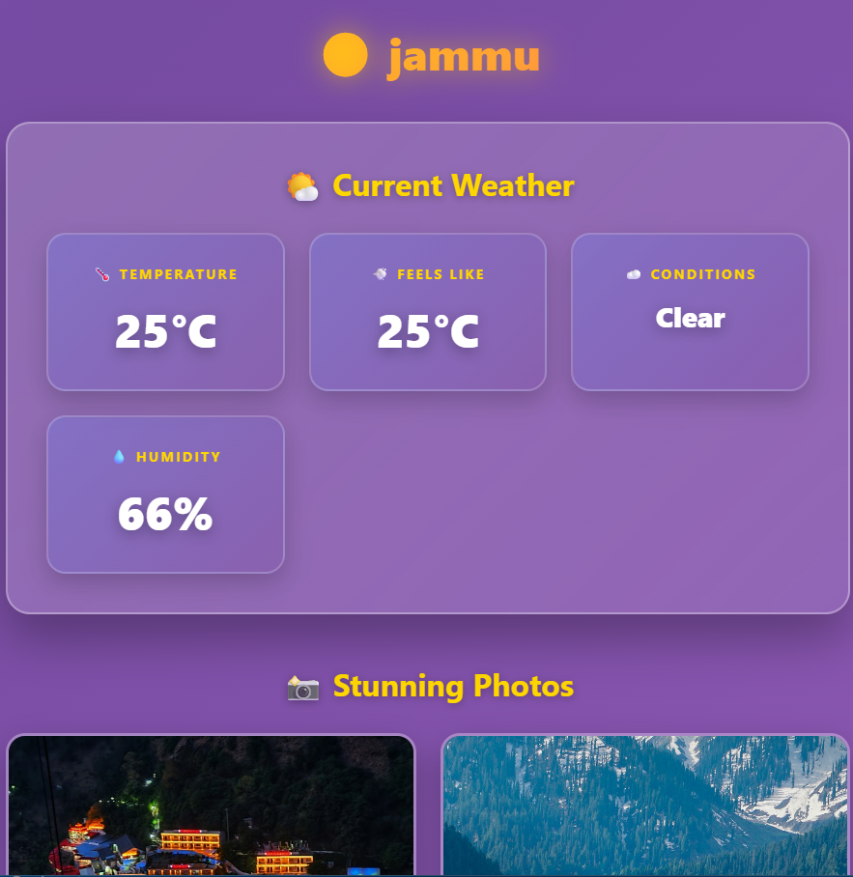
Result

Slide 7
GITHUB AND DEPLOYMNET LINK
Attach your Git hub Link :
https://github.com/ANKIT07SINGH/Travel-Explorer-Interactive-Destination-Weather-Guide.git
Deployment link: https://ankit07singh.github.io/Travel-Explorer-Interactive-Destination-Weather-Guide/

Slide 8
Conclusion
Provides a simple and interactive way to explore destination.
Combines real-time weather updates with visual photo galleries.
Offers an engaging and interactive customer experience.

Slide 9
Future scope(Optional)
Add user accounts to save favorite destination.
Provide offline access with cached data for recent searches.
Admin dashboard for inventory updates.
AI-based product recommendations.

Slide 10
References
List and cite relevant sources, research papers, and articles that were instrumental in developing the proposed solution.
OpenWeatherMap API Documentation – https://openweathermap.org/api
W3Schools – HTML, CSS, JavaScript Tutorials – https://www.w3schools.com

Slide 11
THANK YOU

