Slide 1
KEYLOGGER
Operating System : Windows 7 / Windows 10
IDE : Python

Slide 2
Introduction
Key loggers also known as keystroke loggers, may be defined as the recording of the key pressed on a system and saved it to a file, and the that file is accessed by the person using this malware.
Key logger can be software or can be hardware. Working: Mainly key-loggers are used to steal password or confidential details such as bank information etc.
First key-logger was invented in 1970’s and was a hardware key logger and first software key-logger was developed in 1983.

Slide 3
Purpose
Keylogger attempt to retrieve confidential information by capturing user input via keystroke monitoring and leaking this information for malicious purposes.
Keyloggers are a particularly insidious type of spyware that can record and steal consecutive keystrokes (and much more) that the user enters on a device.
The term keylogger, or "keystroke logger," is self-explanatory: Software that logs what you type on your keyboard. However, keyloggers can also enable cybercriminals to eavesdrop on you, watch you on your system camera, or listen over your smartphone's microphone. Keywords: Keyboard, Keystrokes, Monitoring, Key typed, Capturing.

Slide 4
Scope
Keyloggers are not always illegal to install and use:
▪ Corporations use them for troubleshooting or monitoring employees.
▪ Parents may monitor their children’s activities.
The concern arises when malicious actors use keyloggers without owning the device they infect.
Unauthorized keyloggers can steal passwords, take screenshots, record web pages, and collect sensitive financial information, sending it to remote servers for criminal purposes.
Install reputable antivirus software that detects and removes keyloggers.
Be cautious when downloading software or clicking on suspicious links

Slide 5
Definitions, Acronyms and Abbreviation
1. Keylogger Definition:
A keylogger is a software or hardware component that records everything typed on your computer’s keyboard.
2. Brief History of Keyloggers:
Keyloggers have been used for spying since the early days of computers.
In the 1970s and early 1980s, keyloggers served various purposes, including secret government operations.
3. Ethical Perspectives:
The morality, legality, and consequences of using a keylogger depend on factors like consent, intent, and local regulations.
Keyloggers can be categorized as legitimate, illegitimate, or existing in a ‘grey area’.

Slide 6
References
1.Ethical Hacking - KeyLoggers (GeeksforGeeks): This article provides insights into keyloggers, their types (software and hardware), and their uses. It also discusses protection techniques and features to look for in keylogger software. The post covers both legitimate and illegitimate use cases.
2. GitHub Repositories on Keyloggers: GitHub hosts numerous public repositories related to keyloggers. Developers and researchers share code, tools, and resources related to keylogging. You can explore these repositories to learn more.
3. Avast Definition of Keyloggers: Avast explains that a keylogger is a type of malicious software that records every keystroke made on a computer. It’s one of the most invasive forms of malware, capturing everything you type. The article emphasizes the importance of protecting against keyloggers.
4. Norton Insights on Keyloggers: Norton discusses how keyloggers are commonly spread online via phishing scams, Trojan viruses, and fake websites. The goal is often to obtain victims’ passwords, personal information, and banking details. The article distinguishes between software and hardware keyloggers.
5. Fortinet Explanation of Keyloggers: Fortinet defines keyloggers as malware or hardware that tracks and records keystrokes as users type. The captured information is then sent to a hacker via a command-and-control server. The article provides insights into their functioning.

Slide 7
Overview
Malicious keyloggers can Steal passwords.
Periodically take screenshots
Record web pages visited.
Capture sent emails and instant messaging sessions.
Collect sensitive financial information (credit card numbers, PIN codes, bank accounts).
Send all this data over the network to a remote computer or web server

Slide 8
Overall Description
product perspective Keyloggers, also known as keystroke loggers, are tools designed to record every keystroke made on a device.
While some legitimate and legal uses exist for keyloggers, they are often associated with malicious activities. Here’s what you need to know:
1. Functionality: A keylogger silently captures and logs every keystroke entered by a user.
It records information typed on keyboards, including sensitive data like passwords, credit card numbers, and messages.
Keyloggers operate in the background, often without the user’s knowledge.
2. Malicious Uses: Cybercriminals deploy keyloggers to steal sensitive information.
An infamous example is the DarkHotel attack, where hackers exploit unsecured hotel Wi-Fi networks. They prompt users to download software that acts as a keylogger, recording keystrokes and sending them to the attackers.
DarkHotel then self-deletes after a certain number of recorded keystrokes to avoid detection.

Slide 9
3. Legitimate Uses: Not all keyloggers are malicious. Some legal scenarios include:
▪ Parental Monitoring: Parents may use keyloggers to track their child’s screen time and online activity.
▪ Employee Monitoring: Companies use keyloggers as part of employee monitoring software to enhance productivity.
▪ IT Troubleshooting: IT departments employ keyloggers to troubleshoot issues on devices.
4. Information Captured: o Keyloggers capture a wide range of data:
▪ Credit Card Information: If you enter credit card details, a keylogger can record them.
▪ Websites Visited: It tracks the URLs you visit.
▪ Passwords: Any password you type is vulnerable

Slide 10
2.2. product functions
1. Keystroke Logging: The primary function of a keylogger is to record every keystroke made by a user on a device. It captures information entered via the keyboard, including:
▪ Passwords: Keyloggers can track login credentials, PINs, and other sensitive data.
▪ Messages: They record messages typed in chat applications, emails, and other communication platforms.
▪ Commands: Keyloggers capture commands executed in the command prompt or terminal.
2. Data Collection: Keyloggers collect a wide range of data beyond keystrokes:
▪ Websites Visited: They track URLs visited by the user.
▪ Applications Launched: Keyloggers record which programs are opened.
▪ File Operations: Changes to files (creation, modification, deletion) are logged

Slide 11
. 3. Stealth Mode: Keyloggers operate silently in the background, often without the user’s awareness.
They avoid detection by:
Hiding Processes: Keyloggers don’t appear in the task manager or process list.
Low Resource Usage: They minimize CPU and memory usage.

Slide 12
Specific Requirements
Functionality
Keystroke Logging:
A keylogger captures and records every keystroke made by the user.
It tracks information typed on keyboards, including:
▪ Passwords: Keyloggers can record login credentials, PINs, and other sensitive data.
▪ Messages: They log messages typed in chat applications, emails, and other communication platforms.
▪ Commands: Keyloggers capture commands executed in the command prompt or terminal.

Slide 13
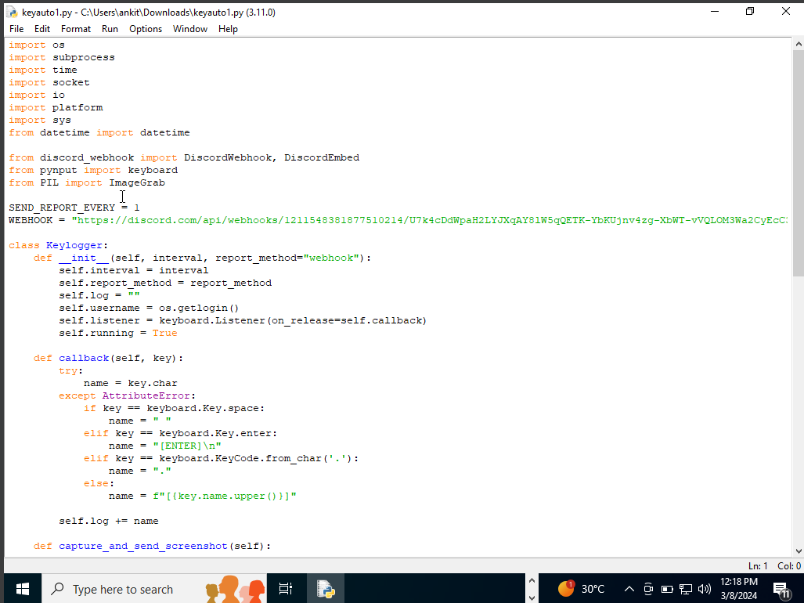
INPUT

Slide 14
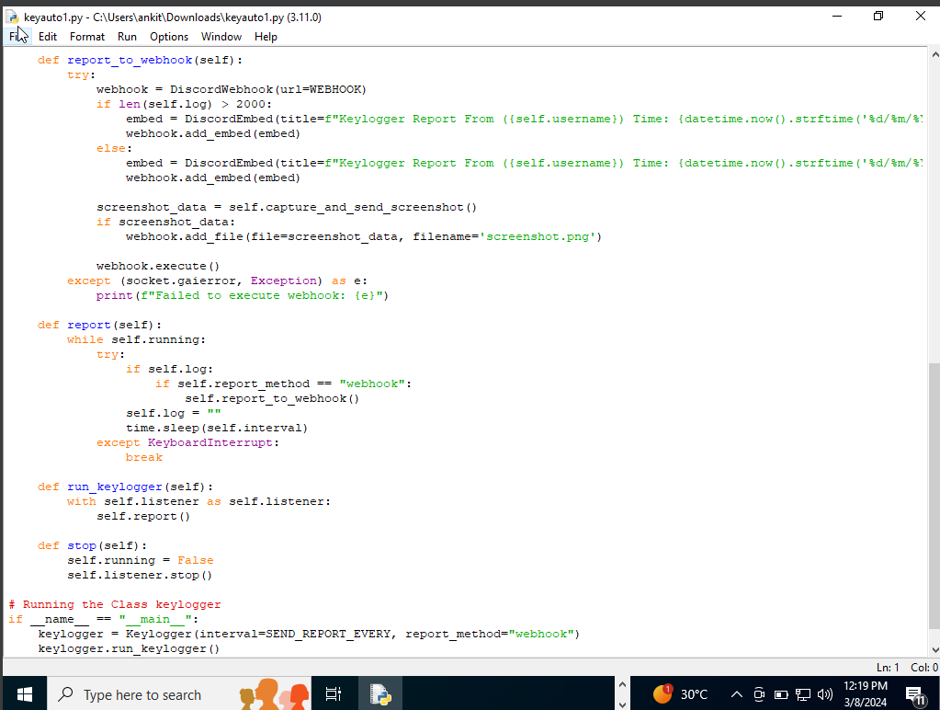

Slide 15
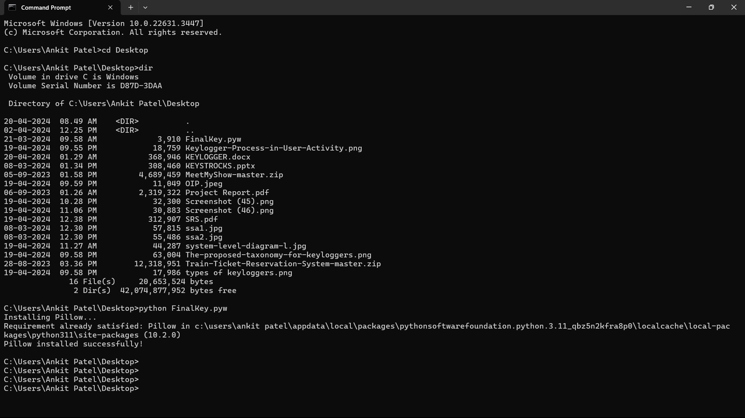

Slide 16


output

Slide 17
2. Data Collection: Keyloggers collect a wide range of data beyond keystrokes:
▪ Websites Visited: They track URLs visited by the user.
▪ Applications Launched: Keyloggers record which programs are opened.
▪ File Operations: Changes to files (creation, modification, deletion) are logged. 3. Stealth Mode:
Keyloggers operate silently in the background, often without the user’s awareness. o They avoid detection by:
▪ Hiding Processes: Keyloggers don’t appear in the task manager or process list. ▪ Low Resource Usage: They minimize CPU and memory usage

