Slide 1
LOST&FOUND
SERVICE TO HUMANITY
Created by ,
ANKITA PANSARE

Slide 2
PROPOSED SYSYTEM
To make use of digitalization for finding people, in more efficient way. Using this web application we can have maximum number of contact to find the people who are lost. This application can save our time, as to go to each any every place and One of the aim of the proposed system is to develop digital awareness into society.
It has feature as Security of data, Ensure data accuracy, Update over the time, , cost efficient etc.

Slide 3
REQUIREMENT SPECIFICATION
SOFTWARE REQUIREMENTS
Front End : HTML, CSS, JS Query
Back end : C#,MVC, MySQLi
SoftwareIDE/ Platform : VisualStudio1015
Operating System : Windows 10
HARDWARE REQUIREMENTS
CPU: UMAX(umax-astrapix-pc-102)
Processor Speed: 2.66GHz
Total RAM: 4GB
Hard Disk: 160GB
Mouse: Logitech Mouse

Slide 4
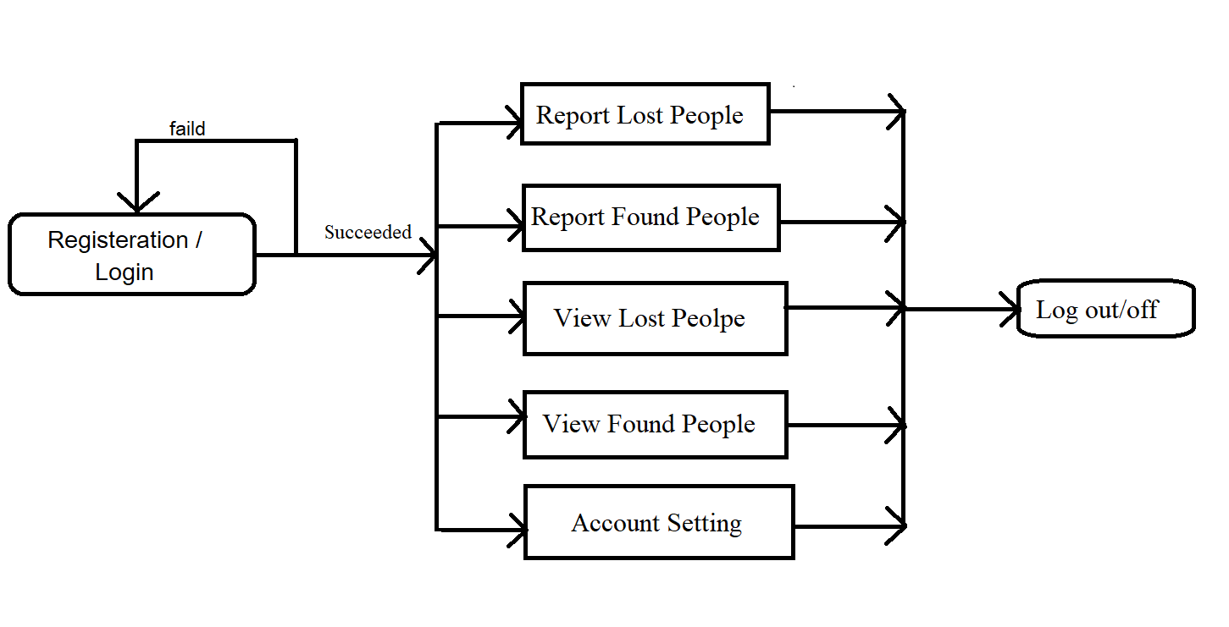
DATA FLOW DIAGRAMS (DFD):

Slide 5
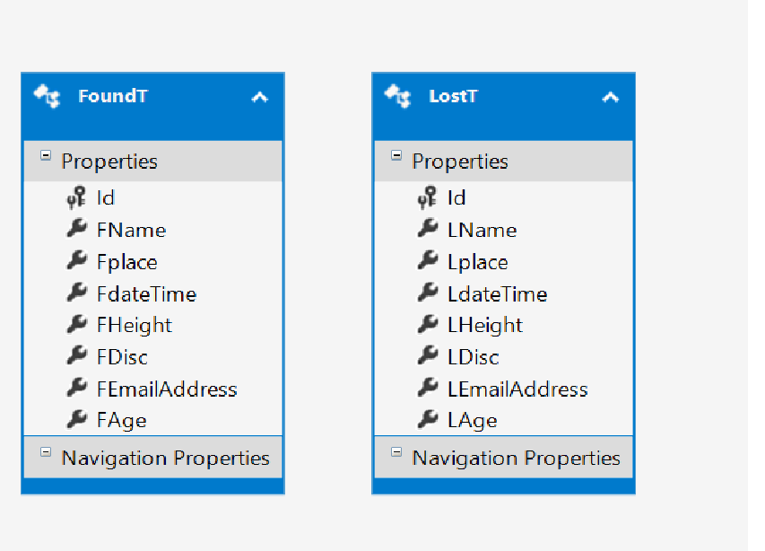
Class diagram

Slide 6
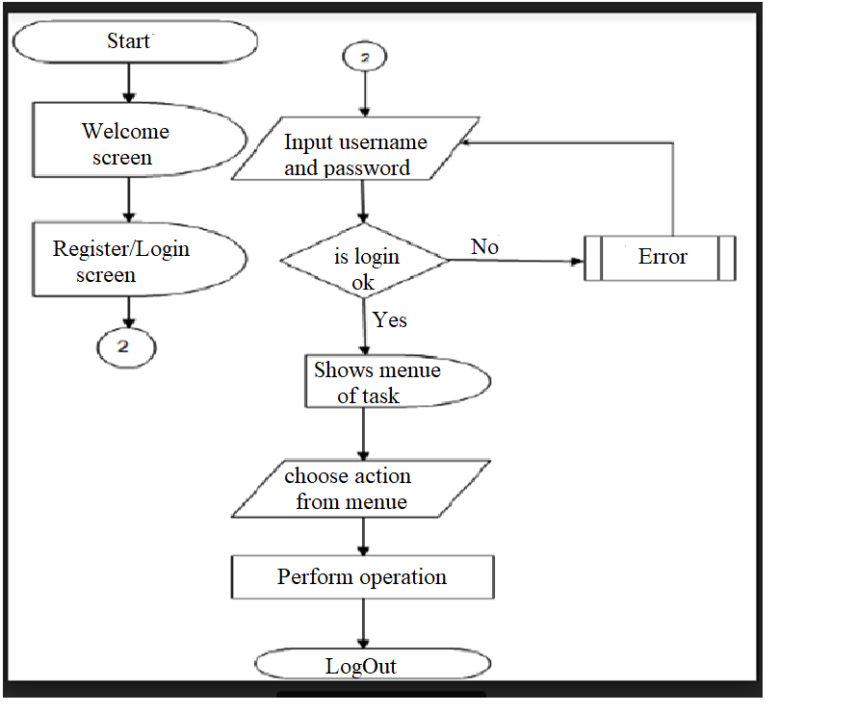
System Flow Diagram

Slide 7
ADVANTAGES
Cost Effective
More Effective
Reach a Bigger Audience
Dynamic Content
Longevity
Expedited Hiring Process

