Slide 1
SOCIAL NETWORK ANALYSIS
School of Business and Management
CHRIST (Deemed to be University)
END TRIMESTER
ANKIT AJAY
2127806
Excellence and service

Slide 2
WHY SOCIAL NETWORK ?
School of Business and Management
CHRIST (Deemed to be University)
Social network analysis is the process of investigating social structures through the use of networks and graph theory. The purpose of this project is to analyze office social structure.
A Manager Mr. Basu exploring workspace via relationship network in order to find a Project head for a testing team based on three parameters as follows:
Who do you get on with in the office?
Who are your best colleague in the office?
Who would you prefer to team up with?
However, the utility of the method largely rests on being able to ascribe meaning to the structure of the network. Without meaningful interpretation of structure there is no added value to a networked model, you will find more success simply regressing your outcome against student characteristics. Understanding measures of centrality and network structure in SNA are therefore an important, though difficult, aspect of the method. As with all SNA work, the vocabulary can be daunting though the ideas are relatively intuitive.
Excellence and service

Slide 3
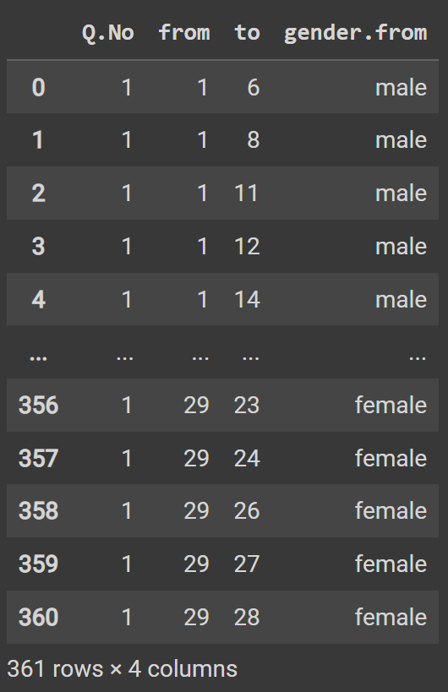
.
DATASET AND COLLECTION
List the parameters used to create social network EDGES(OR LINKS):The link between the source and the targets. VERTICES: there is 29 nodes which represents the employees. SOURCE: Employee TARGET: Employee Data Wrangling Manipulate datasets (best.colleague.csv, get.on.with.csv, prefer.with.csv) to make them suitable for social analysis. Task Q1-Who do you get on with in the office? Q2-Who are your best colleague in the office? Q3-Who would you prefer to team up with? Data has been Collected by Google Forms circulated in workspace.
School of Business and Management
CHRIST (Deemed to be University)
Excellence and service

Slide 4
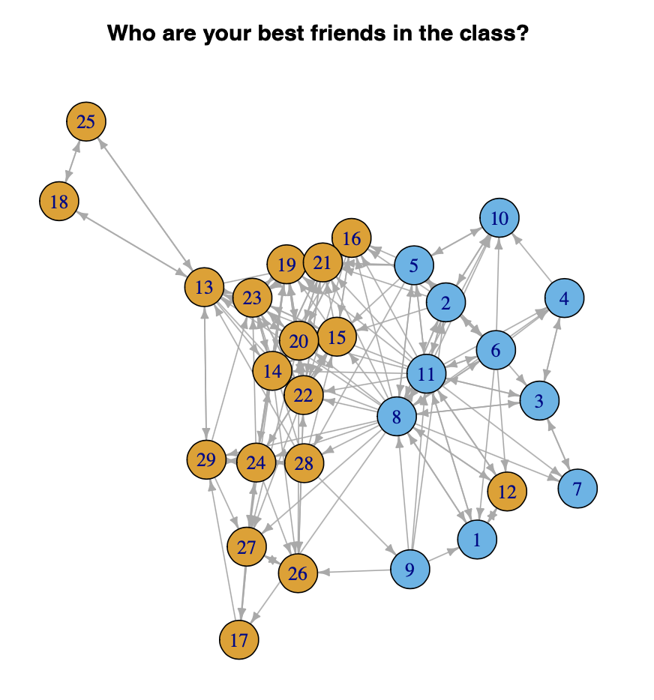
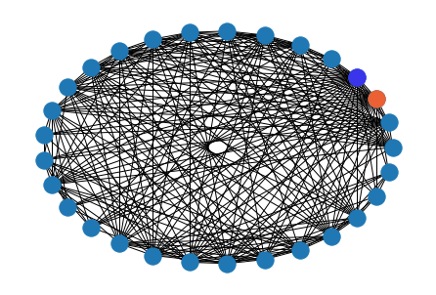
.
IMPLICATION AND GRAPHS
School of Business and Management
CHRIST (Deemed to be University)
.FEMALE .MALE
Visualize the Networks
Who do you get on with in the office?
According to the gender, visualize networking in the class based on three questions asked. We can see some colleagues have strong connection while some have weak. For example, colleague with Emp-ID number 18 and 25 are at the outer edge of the network.
CIRUCLAR LAYOUT:
Excellence and service

Slide 5
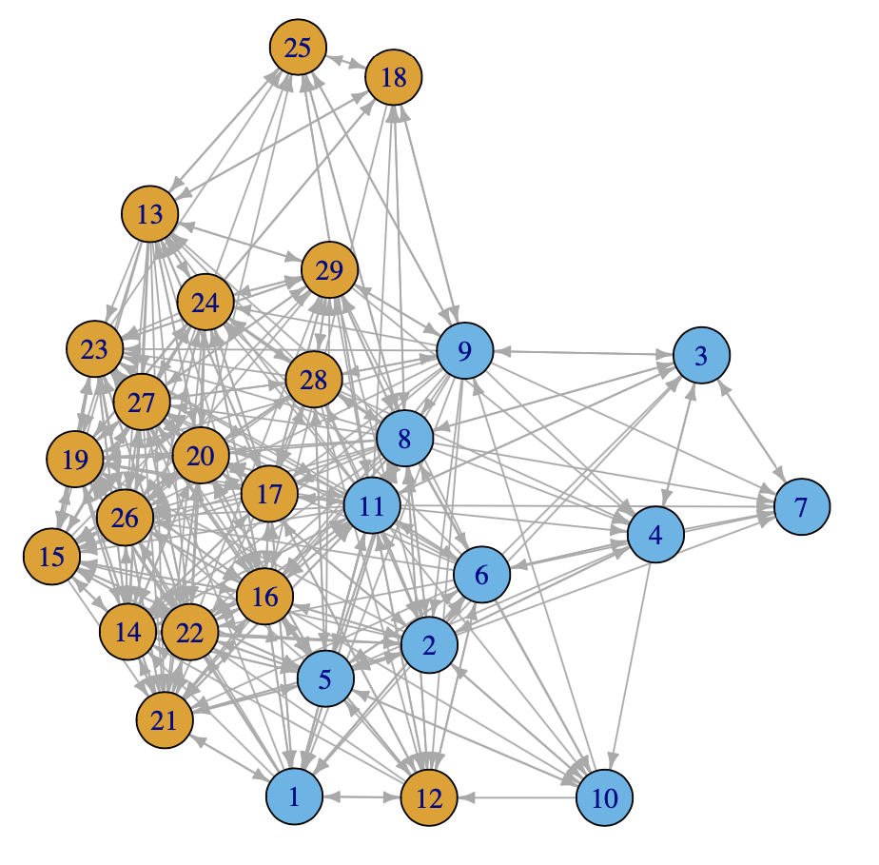
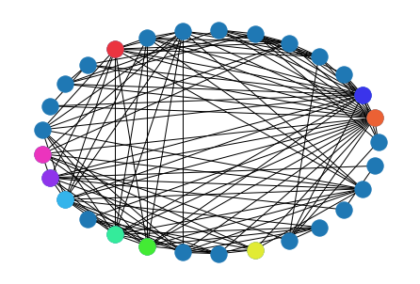
.
IMPLICATION AND GRAPHS
School of Business and Management
CHRIST (Deemed to be University)
.FEMALE .MALE
Visualize the Networks
Who are your best colleague in the office?
There is also a gender distinction.
Female colleague tend to have larger clique than male colleagues. Nonetheless, different gender groups still communicate with each other in the workspace. Employee no. 8, 11, 14, 16, 20, 21, 22, 23 have quite high centrality in all the networks, which implies that these colleagues serve as important connection to other colleagues. In terms of reciprocity, there are more mutual and asymmetric dyads in "Get on with" network than the other two.
CIRUCLAR LAYOUT:
Excellence and service

Slide 6
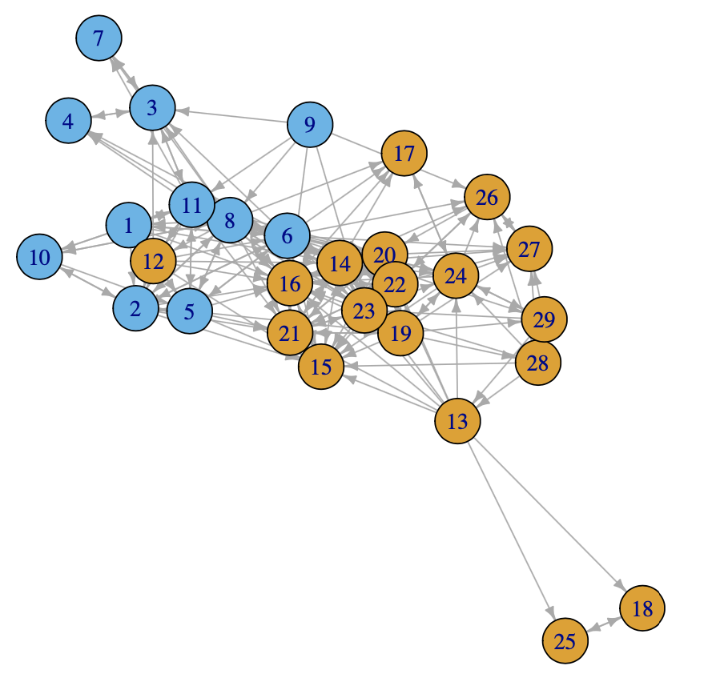
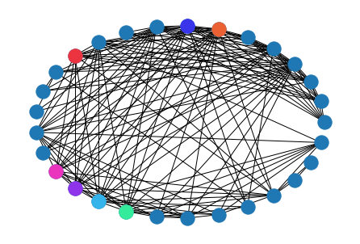
.
IMPLICATION AND GRAPHS
School of Business and Management
CHRIST (Deemed to be University)
.FEMALE .MALE
Visualize the Networks
Who would you prefer to team up with?
centrality and structural metrics on colleagues' ideas of getting along with others, being best friends with others and intention to work with others, it seems that the workspace has a harmonious atmosphere that no one has been isolated so far. However, as the visualization and analysis showed, it appears two distinguishable groups bridged by employee no 13, indicating two possible trends in terms of choosing best friends, and selecting the preferable team player(s).
CIRUCLAR LAYOUT:
Excellence and service

Slide 7
.
IMPLICATION AND GRAPHS
School of Business and Management
CHRIST (Deemed to be University)
.FEMALE .MALE
Centrality Measures
The highest degree of Centrality is = Node[ 8 ] 0.8214285714285714
The edge density is: 0.3103448275862069
Relation between number of existing connections in a network and all possible connections in network
By analyzing degree centrality, we can see three colleagues with Emp-ID number 11, 8, 6 are the people get the highest scores in corresponding question. Colleague 11 is the one the most of times each colleague was chosen by others to get along well with. colleague 8 is the one the most of times each employee was chosen by others as close employees. colleague 6 is the one the most of times each colleague was chosen by others as most wanting to work with.
By analyzing betweenness centrality, we can see who are the people can influence others the most. Degree centrality counts the number of links incident upon a node; Betweenness centrality is a method of determining how often a node influences the flow of information in a graph. It's often used to find nodes that act as a link between two parts of a graph.
Excellence and service

Slide 8
CONCLUSION
School of Business and Management
CHRIST (Deemed to be University)
In the analysis, we can see employee with id = 8 has the highest closeness centrality in close friend part and get on with part. This means this colleague is popular among peers.
From simple structure part, we can see there are 280 non-existent connection in best colleague part, it seems like a group of colleagues is exclusive, I recommend manager to encourage colleagues to strengthen communication between each other.
To improve the analysis, the variable I want to know is the ethnic group. It may help us to analyze social network from the other perspective.
Excellence and service

Slide 9
THANKS
School of Business and Management
CHRIST (Deemed to be University)
THANKS FOR PATIENT LISTENING
SHARE YOUR FEEDBACK
Please keep this slide for attribution
Excellence and service

