Slide 1
Fake News Detection
Ankush
Gautam Halder
Mayur Sakher Patel

Slide 2
Motivation
Prevalence of fake news on social media.
India recorded a massive 214 percent rise in cases related to misinformation and rumors in 2020, a three-fold rise over 2019, according to the latest National Crime Records Bureau (NCRB) data.
A total of 1,527 incidents of fake news were reported when the coronavirus pandemic hit the country, compared to 486 cases recorded in 2019. In 2018, the number was way less, with 280 cases.
Notes:
Fake news is a problem that is heavily affecting society and our perception of not only the media but also facts and opinions themselves.
Before moving to the options that ML/NLP provide us to address these challenges, I think it is worth mentioning why fake news is so prominent today. We might believe that fake news only exists for political advantage, but this is not the only reason. In fact, it might not even be the main one.
The reasons behind fake news include media manipulation and propaganda, political and social influence, provocation and social unrest and financial profit.
Fake stories prior to the US Presidential election, and their motives seem to be nothing but financial (generating revenue via advertising).

Slide 3

Problem Statement
Develop a machine learning program to identify fake/unreliable news based on content acquired.
Propose a solution to the fake news detection problem using the machine learning classification approach. Our study explores textual properties that could be used to distinguish fake contents from real.
The results validate the improved performance of our proposed technique using the 4 commonly used performance metrics (namely, accuracy, precision, recall, and F-1 score.
Notes:
From a pragmatic engineering and research point of view, Fake news is a too general and too vague problem to address directly.
For this reason, it is split into smaller, more approachable problems: Fact Checking, Source credibility and Trust, News bias and Misleading headlines.

Slide 4
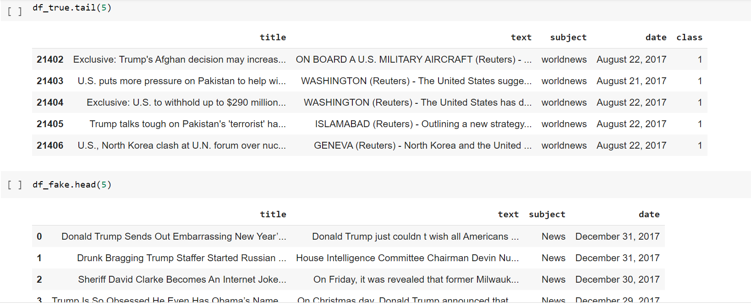
Data
⧫ Dataset source - Kaggle
⧫ ID, Title, Subject Text, Date Label
⧫ Label 1 – Real news
⧫ Label 0 – Fake news

Slide 5
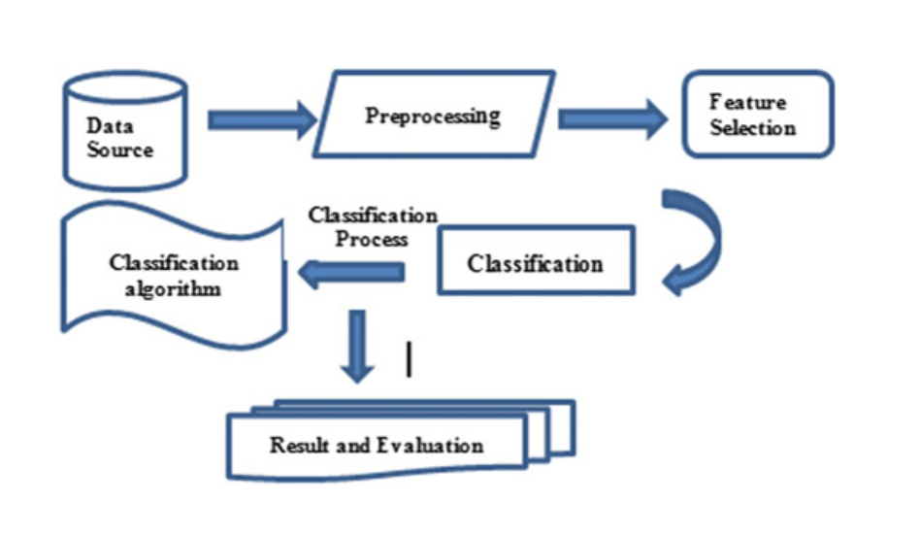
Workflow

Slide 6
Data Preprocessing
Perform various text cleaning steps (remove all non-alphanumeric characters, delete stopwords, delete missing rows, etc.)
Randomly shuffling the data frame.
Defining dependent and independent variable as x and y.
Creating a function to convert the text in lowercase, remove the extra space, special char, URL and links.
Splitting the dataset into training set and testing set.
Convert text to vectors by importing TfidfVectorizer.

Slide 7
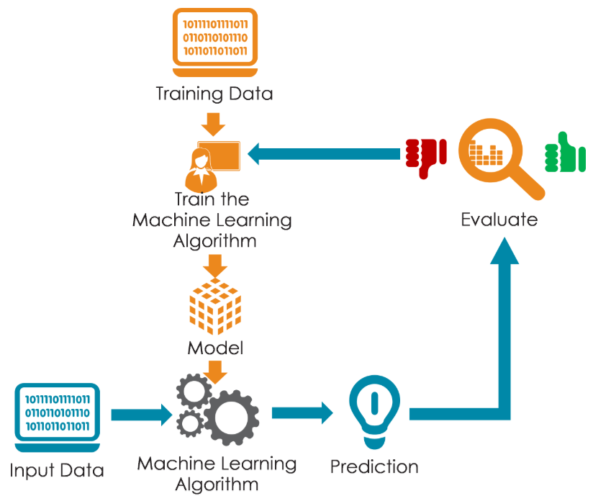
Training a Model
⧫ Models used-
Logistic Regression.
Decision Tree.
Random forest classifier.

Slide 8
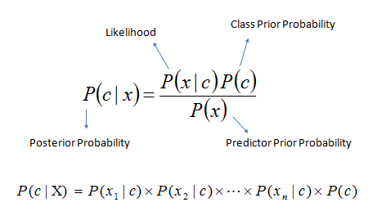
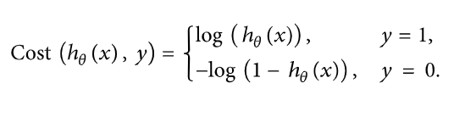
Logistic Regression
As we are classifying text on the basis of a wide feature set, with a binary output (true/false or true article/fake article), a logistic regression (LR) model is used, since it provides the intuitive equation to classify problems into binary or multiple classes.
Logistic regression uses a sigmoid function to transform the output to a probability value; the objective is to minimize the cost function to achieve an optimal probability. The cost function is calculated as shown in

Slide 9
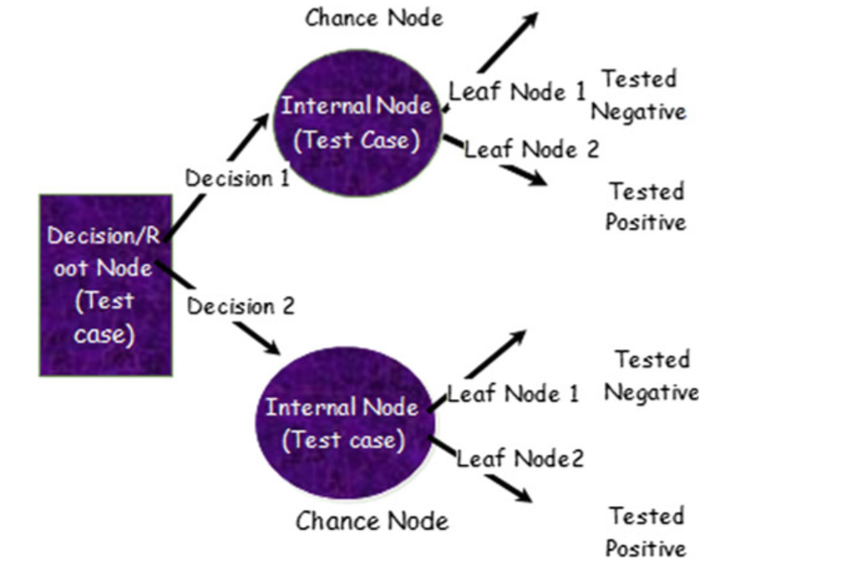
Decision Tree
Decision Trees (DTs) are a non-parametric supervised learning method used for classification and regression. The goal is to create a model that predicts the value of a target variable by learning simple decision rules inferred from the data features. A tree can be seen as a piecewise constant approximation.

Slide 10
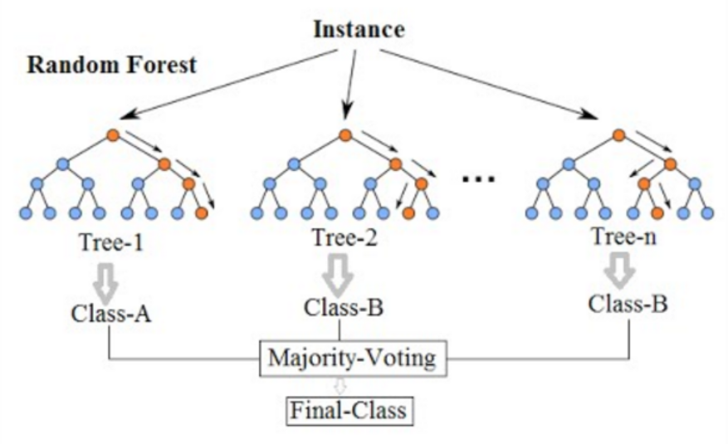
Random Forest Classifier
Random forest (RF) is an advanced form of decision trees (DT) which is also a supervised learning model. RF consists of large number of decision trees working individually to predict an outcome of a class where the final prediction is based on a class that received majority votes.
The error rate is low in random forest as compared to other models, due to low correlation among trees.

Slide 11
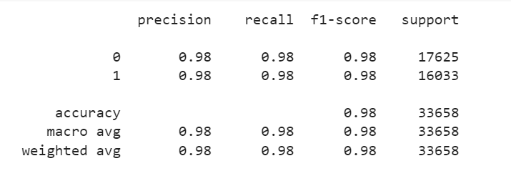
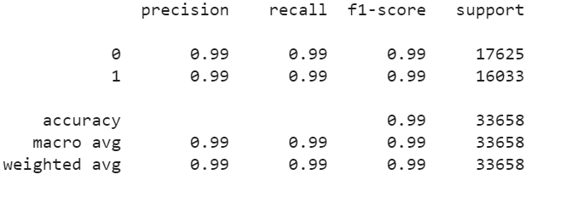
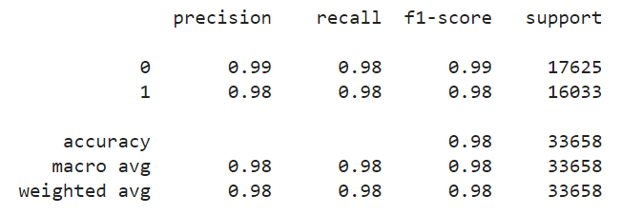
Classification Report
Logistic Regression
Decision Tree
Random Forest

Slide 12
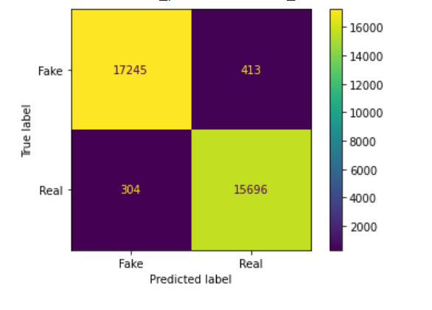
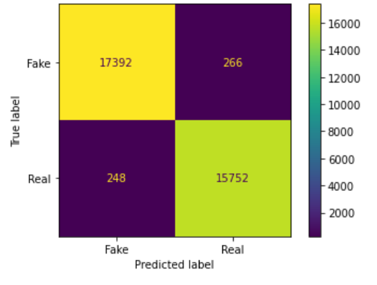
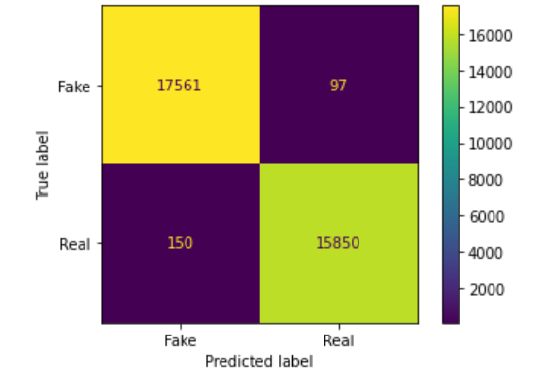
Confusion Matrix
Logistic Regression
Decision Tree
Random Forest Classifier

Slide 13
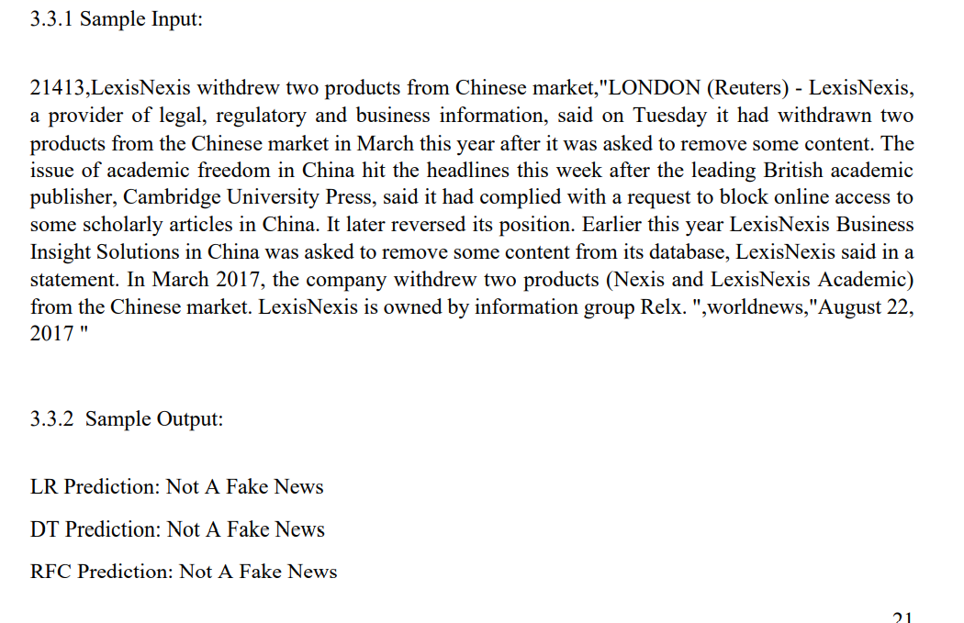
Manual Testing
Manual.csv - We also perform manual testing on dataset by removing 10 records from both True and Fake dataset and merging the records in single dataset and save it as manual_testing.csv file.
Define a function which takes input from manual_testing dataset and the predict the output for the given input.

Slide 14
Live prediction
Basic Requirements:-
Backend :-Python libraries & Flask
Frontend:-HTML and CSS.
Designed a web application which takes input in the form text(news) and predict whether the news is real or fake.

Slide 15
News prediction web app
Designed a web application which receive input text(news) and predict whether the news is fake or real.
Created a html page for frontend and flask for connection to localhost server. Choose the best classifier from the given three classifiers. The accuracy score of the classifiers are as follows: -
Logistic Regression - 91.55%
Decision Tree – 83.5%
Random Forest Classifier -90.21%
We choose Logistic regression as it has better accuracy.

Slide 16
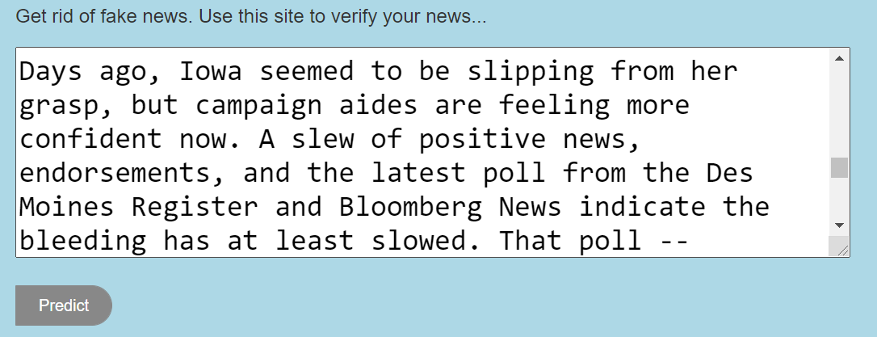
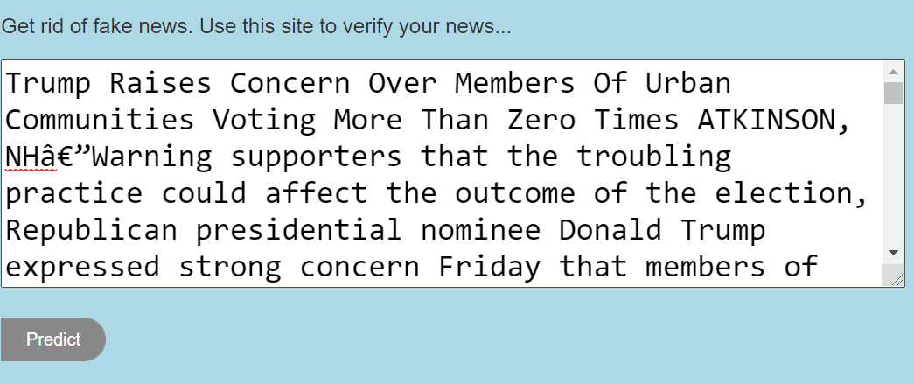
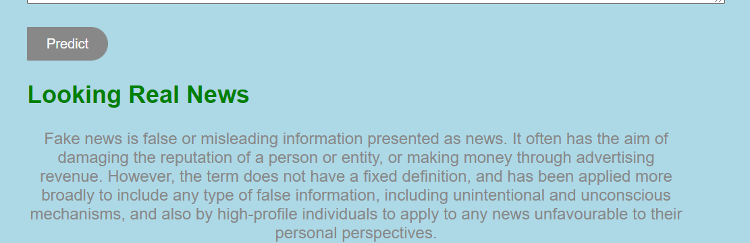
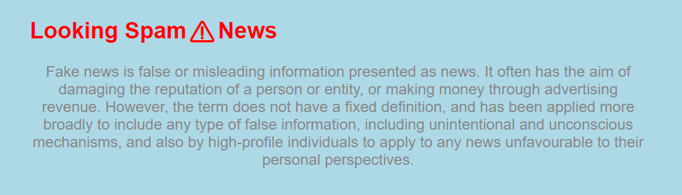
Real News
Fake News

Slide 17

Future Work
⧫ Assemble the classifiers to achieve better performance - Adam Boost
⧫ Check the sources of the news
⧫ Search the news on the web to check the content of the news
⧫Train our model on other datasets.

Slide 18
Thank You
Thanks to our mentor Prof. Dilip Kumar Choubey
for their guidance!

