Slide 1

Braid DB: A from-scratch provenance system for AI-driven science
TRACKABLE PREDICTIONS in machine-controlled experiments
drhgfdjhngngfmhgmghmghjmghfmf
Justin m wozniak and the BRAID TEAM
Data science & Learning Argonne National Laboratory
12th JLESC Workshop
February 25, 2021

Slide 2
Braid project overview
Toward AI-enhanced, self-documenting experimental science
Next-generation scientific instruments collect data at unprecedented rates: multi-GB/s and 100+ TB/day
Need automation via machine learning methods to enable online steering, but learning from online streams needs advanced data management techniques
Need to develop new methods to enable policy-driven automation of the flows used to collect, analyze, organize, and learn from data
Orchestrate data flows using modular and repurposable actions; integrate with HPC resources
Enforce data policies, i.e., data capture quality and performance
Make automatic decisions interpretable, to understand progress and policy adherence (this talk)
Team: Ian Foster (PI), Tekin Bicer, Ben Blaiszik, Kyle Chard, Ryan Chard, Raj Kettimuthu, Zhengchun Liu, Bogdan Nicolae, Min Si, Justin Wozniak
Facility
Braid Flows
HPC
FAIR Records

Slide 3
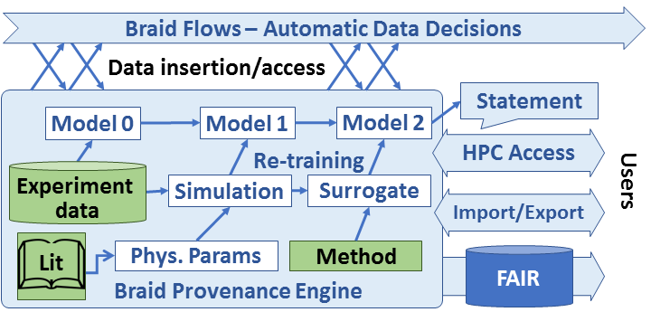
Braid Provenance GOALS
Capture provenance needs of
Embrace automation in data analysis, retention, decision-making
Enable users to trace back to how decisions were made
Necessitates recording what went into model training, including external data, simulations, and structures of other learning and analysis activity
Envision a versioned database for ML model states with HPC interfaces
Integrate with other Braid components

Slide 4
Braid provenance features
Accelerate interpretable ML-driven science
Embrace automation in how and when to analyze and retain data, and when to alter experimental configuration
Automate also the record-keeping so that humans and/or machines can recover how a particular result was obtained
When failures occur, diagnose causes, enable rapid restart
Develop recursive and versioned provenance structures:
Models may be constructed via other models (estimates, surrogates)
Models are constantly updated (track past decisions and allow updates)
Enable runs at scale: CANDLE reference example:
One training epoch is completed per node every five minutes.
On an exascale system of 10K nodes, that is 33 records/second
Ensure capacity for a week’s worth of experimental data collection
Be comprehensive: capture data transformations through to publication
Build toward defensible automated statements: tools for AI science

Slide 5
BRAID-DB Concepts
Approach: mix and match concepts from the provenance literature with popular version control concepts to provide a robust and usable solution
Developing small SQL database with high-level Python API
Braid data types:
Facts: External, static data. E.g., reference data, software
Records: Data produced by Braid-visible processes
Models: Versioned objects that depend on Facts, Records, and other Models
Statements: Externally visible inferences and predictions
Plan to keep core data structures simple, while offering interfaces and interoperation for local, wide area, and HPC infrastructures

Slide 6
Braid provenance prototype
Prototype Python/SQL implementation for initial tests
Simple client/server model for initial evaluation and requirements testing
Usable on one site at a time with import/merge tools for multi-site cases
Abstraction over Postgres/SQLite as needed for site restrictions
Provide API that can be integrated into workflow frameworks or called directly
Applications and/or workflow systems
Optional HPC cache
Import/merge tools
Recursive, versioned model record structures
Data storage model
Postgres
SQLite
Other?

Slide 7
PROVENANCE Subproject MILESTONES
Survey about 3 “key apps” for use cases and requirements
Sketch Python data structure, persistent format, and APIs
Construct synthetic “Mascot” app to flex data structures and performance
Iterate to maintain compatibility with other Braid products and FAIR conventions
Investigate efficient representations of versioned ML state
Achieve target performance metrics (33 records/second, 20M records/week)
Circle back to key apps for validation

Slide 8
partner applications
Initial collaborations with skeleton workflows
SLAC FPGA workflow
Goal: Perform data reduction at the edge
Scientist configures experiment parameters
Workflow launches simulations with experiment parameters
Complete simulations by time experiment data collection is complete
Train model on simulation and experiment data
Run model on an FPGA to perform data reduction in production
BraggNN workflow
Goal: Improve peak finding
Train model to represent Bragg peaks
APS collects raw scattering data
Run peak finding on raw data, label peaks
Train model on peaks to represent raw data
Reproduce and save peak locations
SSX workflow
Goal: Track the provenance of SSX crystal structures
Structures can come from multiple experiments
Analysis is performed on the input data using these configs to create int files
The int files are used to create a structure
Track experimental config files and derived structures
CTSegNet workflow
Goal: Track the history of various U-Net-like models used for trial-and-error image segmentation
Obtain tomo scan
Perform image processing, contrast adjustment, etc.
Apply (labeling) "masks"
Run ensemble models in inference mode
Get new segmentations
Aggregate segmentation results
Re-train models and loop…​
Samarakoon/Osborn workflow
Goals: Fit simulated crystal structure to scattering data
Obtain neutron scattering data
Train and apply auto-encoder to identify important features
Apply dimensionality reduction
Fit to data, repeat until convergence

Slide 9

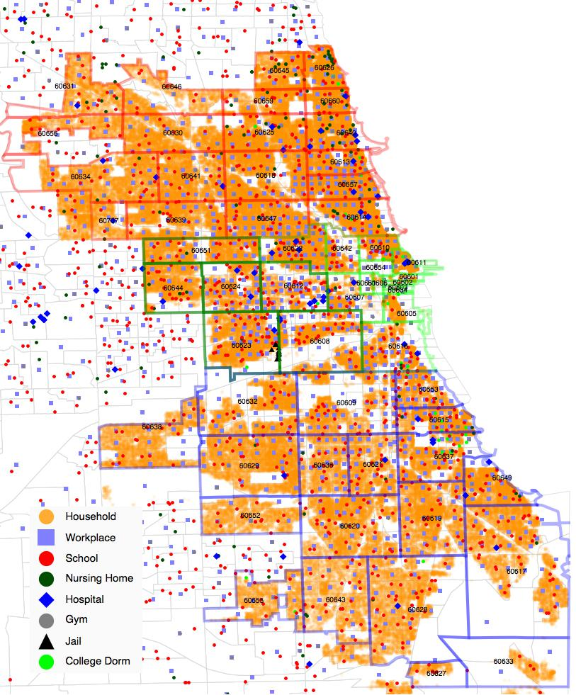
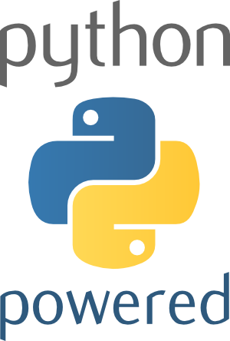

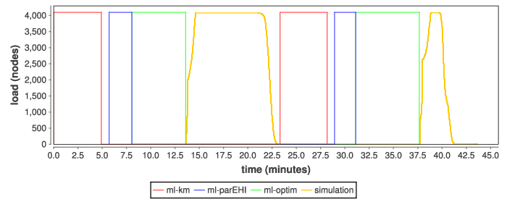


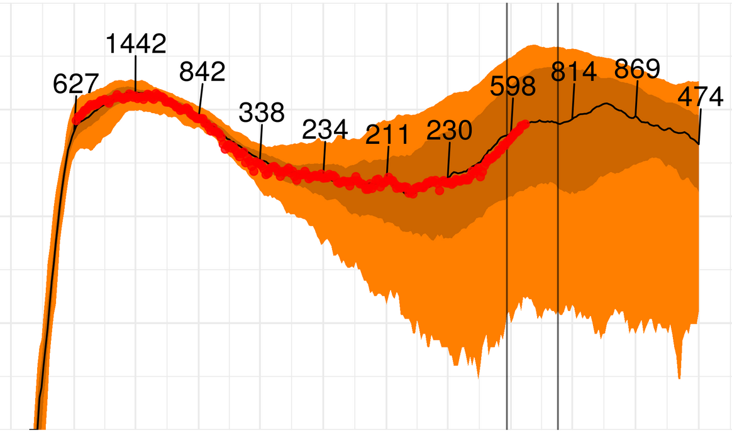
RELATED EXAMPLE: MONITORING ML-driven workflows
Finalist 2020
ML-driven parameter fitting monitored by DB
Large ensemble of RepastHPC-based C++/MPI simulations over 10 million simulated persons, modeling COVID transmission in Chicago
R-based ML libraries (+MKL) propose and evaluate simulation parameters, also using parallel resources, fitting against real-world data reports
Python-based DB API posts results to Postgres for real-time human monitoring from remote sites
Transforms Theta into a data pipeline
Chicago data tables
Swift/T control process
Swift/T worker
C
C++
Fortran
C++
Fortran
C
C++
MPI
ML
ML
ML
SIM
ML
ML
ML
SIM
Actionable
epidemiological predictions
A population data-driven workflow for COVID-19 modeling and learning. Collier, Ozik, Wozniak, Macal, and Binois. Under review for Int. J. High Perform. Comput. Appl. 2021.
DB
COVID-19 Hospital Beds Over Time

Slide 10
QuestionS?
Thanks to the organizers
Braid-DB software and tests available at: https://github.com/ANL-Braid/DB
Collaboration ideas:
Integration with workflow systems (currently totally independent)
Other experimental science applications
Other underlying versioned databases

