Slide 1
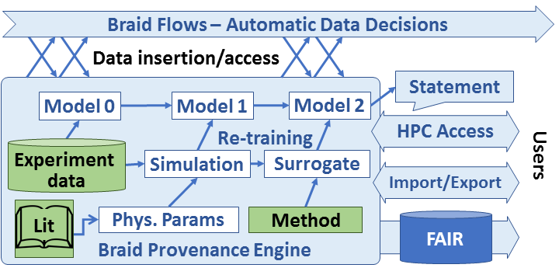
Braid Provenance GOALS
Wozniak (lead), Foster, Nicolae, Liu
Embrace automation in data analysis, retention, decision-making
Enable users to trace back to how decisions were made
Necessitates recording what went into model training, including external data, simulations, and structures of other learning and analysis activity
Envision a versioned database for ML model states with HPC interfaces
Integrate with other Braid components

Slide 2
Braid provenance features
Accelerate interpretable ML-driven science
Embrace automation in how and when to analyze and retain data, and when to alter experimental configuration
Automate also the record-keeping so that humans and/or machines can recover how a particular result was obtained
When failures occur, diagnose causes, enable rapid restart
Develop recursive and versioned provenance structures:
Models may be constructed via other models (estimates, surrogates)
Models are constantly updated (track past decisions and allow updates)
Enable runs at scale: CANDLE reference example:
One training epoch is completed per node every five minutes.
On an exascale system of 10K nodes, that is 33 records/second
Ensure capacity for a week’s worth of experimental data collection
Be comprehensive: capture data transformations through to publication
Build toward defensible automated statements: tools for AI science

Slide 3
Braid provenance prototype
Prototype Python/SQL implementation for initial tests
Simple client/server model for initial evaluation and requirements testing
Usable on one site at a time with import/merge tools for multi-site cases
Abstraction over Postgres/SQLite as needed for site restrictions
Provide API that can be integrated into workflow frameworks or called directly
Applications and/or workflow systems
Optional HPC cache
Import/merge tools
Recursive, versioned model record structures
Data storage model
Postgres
SQLite
Other?

Slide 4
PROVENANCE Subproject MILESTONES
Survey about 3 “key apps” for use cases and requirements
Sketch Python data structure, persistent format, and APIs
Construct synthetic “Mascot” app to flex data structures and performance
Iterate to maintain compatibility with other Braid products and FAIR conventions
Investigate efficient representations of versioned ML state
Achieve target performance metrics (33 records/second, 20M records/week)
Circle back to key apps for validation

