Slide 1
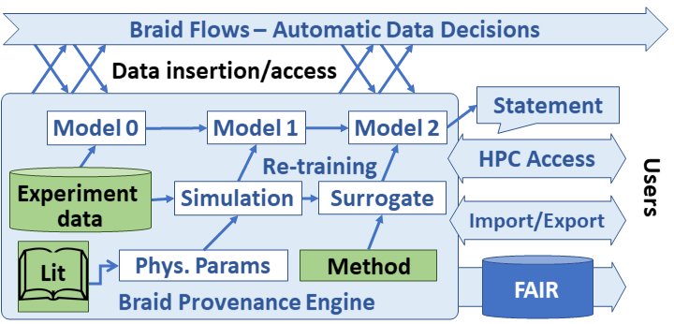
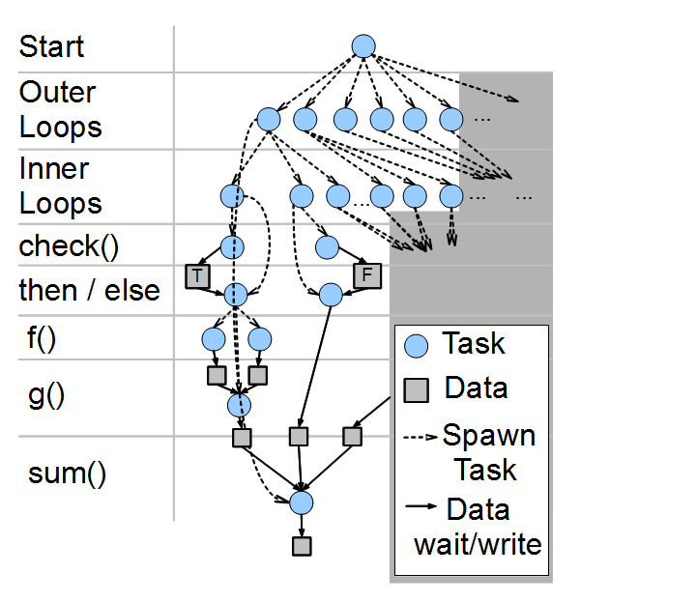
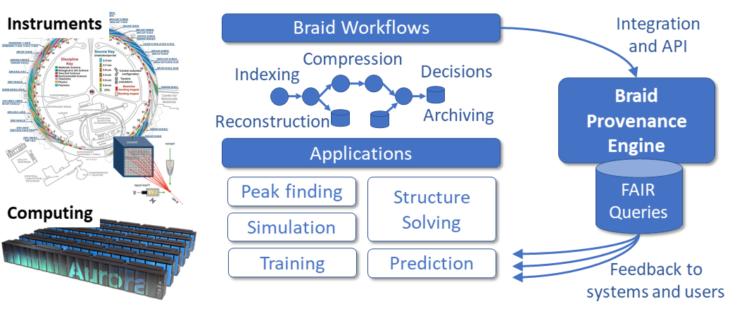
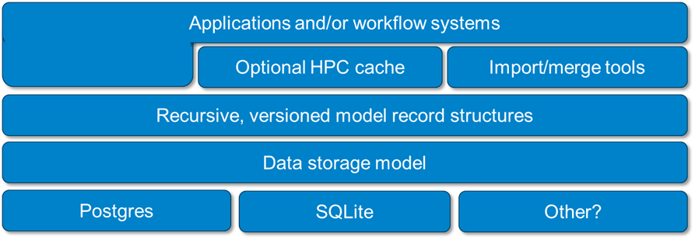
Braid-DB: Toward AI-driven Science with Machine Learning Provenance
Justin M. Wozniak, Zhengchun Liu, Rafael Vescovi, Ryan Chard, Bogdan Nicolae and Ian Foster
Argonne National Laboratory
https://github.com/ANL-Braid/DB
Overview: Provenance for ML Science
Braid-DB Architecture
Next-generation scientific instruments will collect data at unprecedented rates: multiple GB/s and exceeding TB/day.
Such runs will benefit from automation and steering via machine learning methods, but these approaches require new data management and policy techniques to support the distinct I/O patterns of machine learning and the dynamic and more generalized dataflow pattern inherent in automation.
We present here the Braid Provenance Engine (Braid-DB), a system that embraces and is designed to support AI-for-science automation in how and when to analyze and retain data, and when to alter experimental configurations.
Automating such workflows will
need provenance recording that is augmented with richer information about model training inputs, including real-world experiments and observations, simulations, and the structures of other learning and analysis activities.
Braid workflows and policies make automated decisions in support of experimental science
Braid-DB tracks those decisions in terms of data dependency relationships among static data, experimental data, data derived from simulation or analysis, and ML model-produced data
The system produces statements that are supported by records in the database
Braid-DB extends traditional provenance capabilities by:
Allowing ML models to influence other models
Allowing ML models to be updated over time
The current system is implemented as a Python API and object model wrapped around a SQLite database
The system is also accessible via a funcX functional API
An MPI-enabled API will also be developed for use on HPC
Data dependencies and tasks resulting from complex, large scale scripts must
Scalable run time based on ADLB
Braid: Streaming data for experiments
The over-arching Braid project funnels experimental data streams into Braid Workflows controlled by Globus Flows and funcX invocations
ML may be applied to control the experiment, simulation, and analysis at multiple points in the workflow
Braid-DB captures the decisions made and relevant metadata for validation and/or fault diagnosis
Applications
BraidRecord: A super-class for Braid-DB provenance records. Each such entity has a unique ID, a Swift PIPS script: Parallel power grid analysis
(possibly not unique) string name, a list of dependencies, and a dictionary of user-specified, string-keyed metadata tags,
BraidFact: A simpler object consisting of static data: for example, pre-existing trusted data or software, etc. BraidFacts may have a provenance outside the Braid-DB system.
BraidData: The Braid-DB representation of traditional provenance-tracked data, with traditional conceptions of its derivation history from other BraidData and/or BraidFacts. A Braid-DB containing only BraidData and BraidFacts would be functionally indistinguishable from a traditional provenance database.
BraidModel: An ML model tracked by Braid-DB. A BraidModel has the additional capability update() , which represents model exposure to other BraidRecords, possibly including other models. This includes the possibility of dependency cycles that capture complex interactions among models and data as experiment workflows progress.
Abstractions Stored in Database
BraidRecord: A super-class for Braid-DB provenance records. Each such entity has a unique ID, a Swift PIPS script: Parallel power grid analysis
(possibly not unique) string name, a list of dependencies, and a dictionary of user-specified, string-keyed metadata tags,
BraidFact: A simpler object consisting of static data: for example, pre-existing trusted data or software, etc. BraidFacts may have a provenance outside the Braid-DB system.
BraidData: The Braid-DB representation of traditional provenance-tracked data, with traditional conceptions of its derivation history from other BraidData and/or BraidFacts. A Braid-DB containing only BraidData and BraidFacts would be functionally indistinguishable from a traditional provenance database.
BraidModel: An ML model tracked by Braid-DB. A BraidModel has the additional capability update() , which represents model exposure to other BraidRecords, possibly including other models. This includes the possibility of dependency cycles that capture complex interactions among models and data as experiment workflows progress.
Worldwide Swift usage through Nov 2012
This research is supported by the U.S. DOE Office of Science under contract DE-AC02-06CH11357, FWP-57810. Computing resources were provided by the Argonne Leadership Computing Facility. Some work by DSK was supported by the National Science Foundation, while working at the Foundation. Any opinion, finding, and conclusions or recommendations expressed in this material
are those of the authors and do not necessarily reflect the views of the National Science Foundation.

