Slide 1

Scott Collis
On behalf of the MODAL Team
Notes:
All science is incremental, there are no papers published or talks given that have not built on the ideas of others. As data volumes jump the terabyte range and head on into the range of petabytes the days where insight can be gained through simple analysis are gone. Increasingly the code produced by a project is the enduring product and legacy. This presentation charts our own journey in using the scientific python ecosystem, first as users and then as the developers of a community based toolkit for working with weather radar data, the Python ARM Radar Toolkit, Py-ART. Py-ART is a architecture for interacting with and extracting insight from weather radars and enjoys an international following of over 100 users. We will show how Py-ART is built, various modules contributors have added and the science behind them. This will be an example driven talk with lots of data examples and even some code shown!
Go to ”Insert (View) | Header and Footer" to add your organization, sponsor, meeting name here; then, click "Apply to All"

Slide 2
Outline:
Progress to date , work started, hiring post-doc and spending
Rescope: What we plan to do within current funding
Work breakdown and tasks; Timelines for accomplishing the tasks (Gantt chart)
MODAL Architecture and how it fits in with existing projects
Heavy computational lifting: Some initial experiments and future directions
University of North Dakota, Atmospheric Sciences Seminar.

Slide 3
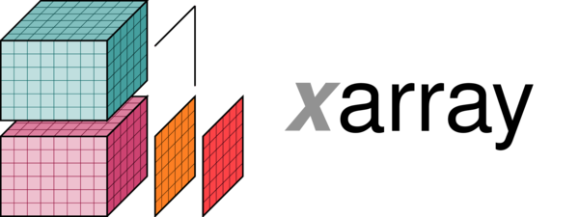

Progress to date
Budget: 0.68 months spent as of Jan 1st. 279K ish remaining. Need in increase Burn Rate. All Effort, no travel or equipment (Will change). Complexities with ARM will see use more going forward.
Hiring: Extensive talent search. Six candidates interviewed either on phone or in person. Clear front runner will be visiting the lab late February. Given all is good we are looking at a early Summer start. Ben Hillman has build radar simulators for GCMs and has worked with several ASR PIs.
Data model: Met with Stephan Hoyer from Climate corp and Sheri Mickelson from NCAR. Tending towards a xarray + ESMPy to build a coordinate system aware grid data model. The vision is to be able to build analytical code that can be independent of the host model coordinate system.
University of North Dakota, Atmospheric Sciences Seminar.

Slide 4
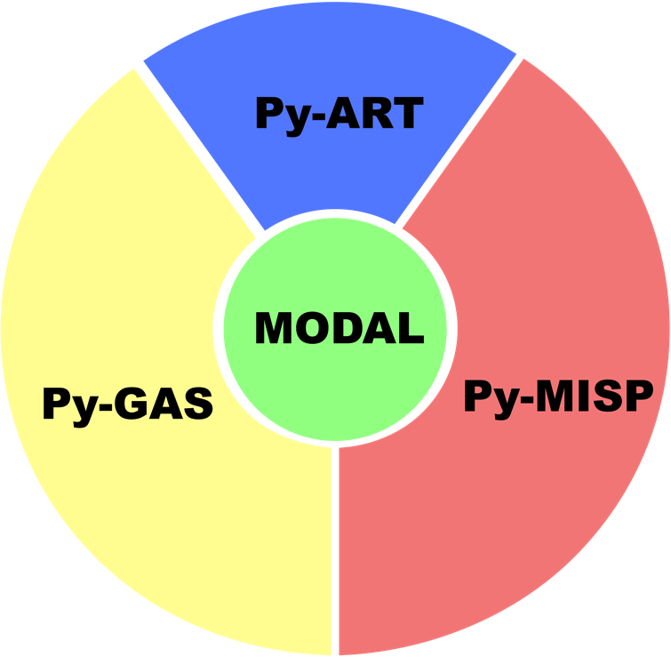
MODAL Ecosystem
Modal will not be one package, nor even a collection of packages. It is a “Way of doing work” an ecosystem under the Scientific Python Ecosystem for interacting with a collection of instruments and grid data. MODAL will achieve, in its lifetime, more than we proposed in the LDRD.
University of North Dakota, Atmospheric Sciences Seminar.

Slide 5
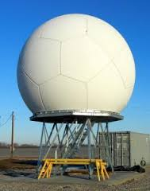
Retrieval
University of North Dakota, Atmospheric Sciences Seminar.

Slide 6

Simulation
University of North Dakota, Atmospheric Sciences Seminar.

Slide 7
Rescope
Dumb down the features. Remove modeling component all together. Focus on RICO WRF-LES case (YF).
Post
University of North Dakota, Atmospheric Sciences Seminar.

