Slide 1
Topic Modeling
ANLY 580 – Fall 2019

Slide 2
What is Topic Modeling?
Topic modeling is a form of text mining
Employs unsupervised and supervised statistical machine learning techniques to identify patterns in a corpus or large amount of unstructured text
Approach is to ingest collection of documents (sometimes very large, sometimes not) and group the words into clusters of words, identify conceptual topics represented by the words, and group documents by employing a process of similarity.

Slide 3
Approaches to Topic Modeling
Probabilistic Approaches
Matrix Factorization Approaches
Conventional topic models such as pLSA and LDA learn latent topics in a corpus by exploiting document-level word co-occurrences
Latent Dirichlet Allocation
Non-negative Matrix Factorization
Latent Semantic Analysis
Prob. Latent Semantic Analysis
Gaussian Mixture Models
Hierarchical Dirichlet Process
Notes:
https://en.wikipedia.org/wiki/Beta_distribution
In probability theory and statistics, the beta distribution is a family of continuous probability distributions defined on the interval [0, 1] parametrized by two positive shape parameters, denoted by α and β, that appear as exponents of the random variable and control the shape of the distribution. It is a special case of the Dirichlet distribution.
https://en.wikipedia.org/wiki/Dirichlet_distribution
In probability and statistics, the Dirichlet distribution (after Peter Gustav Lejeune Dirichlet), often denoted Dir⁡(α), is a family of continuous multivariate probability distributions parameterized by a vector α of positive reals. It is a multivariate generalization of the beta distribution^{[1]}, hence its alternative name of multivariate beta distribution (MBD)^{[2]}.
https://en.wikipedia.org/wiki/Probabilistic_latent_semantic_analysis
https://en.wikipedia.org/wiki/Hierarchical_Dirichlet_process
https://en.wikipedia.org/wiki/Mixture_model#Gaussian_mixture_model
In statistics, a mixture model is a probabilistic model for representing the presence of subpopulations within an overall population belongs.

Slide 4
Latent Dirichlet Allocation (LDA)
“Latent” implies that topics are inferred rather than directly observed
Word order in documents is not important
I.e., Bag of Words or BOW
Document order in the data set is not important.
The number of topics (K) is chosen in advance.
The same word can belong to multiple topics.
Each document in the total collection of D documents is seen as a mixture of K latent topics.
Each topic has a multinomial distribution over a vocabulary of words w.

Slide 5
In other words…….
Go through each document and randomly assign each word in the document to one of K topics. This random assignment gives topic representations of all documents and word distributions of all the topics, albeit not very good ones
So, to improve upon them:
For each document d, go through each word w and compute:
p(topic t | document d): proportion of words in document d that are assigned to topic t
p(word w| topic t): proportion of assignments to topic t, over all documents d, that come from word w
*https://www.kdnuggets.com/2016/07/text-mining-101-topic-modeling.html

Slide 6
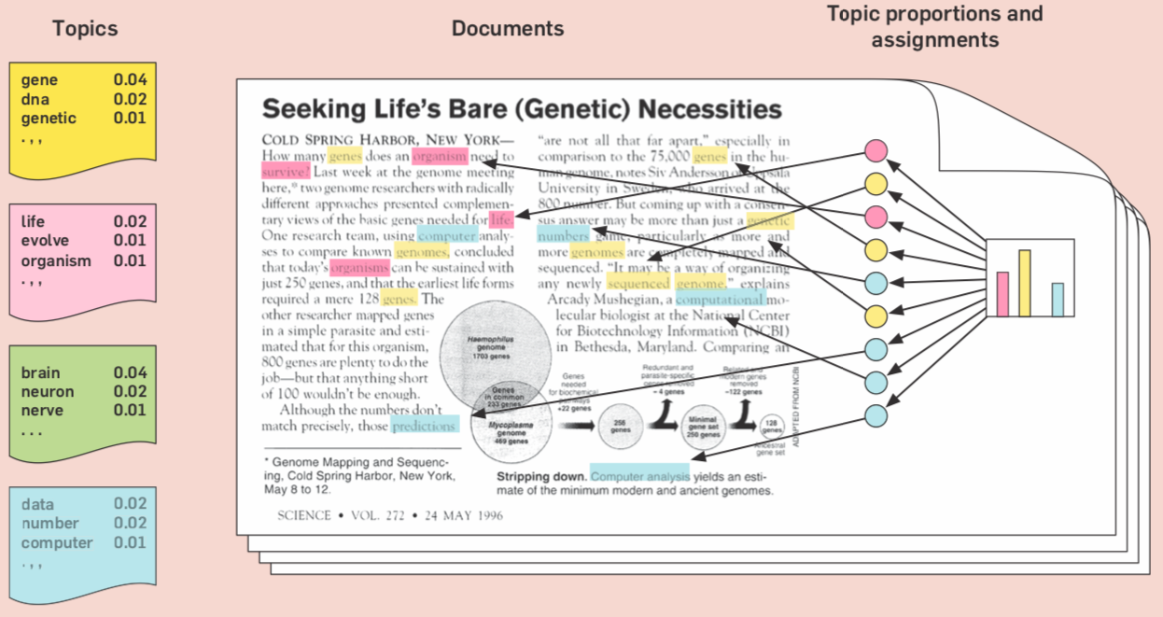
are distributions over words

Slide 7
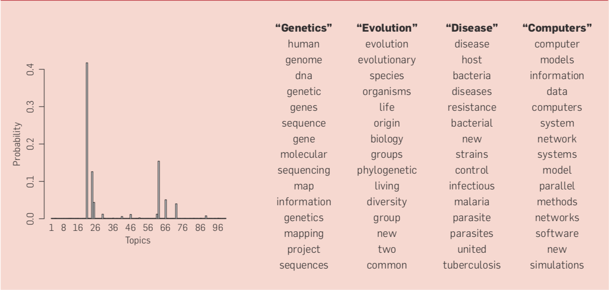

Slide 8
SemEval-2017 Task BD Dataset
An interesting (challenging?) dataset for examining topic modeling
Task B – tweet level - classification
Given a tweet and a topic, classify the sentiment conveyed towards that topic on a two-point scale: POSITIVE vs. NEGATIVE
Task D – topic level - quantification
Given a set of tweets about a topic, estimate the distribution of tweets across the POSITIVE and NEGATIVE classes
Varied topical categories – named entities, geopolitical entities, current issue entities

Slide 9
SemEval-2017 Task BD Dataset
Polarity
Geopolitical
Topic/Polarity Dimensions
Political
Entertainment
Products
Topic

Slide 10
Large Scale Topic Modeling
U.S. National Institutes of Health (NIH) -
80,000 Grants per year
25 grant-awarding Institutes and Centers
Distinct, overlapping and multi-faceted relationships
Reporting (i.e., Congress) and navigating the funding landscape very challenging
http://www.nihmaps.org
Applied topic modeling and automated clustering algorithm to produce a graphical layout of grants across Institutes/Centers

Slide 11
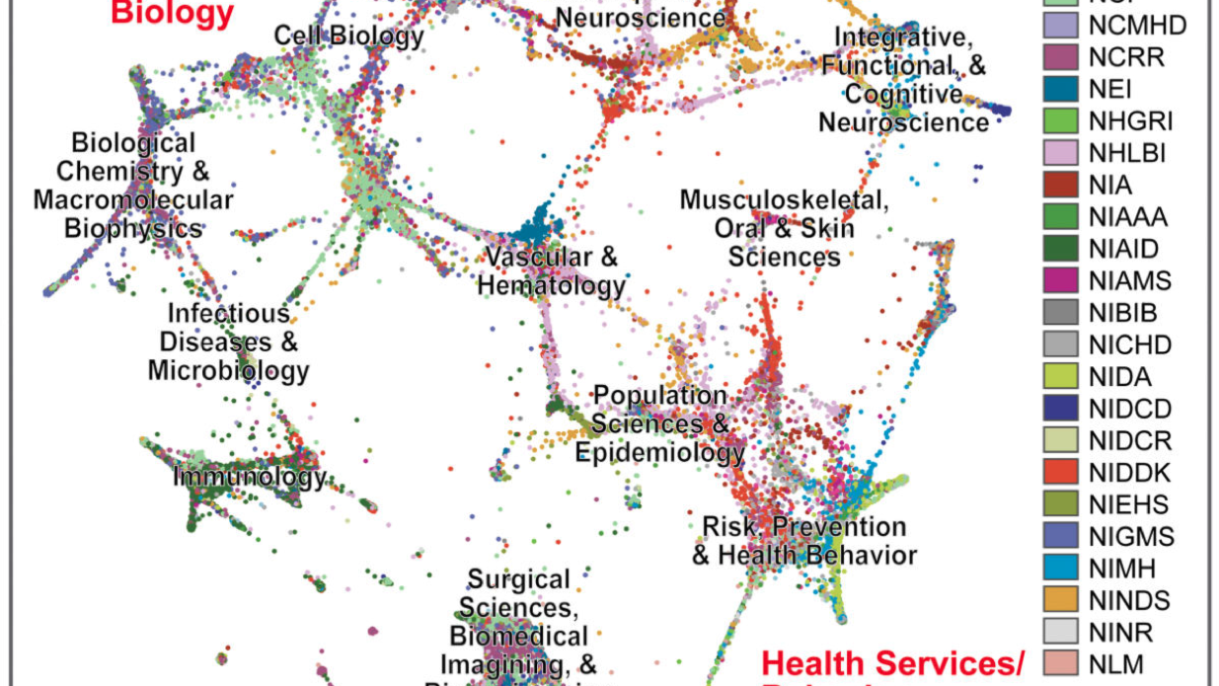
Graphically clustered NIH grants, as rendered from a screenshot of the NIHMaps user interface

Slide 12
Large Scale Topic Modeling - NIH
370,000 documents
150,000 grants
220,000 Pubmed abstracts referenced in grant reports
Preprocessing
Removed stopwords, acronyms, phrases
Non-research terms (e.g., “understanding”, “believe”, “goals”) – 15% corpus
Manually aggregated obviously uninformative terms, increasing stopword list by ~1200 terms
Created a vocabulary using ~600 standardized acronyms and ~4200 commonly used bigrams and phrases
Increased weighing of words in document titles

Slide 13
Large Scale Topic Modeling - NIH
Topic Tuning
Optimize input parameters to generate a individual topics that conveyed a single coherent topic
Number of topics – T
Concentration of topics in a document – alpha
Concentration of terms in a topic - beta
Adjust topic concept resolution to maintain high confidence in the results
Too “few” topics generated topics with ”poor” multiple concepts
Too “many” topics generated numerous “poor” quality or “junk” topics
Eventually select 700 topics as producing an acceptable balance
Well resolved concepts with few topics of poor quality
alpha = 0.05L/T and beta = 0.1, L = average document length

Slide 14
Topic Coherence and Perplexity
Topic Coherence
A measure used to evaluate topic models
A good model will generate coherent topics, i.e., topics with high topic coherence scores
Good topics are topics that can be described by a short label, therefore this is what the topic coherence measure should capture
Perplexity
Is a statistical measure of how well a probability model predicts a sample
Statistic is somewhat meaningless on its own
The benefit of this statistic comes in comparing perplexity across different models with varying Ks
The model with the lowest perplexity is generally considered the “best”
Notes:
https://towardsdatascience.com/evaluate-topic-model-in-python-latent-dirichlet-allocation-lda-7d57484bb5d0
http://svn.aksw.org/papers/2015/WSDM_Topic_Evaluation/public.pdf
https://datascienceplus.com/evaluation-of-topic-modeling-topic-coherence/
https://www.aclweb.org/anthology/N10-1012.pdf
https://cfss.uchicago.edu/notes/topic-modeling/

Slide 15
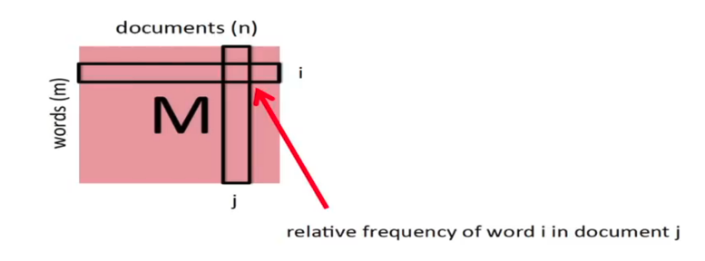
Nonnegative Matrix Factorization (NNMF)*
In linear algebra, a matrix decomposition or matrix factorization is a factorization of a matrix into a product of matrices
(i.e., columns sum to 1)
*https://singsoftnext.com/introduction-to-nonnegative-matrix-factorization/
*https://arxiv.org/abs/1703.00663
*https://www.youtube.com/watch?v=kSfwY68gQ9I&feature=youtu.be&list=PLtelmYjrNBARmdTzrqUGQcoGCHdg5l8MO

Slide 16
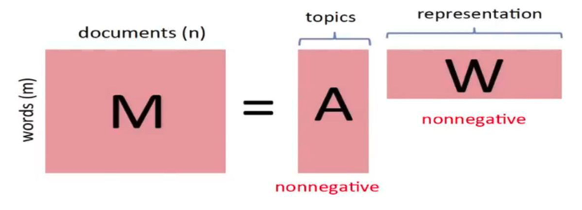
Nonnegative Matrix Factorization (NNMF)
The idea is that documents are linear combinations of topics and topics are linear combinations of words.
We are looking for an 𝑚×r matrix 𝐴 and an 𝑟×𝑛 matrix 𝑊 for which 𝑀=𝐴𝑊. 𝐴 captures the distribution of words over topics. 𝑊 captures the representation of documents by topics.
Notes:
http://citeseerx.ist.psu.edu/viewdoc/download?doi=10.1.1.702.4867&rep=rep1&type=pdf
https://towardsdatascience.com/overview-of-matrix-factorisation-techniques-using-python-8e3d118a9b39

Slide 17
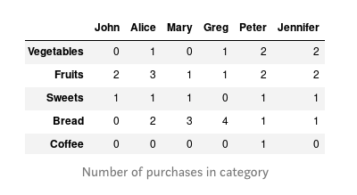
Modeling Applications of NNMF
Item Recommendation*
*https://medium.com/logicai/non-negative-matrix-factorization-for-recommendation-systems-985ca8d5c16c
https://blog.echen.me/2011/10/24/winning-the-netflix-prize-a-summary/

Slide 18
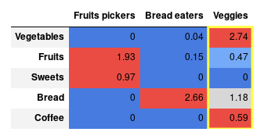
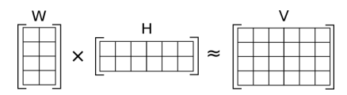
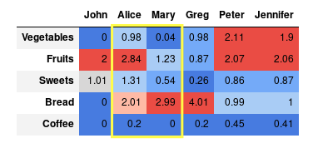
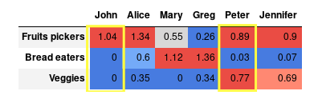
Modeling Applications of NNMF
W
M
A
W
~
X
~
A
Notes:
How to interpret W? It’s not as hard as it sounds: just look at the values (weights — note that they do not sum up to 1) in each column. The higher the weight, the more “determined” the column (segment) is by the variable in the row. This is the place where non-negative constraint pays-off. Could you think how to interpret negative values if positive corresponds to “belongs to” and zero means “does not belong”? I can not.
For instance, I’ve named one segment “Bread eaters,” because it is almost entirely driven by bread consumption. “Fruit pikers” are driven by two product categories — Fruits and Sweets. The third one is a mixed segment with leading Vegetable category.
We can also look at W matrix from another perspective. If we look at the values by rows we can interpret them as follows: provided somebody bought product X, what is the additional assignment weight to the segment. For instance, Coffee purchase contributes exclusively to “Veggies” segment and Bread for both “Bread Eaters” and “Veggies” with higher weight towards the first one.
Let’s move to the H matrix now. The higher the weight value, the more the person belongs to the specific segment. Some people like John can be assigned in 100% to one cluster, and some people like Peter belong to all the segments with some weights.
Can we use the mechanism to prepare food recommendations for people? Yes, and it’s easier than you may think. By multiplying W and H, we obtain initial V matrix approximation:
This reconstructed matrix serves as a basis to the recommendation. The process of assigning values for previously unknown values (zeros in our case) is called collaborative filtering. We can find attraction weight towards certain products in columns of the matrix. By sorting the values in descending order, we could determine which products should be proposed to the customer to match their preferences. For instance, Mary should be offered products in the following order Bread, Fruits, and Sweets. Recommendation order for Alice: Fruits, Bread, Sweets, Vegetables, and Coffee.
http://derekgreene.com/papers/greene14topics.pdf -- number of topics

Slide 19
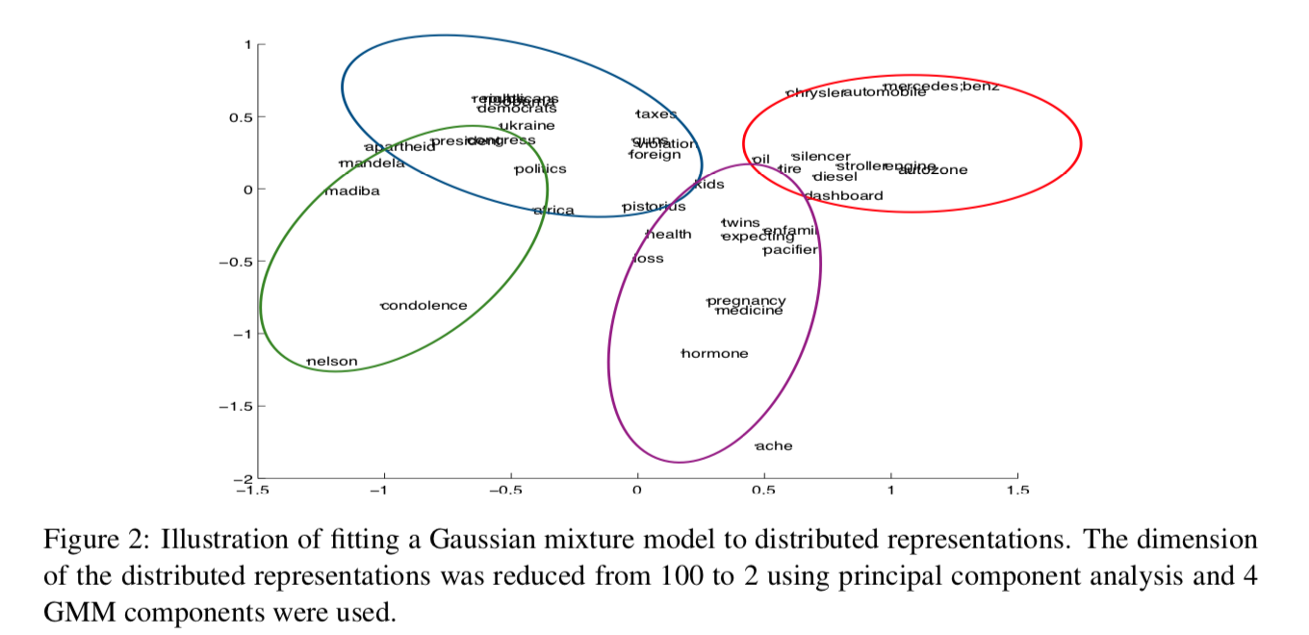
Gaussian Mixture Model
Notes:
https://www.aclweb.org/anthology/W15-1526.pdf

Slide 20
References
Probabilistic Topic Models by David Blei
http://www.cs.columbia.edu/~blei/papers/Blei2012.pdf
David Mimno
https://mimno.infosci.cornell.edu/slides/details.pdf
https://mimno.infosci.cornell.edu/info6150/
Numerous paper references
Database of NIH grants using machine-learned categories and graphical clustering
https://www.ncbi.nlm.nih.gov/pmc/articles/PMC5361216/pdf/nihms430007.pdf
Topic Modeling Visualization
https://www.kaggle.com/ykhorramz/lda-and-t-sne-interactive-visualization
Topic Explorer – https://www.hypershelf.org

Slide 21
References
Number of topics:
https://cran.r-project.org/web/packages/ldatuning/vignettes/topics.html
https://www.quora.com/Latent-Dirichlet-Allocation-LDA-What-is-the-best-way-to-determine-k-number-of-topics-in-topic-modeling
Tutorial on LDA in Gensim
https://www.machinelearningplus.com/nlp/topic-modeling-gensim-python/
Similarity Measures
https://dataaspirant.com/2015/04/11/five-most-popular-similarity-measures-implementation-in-python/

