Slide 1
Topic Modeling
ANLY 580 – Fall 2019

Slide 2
What is Topic Modeling?
Topic modeling is a form of text mining
Employs unsupervised and supervised statistical machine learning techniques to identify patterns in a corpus or large amount of unstructured text
Approach is to ingest collection of documents (sometimes very large) and group the words into clusters of words, identify conceptual topics represented by the words, and group documents by employing a process of similarity.

Slide 3
Approaches to Topic Modeling
Probabilistic Approaches
Matrix Factorization Approaches
Conventional topic models such as pLSA and LDA learn latent topics in a corpus by exploiting document-level word co-occurrences
Latent Dirichlet Allocation
Non-negative Matrix Factorization
Latent Semantic Analysis
Prob. Latent Semantic Analysis
Gaussian Mixture Models
Hierarchical Dirichlet Process

Slide 4
Latent Dirichlet Allocation (LDA)
“Latent” implies that topics are inferred rather than directly observed
Word order in documents is not important
I.e., Bag of Words or BOW
Document order in the data set is not important.
The number of topics has to be known in advance.
The same word can belong to multiple topics.
Each document in the total collection of D documents is seen as a mixture of K latent topics.
Each topic has a multinomial distribution over a vocabulary of words w.

Slide 5
In other words…….
Go through each document and randomly assign each word in the document to one of K topics (K is chosen beforehand)
This random assignment gives topic representations of all documents and word distributions of all the topics, albeit not very good ones
So, to improve upon them:
For each document d, go through each word w and compute:
p(topic t | document d): proportion of words in document d that are assigned to topic t
p(word w| topic t): proportion of assignments to topic t, over all documents d, that come from word w
*https://www.kdnuggets.com/2016/07/text-mining-101-topic-modeling.html

Slide 6
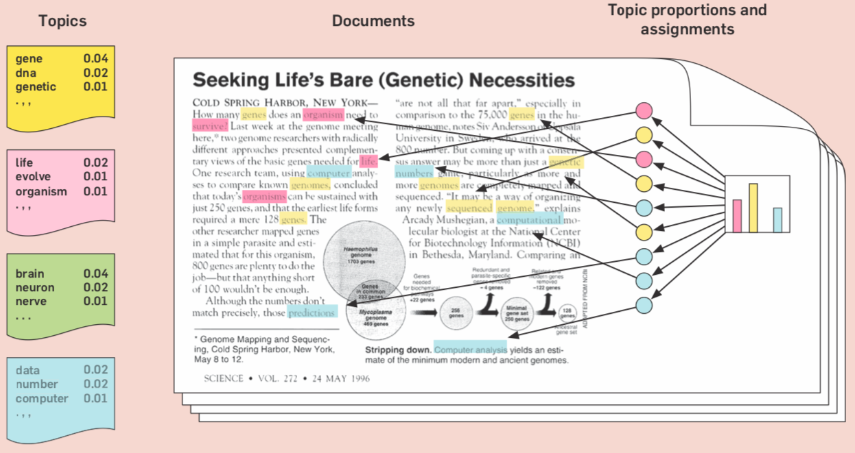
are distributions over words

Slide 7
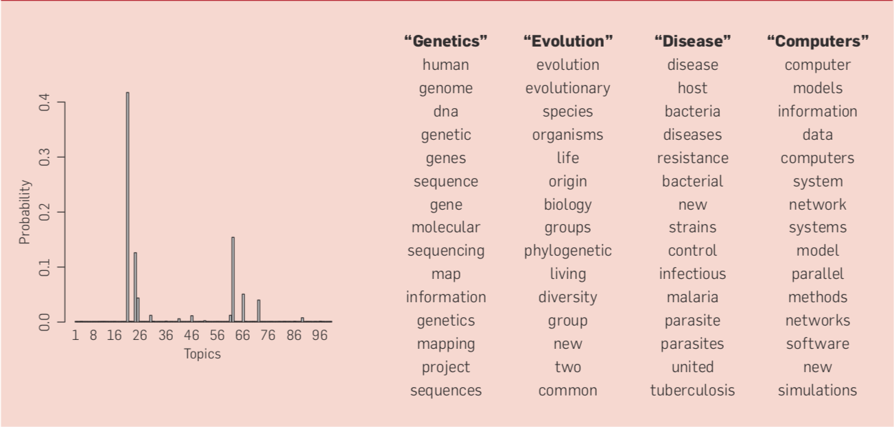

Slide 8
Large Scale Topic Modeling
U.S. National Institutes of Health (NIH) -
80,000 Grants per year
25 grant-awarding Institutes and Centers
Distinct, overlapping and multi-faceted relationships
Reporting (i.e., Congress) and navigating the funding landscape very challenging
http://www.nihmaps.org
Applied topic modeling and automated clustering algorithm to produce a graphical layout of grants across Institutes/Centers

Slide 9
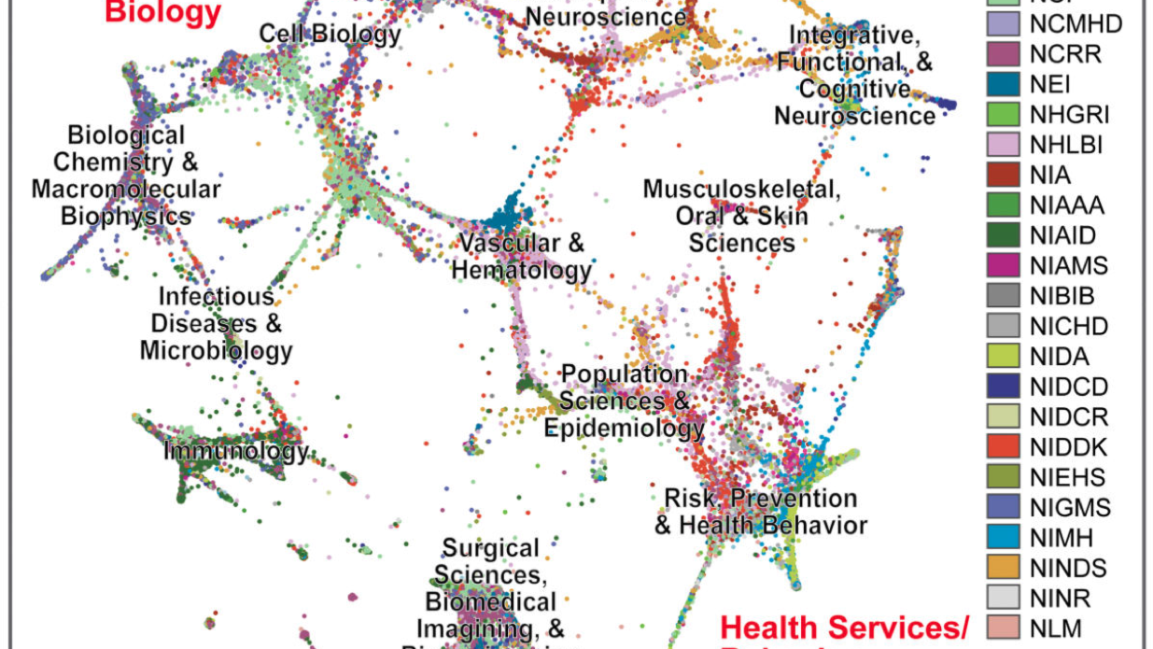
Graphically clustered NIH grants, as rendered from a screenshot of the NIHMaps user interface

Slide 10
Large Scale Topic Modeling - NIH
370,000 documents
150,000 grants
220,000 Pubmed abstracts referenced in grant reports
Preprocessing
Removed stopwords, acronyms, phrases
Non-research terms (e.g., “understanding”, “believe”, “goals”) – 15% corpus
Manually aggregated obviously uninformative terms, increasing stopword list by ~1200 terms
Created a vocabulary using ~600 standardized acronyms and ~4200 commonly used bigrams and phrases
Increased weighing of words in document titles

Slide 11
Large Scale Topic Modeling - NIH
Topic Tuning
Optimize input parameters to generate a individual topics that conveyed a single coherent topic
Number of topics – T
Concentration of topics in a document – alpha
Concentration of terms in a topic - beta
Adjust topic concept resolution to maintain high confidence in the results
Too “few” topics generated topics with ”poor” multiple concepts
Too “many” topics generated numerous “poor” quality or “junk” topics
Eventually select 700 topics as producing an acceptable balance
Well resolved concepts with few topics of poor quality
alpha = 0.05L/T and beta = 0.1, L = average document length

Slide 12
Nonnegative Matrix Factorization (NMF)
Material here related to NMF

Slide 13
References
Probabilistic Topic Models by David Blei
http://www.cs.columbia.edu/~blei/papers/Blei2012.pdf
David Mimno
https://mimno.infosci.cornell.edu/slides/details.pdf
https://mimno.infosci.cornell.edu/info6150/
Numerous paper references
Database of NIH grants using machine-learned categories and graphical clustering
https://www.ncbi.nlm.nih.gov/pmc/articles/PMC5361216/pdf/nihms430007.pdf
Topic Modeling Visualization
https://www.kaggle.com/ykhorramz/lda-and-t-sne-interactive-visualization
Topic Explorer – https://www.hypershelf.org

Slide 14
References
Number of topics:
https://cran.r-project.org/web/packages/ldatuning/vignettes/topics.html
https://www.quora.com/Latent-Dirichlet-Allocation-LDA-What-is-the-best-way-to-determine-k-number-of-topics-in-topic-modeling
Tutorial on LDA in Gensim
https://www.machinelearningplus.com/nlp/topic-modeling-gensim-python/
Similarity neasures
https://dataaspirant.com/2015/04/11/five-most-popular-similarity-measures-implementation-in-python/

