Slide 1

Cyberstalking
Cyberstalking is the use of internet to stalk or harass an individual or a group of individual.
It often happens on social media, email, messaging apps, and online forums.
It may include making false accusations or statements, monitoring, making threats, identity theft, damage to data, etc.
It can cause fear, stress, anxiety and mental issues.
PREVENTION TIPS
Keep personal information private online
Use strong password
Block and report suspicious
Don’t engage with the stalker

Slide 2
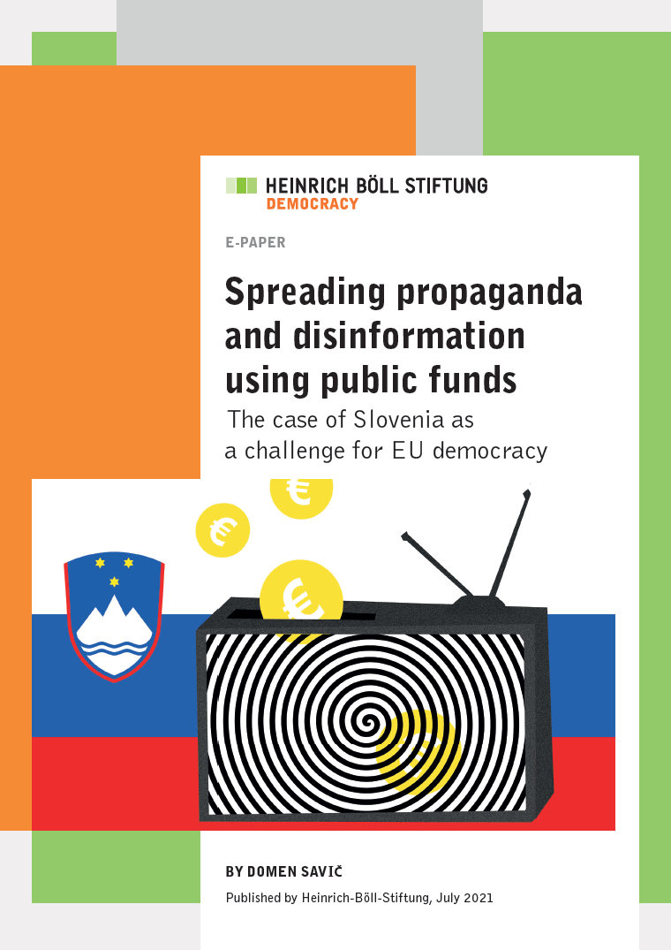
Spreading Rumours Online
With the widespread use of social networking, people think that they can post anything, anywhere.
People create fake email ids and masking their actual identity and believe they’ll never be caught.
Through such fake profiles, they post false information and spread rumours which may hurt others and even lead to communal tensions.
Thus, spreading rumours should be checked as it comes
under the category of cybercrime and punishable offence
under the Information Technology Act
This Photo by Unknown Author is licensed under CC BY-NC-ND

