Slide 1




Smart Phishing Detection: Leveraging Machine Learning for Security
PHISHDETECTOR
Project Guide:
Ms . K. Neelima [M.Tech]
P Nikhila Sai Y21ADS424
Ch Pavan Sai Y21ADS408
A Abhinav Y21ADS403
B Kalyani Y21ADS406

Slide 2

CONTENTS
Abstract
Literature Survey
Existing System
Proposed System
Block Diagram
System Requirements
Algorithms
Applications
Work Plan
Results
Future Scope
References
Conclusion

Slide 3
ABSTRACT
Phishing is a kind of worldwide spread cybercrime that uses disguised websites to trick users into downloading malware or providing personally sensitive information to attackers.
With the rapid development of artificial intelligence, more and more researchers in the cybersecurity field utilize machine learning algorithms to classify phishing websites.
This project proposes a comprehensive framework for detecting phishing websites using machine learning techniques. It involves data collection, preprocessing, feature extraction, model selection, training, evaluation, and deployment.
Relevant features are extracted from URLs, and various machine learning models are explored for classification, with hyperparameter tuning for optimization

Slide 4
LITERATURE SURVEY
Project Title | Author | year | Techniques
Phishing Website Detection using Machine Learning Algorithms | Rishikesh Mahajan, Irfan Siddavatam | 2018 | Decision Tree, Random Forest, Support Vector Machine
Phishing Detection by Using Classification Machine Learning Techniques | Vahid Shahrivari, Mohammad Mahdi Darabi, Mohammad Izadi | 2021 | Logisitc Regression, K Nearest Neighbours, Support Vector Machine
Sufficiency of Ensemble Machine Learning Methods for Phishing Websites Detection | YI WE, YUJI SEKIYA | 2022 | K Means, SVM, Random Forest

Slide 5

EXISTING SYSTEM
Depend heavily on Random Forest and Decision Tree algorithms, need accuracy enhancement.
Decision Trees:
Sensitive to Data Changes: Small changes in training data can significantly alter tree structure and predictions, affecting robustness.
Random Forest:
Imbalanced Data Handling: May favor majority classes in imbalanced datasets, leading to biased predictions.
Overfitting Risk: Can still overfit on noisy or sparse data, affecting generalization despite ensemble learning.
DISADVANTAGES :
Encounter false positives and false negatives, impacting accurate classification.

Slide 6
PROPOSED SYSTEM
• In the proposed system, we introduce machine learning models such as Logistic Regression, Support Vector Machine, Gradient Boost, XGBoost, Naive Bayes alongside Random Forest and Decision Tree algorithms used in existing systems.
• By Performing the training over the all Machine Learning models, we choose the best performed Model based on accuracy score of model to perform test data. Here the Machine Learning model is Gradient Boost which having the accuracy score over 97%.
• These additions aim to diversify the model ensemble and improve accuracy. Moreover, we prioritize enhancing the system's latency performance.
• Additionally, a user-friendly interface will be developed to facilitate ease of use.

Slide 7

ADVANTAGES
High Accuracy
Robust Model Selection
Improved Reliability
Optimized Performance
User-Friendly Interface

Slide 8
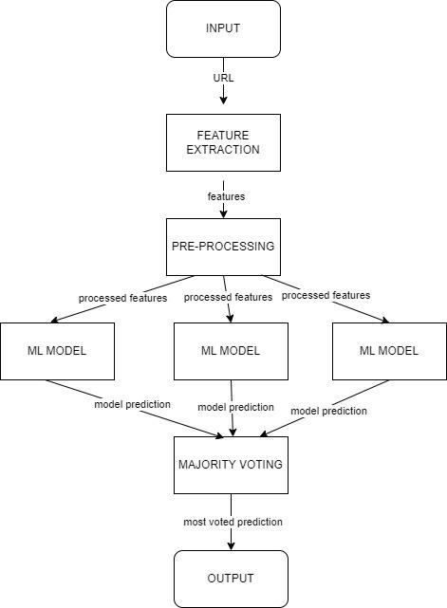
BLOCK DIAGRAM
REQUIREMENTS ANALYSIS
Understand user needs and system expectations, considering limitations of existing systems.
DATA COLLECTION AND PREPROCESSING
Gather and clean a diverse dataset of website URLs, ensuring representation of both legitimate and phishing sites.
FEATURE EXTRACTION AND SELECTION
Extract relevant features such as domain age, URL length, and presence of HTTPS, selecting those most indicative of phishing.

Slide 9
BLOCK DIAGRAM
Choose algorithms like Logistic Regression and XG Boost, train models on the dataset, and optimize parameters through techniques like cross-validation.
MODEL SELECTION AND TRAINING
Assess model performance using metrics like accuracy, precision, recall, and F1-score, ensuring a comprehensive understanding of detection capabilities.
EVALUATION METRICS
Design an intuitive interface for user interaction, allowing seamless input of URLs and clear display of detection results.
USER INTERFACE DEVELOPMENT

Slide 10
HARDWARE
REQUIREMENTS
CPU
Processor: Intel Core i5 or Ryzen 5
GPU
Graphics: NVIDIA Graphics , Radeon Graphics
Memory
Installed RAM: 8 GB OR 16 GB
Installed ROM 516 GB or 1 TB

Slide 11
SOFTWARE
REQUIREMENTS
Operating System
Windows (64bit operating system)
Libraries and Frameworks
- Python : sklearn, XG Boost classsifier, flask [Backend]
ReactJS, Node Js [Frontend]
- Editor : VS Code, Google Colab

Slide 12
ALGORITHMS
Gradient Boosting Classifier (GBC)
Type: Supervised Learning, Ensemble Method
Category: Classification
Use in Project: Used to predict whether a URL is phishing or legitimate based on extracted features.
Why Gradient Boosting?
Combines multiple weak learners (decision trees) to form a strong predictive model.
Focuses on correcting errors made by previous trees in the sequence.
max_depth = 4 – Limits tree depth to avoid overfitting.
Offers high accuracy and robustness for binary classification tasks.

Slide 13
APPLICATIONS
Web Security & Safe Browsing
Email Security & Anti-Phishing Filters
Financial Fraud Prevention
Enterprise Cybersecurity Solutions
Browser Extensions & Security Tools

Slide 14
PLANNING OF PROJECT AND TEAM WORK
Week1 | Week2 | Week3 | Week4 | Week5 | Week6 & Week7 | Week8 | Week9 & Week10 | Week11 | Week12
Explored on various problems in present days and project selection. | Gone through various research papers. | Study of previous models and their disadvantages. | Worked on various formats of machine learning models. | Dataset collection | Developin-g code | Developing code and debugging errors | Enhancement of code | Real world deployment | Documentation

Slide 15
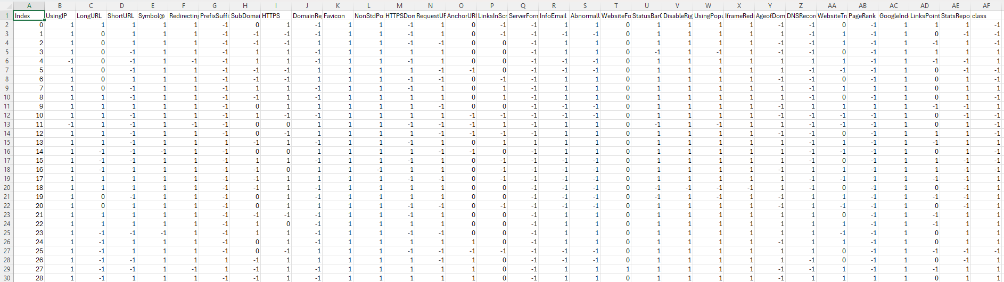
PHISHING URL’S DATASET

Slide 16
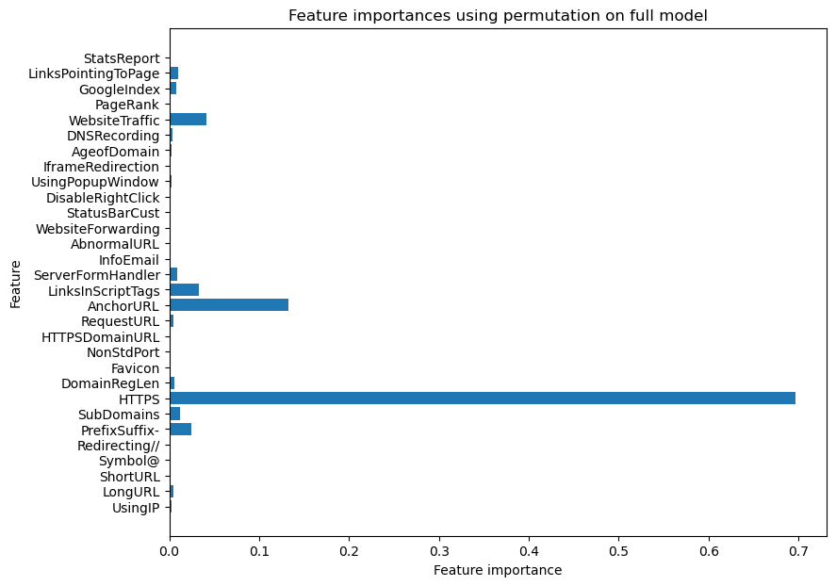
FEATURE EXTRACTION
There are 11054 instances and 31 fearures in dataset.
Out of which 30 are independent features where as 1 is dependent feature.
Each feature is in int datatype, so there is no need to use LabelEncoder.
There is no outlier present in dataset.
There is no missing value in dataset.

Slide 17
Step-by-Step: From URL to Prediction
MACHINE LEARNING MODEL TRAINING:
Dataset: phishing.csv with features and labels (1=Safe, -1=Phishing).
Model: Gradient Boosting Classifier trained on extracted features.
Data split: 80% training,20% testing.

Slide 18
FLASK WEB APPLICATION:
User Interface: Built using Flask with an HTML form to input a URL.
Feature Extraction: The FeatureExtraction class processes the input URL and returns a list of 30 features.
Prediction:
The model predicts if the URL is phishing or not(1=safe, -1=unsafe).
Probabilities for both classes are also calculated .
Output Display: Displays the prediction result on the webpage with probability of being safe.

Slide 19
FULL FLOW :
User enters a URL on the webpage.
Features are extracted from the URL.
Trained model predicts phishing status.
Result is shown back to the user with confidence level.

Slide 20
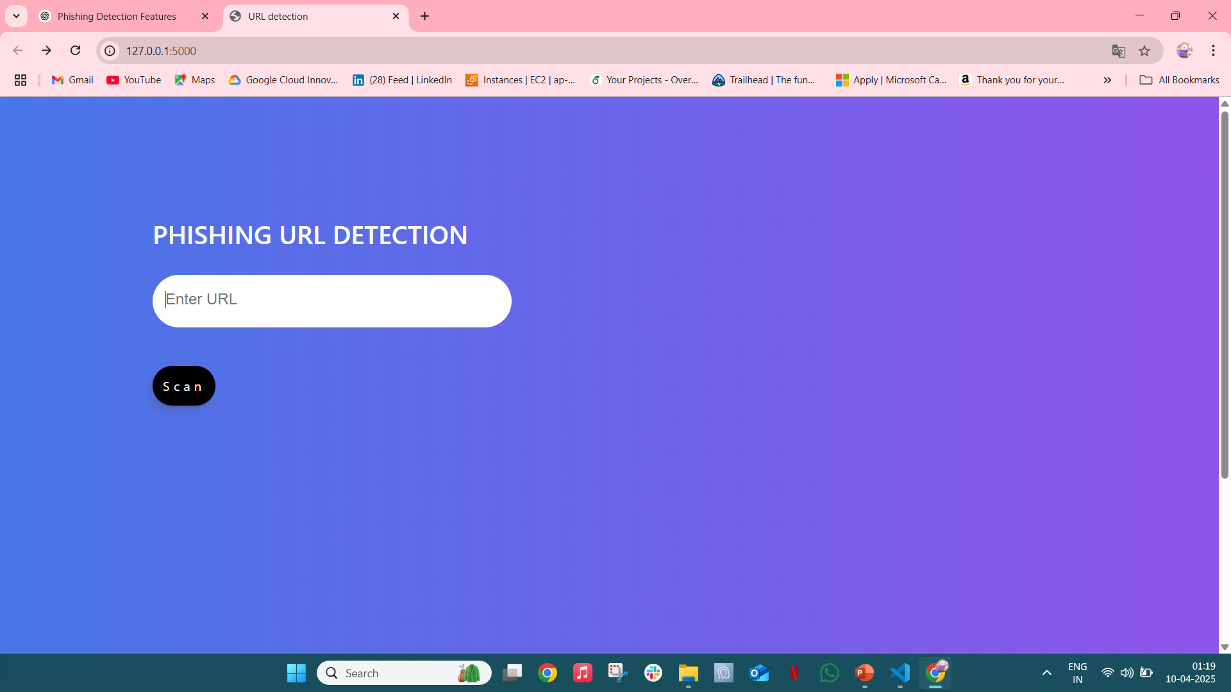
RESULTS

Slide 21
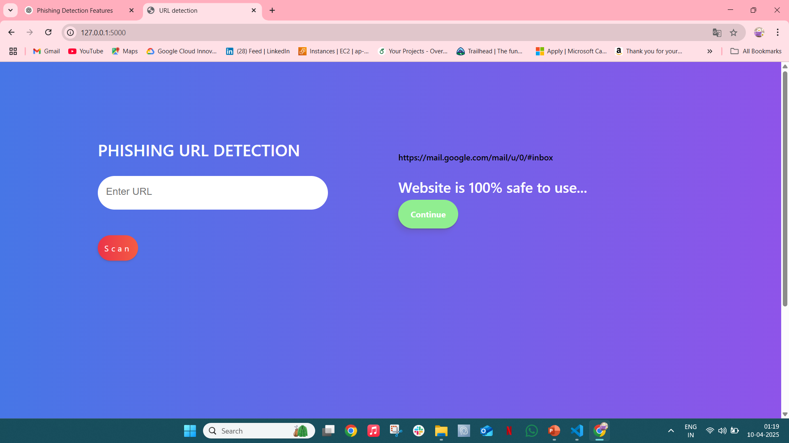

Slide 22
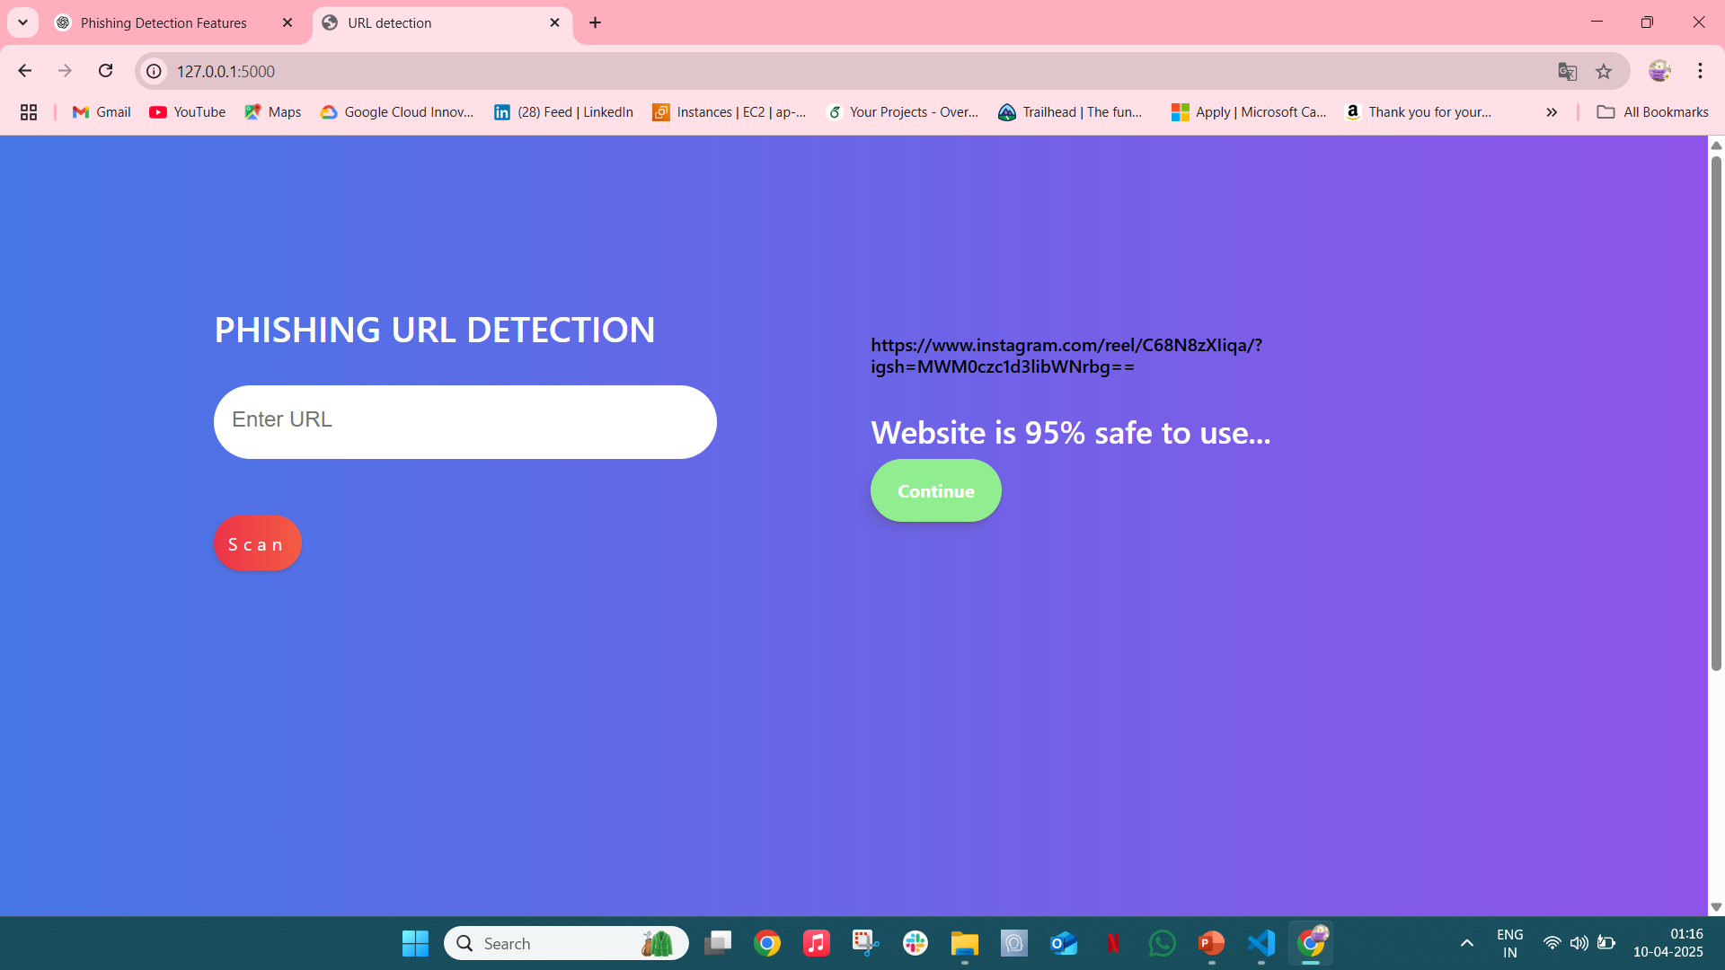

Slide 23
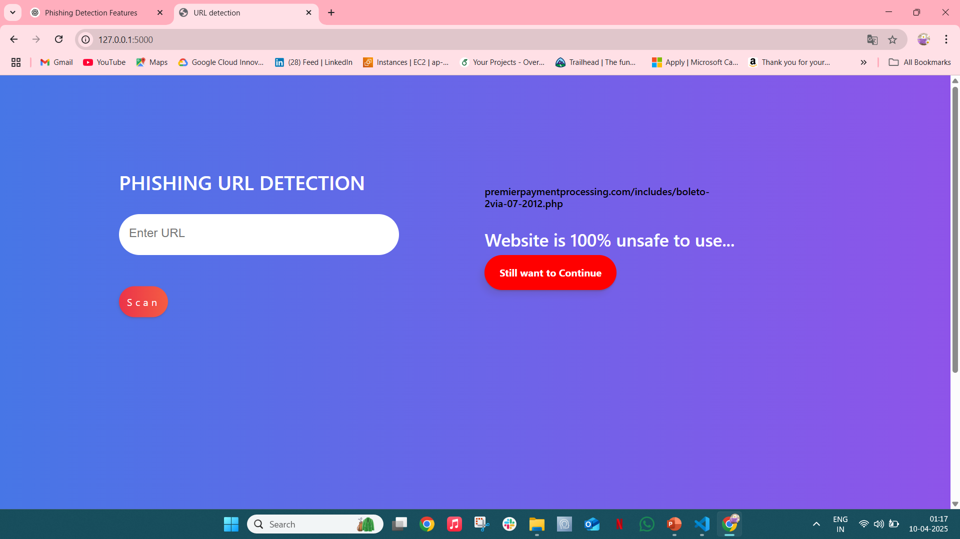

Slide 24
FUTURE SCOPE
By including auxiliary modules like registration services, website content, network reputation, file paths, & registry keys, DeepURLDetect (DUD) model can be strengthened.
One about key directions considering future work can be considered towards this.

Slide 25
REFERENCES
Shreya Gopal, Phishing Website Detection using Machine Learning Techniques, GitHub, Link
Research Paper: Phishing Website Detection using ML Algorithms, ResearchGate, Link
Phishing Detection using Machine Learning, SlideShare
Video: Phishing Detection with ML, YouTube, Link

Slide 26
CONCLUSION
To the best of our knowledge, this study is the first analysis to include the findings of all other studies into the detection of phishing websites using machine learning techniques.
The website functionality is used by ML-based phishing approaches to collect information that could be used to classify websites for the purpose of identifying phishing sites. Developing focused anti-phishing approaches and methods as well as minimizing their inconvenience are two waysto prevent phishing.
We achieved 97% detection accuracy using Gradient Boost algorithm with lowest false positive rate. Also result shows that classifiers give better performance when we used more data as training data

Slide 27
THANK YOU

