Slide 1
Recipe Preparation Agent: AI Sous Chef for Smart Cooking
Presented By:
Student Name-Anirudh Panwar
College Name-Graphic Era Deemed to be university
Department-CSE

Slide 2
OUTLINE
Problem Statement
Proposed System/Solution
System Development Approach (Technology Used)
Algorithm & Deployment
Result (Output Image)
Conclusion
Future Scope
References

Slide 3
Problem Statement
Current meal planning and cooking are often limited by the ingredients on hand, leading to food waste, inconvenience, or poor dietary choices.
There is no intelligent solution to suggest recipes, substitutions, or dietary adaptations based on available kitchen items and restrictions (allergies, preferences) in real time.

Slide 4
Proposed Solution
The system addresses the challenge of suggesting smart, personalized recipes based on available ingredients, while considering dietary restrictions and minimizing food waste. It combines language models with real-time knowledge retrieval.
Ingredient Collection:
Users input ingredients via text (future: voice/image).
Optional filters: diet type, allergies, cooking time.
Input Preprocessing:
Clean and map ingredients to standard formats.
Recognize ingredient categories (e.g., leafy greens).
Recipe Generation:
Suggests step-by-step instructions and smart substitutions.
Deployment:
Built using IBM watsonx Agent Lab and deployed as a REST API.
Usable via chatbot, web, or smart device interfaces.
Evaluation:
Based on user satisfaction, clarity, and ingredient match.
Improved with continuous feedback.
Result:
Smarter meal planning
Reduced waste
Cooking made easier and more inclusive

Slide 5
System Approach
System Requirements:
IBM Cloud Lite account
watsonx.ai and Agent Lab
Cloud Object Storage
Technologies:
LangGraph
IBM Foundation Models (Mistral)
REST API
Methodology:
Low-code agent via GUI
Web/Knowledge tools
Deployable as reusable AI service

Slide 6
Algorithm & Deployment
Data Input: The agent takes input in various forms:
A list of available ingredients (entered as free text)
Optional dietary constraints (e.g., vegan, gluten-free, nut allergy)
Cooking preferences (e.g., quick recipes, no oven, Indian cuisine)
Future expansion may include:
Images of ingredients (via computer vision)
Voice input (for hands-free kitchen use)
Training Process:
No fine-tuning or supervised training is required as the agent uses pre-trained foundation models.
The system is enhanced with a curated set of retrieval tools: web search, Wikipedia, and internal recipe datasets.
Tools are connected via IBM watsonx Agent Lab using the LangGraph framework with the ReAct agent strategy.
Prediction Process:
When the user provides ingredients and constraints, the agent first performs knowledge retrieval using built-in tools.
The retrieved results are passed to the LLM, which generates a personalized, step-by-step recipe.
The agent also suggests smart substitutions (e.g., “Out of eggs? Try using yogurt or banana.”) and highlights allergy considerations.
The model generates natural language output suitable for display in web/mobile apps.
Deployment:
The system is deployed using the “Deploy as AI service” option in IBM watsonx Agent Lab.
A REST API is automatically generated, enabling integration with other applications (e.g., mobile app, smart fridge UI).
The deployment is scalable and can handle multiple concurrent users with low latency.

Slide 7
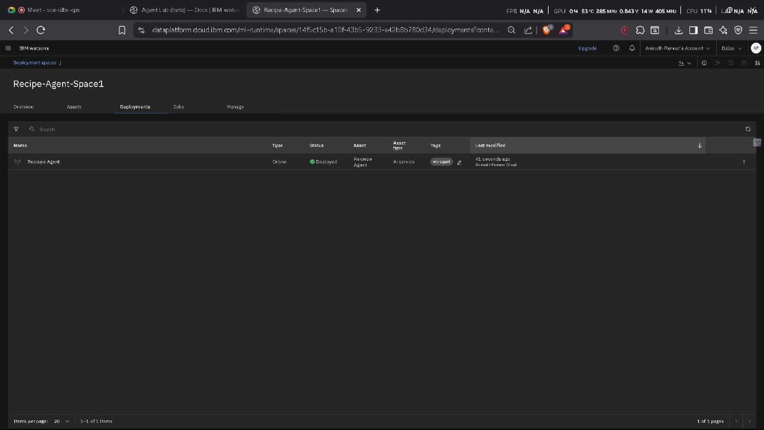
Result

Slide 8
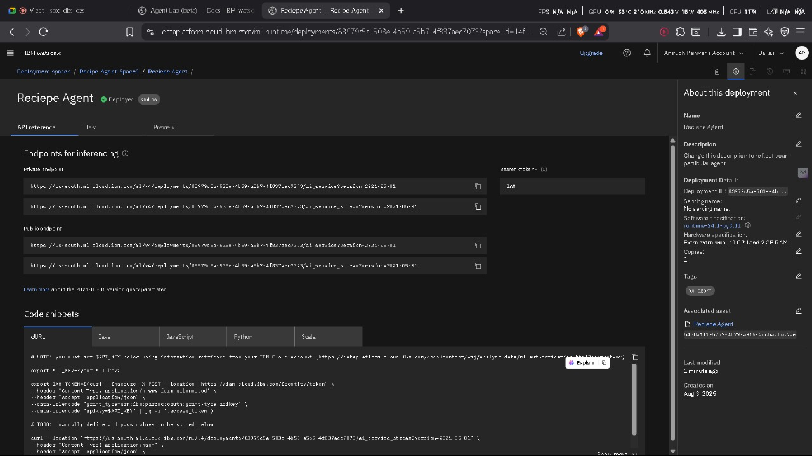

Slide 9
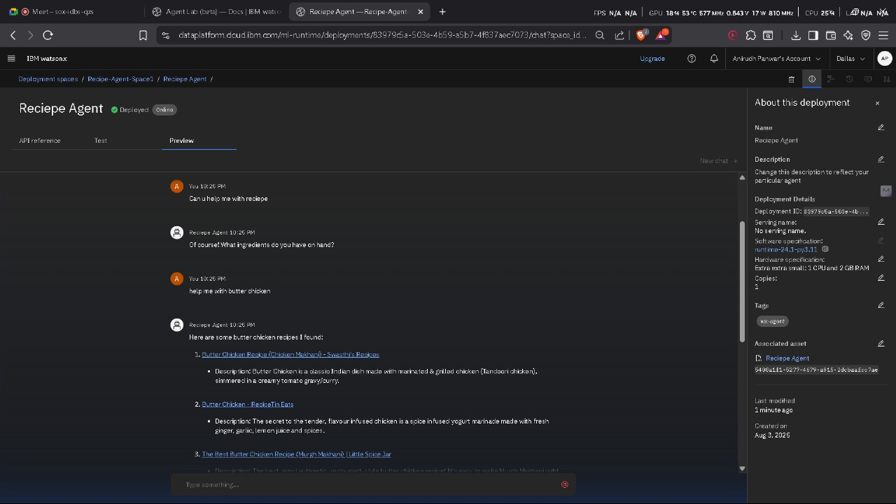

Slide 10
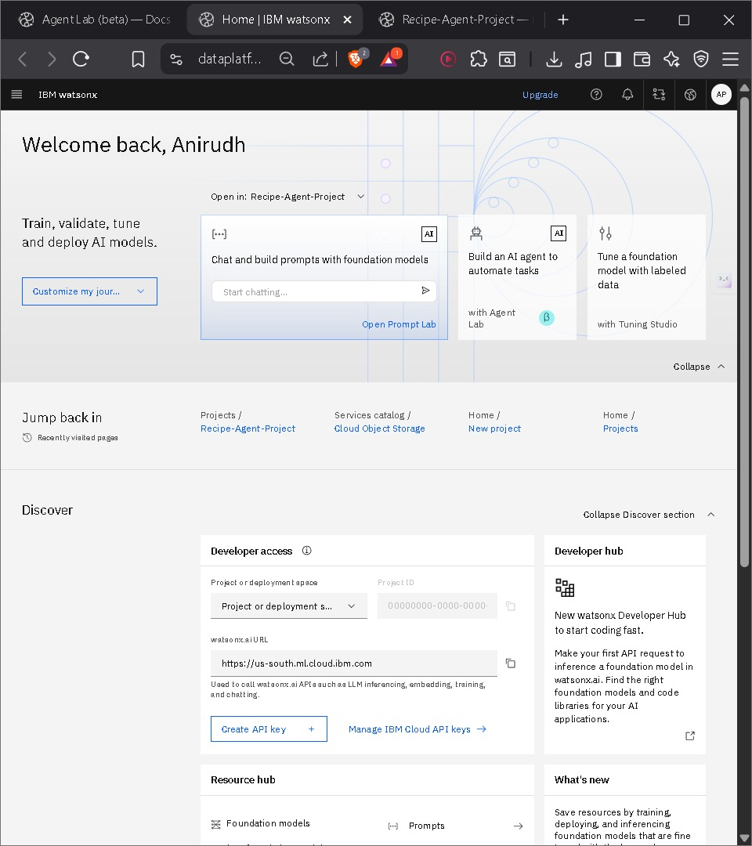

Slide 11
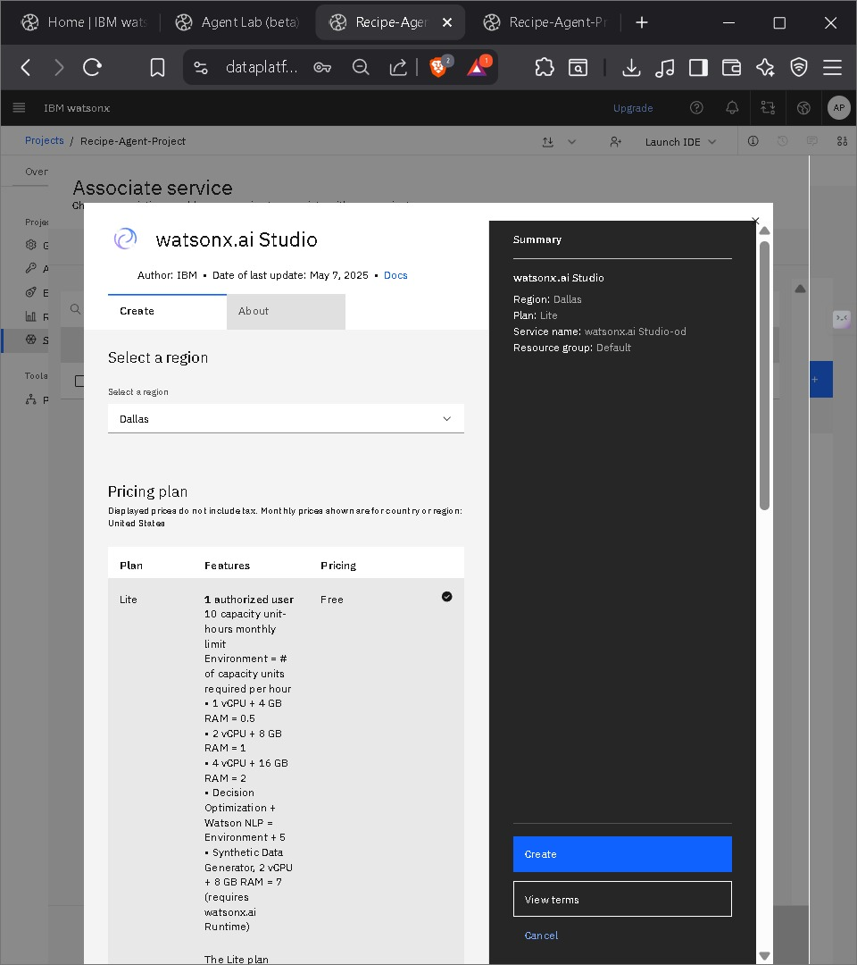

Slide 12
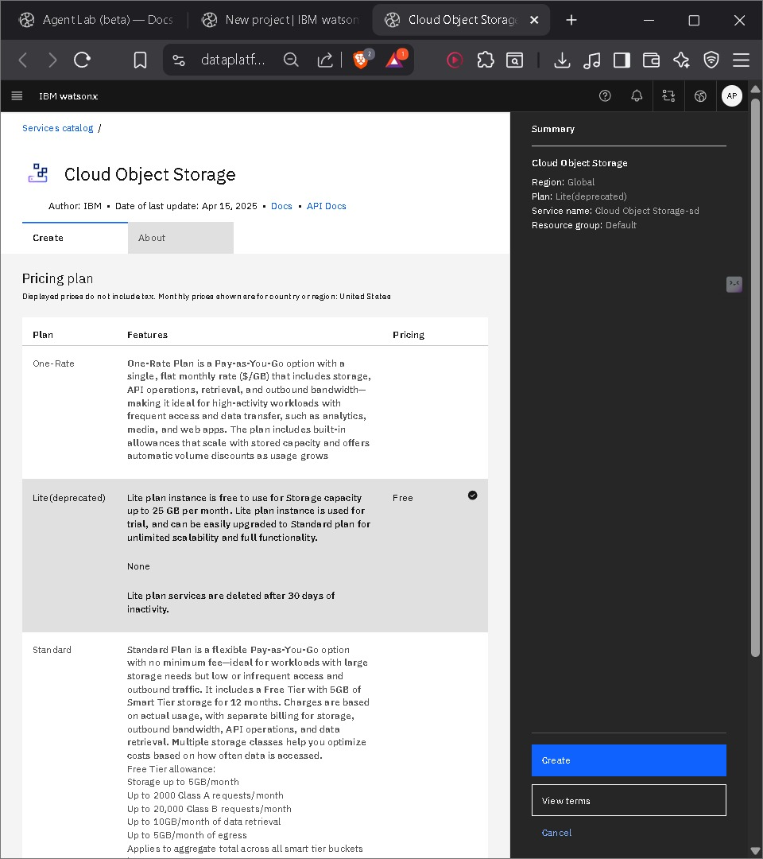

Slide 13
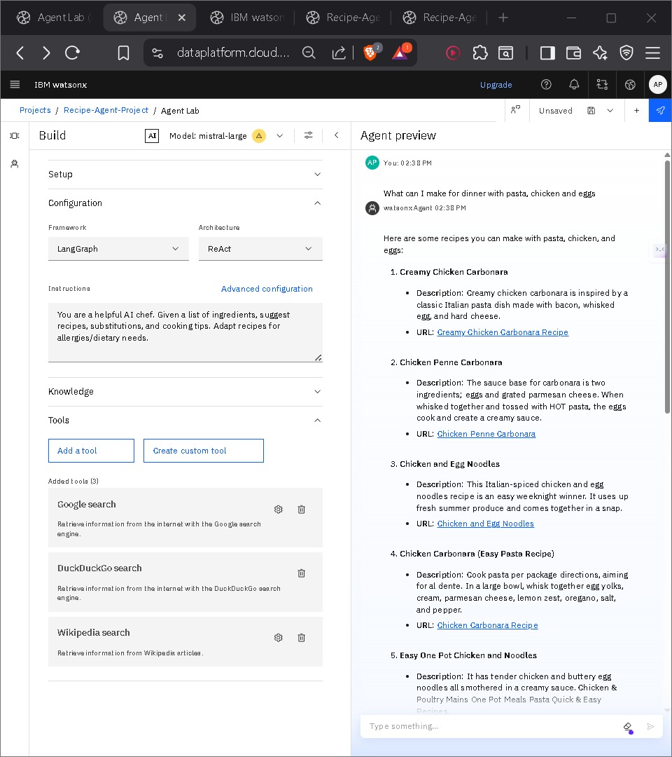

Slide 14
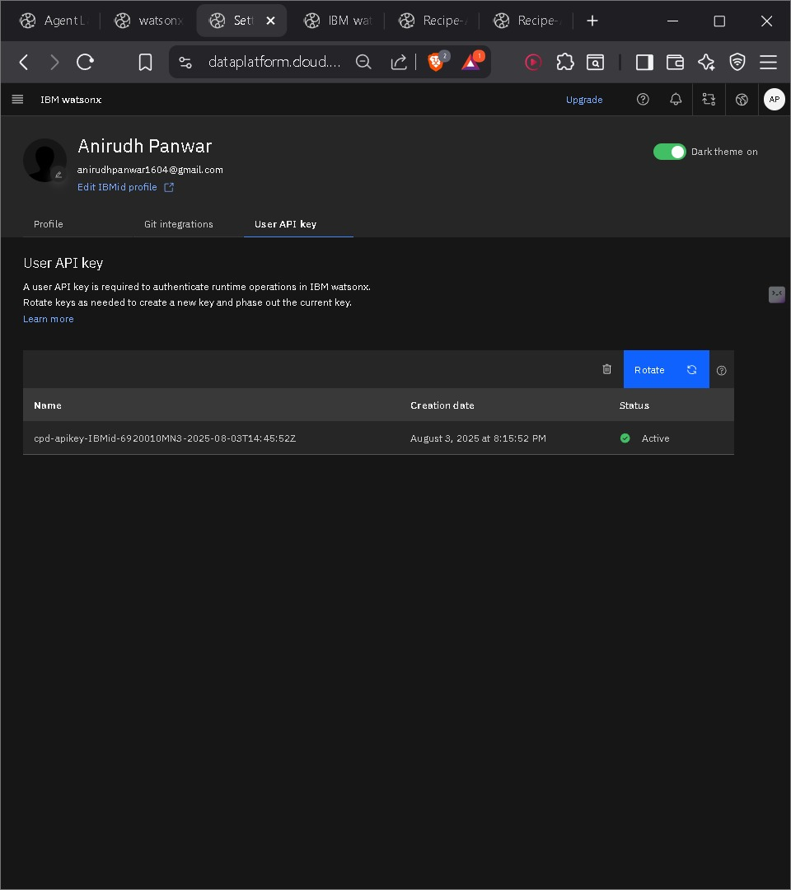

Slide 15
Conclusion
The Recipe Preparation Agent is a practical AI assistant for cooking.
Adapts to kitchen constraints
Reduces food waste
Promotes healthy eating
Scalable & easily integratable via IBM Cloud

Slide 16
Future scope
Smarter Data
Integrate nutritional info, grocery APIs, and user preferences.
Support regional and seasonal recipes.
Algorithm Improvements
Use advanced ML (e.g., reinforcement learning) for personalized suggestions.
Learn from user feedback and history.
Scalable Reach
Expand to support multiple cuisines, languages, and cities.
Adapt recipes to local ingredients and culture.
Emerging Tech
Add voice and image input for hands-free, visual cooking.
Enable offline use via edge computing.
Seamless Integration
Auto-generate shopping lists.
Recommend recipes using soon-to-expire items.

Slide 17
References
IBM watsonx.ai documentation
IBM Cloud Lite Services
IBM SkillsBuild project.

Slide 18
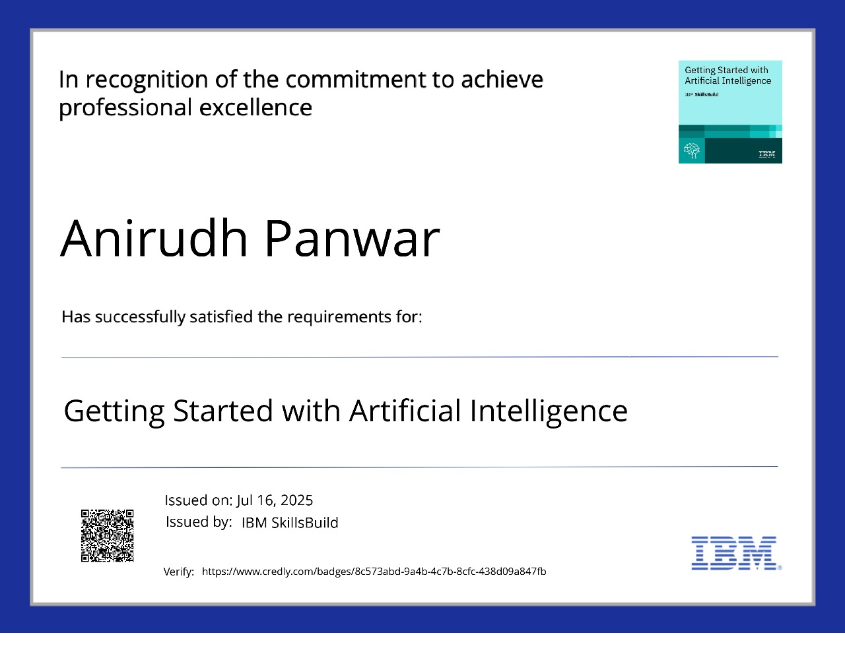
IBM Certifications

Slide 19
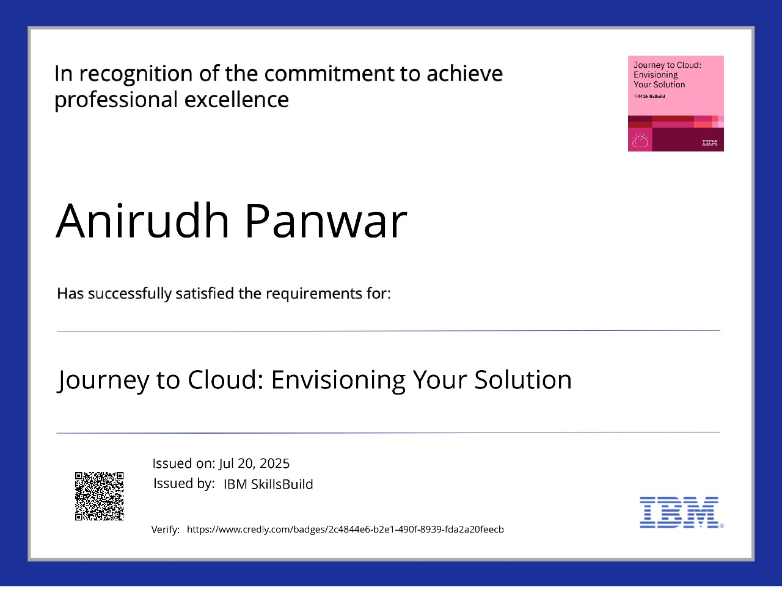
IBM Certifications

Slide 20
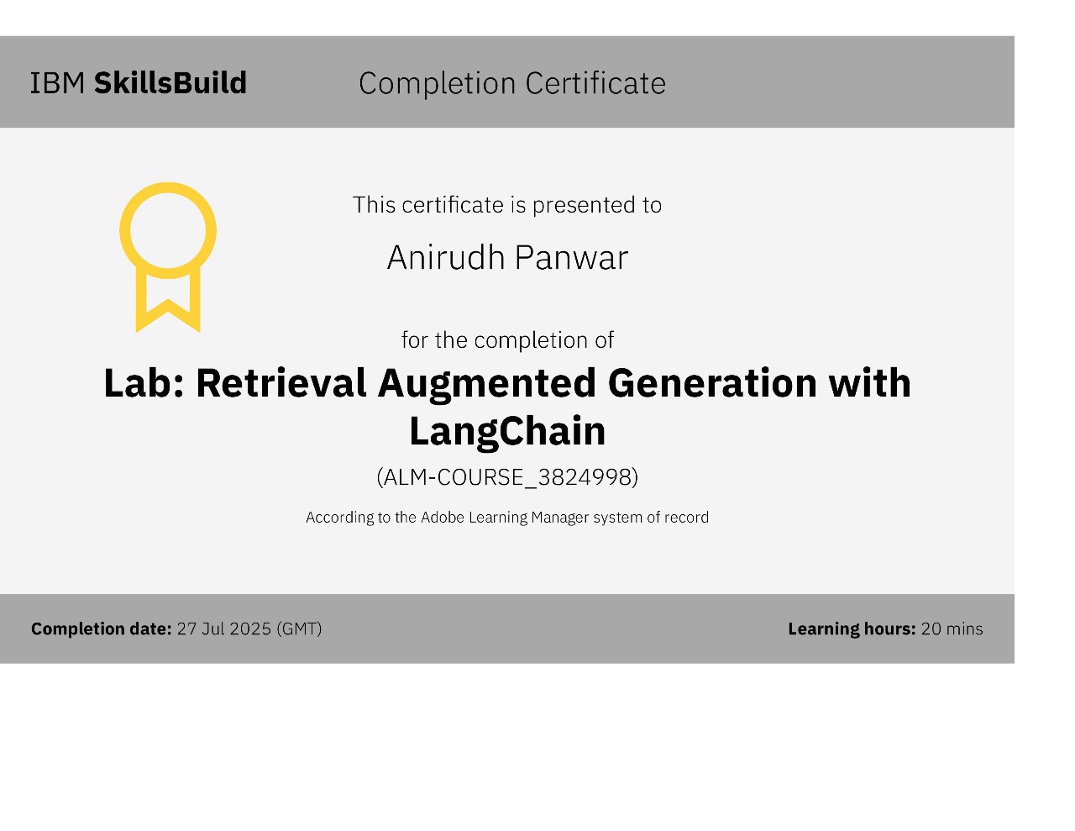
IBM Certifications

Slide 21
THANK YOU

