Slide 1
EEG

Slide 2
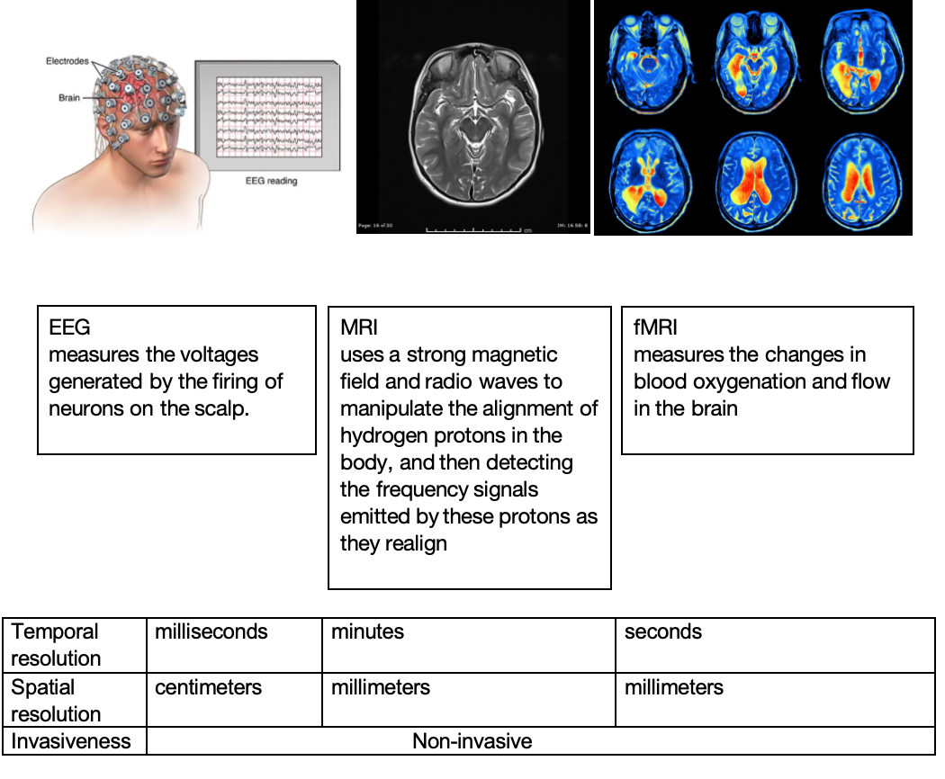

Slide 3
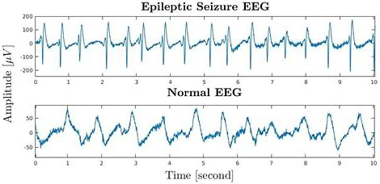
Application of EEG: epilepsy detection

Slide 4
BCI

Slide 5
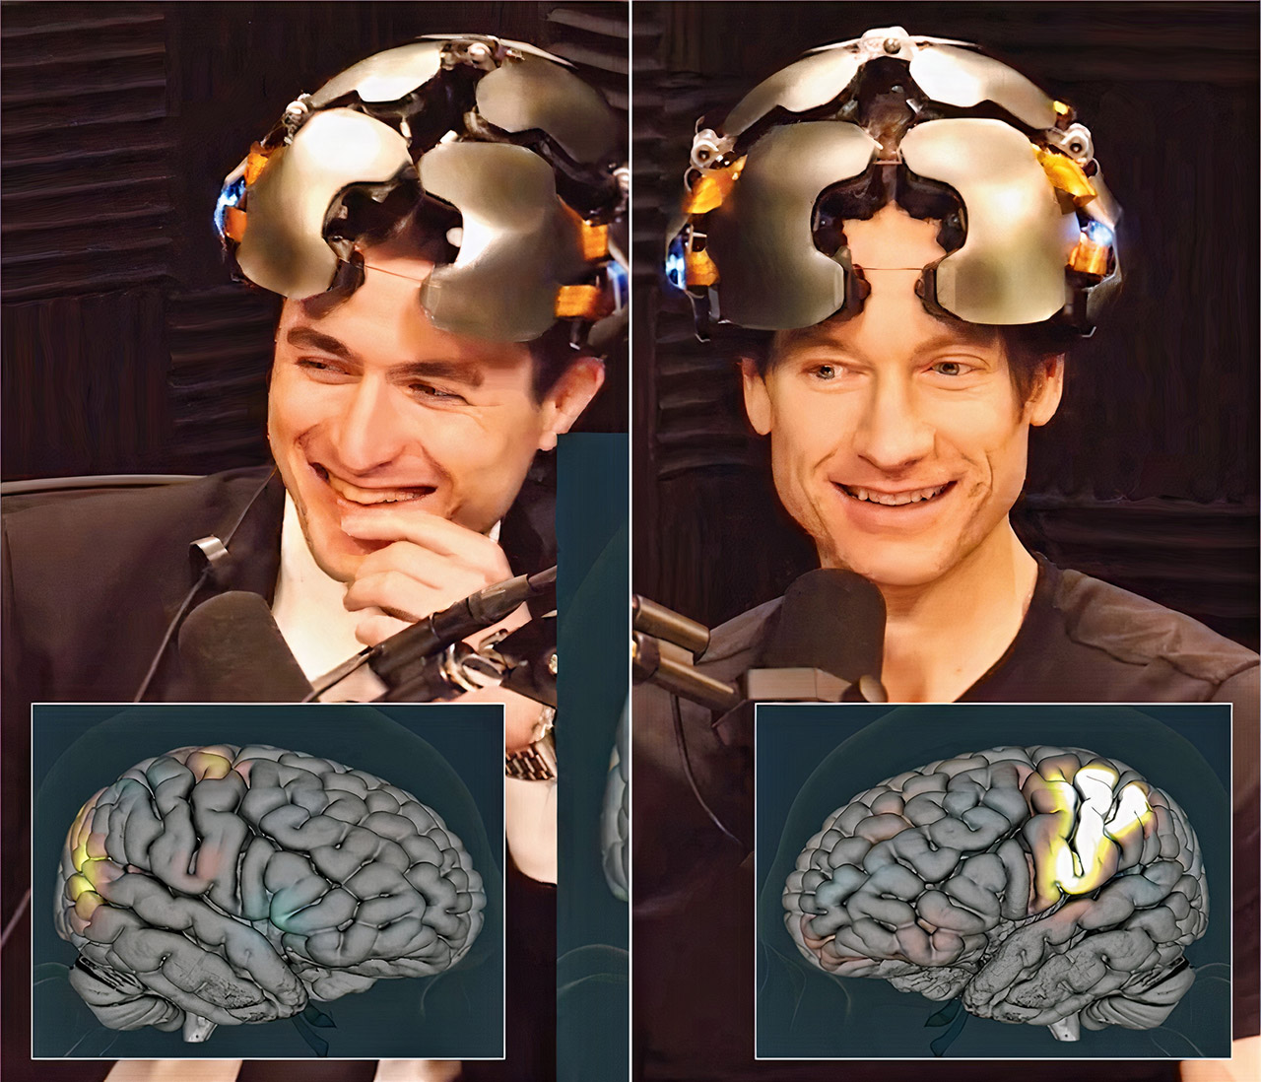
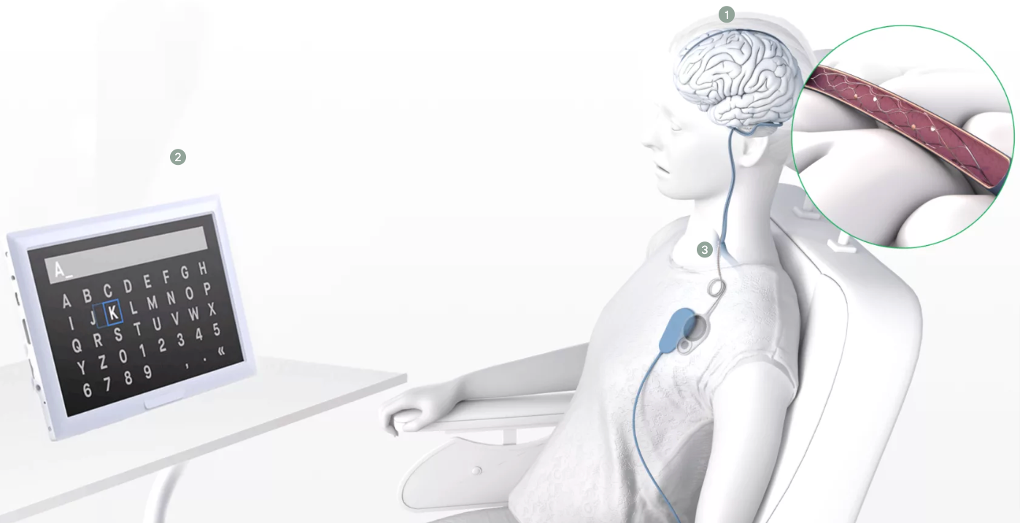
BCI
Neuralink: invasive, surgical implant
Synchron: via the large vein next to the motor cortex in the brain, minimally invasive
OpenBCI: open source, EEG
Kernel, brainco: non-invasive
宏智力科技

Slide 6
Neuralink
Founder: Elon Musk
"years of internal conflict in which rushed timelines have clashed with the slow and incremental pace of science."
Invasive - disabled people
Monkey: https://www.youtube.com/watch?v=rsCul1sp4hQ
progress: implant wireless and increasing the number of implanted electrodes
Human: https://www.youtube.com/watch?v=ZzNHxC96rDE&t=268s
problem: 85% wires retract, risk associated with retraction, granulomas
Blindsight

Slide 7
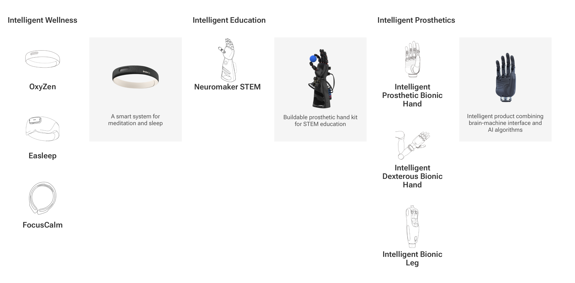
Brainco
公众号：brainco强脑科技

Slide 8
