Slide 1
Tuesday, 14th Mar 2023
PROJECT ADVISOR
TEAM 07
Dr. Aneesh G Nath
Prof. Shyna A
Ann Mary Saji
Muhammed Farhan
Sreelakshmi Chandran
Vishal Vidyanand
R6B, TKMCE
ScribbleInspect
Assignment Evaluator
Software Requirement Specification

Slide 2
Table of
Contents
Page
I
Problem statement
1
II
Why this software?
2
III
Scope
3
IV
Stakeholder identification and survey
4
V
Requirement Gathering Methodologies
5
VI
Project Plan
6
VII
Literature Review
7
VIII
Functional Requirements
8

Slide 3
Table of
Contents
Page
IX
Non Functional Requirements
11
X
Application Interface and Requirements
12
XI
Landing Page
13
XII
Login/Register Page
14
XIII
Student/Teacher Dashboard
15
XIV
Grade Card and Analysis Report
16
XV
Student Request for Review
17
XVI
Tools used
18

Slide 4

I
Problem Statement
The problem is the need for an efficient and accurate handwritten assignment grading software that can automate the grading process while reducing the workload for teachers. The proposed software aims to address this issue by providing an automated solution that can handle different types of assignments, analyze handwriting, and provide accurate feedback to students.
1

Slide 5

II
Why this software?
We need this app to automate the process of grading handwritten assignments, reduce the workload for teachers, and provide accurate feedback to students while minimizing the risk of subjective grading.
2

Slide 6
III
Scope
Automatic evaluation of handwritten assignments will help teachers save a lot of time
Consistent grading standard
Analyse different handwritings in the same way
Provide accurate feedback to students
User-friendly interface
Absence of a strong market competitor
3

Slide 7

IV
Stakeholder Identification
Primary Stakeholders
Teachers
Students
Developers
Secondary Stakeholders
School administrators
Parents
4

Slide 8



V
Requirement Gathering Methodologies
Google Form Survey
Various requirements can be figured out by conducting survey for teachers as well as students in separate google forms
Ethnographic method
Development team go through the life cycle of an assignment in real life and gather explicit and implicit requirements
5

Slide 9
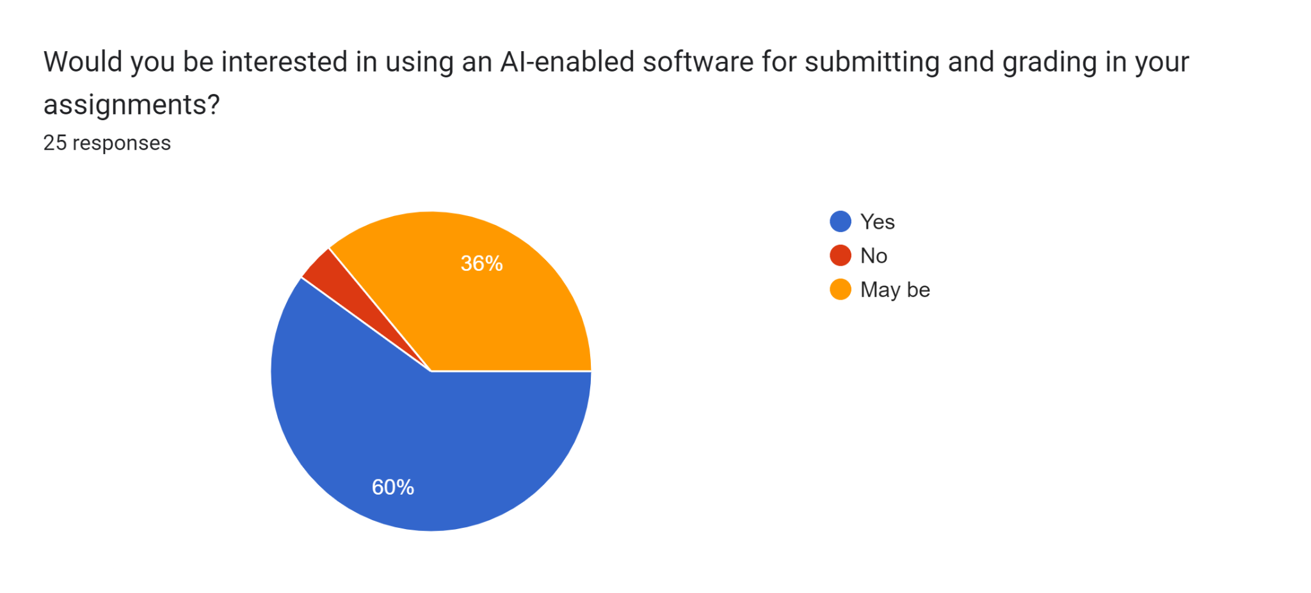
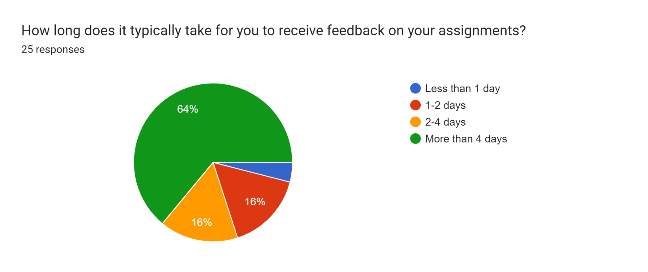

Slide 10
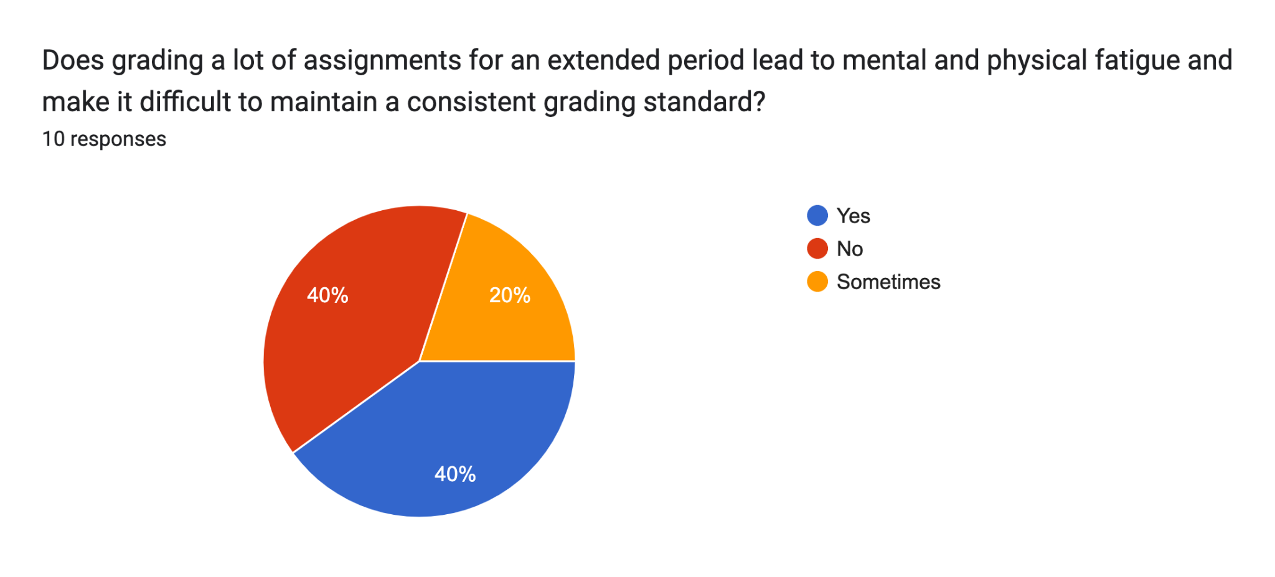
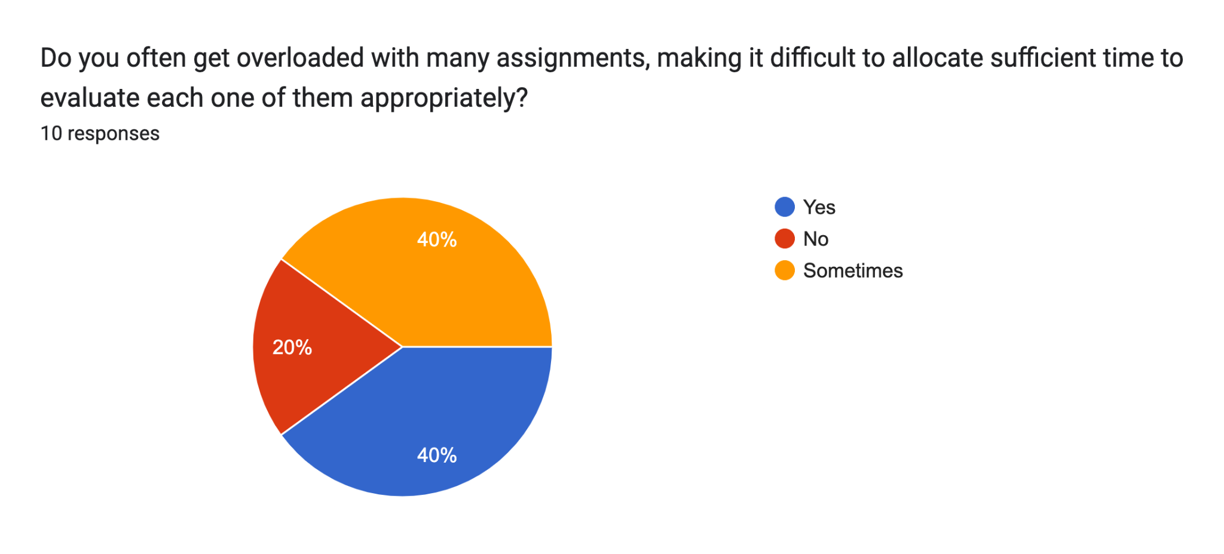

Slide 11
VI
Project Plan
Define project scope, goals and objectives
Conduct feasibility study
Identify primary and secondary stakeholders
Define software requirements
Design software architecture and design
Develop and test source code
Frontend
Backend
ML model integration
Integrate the software with the user-friendly interface
Conduct User Acceptance Testing (UAT)
Implement the software in pilot environment and collect user feedback
Make necessary modifications
Launch the software in production
Provide training and user support
Monitor and maintain the software
6

Slide 12
VII
Literature Review
Despite the availability of individual and fully operational systems for handwriting recognition and assignment evaluation, the integration of these systems into a cohesive and functional product remains a challenging task.
A functional product for grading handwritten assignments has not been released despite continued research efforts and testing of various models.
Several studies have explored the use of machine learning algorithms for grading handwritten assignments.
Literature review
7

Slide 13
VIII
Functional Requirements
Input requirements
The software application will require the following input requirements
Teacher
Assignment details: Name, maximum marks, deadline, etc
Answer key: Correct answer for each question, max marks for each question, etc
Moderation: Reviewed assignment marks
Student
Written assignment: Assignment uploaded as pdf or any image format
Request for review: If assignment grading is not satisfactory
8

Slide 14
VIII
Functional Requirements
Output requirements
The software application will require the following output requirements
Teacher
Assignment grades: Marks of each student, analysis reports, etc
Review requests: Requests from students if result is unsatisfactory
Student
Assignment grade: Evaluated assignment grades
9

Slide 15
VIII
Functional Requirements
Processing requirements
The software application will require the following processing requirements
Convert the handwriting in the pdf to text
Perform subjective analysis and similarity checks for the text vs answer keys
Communication between Django server and React application
Communication between Django server and CloudSQL
10

Slide 16
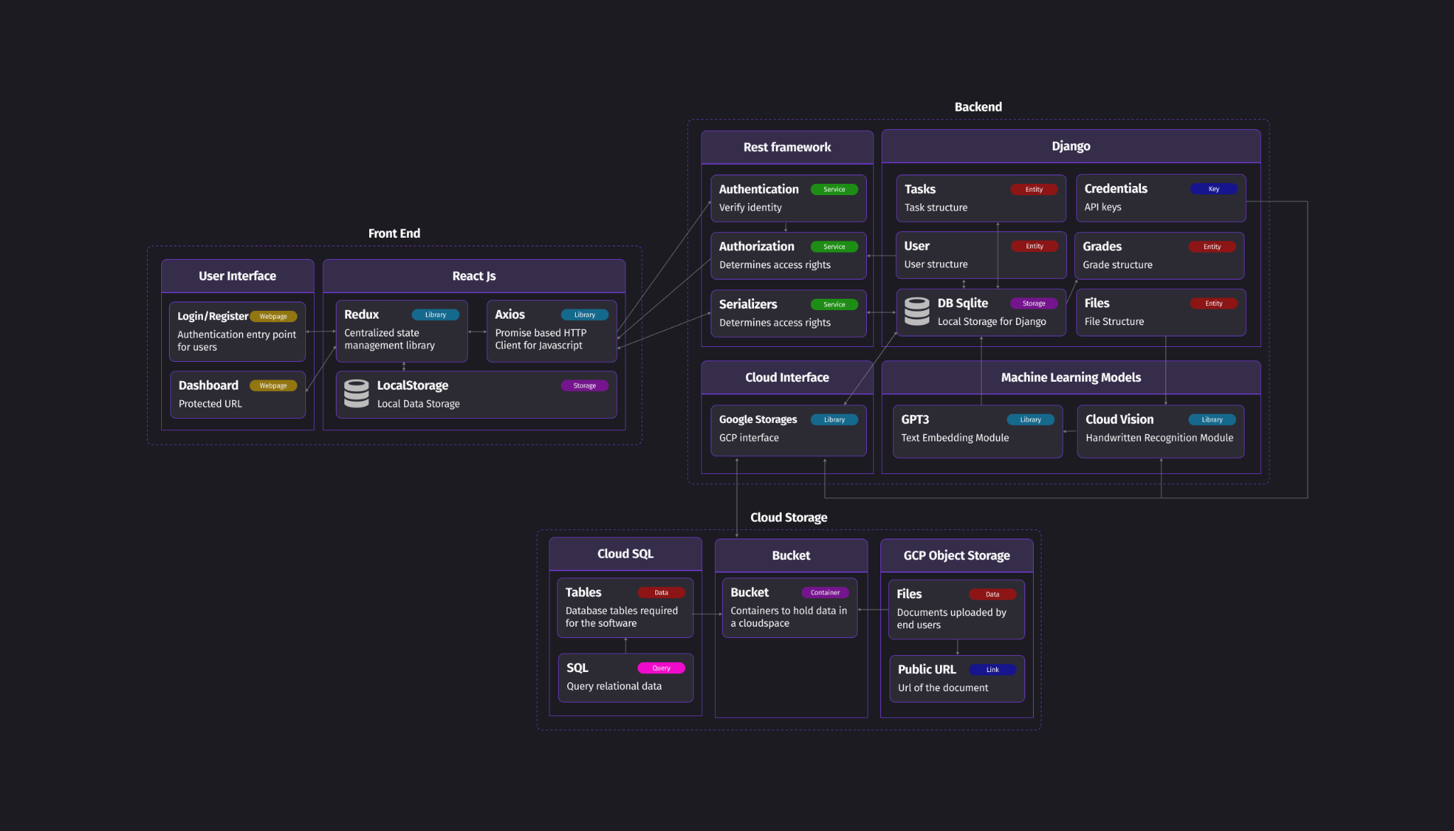
10

Slide 17
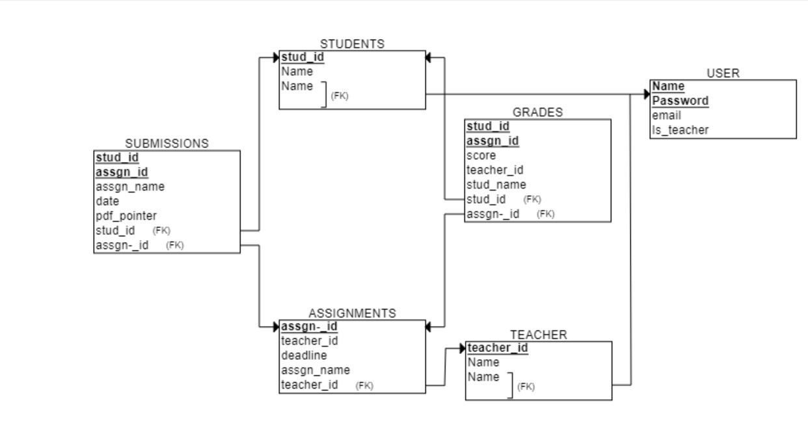
10

Slide 18
IX
Non Functional Requirements
Performance: Analyse and grade assignments quickly and accurately, without any significant latency
Usability: User-friendly interface for teachers and students
Security: Password-protected authorisation
Scalability: Handle a large number of assignments simultaneously without any degradation in performance
Reliability: Reliable, minimal downtime and robust error-handling mechanisms
Maintainability: Software should be easy to maintain, update and modify over time
Compatibility: Compatible with different handwriting styles and formats
Accessibility: Accessible to all users and comply with relevant accessibility standards
11

Slide 19
X
Application Interface and Requirements
Landing page
Login/Register page
Student/Teacher Dashboard
Grade Card and Analysis Report
Request for Review
12

Slide 20
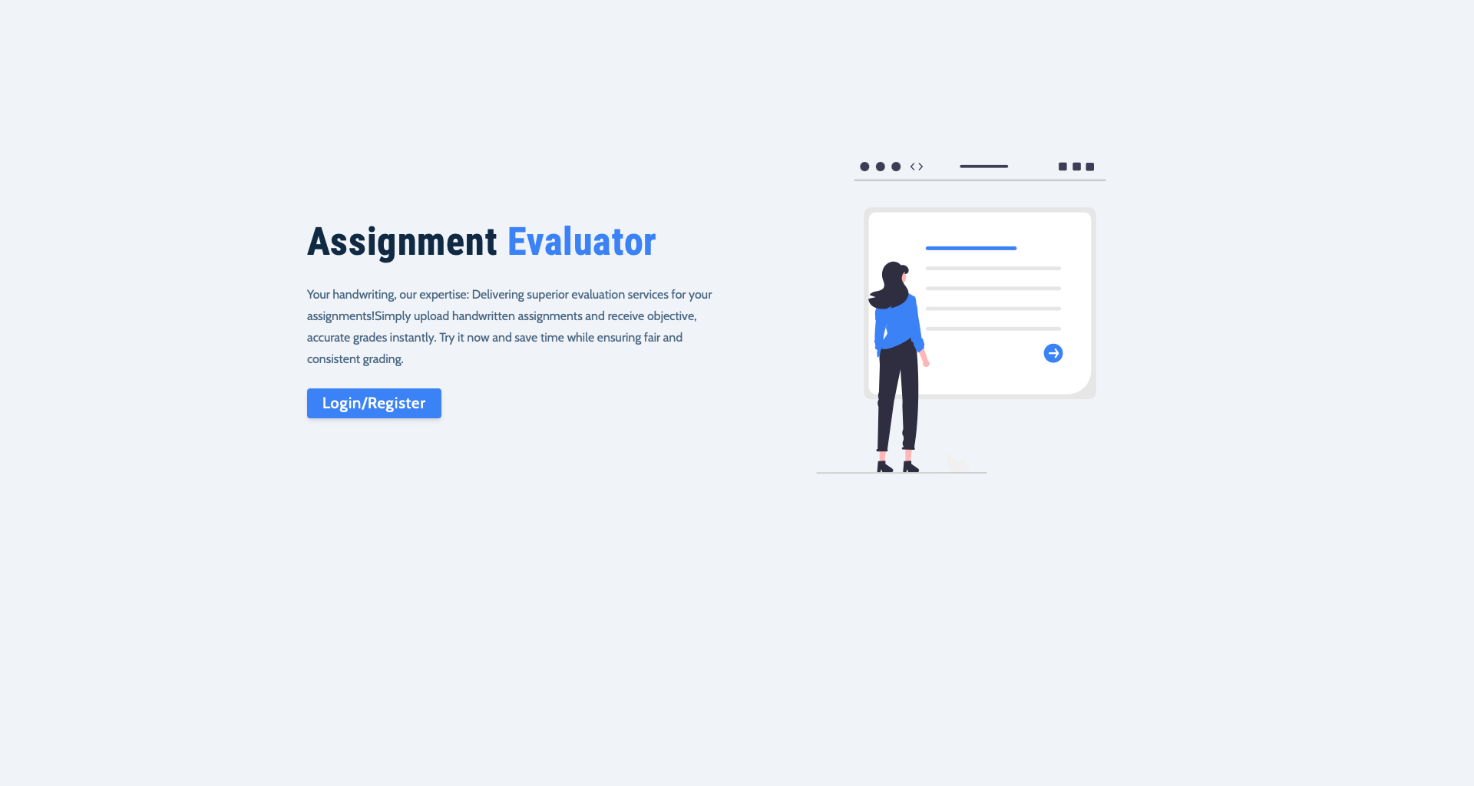
XI
Landing Page
Landing page is designed to encourage users to take a specific action, typically the first page a user sees after entering the website
Functional Requirements
Button provided should lead the user to the Login/Register page
Non Functional Requirements
Should be appealing to the user since it creates a first impression
13

Slide 21
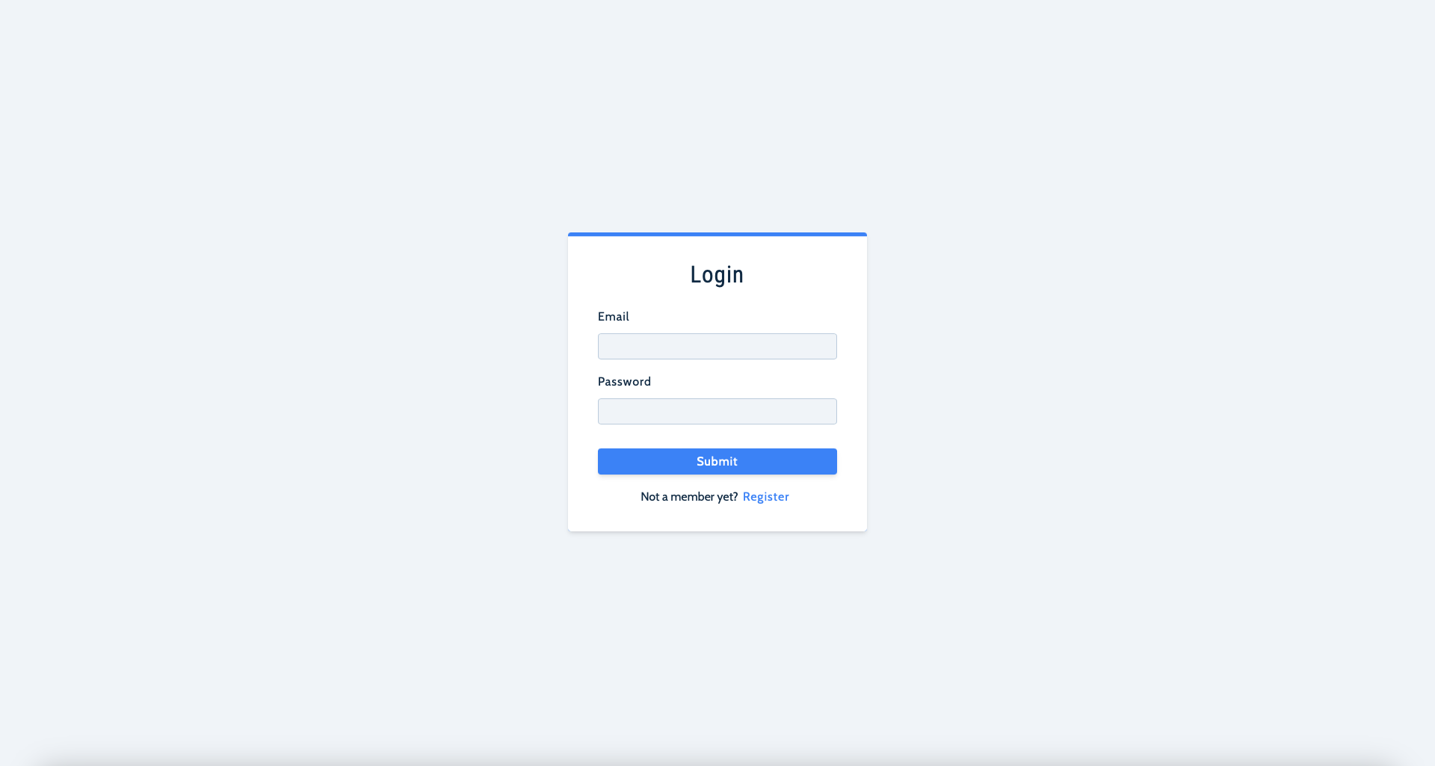
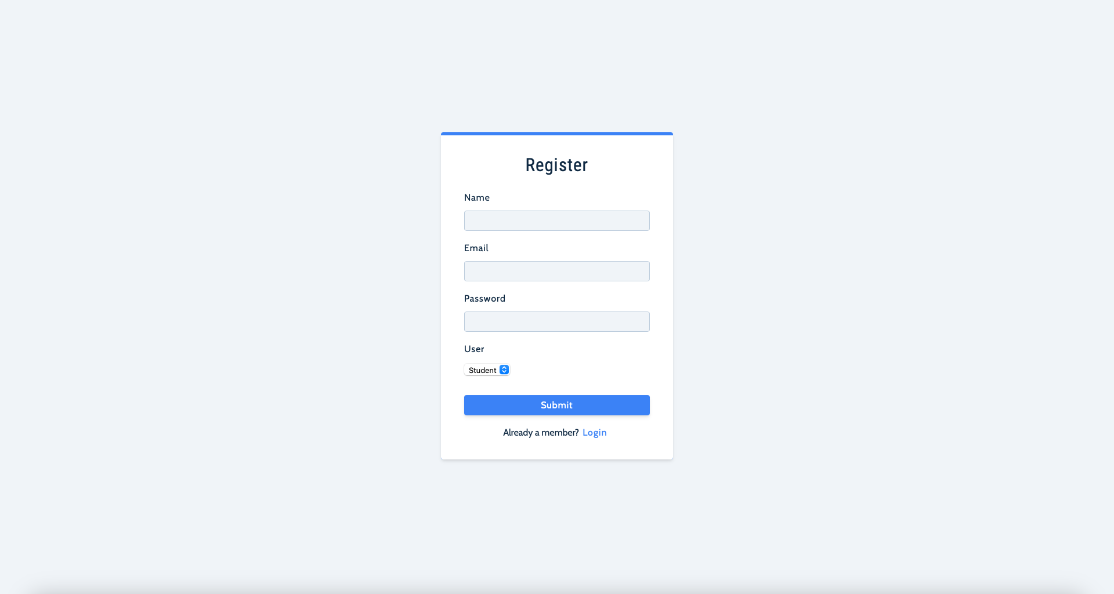
XII
Login/Register Page
Login page is to authenticate a user before entering a website. Register page is to create a new student/teacher
Functional Requirements
Takes input from the user
Shows an error message if user didn’t enter all values or user credentials are wrong
Lead user to dashboard of student or teacher based on who is logged in
Non Functional Requirements
Security: Students should not be able to register as a teacher
14

Slide 22
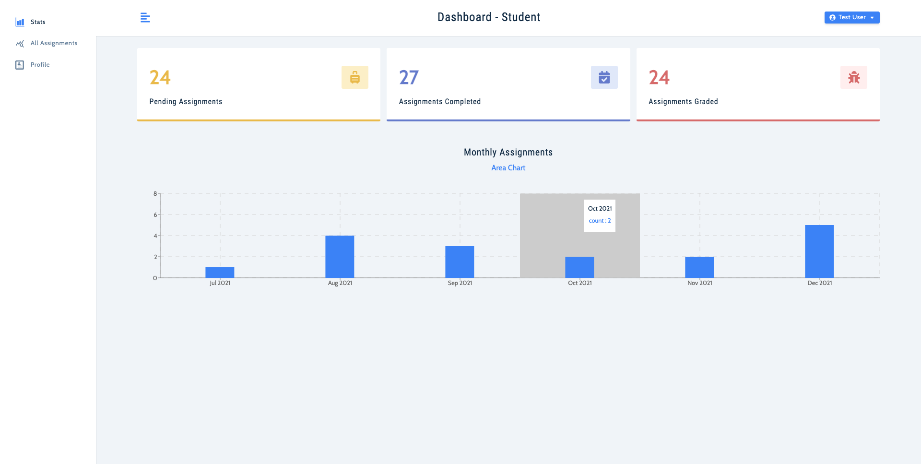
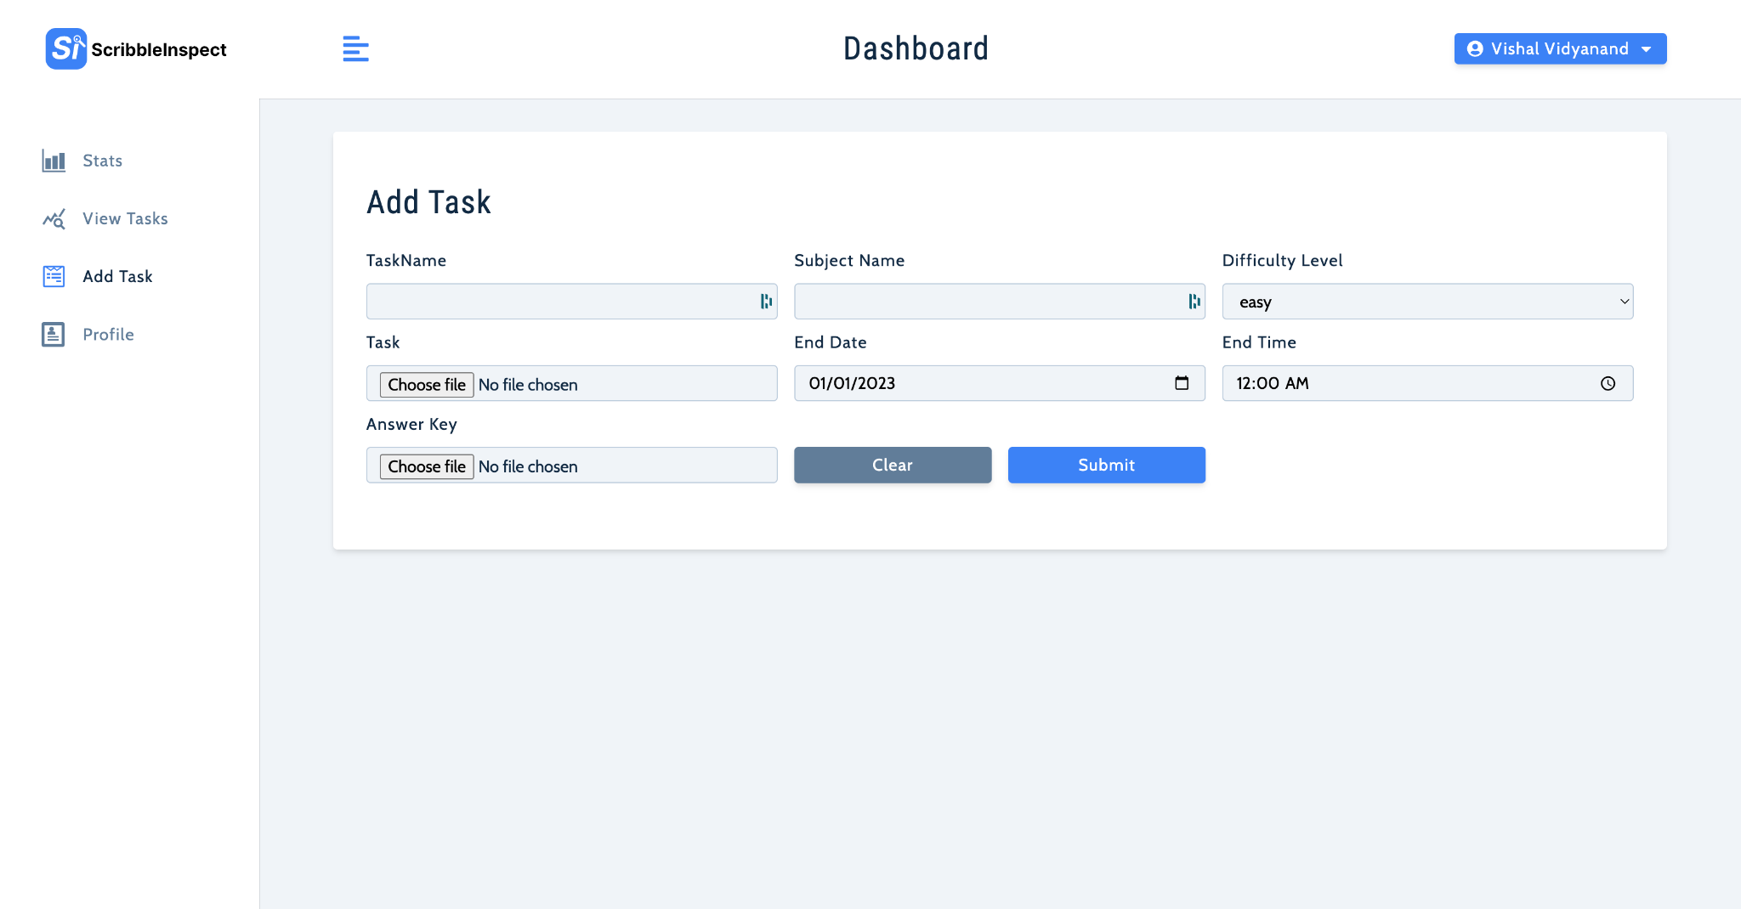
XIII
Student/Teacher Dashboard
Dashboard is to display the key analytics of assignment information
Functional Requirements
Show the assignment statistics
Add a new assignment option for the teacher
Upload assignment for the student
View user profile for both
Non Functional Requirements
Security: Students should prohibited from using teacher’s only actions
15

Slide 23

XIV
Grade Card and Analysis Report
This page shows the result of the assignment grading. How much marks a student has received
Functional Requirements
Shows score out of maximum
Shows average score of the class
Shows feedback based on the scores obtained
Request for review for moderation
Non Functional Requirements
Security: Students can access their own marks only, preventing unauthorized access by other students.
16

Slide 24

XV
Student Request for Review
Through this page teachers will be able to see the student requests for review of their particular assignment
Functional Requirements
Teacher able to see all the student requests
Teachers able to see the particular assignment
Non Functional Requirements
Student requests should be available to the teachers at all times without any downtime
17

Slide 25

XVI
Tools Used
Google Vision API: For Optical Character Recognition
ChatGPT API: For subjective analysis and similarity checks
ClickUp: Project Management Tool
Figma: For UI Design
MongoDb Atlas: Database management tool
Redux toolkit: Tools that help to speedup Redux development
18

Slide 26
PROJECT ADVISOR
TEAM 07
Tuesday, 14th Mar 2023
Ann Mary Saji
Muhammed Farhan
Sreelakshmi Chandran
Vishal Vidyanand
Dr. Aneesh G Nath
Prof. Shyna A
R6B, TKMCE
Thank you
for listening!

