Slide 1

Ethical Hacking Training | Ethical Hacking Course
https://cysecon.com/

Slide 2
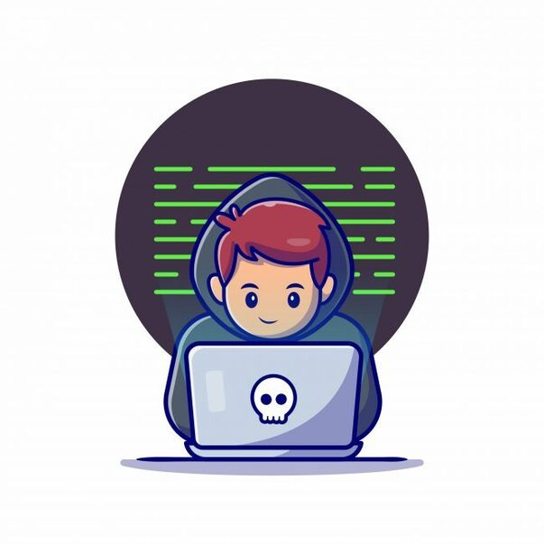
Password Cracking
Spyware, Viruses & Trojans
You will learn how to successfully break passwords and gain access into applications such as Facebook, Gmail, Pay pal, etc. and how you can create passwords that are virtually unbreakable for yourself or your clients.
Spyware/Malware attacks have been growing exponentially. You will learn how to create your own viruses, malware, etc. for vulnerability testing & to protect yourself or your clients against these intrusions.

Slide 3
Our Mission
To Coach & Guide You To Become The Next Cybersecurity Superstar
We began our journey as a staffing firm that operated as an extended recruiting arm for some of the leading Fortune 500 companies, helping them to meet their demand for qualified employees who could support their ever-growing Cyber Security infrastructure
They say most businesses are born when a pain point is identified and that pretty much summarizes the birth of Cysecon. Let’s elaborate on that a little more Currently, there are over 300,000+ job openings in the field of Cyber Security, and this is in the USA alone. Are you beginning to see the dilemma? In an exceptionally good year, only 20-25 job roles get filled

Slide 4
Why me? Why should I care? What's in it for me?
How do I know this is worth my time?
You have hit a ceiling in your career.
You are worried that your job may be outsourced or automated.
Your job lacks flexibility, leaving no time for loved ones.
You want to be a member of the exclusive 6-figure club.
You are fresh out of school and want to build a career in an exciting, You want to feel the thrill of learning something new but do not know what.
You want to be in a field that is guaranteed to experience exponential growth with no signs of slowing down in your lifetime.
You want to develop a skill that is industry agnostic.
You are tired of applying for jobs but never hearing back.

Slide 5

Cysecon
https://cysecon.com/
5100 Eldorado Pkwy, STE 102-491 Mckinney, Texas, 75070 USA

