Slide 1

Amazon's Fine Food Product Reviews
DataSci 207 Final Project
Mike Caswell, Karanveer Lamba, Nicole McNabb, Abbas Siddiqui

Slide 2

Motivation for NLP Sentiment Analysis
Textual information, such as reviews, are widely available
Sentiment analysis can help automate this process
Tedious and repetitive to have to look through manually
Evaluation of reliability of reviews
Can be used to quickly identify public opinion on items, and may be combined with summarization techniques to quickly identify key points across many reviews
Notes:
Nicole
Textual information, like product reviews, is widely available, but analyzing it manually can be tedious and repetitive. Sentiment analysis can automate this process, evaluating the reliability of reviews and quickly identifying public opinion on items. By combining sentiment analysis with summarization techniques, we can efficiently highlight key points across many reviews. In our project, we're applying sentiment analysis to Amazon Fine Food product reviews to extract meaningful insights.

Slide 3
Data: Amazon's Fine Food Product Reviews
Overview
Total Reviews: Over 500,000
Total Users: Around 256,000
Total Products: Approximately 74,000
Purpose: Analyze consumer opinions, develop recommendation systems, study review patterns
Link to Data
Features
User ID: Unique identifier for each user
Product ID: Unique identifier for each product
Profile Name: User's profile name
Helpfulness Rating: Helpfulness of the review as voted by users
Score: Rating given by the user (1 to 5 stars)
Time: Timestamp of the review
Summary: Short summary of the review
Text: Full text of the review
Paper: J. McAuley and J. Leskovec. From amateurs to connoisseurs: modeling the evolution of user expertise through online reviews. WWW, 2013.
Notes:
Mike

Slide 4
Workflow - 4 Main Models
Logistic Regression
LSTM with Attention
BERT
CNN with Embeddings
Notes:
Nicole
For our workflow, we each developed a different model: logistic regression, LSTM with attention, BERT with neural networks, and CNN with embeddings. Our models were built on the pre-processed data prepared by Abbas, which he will discuss in detail later. This collaborative approach allowed us to explore various techniques and compare their performance in sentiment analysis of Amazon Fine Food product reviews.

Slide 5
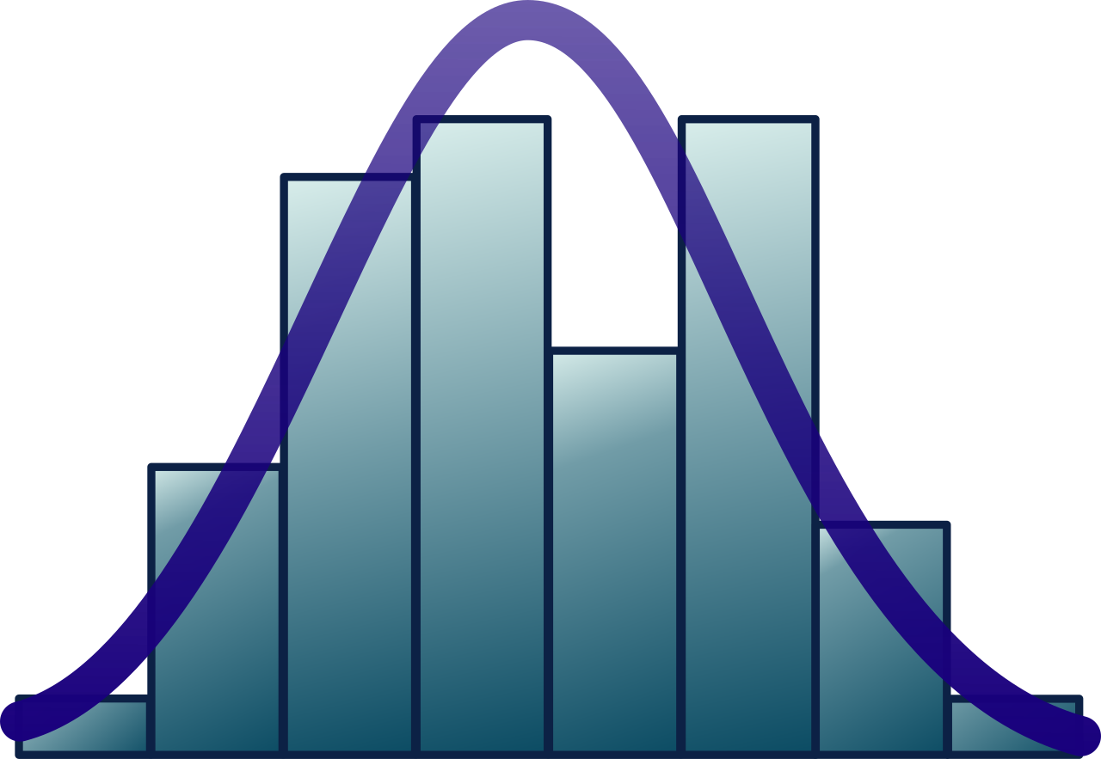
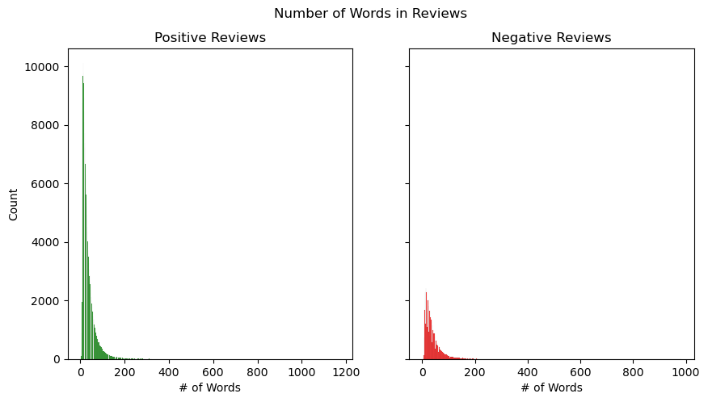
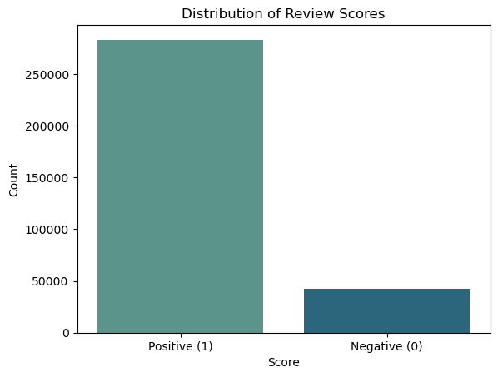
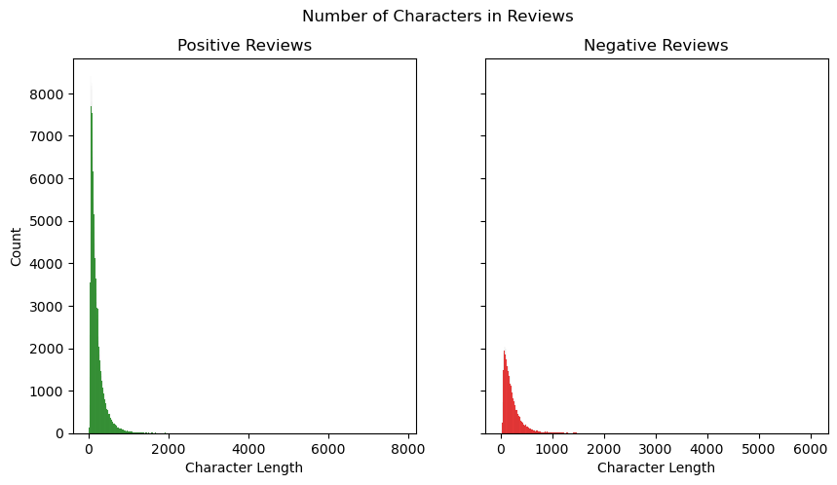
Data Distribution
Character and Word Length
Review Score
Notes:
Similar distribution before and after pre-processing

Slide 6

Data Preprocessing
Use pre-trained transformer (Roberta) to identify conflicting sentiment amongst review-score pairs
Limit token values to only the 5000 most frequently occurring words
Balance sentiment classes (0, 1)
Step 2
Step 4
Step 6
Step 1
Step 3
Step 5
Convert classification task from ratings to positive/negative sentiment
Remove punctuation, numbers, html tags, and stopwords from the reviews
Tokenize each review and encode each word as a number
Notes:
Abbas

Slide 7

Baseline Model
Used a base decision tree as our baseline since it can handle imbalances well
Ran it on base, unbalanced data
Notes:
Abbas

Slide 8

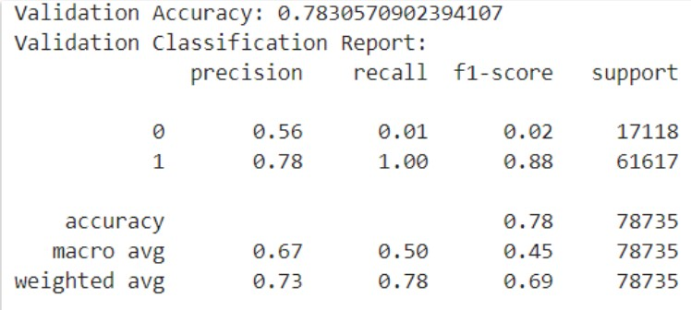
Baseline Model Classification Report

Slide 9

Logistic Regression - Model 1
Step 1: N-Grams Implementation
Step 2: Hyper Parameter Tuning
Step 3: Results
TF-Vectorizer with n-grams
Understand the context in which words appear
Enhance the feature set with contextually meaningful information
Methods Explored:
SMOTE
Random Search
Bayesian Optimization
Initial Results:
TF-Vectorizer with n-grams helped add contextual understanding
Bayesian Optimization yielded the best results
Issues Addressed
Capturing Common Phrases
Disambiguation
Improved Feature Set
Handling Negations
Final Findings
Bayesian Optimization:
Training Accuracy: 97.55%
Test Accuracy: 94.91%
Issues Addressed
Class Imbalances
Feature Selection
Random Search
Bayesian Optimization
Notes:
Nicole
Step 1: N-Grams Implementation Using TF-IDF vectorizer with n-grams, I enhanced the model's ability to understand word context and relationships, enriching the feature set and improving performance.
Step 2: Hyperparameter Tuning Addressing class imbalances with SMOTE and optimizing parameters using Random Search and Bayesian Optimization, we achieved significant accuracy improvements. Bayesian Optimization yielded the best results, with a training accuracy of 97.55% and test accuracy of 94.91%, effectively fine-tuning the model for higher precision.

Slide 10
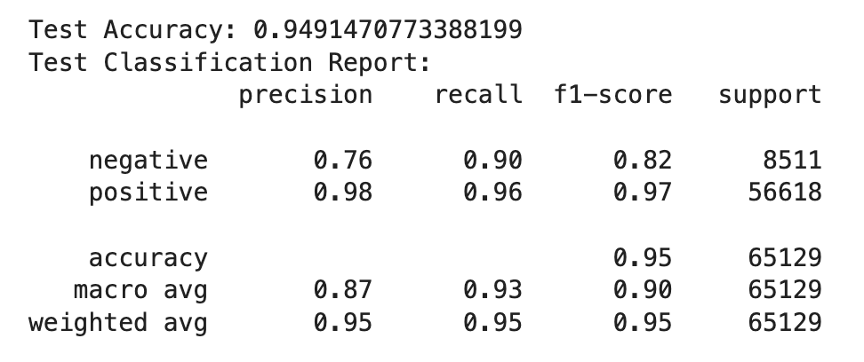
Logistic Regression Classification Report
Notes:
Nicole
Here's the classification report for our Bayesian optimized model, which achieved a test accuracy of 94.91%. The model shows a precision of 0.76, recall of 0.90, and an F1-score of 0.82 for negative reviews, and a precision of 0.98, recall of 0.96, and an F1-score of 0.97 for positive reviews. Overall, the accuracy is 95%, with a macro average F1-score of 0.90 and a weighted average F1-score of 0.95. These metrics indicate strong performance, particularly in identifying positive reviews accurately."

Slide 11

BERT with Neural Network - Model 2
Step 1: Pre-Processing & Transformers
Step 2: Hyper Parameter Tuning
Step 3: Results
Initial Results:
Successfully obtained BERT embeddings for tokenized text
Implemented a neural network with dense layers
TF
Tokenizer: bert-base-uncased
Model: TFAutoModel from Hugging Face
Tokenized reviews with sequence length of 128
Methods Explored:
SMOTE
Sequential model with multiple layers
Issues Addressed
Text Data Variability
Tokenization specific for BERT
Issues Addressed
Class Imbalances
Implementation of NN
Final Findings
Training Accuracy: 91%
Validation Accuracy: 89%
Test Accuracy: 88%
Notes:
Mike

Slide 12
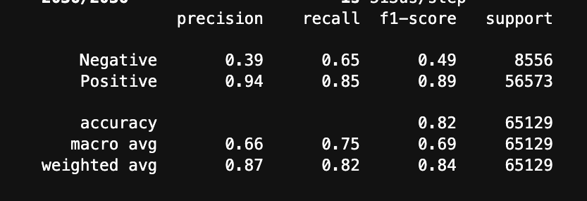
BERT with Neural Network Classification Report

Slide 13

CNN with Embeddings- Model 3
Step 1: Pre-Processing & Transformation
Step 2: Hyper Parameter Tuning
Step 3: Results
Techniques Used:
Text Cleaning & Tokenization
Padding
Exploratory Data Analysis
Vocabulary and word count
Methods Explored:
Addressing class imbalance in model
Bayesian optimization
Model callbacks
Accuracy maximization and loss minimization
Initial Results:
Sequential model with multiple layers
Model architecture with embeddings and CNN yield high accuracy
Tackling class imbalance with class weights
Issues Addressed
Text data variability
Consistent dimensions
Handling Negations
Reduced training time
Issues Addressed
Overfitting
Class imbalance
Efficient hyperparameter search & training speed
Final Findings
Training Accuracy: 99%
Validation Accuracy: 96%
Test Accuracy: 95%
Notes:
Karanveer

Slide 14
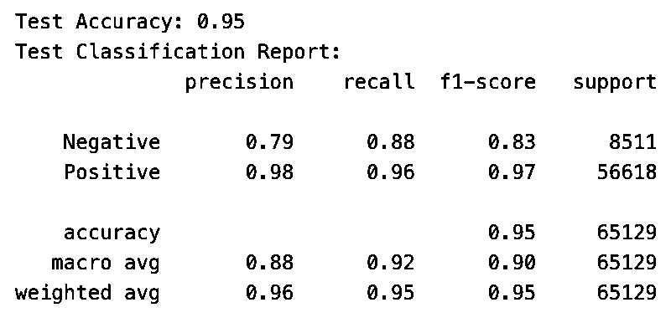
CNN with Embeddings Classification Report

Slide 15

LSTM with Attention- Model 4
Step 1: Additional Pre-Processing
Step 2: Hyper Parameter Tuning
Step 3: Results
Methods Explored:
Embedding Layers & pre-trained embedding
(Multi-head) Attention Layers
Bidirectional LSTM layers
Pooling
Initial Results:
Embedding layers immediately boosted accuracy over dense NN
LSTM + attention layers helped improve generalization to unseen data
Techniques Used:
All of the formerly mentioned
pre-processing
Embedding Lengths
Class Weights
Undersampling
Issues Addressed
Optimizing encoding
Balanced the classes to mitigate bias in training
Issues Addressed
Testing various NN architectures to see what mechanisms help
Final Findings
Training Accuracy: 96%
Test Accuracy: 91%
Notes:
Abbas

Slide 16
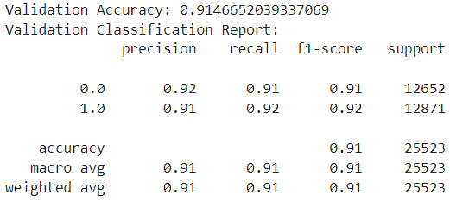
LSTM with Attention Classification Report

Slide 17

NeurIPS 2021 Paper Checklist Guidelines
The purpose of this project is to gain an understanding of how to conduct sentiment analysis (POC).
Our experimentation phase is well documented
Considerable parts of our workflow depend on having access to a GPU.
Dataset was open source and backed by a trusted source.
We read through the ethics review guidelines and ensured that the project conforms to them.

Slide 18




Conclusion
Key Results
What We Learned
If we had more time…
Context is extremely important!!!
Task was computationally and time intensive
Translating lower occurrence reviews to foreign languages and back to augmented data

