Slide 1


Introduction to IoT
Names of presenter(s)
email(s)
Autonomous Networks Research Group
Viterbi School of Engineering
University of Southern California
https://anrg.usc.edu
March 31, 2021 International Conference on xyz

Slide 2
Overview of Talk
Internet of Things (IoT) and smart cities
IoT 1.0: the problem of data silos
The I3 data marketplace for smart cities

Slide 3

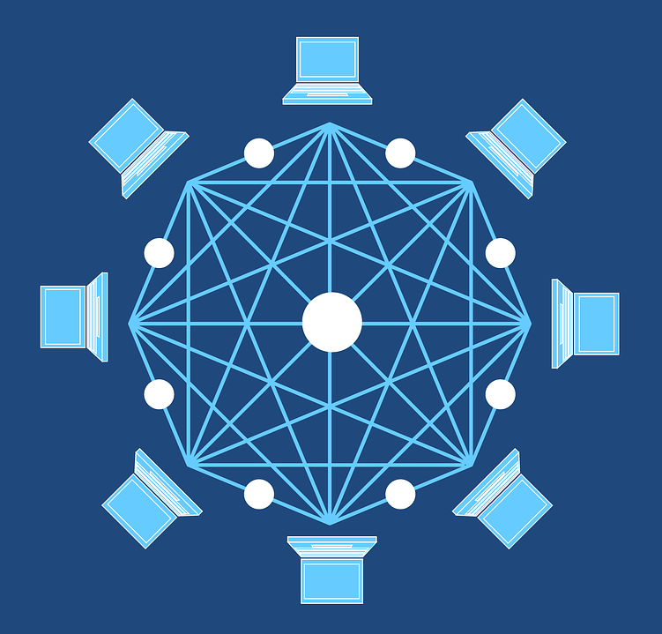
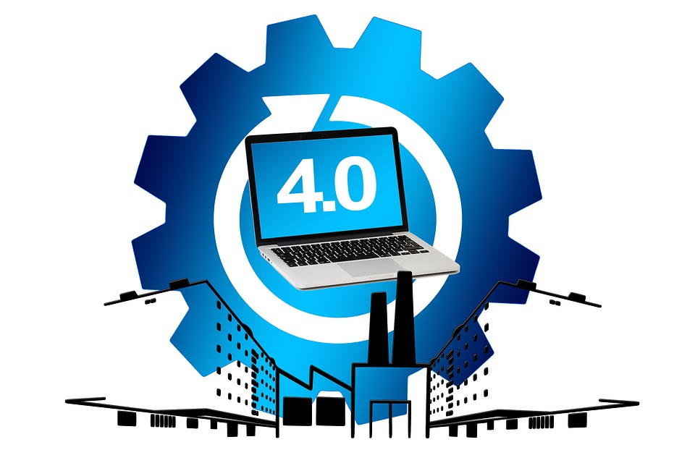
The ABC of Data Technologies
A.I.
Artificial Intelligence
Blockchain
Connected Devices (IoT)
https://medium.com/@bhaskark2/the-abc-of-emerging-technologies-4c52da5cc51b

Slide 4

Fundamental Questions
Who owns data? Who needs the data?
What rights do data owners have?
How can data owners manage and monetize their data?
Bhaskar Krishnamachari, Jerry Power, Seon Ho Kim, Cyrus Shahabi, “I3: An IoT Marketplace for Smart Communities,” In Proceedings of the 16th ACM International Conference on Mobile Mobile Systems, Applications, and Services (MobiSys) (ACM IoT Day Vision Paper), Munich, Germany, June 10-15, 2018.

Slide 5
Blockchain Technology: New Capabilities
Immutable
Ledger
Ordering,
Time Stamping
Incentives
Distributed
Consensus
State Channels
Micro-payments
Privacy, Anonymity
Smart Contracts
Decentralized
Apps
Oracles
TCRs
Notification,
Querying
Off-chain Processing & Storage

Slide 6

System Analysis
The temporal dynamics of the system can be modeled as follows:
Universal constant
Scaling effects
Population model
Link for creating colored LaTeX equations for presentations: https://latex.codecogs.com/eqneditor/editor.php

Slide 7
Summary
New algorithm for scheduling computations
Results show 30% higher throughput than state of the art
Future work needed to address security and reliability

Slide 8
Acknowledgements
This work was supported in part by [NSF/DARPA/ARL/Company] through [grant/award number]. Any views, opinions, and/or findings expressed are those of the author(s) only.

Slide 9
Thanks
Contact: email@usc.edu

