Slide 1


DSF: A Network-Aware DAG Scheduling Framework for Heterogeneous Edge Clusters
Mohammadali Khodabandehlou
mohammadali.khodabandelou@gmail.com
Autonomous Networks Research Group
Viterbi School of Engineering
University of Southern California
https://anrg.usc.edu
April 28, 2026 · ANRG Group Meeting
Notes:
Title slide. Brief greeting; ~35 minutes of material plus Q&A. I'll outline the motivation, system, scheduling, and what we measured.

Slide 2
Outline
Background and problem statement
Limitations of existing DAG/streaming frameworks on the edge
DSF: system model and architecture
Network-aware scheduling: HEFT with online profiling
ε-tolerant tie-breaking under estimator noise
Experimental evaluation on an 8-node tc-shaped testbed
Limitations and future work
2
Notes:
Outline. Heavier on system and scheduling than on motivation; evaluation is three result figures plus an ablation.

Slide 3
Background: DAG-shaped workloads on edge clusters
Edge / on-premises clusters increasingly host structured pipelines:
Sensor capture → preprocessing → ML inference → action / storage
Examples: IoBT mission analytics, scientific data processing, distributed network measurement
These workloads are naturally DAG-shaped:
Tasks have explicit dependencies and per-stage hardware affinity
Inter-stage payloads range from kilobytes to hundreds of megabytes
The deployment substrate is heterogeneous in two dimensions:
Compute: ARM single-board computers, x86 servers, GPU nodes
Network: inter-node bandwidth varies 10–20× across pairs in real deployments (mixed wired / wireless, multi-tier topologies)
3
Notes:
Set the scene. The point is that edge DAGs differ from cloud DAGs in two specific ways: hardware affinity matters, and the network between nodes is not flat.

Slide 4
Problem statement
Given:
A DAG G = (T, E) with per-task resource demand r(t) and inter-task data volume d(t, t′)
A heterogeneous cluster N with a bandwidth matrix B : N × N → ℝ⁺ and per-node capacity c(n)
Per-task affinity sets A(t) ⊆ N (hardware-driven, e.g. GPU)
Find a placement τ : T → N with τ(t) ∈ A(t) that:
Minimises makespan for one-shot DAGs
Minimises end-to-end latency (mean and p95) for streaming DAGs
Subject to:
Per-(task, node) runtime w(t, n) and bandwidth B(n, n′) are unknown a priori on real hardware
The placement must be implementable inside a Kubernetes controller, with bounded memory and reconciliation latency
4
Notes:
Formal-ish problem statement. The 'unknown a priori' constraint is the part that motivates the online profiler — most HEFT papers assume w and B are given.

Slide 5
Limitations of existing DAG / streaming frameworks
Argo Workflows, Tekton, Airflow, Kubeflow Pipelines
Artifact-based: every inter-task transfer goes A → object store → B
Network-blind placement; no notion of inter-node bandwidth
Object store (S3 / MinIO / NFS) consumes scarce edge resources
Apache Kafka, Flink, Spark Streaming
Heavyweight broker / coordinator clusters; not suited to small edge deployments
Streaming-only; cannot express finite pipelines uniformly
Ray, Dask
Object-store mediated; centralised scheduling for cloud topology
No first-class concept of per-task hardware affinity
Common gap: the network is treated as plumbing. Task completion and data availability are conflated, even when topology and affinity make the difference quantifiable.
5
Notes:
One slide on prior work. The unifying observation across the comparison: none of these systems reason about which physical node a payload needs to land on, or about non-uniform link bandwidth.

Slide 6
Contributions
C1. Network-aware HEFT scheduler with online EMA profiling for per-(task, node) runtime and per-(node, node) bandwidth on k3s.
C2. ε-tolerant tie-breaking — a bounded-uncertainty extension to list scheduling that addresses estimator-noise–induced concentration of parallel work.
C3. Unified Kubernetes-native abstraction for batch (ODAG) and streaming (CDAG) DAGs, with a single SDK and observability layer.
C4. Brokerless P2P data plane (data-agent + ZMQ) that avoids shared object stores and message brokers.
C5. Empirical evaluation on an 8-node, tc-shaped testbed using three benchmarks; 27% mean / 32% converged makespan reduction (ODAG) and 39% p95-latency reduction (CDAG) over baselines.
6
Notes:
Five contributions; C1 and C2 are the research core, C3–C4 are the platform that makes them measurable, C5 is the empirical evidence.

Slide 7
Part I — System architecture
CRDs and controllers
Programming model
Communication transports
Observability
What DSF is
7
Notes:
Section: Part I — System architecture.

Slide 8
System architecture
User · dsf CLI / kubectl
dsf-system (master)
Worker pods (k3s)
odag-controller (one-shot DAGs)
cdag-controller (continuous DAGs)
task pod (DSF SDK)
K8s API server (CRDs)
ui-server · watch cache · SQLite · SSE
task pod (DSF SDK)
task pod (DSF SDK)
data-agent (DaemonSet, P2P HTTP)
ZMQ PUSH/PULL · PUB/SUB
Design choices
• All ODAG pods start simultaneously; downstream blocks on recv() · one ClusterIP Service per task → stable DNS
• CDAG reconciles every 30 s; failed pods are recreated within constraint sets · owner references → GC on CR delete
8
Notes:
Two CRDs, two controllers, one UI, one DaemonSet for P2P transfers. The shape mirrors a standard K8s controller layout, but with our scheduling and data-plane sitting inside it.

Slide 9
Two execution models in one CRD group: dsf.io/v1
ODAG — one-shot
Use case: finite pipelines (ETL, mission analytics)
Transport: ZMQ PUSH/PULL + data-agent for large files
Lifecycle: all pods scheduled simultaneously, run, terminate
Status: phase, makespan, completionTime, per-task node
Failure handling: spec.retryPolicy.maxRetries per task
CDAG — continuous
Use case: streaming pipelines (sensor fusion, monitoring)
Transport: ZMQ PUB/SUB (publisher binds, subscribers connect)
Lifecycle: 30-s reconcile loop recreates missing pods
Status: per-task readyReplicas / desiredReplicas / node
Failure handling: restartPolicy ∈ {Always, OnFailure, Never}
9
Notes:
Same CRD group, two kinds. The user's mental model is one tool for both finite and continuous workloads.

Slide 10
ODAG controller lifecycle
1. Watch fires on CR ADDED → goroutine started for this ODAG
2. Schedule: assignTasks() returns task → node mapping
Constraint-aware random (baseline) or HEFT (network-aware)
3. Create ClusterIP Service + Pod for every task simultaneously
Pods carry NodeAffinity to the assigned node
DSF_PEER_<TASK> env vars injected with stable DNS endpoints
4. Run: pods communicate via ZMQ PUSH/PULL or data-agent HTTP
5. Pod-watch loop writes status.tasks[] (phase, node, timing)
6. When all tasks Succeeded: makespan = end − start, phase = Succeeded; profiler updates EMA estimates
10
Notes:
Six steps. The non-obvious choice is step 3 — pods are created all at once. ZMQ PUSH/PULL needs the receiver bound first; downstream tasks block on recv() until the upstream sends.

Slide 11
CDAG controller: continuous reconciliation
Reconcile every 30 s, for every CDAG known to the controller:
List pods by dsf-cdag={name}, dsf-task={task}
Count alive pods (Running ∪ Pending)
Read pod.Spec.NodeName for status.tasks[].node
If alive < desiredReplicas: delete Failed pods, recreate via pickNode(constraints, schedulableNodes)
Update status.tasks[] (replicas, podNames, node)
phase = Running if all tasks fully ready, else Degraded
Properties:
Stateless — relies only on live K8s state, not in-memory snapshots
Constraint-respecting — pickNode never violates allowed-node sets
Idempotent — repeated reconciles converge to the same state
11
Notes:
CDAG has no completion event, so reconciliation is the design. Idempotent and stateless — the controller can be killed and restarted without orphaning pods.

Slide 12
Programming model: a four-line task contract
Injected by the controller
DSF_TRANSPORT_PATTERN pushpull | pubsub
DSF_RECV_PORT 5555
DSF_PEER_<TASK> zmq://svc.ns.svc.cluster.local:5555
DSF_TASK_NAME capture
The same contract works for both ODAGs and CDAGs. Transport selection is hidden behind transport/router.py.
from dsf_sdk import DSFTask
task = DSFTask()
data = task.recv("upstream")
result = process(data)
task.send("downstream", result)
task.close()
12
Notes:
Four-line contract. Tasks don't know whether they're in an ODAG or CDAG — the env vars decide. Same code path for batch and streaming.

Slide 13
Communication transports
ZMQ PUSH / PULL — one-shot DAGs
Receiver binds, senders connect. LINGER = 5 s. 0.2 s sleep after connect (ZMQ slow-joiner). 0.3 s sleep after send (flush).
ZMQ PUB / SUB — continuous DAGs
Publisher binds, subscribers connect. [topic, payload] multipart frames. Subscribers SUBSCRIBE = "" (all topics).
data-agent (HTTP) — large file transfers
DaemonSet on every node. Pod writes locally, agent pushes across the network. Same-node transfer is a local copy. Decouples compute completion from data delivery.
All endpoints are stable ClusterIP DNS names ({name}-{task}.{ns}.svc.cluster.local:5555), injected at pod creation time.
13
Notes:
ZMQ for messaging because brokerless. data-agent for files because we want compute–transfer decoupling.

Slide 14
Observability: web UI, history, live updates
Stack: Go HTTP server with K8s watch caches + React + React Flow + Recharts
Pages:
/ — ODAG list (phase, makespan, age)
/odags/{ns}/{name} — graph, tasks table, run history
/cdags — CDAG list
/cdags/{ns}/{name} — graph, replicas, node assignment
/batch — multi-ODAG HEFT Gantt
Live updates via Server-Sent Events at /api/events
Every K8s ADDED/MODIFIED → broadcast to subscribed clients
Frontend invalidates the relevant React Query cache
ODAG run history persisted in SQLite (hostPath)
INSERT OR IGNORE keyed on uid + resourceVersion (idempotent)
Survives ui-server restarts
14
Notes:
Read-only UI; submission goes through the CLI. SSE-driven so it feels real-time without polling. Will demo if time permits.

Slide 15
Part II — Scheduling
Constraint-aware random baseline
Network-aware HEFT
Online EMA profiler
ε-tolerant tie-breaking
From random placement to ε-HEFT
15
Notes:
Section: Part II — Scheduling.

Slide 16
Baseline: constraint-aware random placement
Properties
• Trivial, predictable, encodes hardware affinity
• Scheduler logic is independent per controller (ODAG/CDAG)
What it does not model
• Pairwise inter-node bandwidth
• Per-(task, node) runtime variability
• Co-location vs spread of independent tasks
for each task t:
A_t = constraints.nodeNames
∩ schedulableClusterNodes
if A_t == ∅: A_t = schedulableClusterNodes
τ(t) ← Uniform(A_t)
16
Notes:
This is the floor — the scheduler we compare against. It's the right default when nothing is known about runtimes or bandwidth.

Slide 17
Network-aware HEFT, adapted for k3s
Heterogeneous Earliest-Finish-Time [Topcuoglu et al., 2002], with two adaptations for our setting:
Step 1 — Upward rank (DAG priority):
rank(t) = w(t) + max_{t′ ∈ succ(t)} [ c(t, t′) + rank(t′) ]
w(t) = average runtime; c(t, t′) = d(t, t′) / B̄
Step 2 — Greedy placement:
for t in tasks ordered by descending rank:
τ(t) = argmin_{n ∈ A(t)} EFT(t, n)
Adaptations:
Bandwidth-weighted edge cost uses learned B(n, n′), not a constant
Resource-aware nodeAvail (HEFT v2): models that k3s schedules independent pods on the same node in parallel when CPU and memory permit
17
Notes:
HEFT itself isn't novel. The contribution is (i) running it online with a profiler and (ii) modelling parallel pod execution on the same node — classical HEFT assumes sequential.

Slide 18
Online profiler: EMA estimates of runtime and bandwidth
EMA update (per (task, node) and per (node, node) pair):
μ_{i+1} = α · sample + (1 − α) · μ_i with α = 0.7
Resolver chain at scheduling time:
1. profiler estimate, if #samples ≥ minSamples
2. spec hint (runtime, dataSize from YAML)
3. template default (scheduler-level fallback)
4. hardcoded floor (never NaN)
Settings: warmupRuns = 0, minSamples = 2, maxSamples = 50
Persistence: EMA state stored in SQLite alongside ODAG run history; survives controller restart.
Implication: HEFT inputs are learned online, with no operator-supplied per-task profile required.
18
Notes:
Cheap, robust, defensible. The resolver chain is the part reviewers may push on — we never let HEFT see NaN, even on run 0.

Slide 19
ε-tolerant tie-breaking under estimator noise
Pathology — observed in the IoBT 4-sensor benchmark:
All four parallel infer-i tasks land on a single compute node, across consecutive runs, despite three candidate nodes with near-identical EMA-learned runtimes.
Cause: EMA estimates are point estimates with hidden uncertainty. Strict EFT comparison ( < ) makes the tiebreaker the iteration order.
Fix — bounded tolerance:
minEFT = min_{n} EFT(t, n)
candidates = { n : EFT(t, n) ≤ minEFT + ε }
τ(t) = arg min_{n ∈ candidates} load(n)
Properties:
ε = 0 is already strictly better than classical HEFT (exact ties broken by load instead of iteration order)
ε > 0 absorbs profiler noise; mean makespan unchanged, p95 tightens; placement entropy increases
Generalises naturally to variance-aware EFT: EFT + k · σ
19
Notes:
This is the contribution that emerged from a debugging session and turned out to be the cleanest research point. Bounded knob, measurable Pareto front, principled framing.

Slide 20
Part III — Evaluation
8-node tc-shaped testbed
Three ODAG benchmarks
ε-HEFT ablation
Calibration and scalability
What we measured
20
Notes:
Section: Part III — Evaluation.

Slide 21
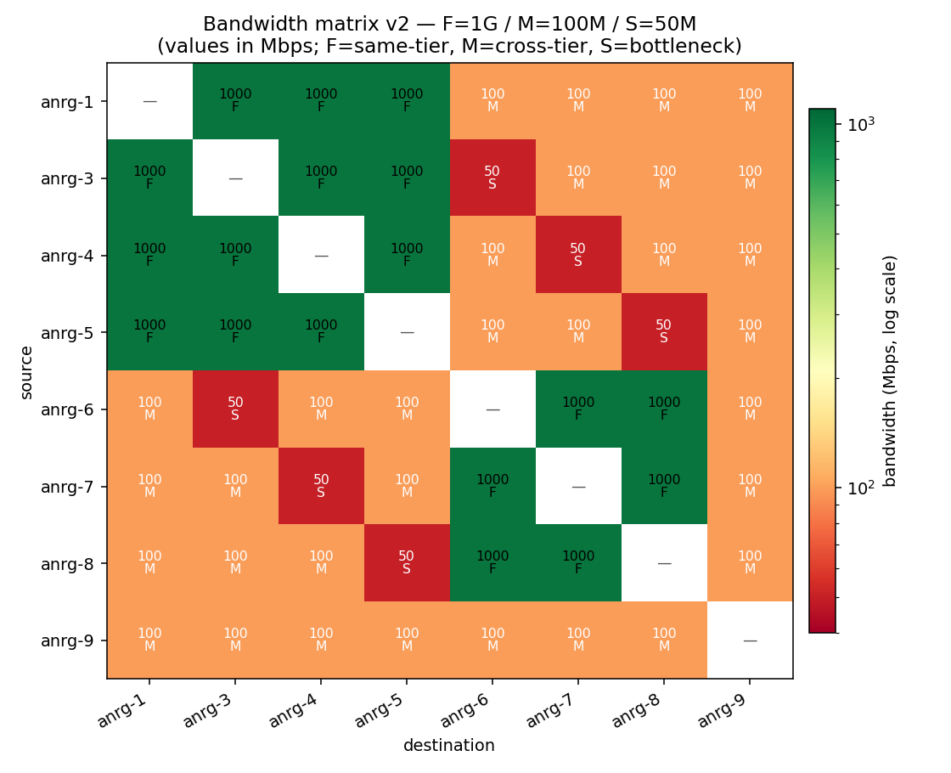
Experimental setup: 8-node tc-shaped cluster
Cluster
• k3s, dsf-system namespace
• 8 schedulable workers (anrg-1, 3..9)
• Master anrg-2 (NoSchedule)
• Local registry on master
tc bandwidth matrix (asymmetric, 20×)
• F = 1 Gbps (same-tier)
• M = 100 Mbps (cross-tier)
• S = 50 Mbps (engineered bottlenecks)
Benchmarks (3 ODAGs)
• iobt — 14 tasks, 5 layers, 80–150 MB
• hetero-compute — 5 tasks, runtime hints
• wide-pipeline-flex — fan-out × 2, fan-in × 2
21
Notes:
20× asymmetry sounds extreme but it's well within real edge (WAN + LAN, or 5G + wired). The bottleneck pairs are engineered so HEFT has somewhere to be smart.

Slide 22
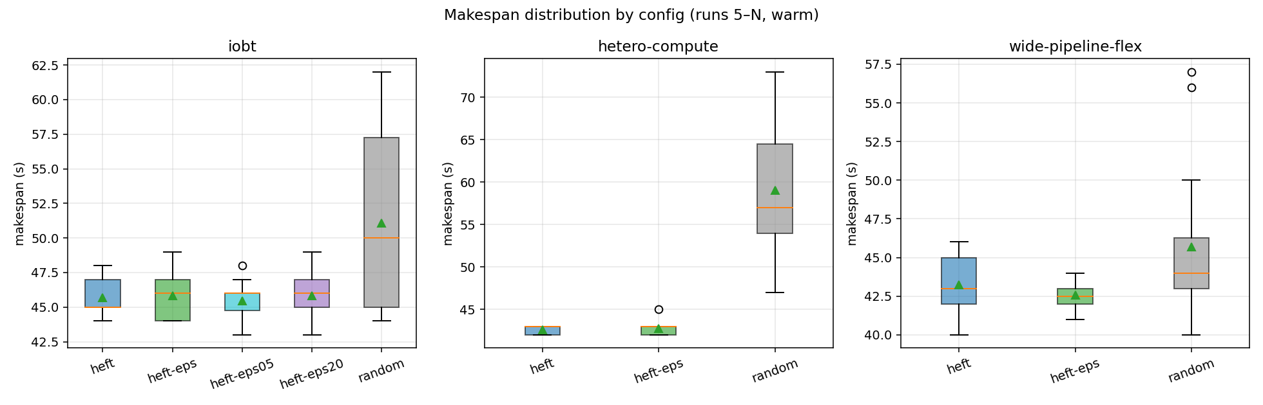
Experiment 1A: makespan, random vs HEFT vs ε-HEFT
Setup
iobt + hetero-compute + wide-pipeline-flex
20 runs per (benchmark × scheduler)
Warm makespans (post-convergence)
Headline (iobt)
random: 35.5 s (σ 5.5 s)
HEFT: 25.8 s (σ 4.7 s)
HEFT*: 24.0 s (σ 0.8 s) — converged
−27 % overall, −32 % converged
* runs ≥ 4 (after EMA convergence)
22
Notes:
Headline result. Two things to call out: the mean drop and the variance collapse (5.5 → 0.8 s). Real-time edge cares about both.

Slide 23
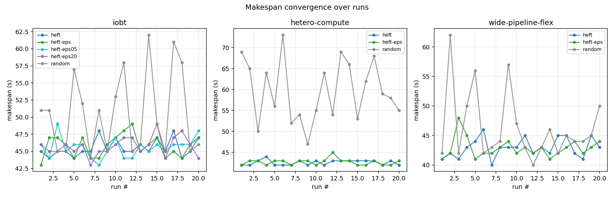
Profiler convergence: cold-start to optimal in 3–4 runs
Reading the curve
Run 1: HEFT > random (cold profiler)
Runs 2–3: EMA accumulates samples
Runs ≥ 4: HEFT settles ~32 % below random
Caveat
First-run cost is real; not hidden in our reporting
23
Notes:
Don't gloss over the cold-start cost — call it out. Honest story: 3–4 runs to converge, run 1 sometimes worse than random, stable thereafter.

Slide 24
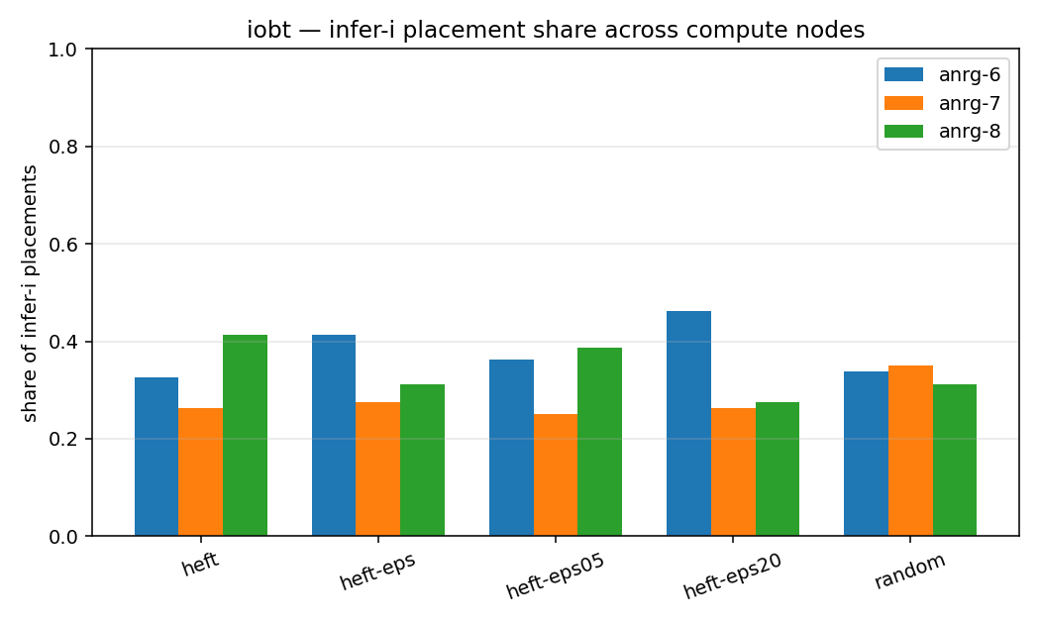
ε-HEFT ablation: placement spreads, mean unchanged
iobt infer-i placement share
ε = 0 (strict): one node dominates
ε = 0.5: two nodes share the work
ε = 1.0: ~uniform across three nodes
ε = 2.0: uniform (saturates)
Effect on makespan
Mean ≈ unchanged across ε
p95 tightens as ε grows
Spread vs efficiency Pareto front
24
Notes:
Justifies ε as a real contribution and not a heuristic. Bounded knob, measurable effect, honest saturating curve.

Slide 25
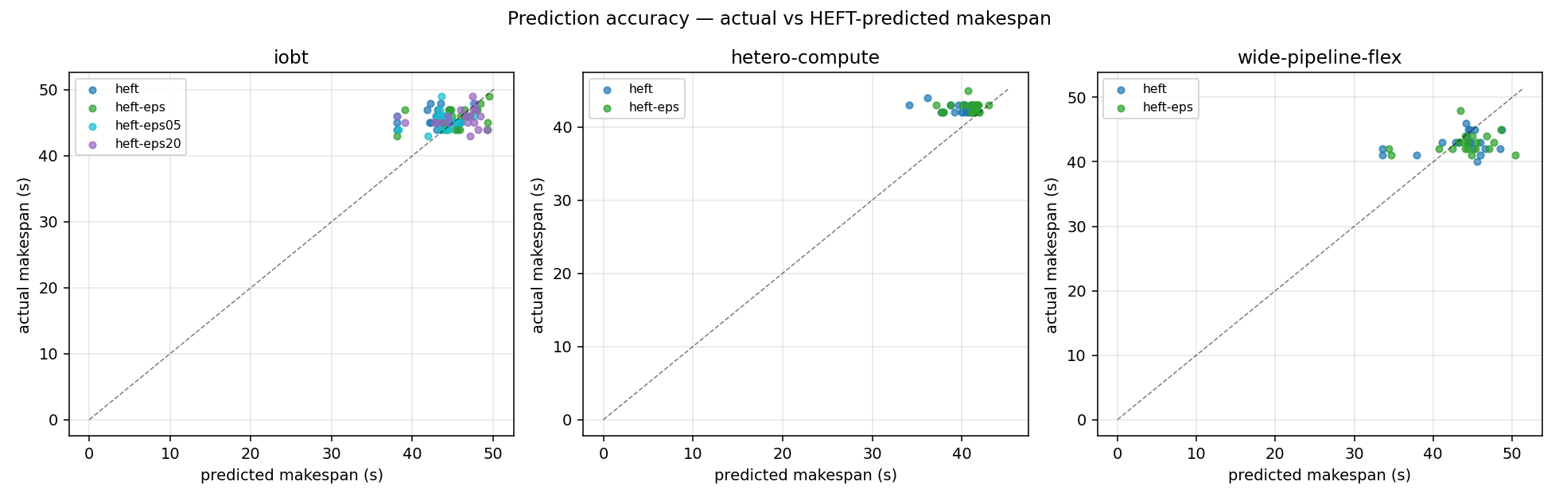
Calibration: predicted makespan vs measured wall-clock
Reading the scatter
Cluster around y = x → calibrated
Slight under-prediction in early warm runs
Sources of error not modelled
Image-pull jitter
Same-node memory contention
Pod-startup variance
25
Notes:
Use this slide to discuss model fidelity. The right framing: predicted is good enough to drive placement, not good enough to be quoted as wall-clock SLA.

Slide 26
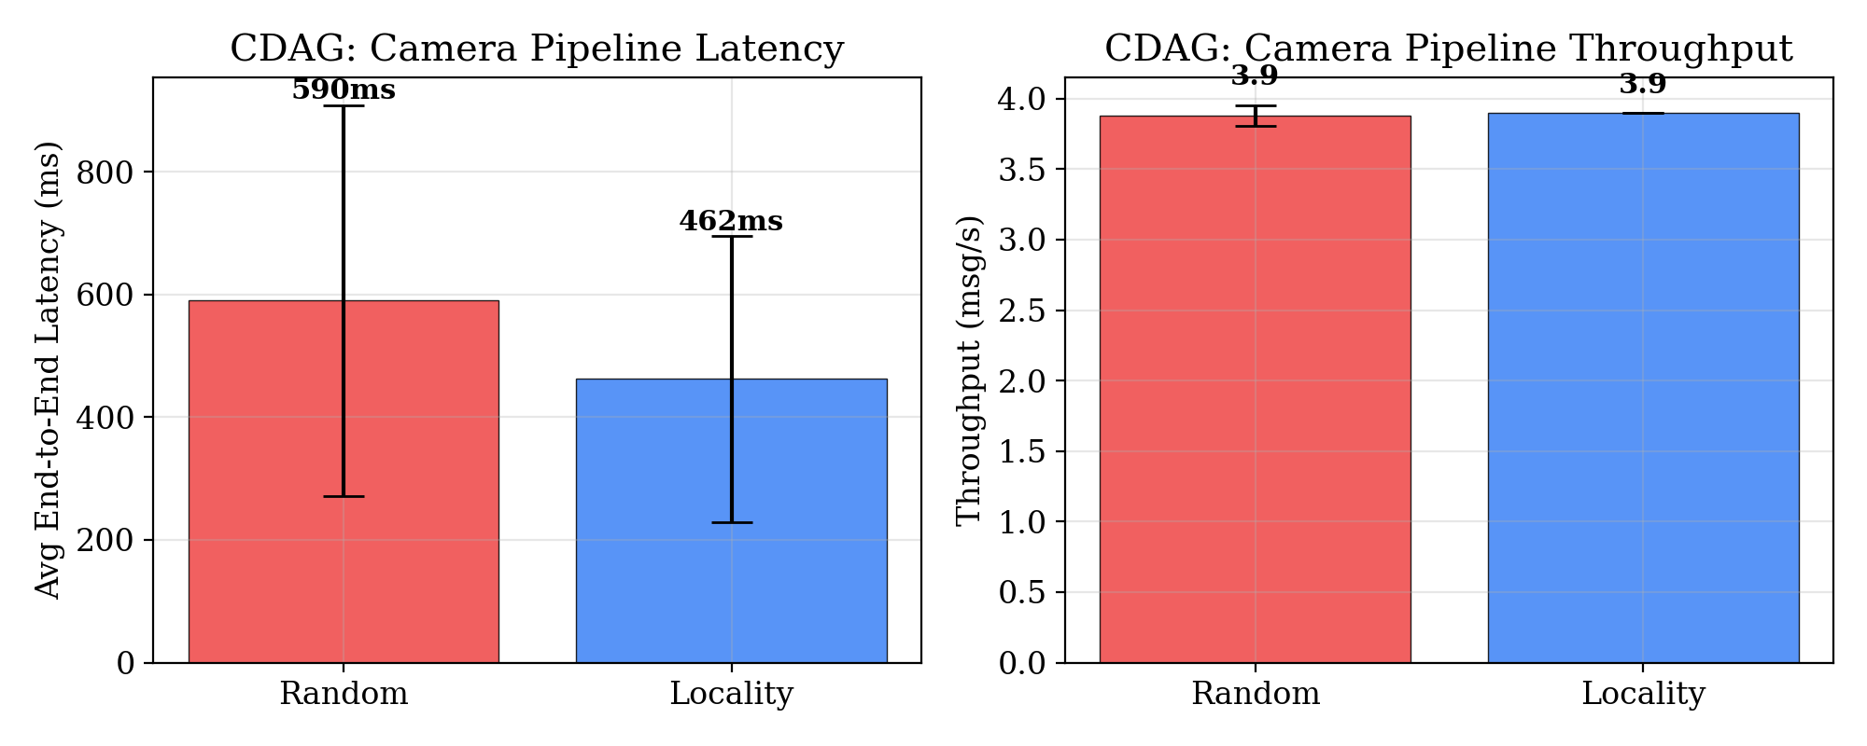
Experiment 1B: CDAG random vs locality (latency)
Camera fusion pipeline
9 tasks, 5 MB frames at 1 Hz
5 instances × 120 s each
Headline
Mean latency: 590 → 462 ms (−22 %)
p95 latency: 1238 → 749 ms (−39 %)
Throughput unchanged (camera-bound)
Tail dominates real-time edge SLAs
26
Notes:
Tail latency is the headline for streaming. 39 % p95 reduction matters more than the 22 % mean reduction for any real-time pipeline.

Slide 27
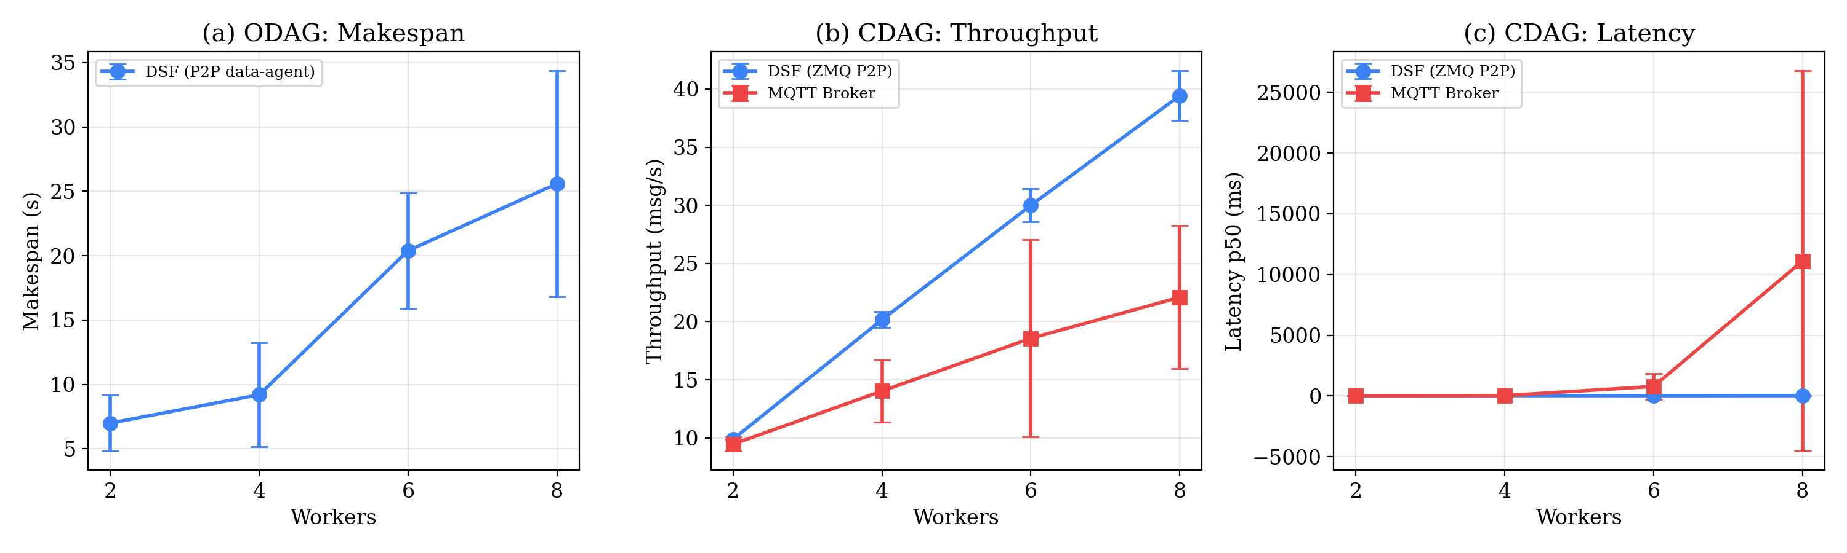
Experiment 2: P2P vs centralised data plane
Topology
source → N workers → sink, N ∈ {2, 4, 6, 8}
ODAG: P2P vs NFS
P2P data-agent: parallel HTTP push
NFS: all I/O funnels through one pod
Expected: NFS makespan grows with N
CDAG: ZMQ vs MQTT
ZMQ: direct PUB/SUB
MQTT: source → broker → subscribers
Expected: ZMQ throughput linear; MQTT plateaus
27
Notes:
Mostly a structural argument — at edge sizes the broker overhead is large because the cluster is small.

Slide 28
Part IV — Discussion
Implementation lessons
Limitations
Future directions
Lessons, limitations, and what's next
28
Notes:
Section: Part IV — Discussion.

Slide 29
Lessons learned during implementation
Pod parallelism on a single node breaks classical HEFT
k3s schedules independent pods in parallel when resources permit; HEFT v2 models nodeAvail as resource intervals, not a scalar.
EMA-learned runtimes converge — and tie
Per-task estimates on equivalent compute nodes converge to near-identical values; strict EFT then concentrates load.
ZMQ is timing-sensitive even for small messages
LINGER and slow-joiner sleeps are not optional in multi-pod K8s deployments; revisited every ZMQ pitfall.
imagePullPolicy interacts with first-run measurements
imagePullPolicy: Always is required for correctness with :latest tags; first-run overhead must be reported separately.
K8s API quirk: CRD type number is stored as int64
Strict float64 assertion fails silently; nestedFloat() helper handles the three observed encodings.
29
Notes:
Five honest 'what surprised us' bullets. Lab audiences value these more than polished results.

Slide 30
Limitations
Single-cluster, single-region testbed
All evaluation on a LAN with engineered tc shaping; WAN-scale or multi-cluster scenarios not validated.
Profiler is keyed on (task, node), not input size
Variable-input pipelines may need finer-grained estimates.
ε is a fixed scalar
Variance-aware EFT (EFT + k·σ) is a natural extension; not yet implemented.
No fault-injection campaign
data-agent retries (5×, 500 ms backoff) are unmeasured under partial-network partitions.
Broker-comparison numbers (Experiment 2) collected but not yet analysed at full breadth.
30
Notes:
Lay these out before the audience does. A clean limitations slide is worth two reviewer rounds.

Slide 31
Future work
Variance-aware HEFT
Move from ε-tolerance to a proper risk-adjusted EFT, EFT + k·σ, with σ from the EMA second moment.
Cross-CDAG flow tracker
Locality scheduler aware of bandwidth already in use by other concurrent CDAGs.
DataReady triggering
Fire downstream tasks when data lands on their node, not when the upstream pod exits — closes the compute–transfer decoupling story.
Per-input-size profiler keys
Per-(task, node, input-bucket) estimates for variable-input pipelines.
Paper: targeting a systems venue (SEC / SoCC / EuroSys 2026)
31
Notes:
Open with variance-aware HEFT — it's the most natural follow-up to ε. End on the paper target so the room knows what the next deliverable is.

Slide 32
Summary
DSF is a network-aware DAG scheduling framework for k3s, supporting both one-shot and continuous pipelines under one CRD group.
Network-aware HEFT with online EMA profiling reduces makespan by 27 % (mean) / 32 % (converged) on an 8-node testbed; variance drops from 5.5 s to 0.8 s.
ε-tolerant tie-breaking spreads parallel work without losing EFT optimality; p95 makespan tightens as ε grows.
Brokerless P2P data plane (ZMQ + data-agent) avoids the shared-store and broker overhead that dominates small clusters.
Code: github.com/anrg/dsf
32
Notes:
Close on these four bullets. One sentence each. Then questions.

Slide 33
Acknowledgements
ANRG group members for discussions and feedback throughout the implementation, evaluation, and ε-HEFT design.
Cluster infrastructure provided by the Autonomous Networks Research Group at USC Viterbi.
Foundational work: Topcuoglu et al. (2002) on HEFT, and the broader literature on workflow scheduling, stream processing, and Kubernetes-native orchestration.
This work was supported in part by [grant/agency], [award number]. Any opinions and conclusions are those of the author and do not reflect those of the funding agencies.
33
Notes:
Standard ANRG acknowledgements slide. Fill in the actual grant before presenting.

Slide 34
Thank you. Questions?
34
Notes:
Open the floor.

Slide 35
Backup: IoBT DAG topology (14 tasks, 5 layers)
[ FIGURE: IoBT DAG: capture → preprocess → infer → fuse → report ]
35
Notes:
Backup. Pull up if asked about the benchmark structure.

Slide 36
Backup: numerical results
Bench
Config
Mean (s)
σ (s)
p95 (s)
Δ vs random
iobt
random
35.5
5.5
44.0
—
iobt
HEFT
25.8
4.7
32.5
−27 %
iobt
HEFT*
24.0
0.8
25.6
−32 %
iobt
ε-HEFT
24.1
0.7
24.9
−32 %
hetero-c.
random
—
—
—
—
hetero-c.
HEFT
—
—
—
—
wide-flex
random
—
—
—
—
wide-flex
HEFT
—
—
—
—
* HEFT, runs 4+ (post-convergence). Em-dashes denote values not yet committed at this draft.
36
Notes:
Backup table for Q&A.

