Slide 1

Department of Computer Science
Gujarat University
5 Year Integrated M.Sc.(Computer Science)
Semester - III
Project members :
ANSARI YUSUF (30002)
DEVANG SHRIMALI(30113)
TARUN PANNEL (30112)
Under the Guidance of :
Dr. Bhumika Shah
Department of Computer Science

Slide 2

Table of Content
Project Profile
Project Description
Objective
Related Work
Tools and Technologies used
Screenshots / Animation
Conclusion & Future Work
Bibliography
Bahnschrift SemiLight
Department of Computer Science

Slide 3

Logo:

Slide 4


Project Profile
“GEN-X GAMES” is an web game with many sub-games like :
Memory game
Its an online web game for user and
Its an interactive game
Quick memory improvement in it
And good to use

Slide 5
Project Description
Memory game
It is a memory game.
There is 4x4 boxes in screen.
We have to memorize the same color position in screen.
We will get two moves to check the colour of the box
It is very simpl game.
When you click on the box you will get what the colour at that position.
If you get the same colour at other position and you click it sipultaniosly then it shows the color wich is done
Game ends when all boxes fill with colours.

Slide 6
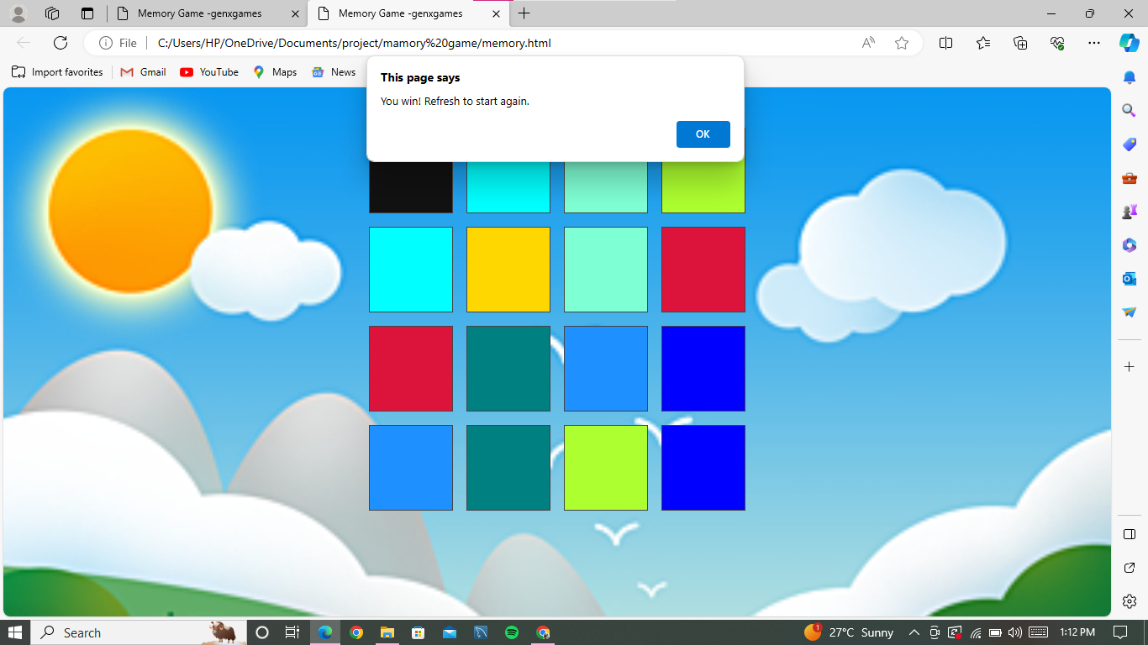
Memory game

Slide 7
objectives
Develop an interactive educational game or presentation for entertainment and learning.
Integrate diverse historical questions to challenge the user's knowledge, encouraging logical thinking.
Ensure high interaction by user to end the game
The project aims to create an good experience for user not only for entertains but also educates users too.

Slide 8
Conclusion:
In conclusion, the Color Memory Game provides an entertaining and intellectually stimulating experience for players of all ages.
This game not only captivates with its visually appealing design but also challenges and enhances memory and concentration skills in a fun and interactive way.
The progressive difficulty levels ensure that the game remains engaging and offers a continuous challenge to keep players on their toes.

Slide 9
Tools and Technologies used
Tooles :-
Visual studio code
Notepad++
Github
Technologies :
HTML
CSS
JAVA SCRIPT

Slide 10
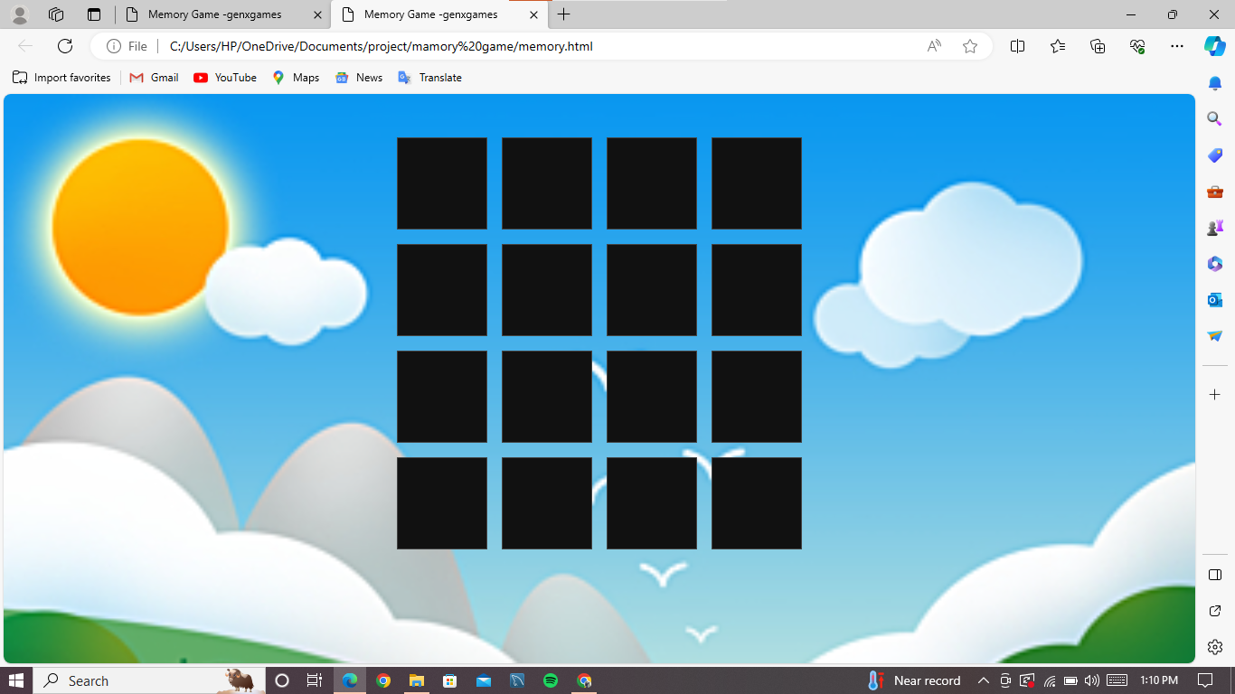
Screenshots / Animation

Slide 11
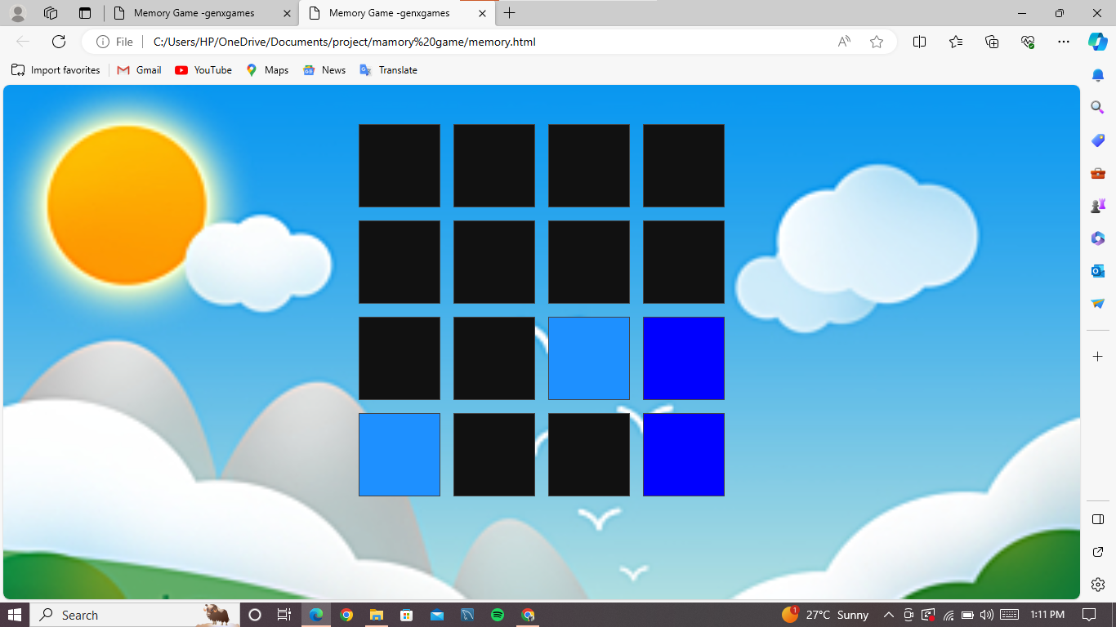
Screenshots / Animation

Slide 12
Screenshots / Animation

Slide 13
Conclusion & Future Work
Know the latest technology and tools.
how to Improved game quality for future
How to Increased Creativity in game making
Include more levels in it.
Make more difficult games for user
Ex : chess , quiz etc..

Slide 14
Bibliography
W3Schools Online Web Tutorials
(w3 school)html
code with harry - YouTube (code with harry videos)
https://github.com/ANSARI-YUSUF/project
(github)

Slide 15
Thank you

