Slide 1

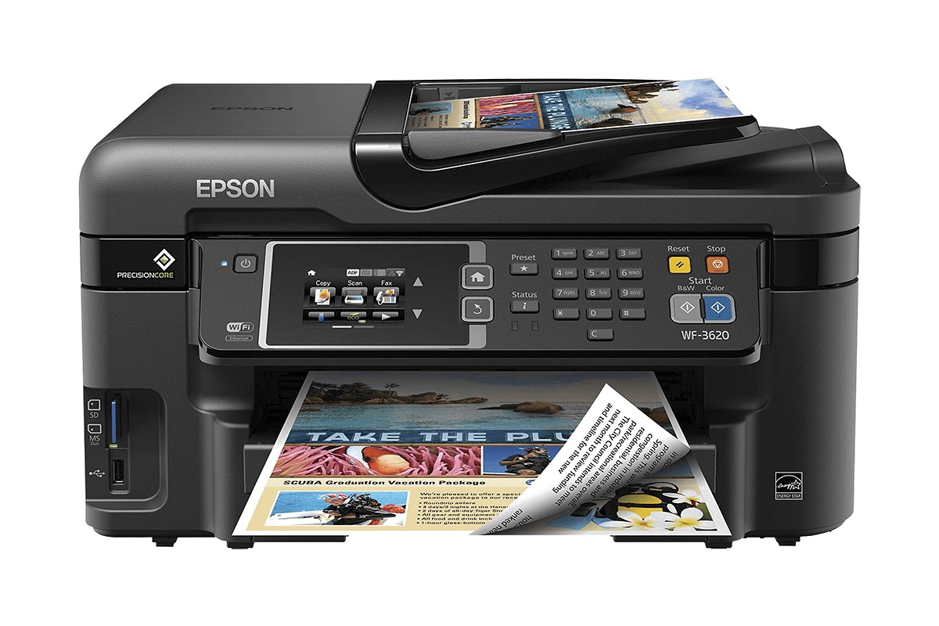
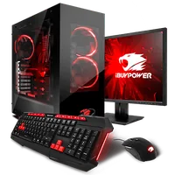
Computer receives data through input devices like a keyboard and mouse.
Printer converts digital documents and images from a computer or phone into physical paper copies.

