Slide 1


EV Vehicle/Charging Demand Prediction
Ansh Sharma
AICTE Student ID: STU683601376ca011748369719
AICTE Internship ID: INTERNSHIP_1748923002683e727a876ea

Slide 2

Learning Objectives
To analyze historical electric vehicle (EV) data at the county level in the US.
To build predictive models for future EV adoption and distribution.
To identify trends and contributing factors affecting EV uptake.
GOAL
Source :
www.freepik.com/

Slide 3
Tools and Technology used
Programming Language
Python: Programming language for data processing and modelling.
Libraries Used:
pandas, numpy: Data manipulation and analysis.
matplotlib, seaborn: Data visualization.
scikit-learn: Machine learning (RandomForestRegressor, GradientBoostingRegressor), preprocessing, evaluation.
joblib: Model persistence.

Slide 4
Methodology
Data Loading & Exploration:
Load CSV data on EV populations.
Inspect columns such as date, county, state, EV totals, non-EV totals, and percent of EVs.
Data Preprocessing:
Date formatting, handling categorical variables (LabelEncoding).
Feature engineering: time features (months_since_start), lag and rolling window values, growth rates, cumulative sums.
3. Model Development:
Feature and target selection
Split data into training and test sets.
Model training (Random Forest, Gradient Boosting).
Hyperparameter tuning (RandomizedSearchCV).
4. Model Evaluation:
5.Deployment

Slide 5
Problem Statement:
Growing Need: With the fast pace of EV adoption, urban planners must predict future demand to guide infrastructure—especially charging stations.
Risk of Poor Planning: Inadequate forecasting could cause shortages, long wait times, and hinder sustainability goals.
Data-Driven Insight: Using county-level vehicle registration data from 2017–2024 (including EV, non-EV, vehicle types), we can analyze trends in EV growth.
Comprehensive Dataset: The dataset provides monthly records by county, distinguishing between types of EVs (BEVs, PHEVs) and regional characteristics.
Modeling Goal: Build a regression model to accurately predict the future number of EVs at the county level based on historical trends and data features.
Application: Accurate forecasts will help policymakers and planners anticipate demand, optimize charging infrastructure placement, and facilitate sustainable EV growth.

Slide 6
Solution:
Algorithms Used:
Random Forest Regressor
Gradient Boosting Regressor Both are powerful ensemble regression methods suitable for capturing complex trends and relationships in the data.
Feature Engineering:
Created time-based features (e.g., months since start)
Encoded counties numerically
Generated lag features, rolling averages, and growth rates to capture adoption trends
Model Training:
Data split into training and testing sets
Hyperparameter tuning via RandomizedSearchCV for optimal results
Evaluation Metrics:
Model performance assessed using:
Mean Absolute Error (MAE)
Mean Squared Error (MSE)
R² score (Coefficient of Determination)
GITHUB REPOSITORY LINK: https://github.com/ANSH-SHARMA912/EV_Prediction.git

Slide 7
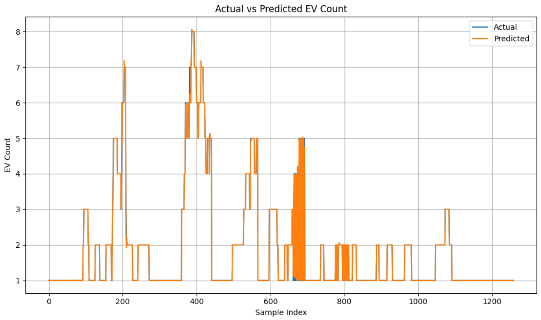
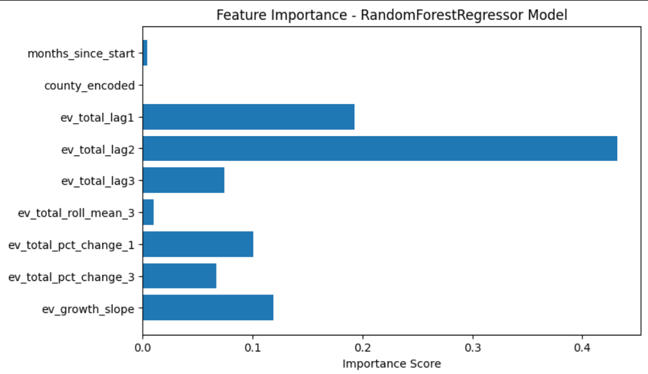
Screenshot of Output:

Slide 8
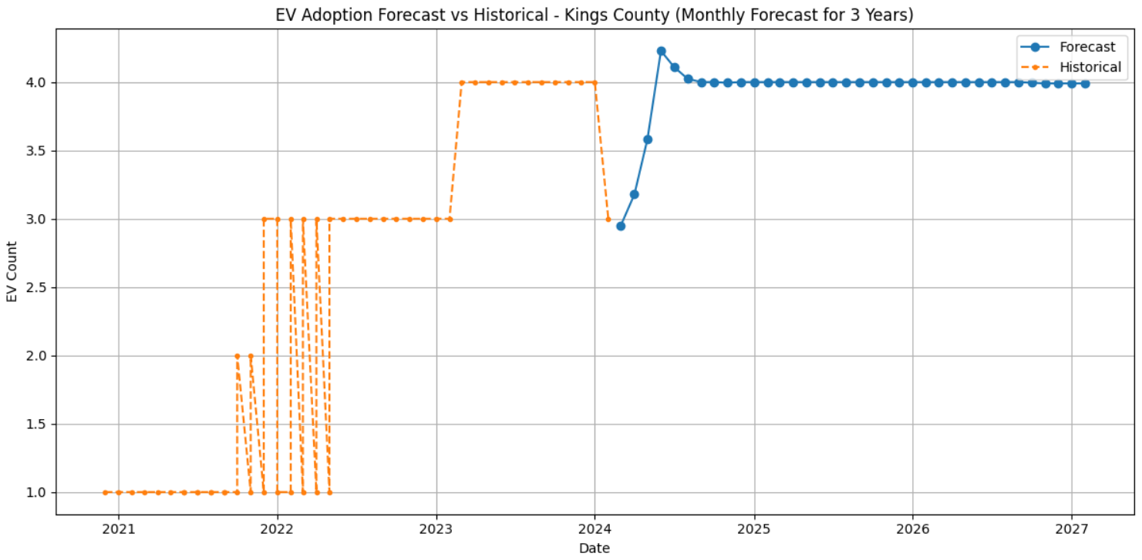
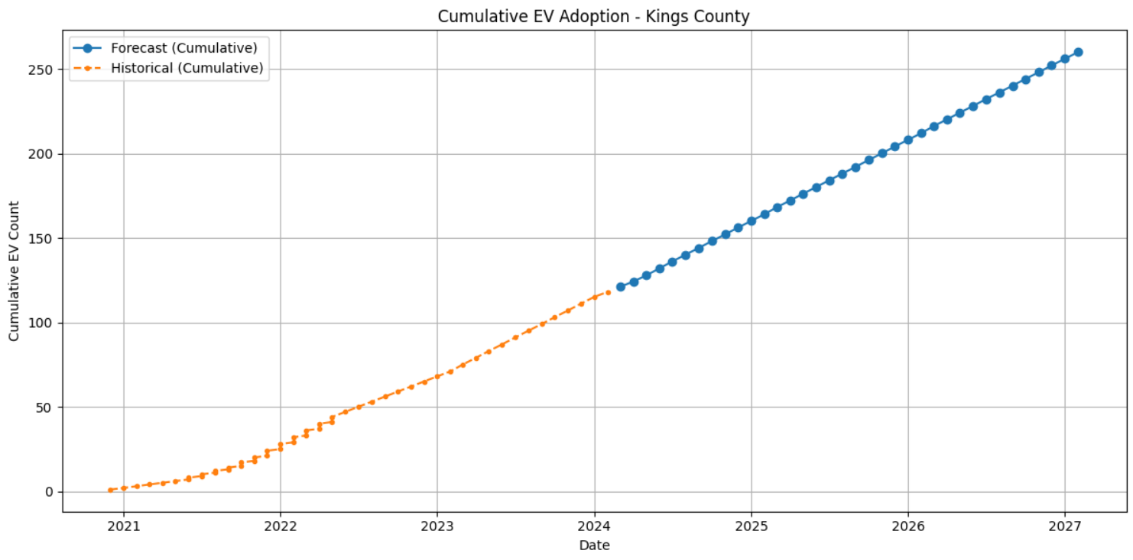
Screenshot of Output:

Slide 9
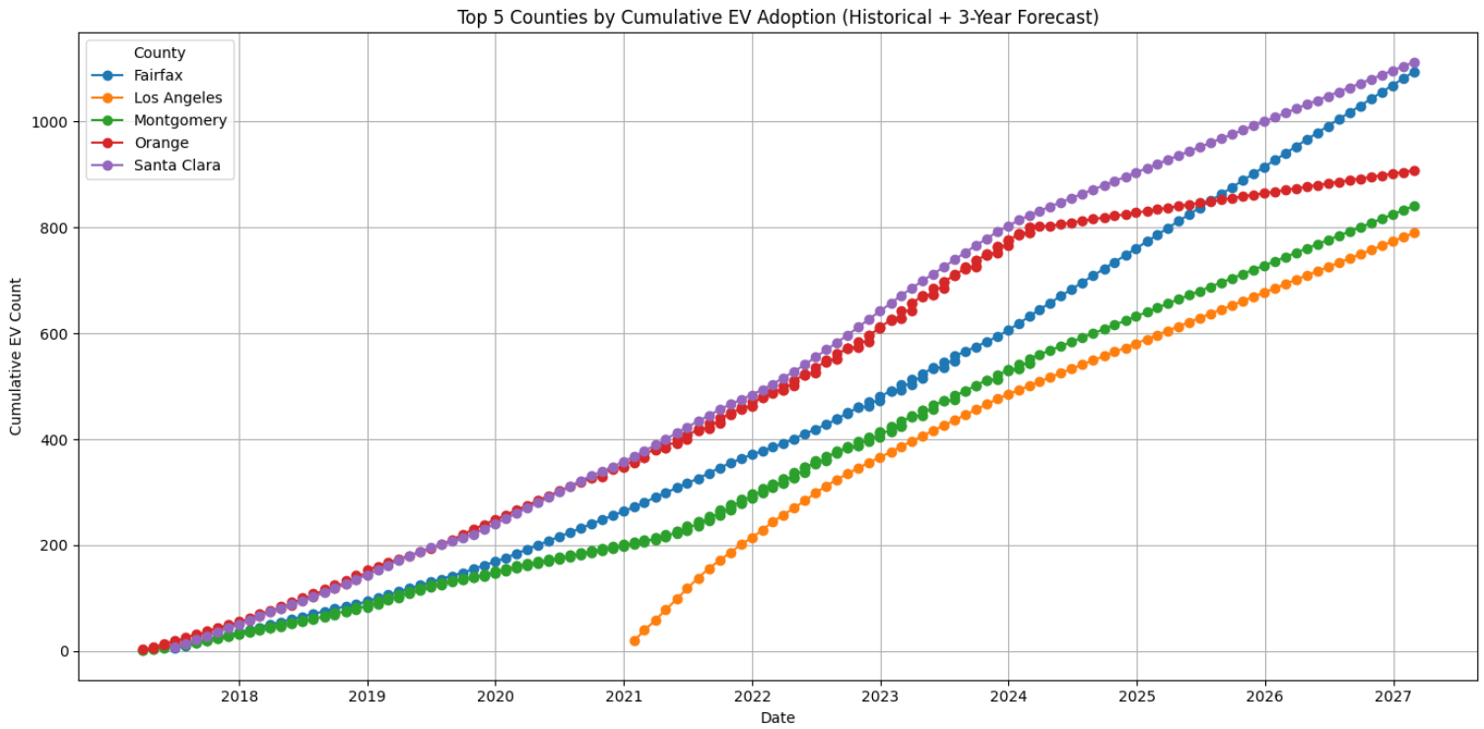
Screenshot of Output:

Slide 10
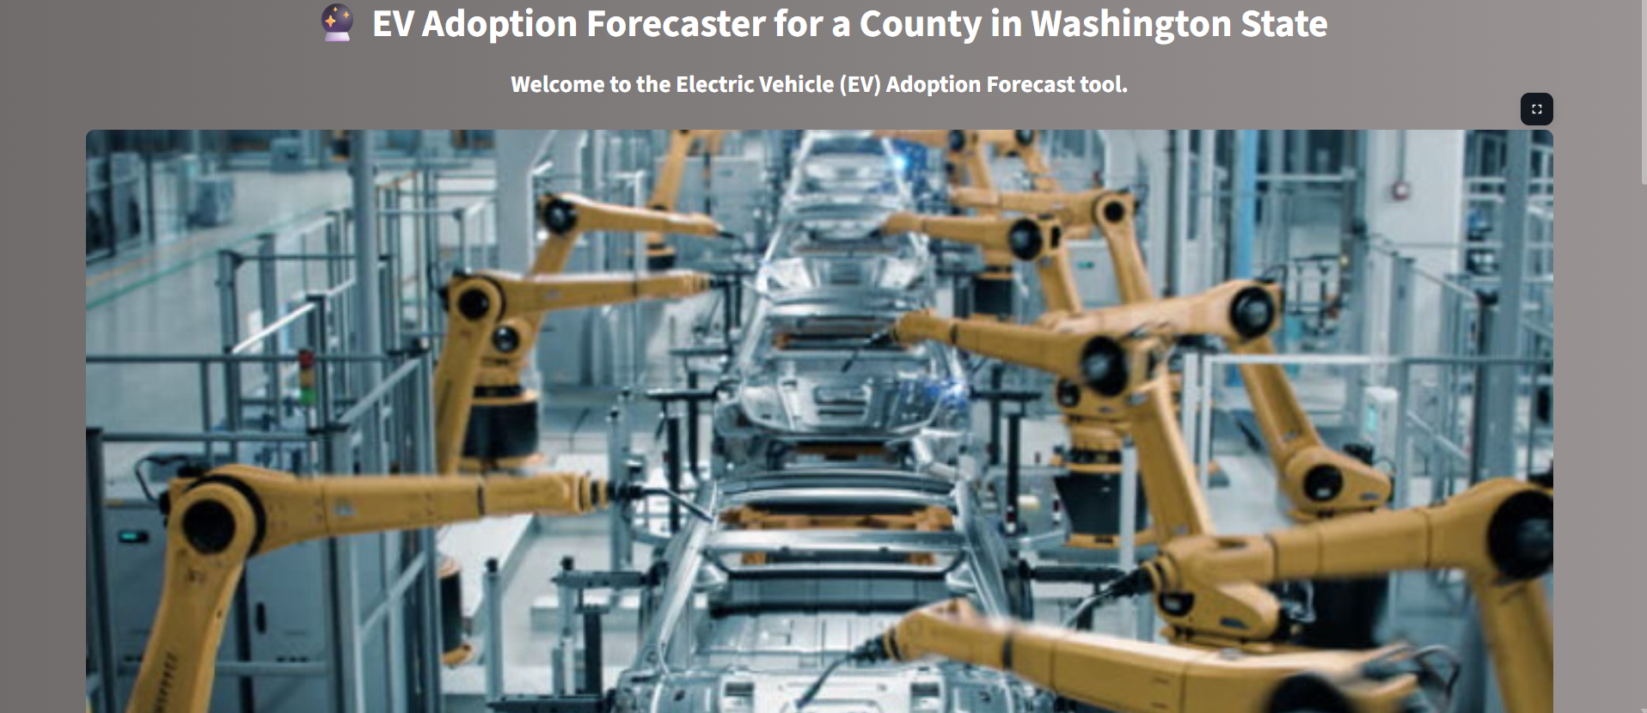
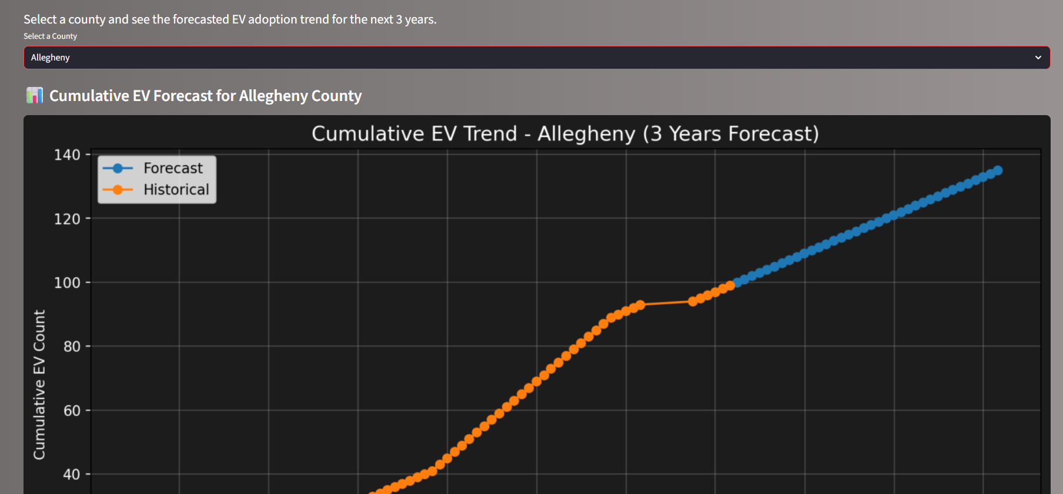
Screenshot of Output: Streamlit Deployment

Slide 11
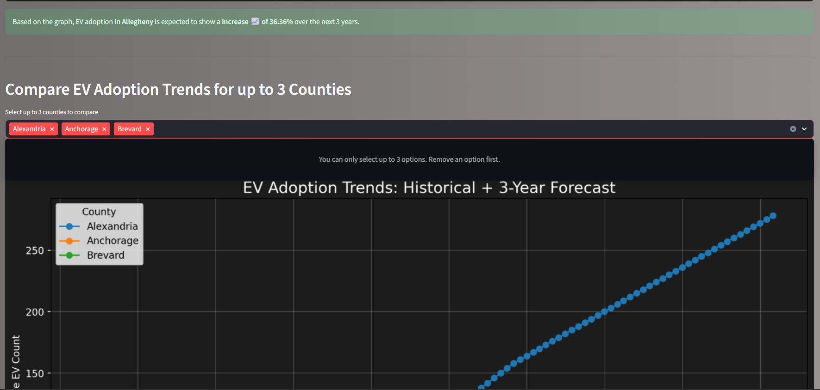
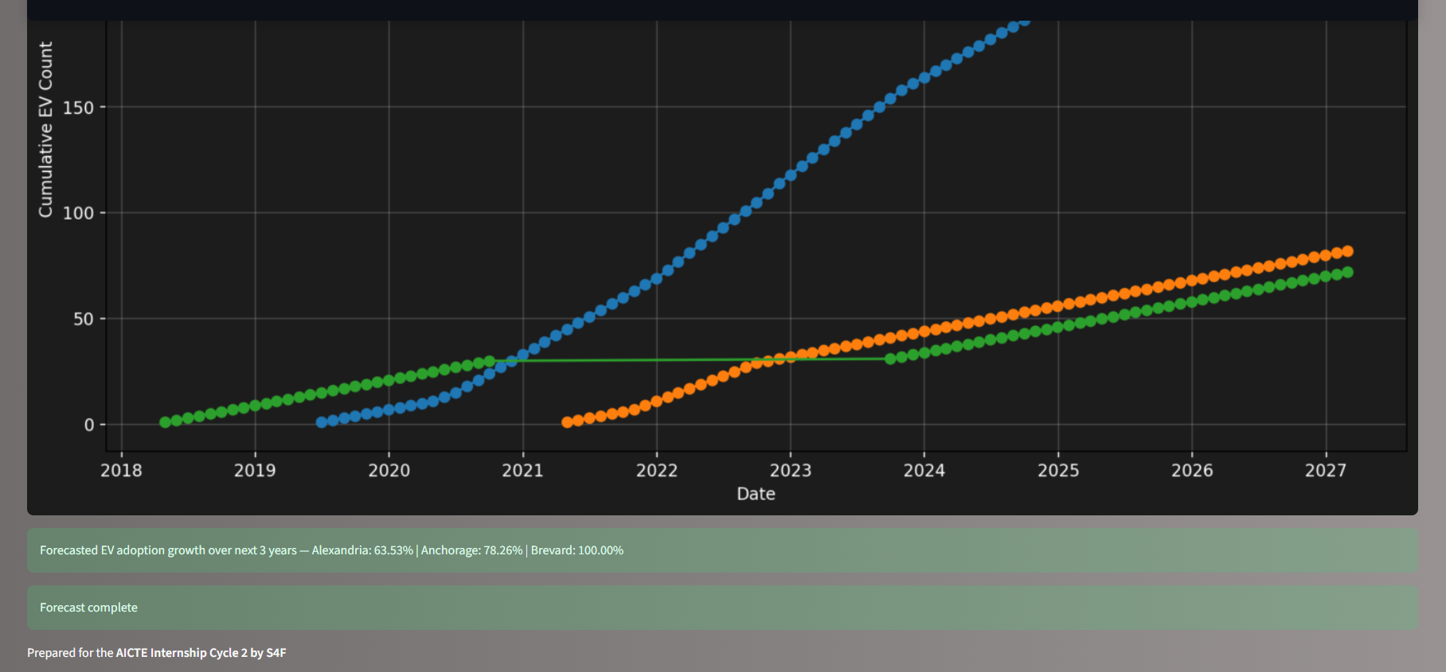
Screenshot of Output:

Slide 12
Conclusion:
Summary
Objective: Developed regression models (Random Forest and Gradient Boosting) to accurately forecast county-level electric vehicle (EV) adoption trends using historical vehicle registration data from Washington State (2017–2024).
Approach: Engineered temporal and regional features, performed data preprocessing, and optimized models with hyperparameter tuning to capture complex growth patterns in EV populations.
Results: Models demonstrated strong predictive accuracy (evaluated via MAE, MSE, and R²), enabling reliable forecasts to assist urban planners and policymakers in infrastructure planning, especially EV charging station deployment.
Future Scope
Integrate external data sources such as regional demographics, economic indicators, and charging station usage to enhance prediction accuracy.
Expand modeling to include real-time data streams and adapt models for continuous learning to keep forecasts up-to-date.
Develop interactive dashboards or web applications for stakeholders to visualize predictions and simulate infrastructure planning scenarios.
Explore spatial analysis techniques and geospatial modeling to optimize charging station locations dynamically as EV adoption evolves.

