Slide 1
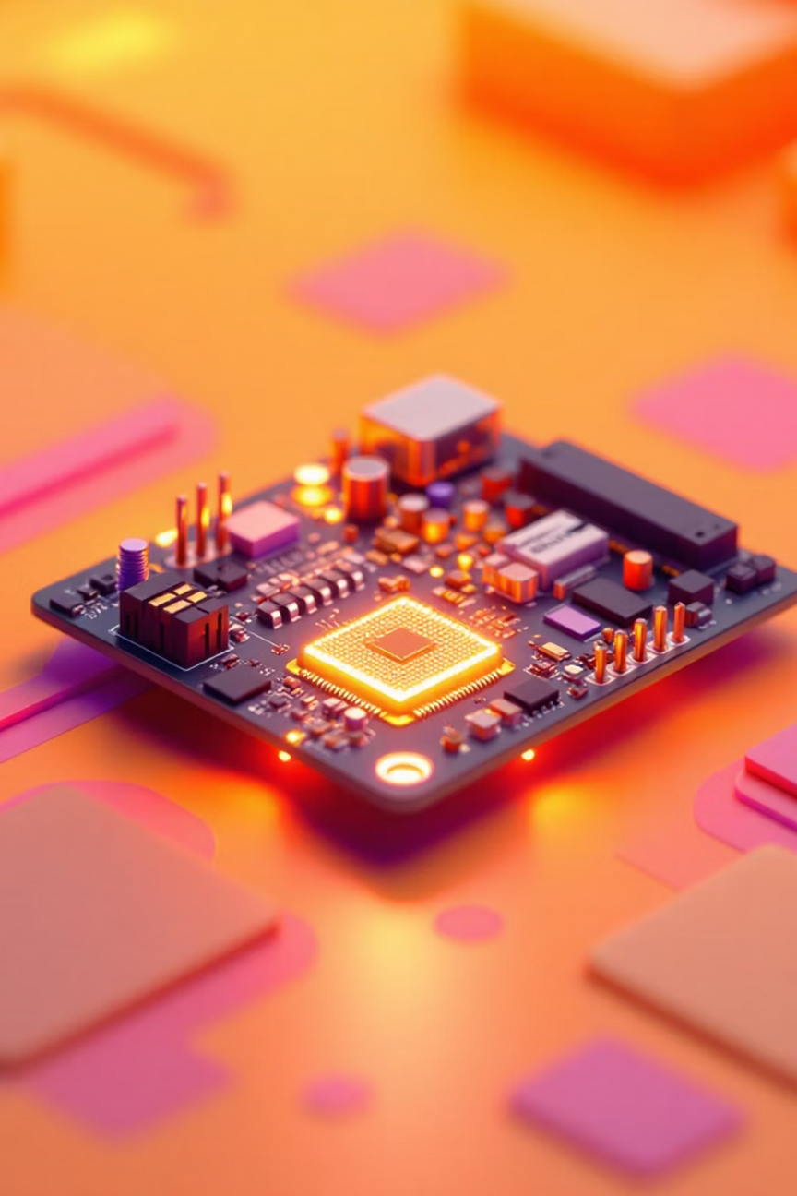

Power-Aware Embedded System Using Interrupt-Based Wake-Up
Presented by: ANSHAD CK
Notes:
1

Slide 2






Chapter 1: The Challenge
The Problem of Power
Idle Power Draw
Polling Overhead
Efficiency is Key
Traditional embedded systems consume power even when the system is idle.
Continuously checking sensors keeps the CPU active, causing unnecessary battery drain.
Power efficiency is critical for battery-powered and long-life embedded devices.
Notes:
2

Slide 3
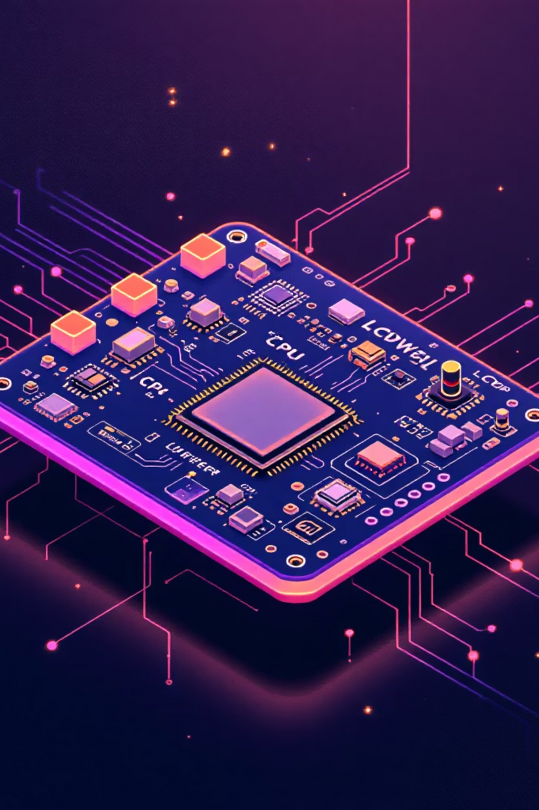
Project Objectives: Designing for Efficiency
Design a Power-Aware System
Leverage Low-Power Modes
Design an embedded system that minimizes energy consumption during both idle and active states.
Reduce power consumption by using the microcontroller’s sleep and low-power modes during idle periods.
Implement Interrupt-Based Execution
Shift from continuous execution to an event-driven approach where the CPU wakes only when required.
Notes:
3

Slide 4

Chapter 2: System Architecture
Power-Aware System Overview
Demand-Based Execution
Interrupt Wake-Up
Sleep Mode Operation
System wakes up from sleep using hardware interrupts when an event occurs.
Tasks and required computations are executed only in response to a specific event, eliminating idle processing.
The microcontroller resides in low-power sleep modes for the majority of its operation cycle during periods of inactivity.
Notes:
4

Slide 5
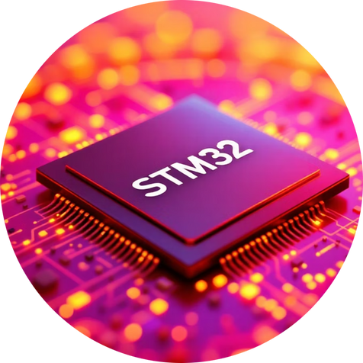



Key Hardware Components
STM32 Microcontroller
Sensors & Peripherals
Push Button Input
Power Supply and Battery
Detect environmental or system state changes, generating the critical input events needed for wake-up.
Used primarily to generate external interrupts for demonstration, simulating user interaction or a simple trigger.
Acts as the brain of the system, chosen for low-power operation and extensive peripherals.
A battery or low-noise power supply feeds the system, demanding efficiency for maximum operational life.
Notes:
5

Slide 6




Communication & Interfacing Protocols
Efficient data handling and debugging rely on selecting the right communication protocols suited for low-power operation.
UART (Universal Asynchronous Receiver/Transmitter)
I2C (Inter-Integrated Circuit)
The primary choice for communicating with low-power sensors and peripherals due to its simplicity and efficiency.
Utilized for system monitoring, debugging, and initial configuration output.
ADC (Analog-to-Digital Converter)
Interrupts
Converts analog signals to digital for sensor readings and battery voltage monitoring.
The core event-based mechanism that dictates when the system becomes active and executes tasks.
Notes:
6

Slide 7





The Interrupt-Based Wake-Up Concept
Interrupt Occurs
Enter Deep Sleep
Wake & Execute
Return to Sleep
This methodology ensures that CPU time is reserved strictly for value-adding operations, keeping power consumption minimal when idle.
Notes:
7

Slide 8
Operational Workflow
The system follows a strict state machine to minimize time spent in the high-power active state.
1
Initialization and Setup
System powers on, initializes all required peripherals, and configures interrupt handlers.
2
Enter Low-Power Mode
The microcontroller immediately transitions to the designated low-power sleep mode.
3
Interrupt Event Trigger
An event (from a button, sensor, or timer) generates a hardware interrupt.
4
Wake-Up and Task Execution
The CPU wakes up, processes the interrupt, and executes the required event-specific task.
5
Data Processing & Transmission
Any collected data is processed, logged, or transmitted via the communication protocols (UART/I2C).
6
Peripherals Disable & Return to Sleep
All non-essential peripherals are powered down, and the system re-enters sleep mode to await the next event.
Notes:
8

Slide 9

Core Power Management Strategy
Our power saving is achieved through a multi-pronged approach targeting every aspect of energy usage.
Key Techniques
Systematic use of low-power modes (Stop/Standby) to minimize baseline energy consumption.
Interrupt-driven execution completely replaces power-hungry, continuous polling loops.
Strict power-gating: unused or unnecessary peripherals are explicitly disabled when not in use.
CPU active time is minimized by optimizing code execution speed and task scheduling.
Notes:
9

Slide 10












Project Impact: Advantages & Applications
Extended Battery Life
Fast Response Time
Significant power reduction directly translates to dramatically improved device endurance.
Immediate wake-up ensures a quick and reliable response to external events.
IoT Devices
Efficient Resource Use
Perfectly suited for battery-powered, decentralized Internet of Things (IoT) devices.
CPU resources are used only on-demand, improving overall system efficiency and throughput.
Industrial Applications
Wearables & Portable Tech
Applicable to smart sensors and monitoring systems in low-power industrial environments.
Ideal for power-critical portable electronics and battery-operated wearable technology.
Notes:
10

Slide 11

Conclusion: Sustainable Power, Smart Design
The system efficiently manages power by keeping the microcontroller in low-power sleep modes during inactivity and using interrupt-driven execution to run tasks only when needed. Optimized use of sensors, peripherals, and communication interfaces further reduces energy consumption, while the power supply and battery are designed for long-lasting, low-noise operation. Overall, these strategies result in extended battery life and highly energy-efficient system performance.
Notes:
11

Slide 12

Thank You!
We appreciate your time and attention to our presentation on power-aware embedded systems. We believe this interrupt-based wake-up methodology offers a robust solution for extending battery life and enhancing efficiency in various applications.
We are now open for any questions you may have.
Notes:
12

