Slide 1
Exploratory Data Analysis

Slide 2
Exploratory Data Analysis can never be the whole story, but nothing else can serve as the foundation stone.
-Tukey(1977)

Slide 3
Measures of Central Tendency

Slide 4
Mean
The mean is the average of all numbers and is sometimes called the arithmetic mean.

Slide 5
Median
The statistical median is the middle number in a sequence of numbers. To find the median, organize each number in order by size; the number in the middle is the median

Slide 6
Mode
The mode is the number that occurs most often within a set of numbers.

Slide 7
Data Variability

Slide 8
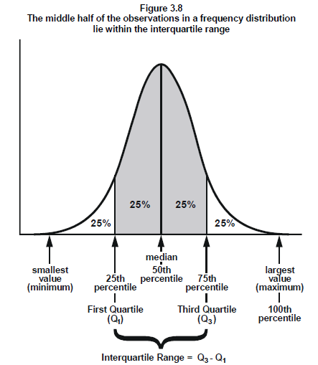
Range
The range is the difference between the highest and lowest values within a set of numbers.

Slide 9
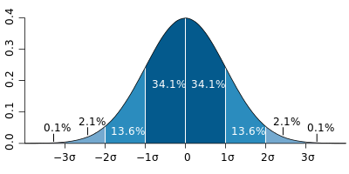
Standard Deviation (σ)
Standard Deviation (SD) is a measure that is used to quantify the amount of variation or dispersion of a set of data values.

Slide 10
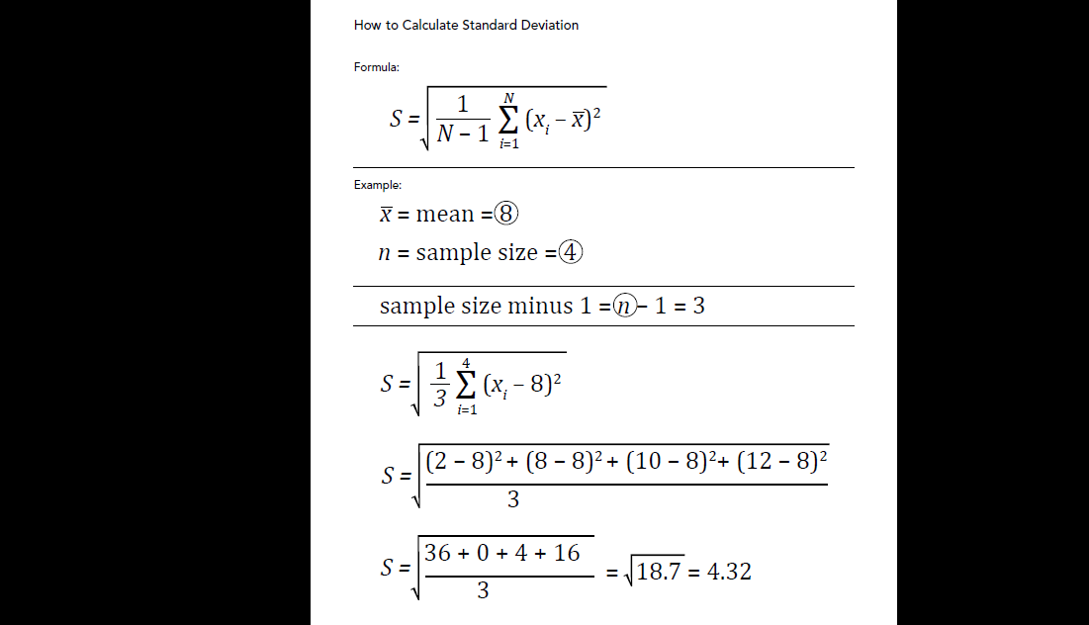

Slide 11
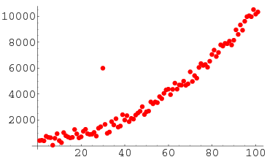
Outliers
an outlier is an observation point that is distant from other observations. An outlier may be due to variability in the measurement or it may indicate experimental error; the latter are sometimes excluded from the data set.

Slide 12
Distribution and Relative Position

Slide 13
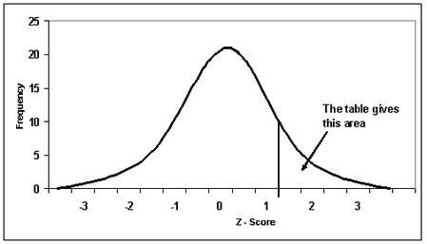
Z-Score
A z-score is the number of standard deviations from the mean a data point is. But more technically it's a measure of how many standard deviations below or above the population mean a raw score is.

Slide 14
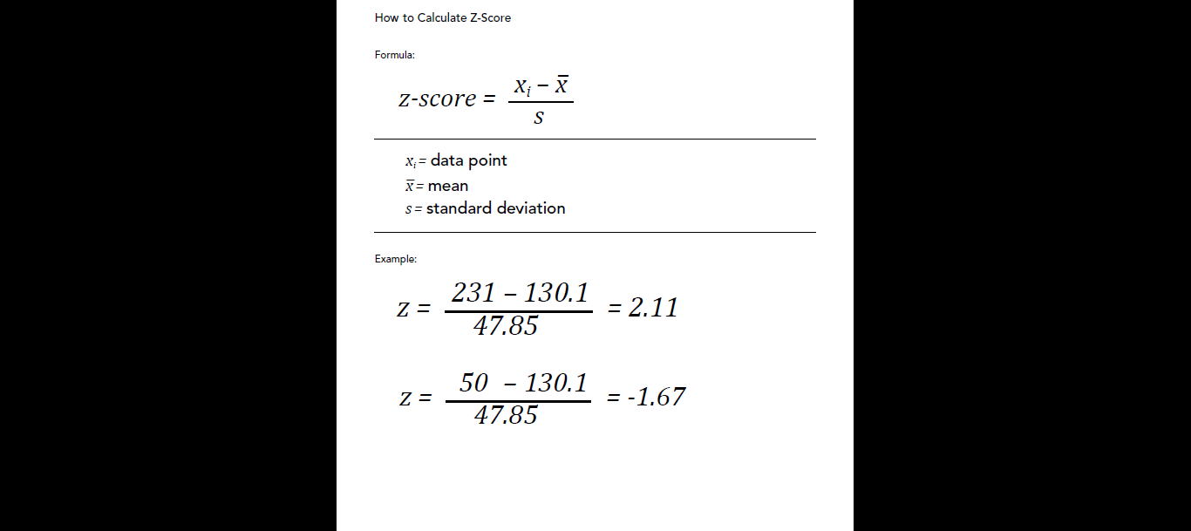

Slide 15
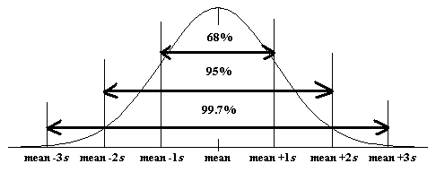
Emphirical Rule
The empirical rule states that for a normal distribution, nearly all of the data will fall within three standard deviations of the mean. The empirical rule can be broken down into three parts:
68% of data falls within the first standard deviation from the mean. (1 Sigma)
95% fall within two standard deviations. (2 Sigma)
99.7% fall within three standard deviations. (3 Sigma)
99.99966% → (6 Sigma)

Slide 16
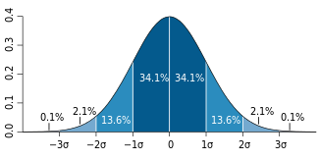
Calculating Percentiles
A percentile (or a centile) is a measure used in statistics indicating the value below which a given percentage of observations in a group of observations fall.

Slide 17
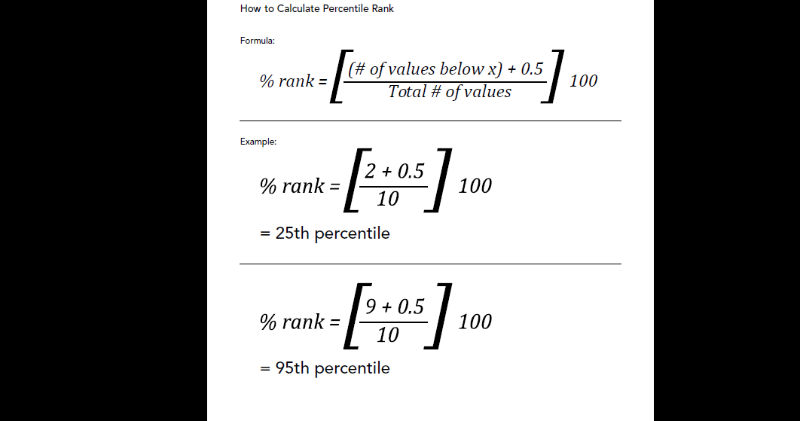

Slide 18
Probability Explained

Slide 21
Multiple Event Probability

Slide 24
Permutations and Combinations

Slide 27
Discrete vs Continuous Distribution

Slide 30
Continuous Probability Distribution

Slide 33
Sampling

Slide 36
Sample Size

Slide 39
Confidence Interval

Slide 42
Hypothesis Testing

Slide 45
T and Z distributions

Slide 48
T and Z distributions

Slide 51
Comparing Two Populations
Proportions

Slide 54
Comparing Two Populations (Means)

Slide 57
Chi-Square

Slide 60
Anova: Analysis of Variance

Slide 63
Regression

Slide 66
Co-relation

