Slide 1
Online Parking Booking System
Group Members:-BISWAPATI MAHATO (220343120025)
PRATIK GHOGARE (220343120083)
ANSHUMAN KUMAR (220343120014)
TUSHAR PATIL (220343120110)
Project Guide:- Mrs. Harshita Maheshwari

Slide 2
ABSTRACT
In cities where the population is at its peak and the roads are all messed with vehicle's and long traffics. In such over increasing population it becomes a difficult job to find a parking spot for our vehicle. We came up with an idea where users can logon to our Web Application and find the ideal parking spot. Our project Online Parking Booking system is developed in Java,ReactJs, MYSQL. With this the users save's both time as well as fuel. The user can easily view the parking availability on the web application and drive straight to the spot without wasting any time.

Slide 3
EXISTING SYSTEM
In metropolitan cities where the population is at its peak and the roads are all messed with vehicle’s and long traffics. In such over increasing demand for vehicle’s it becomes a difficult job to find a parking spot for our wheels. Due to this people are forced to haphazardly park their vehicle wherever they find space, which results in traffic offence like illegal, haphazard double or angular parking.

Slide 4
In the existing system the parking management were all made in Manual mode, so it’s unable to make the process easy and smooth.
The existing system of parking management does not consider the parking timing slots where they can give bigger confusions and not efficiently utilized the space.

Slide 5
DISADVANTAGES OF EXISTING SYSTEM
Manual Works.
Everything is paper work.
User cannot able to select the desired location, date or time.
More manual hours are needed for checking the spaces available.
It is tedious to manage historical data on which date and time the booking has been done

Slide 6
PROPOSED SYSTEM
The proposed project is an Online parking booking system that provides customers an easy way of reserving a parking space online. It overcomes the problem of finding a parking space in commercial areas that unnecessary consumes time. Hence this project offers a web based reservation system where users can view various parking areas and select the space to view whether space is available or not. If the booking space is available then he can book it for specific time slot. The booked space will be marked yellow and will not be available for anyone else for the specified time. Users can even make payment online.

Slide 7
Parking Area
The project can be implemented in commercial areas for employee parking.
It can be utilized by companies and organizations (hospitals, schools, colleges) to automate their parking system.
The system can also be used in public places for public parking like in malls, station, and so on.

Slide 8
ADVANTAGES OF PROPOSED SYSTEM
Users can get learn about parking areas for particular locations.
It saves user time in search of parking space available in such a long parking area.
The system provides a graphical view of the parking spaces.
User can pay online on the spot and confirm their space.
It excludes the need of human efforts for managing parking spaces.
Cost-effective.

Slide 9
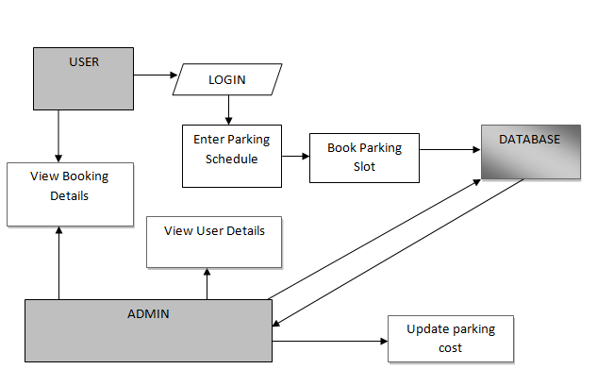
SYSTEM ARCHITECTURE

Slide 10
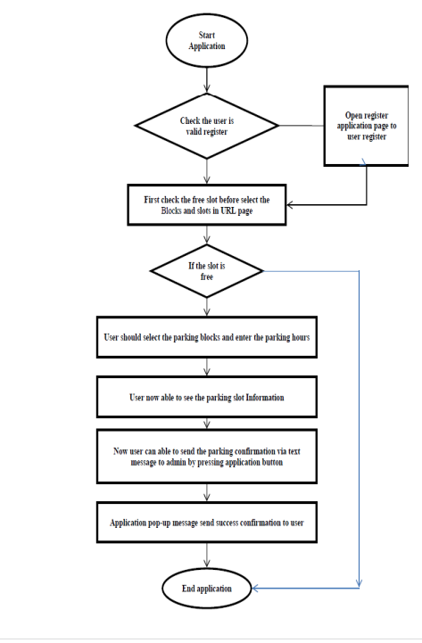
Work Flow Of Website

Slide 11
HARDWARE REQUIREMENTS
System : Pentium i3 Processor
Hard Disk : 500 GB.
Monitor : 15’’ LED
Input Devices : Keyboard, Mouse
Ram : 2 GB

Slide 12
SOFTWARE REQUIREMENTS
Operating system : Windows 10.
Coding Language : JAVA
Tool : STS 3.9.18,VS CODE
Database : MYSQL

Slide 13
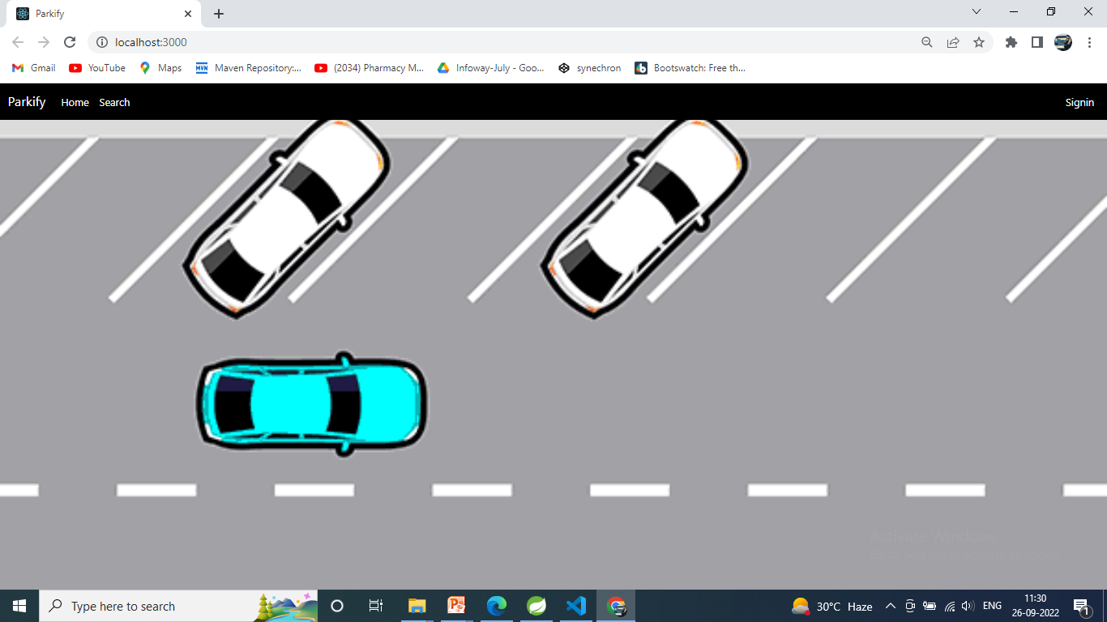
HOME PAGE OF THE WEB APP

Slide 14
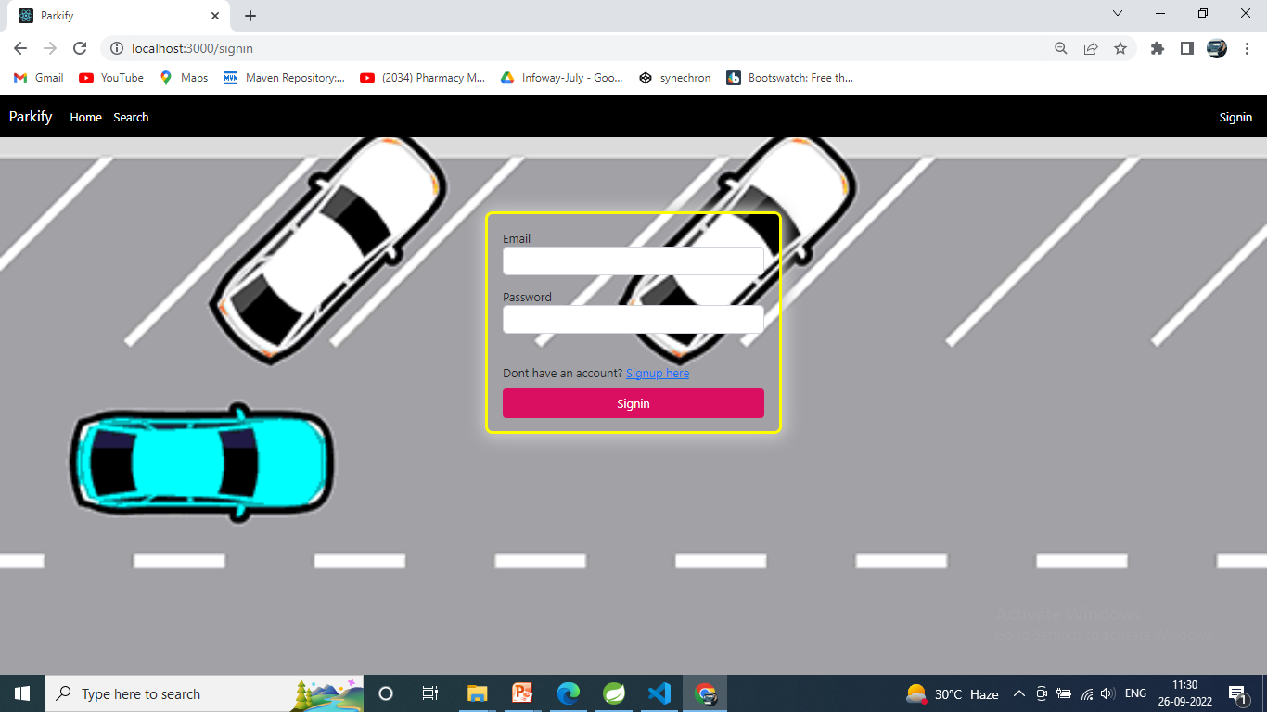
Login Page

Slide 15
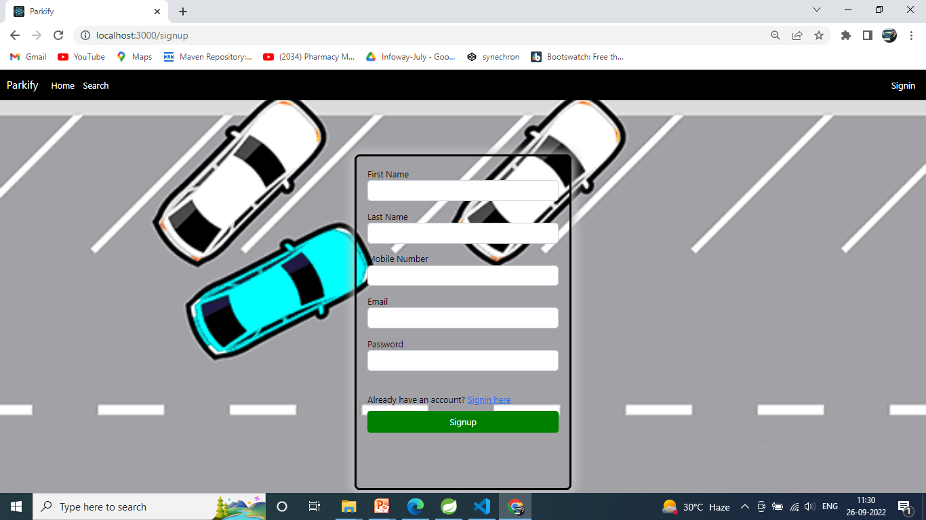
Sign Up Page

Slide 16
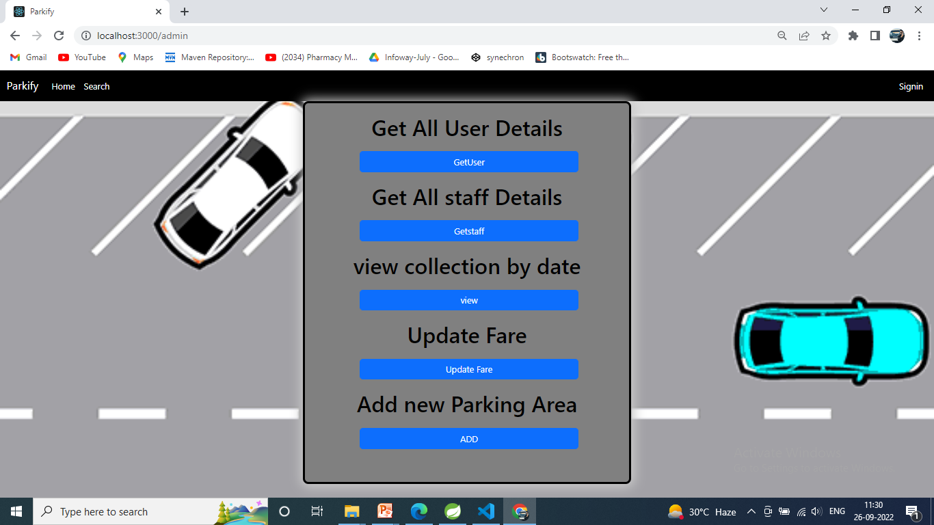
Admin Page

Slide 17
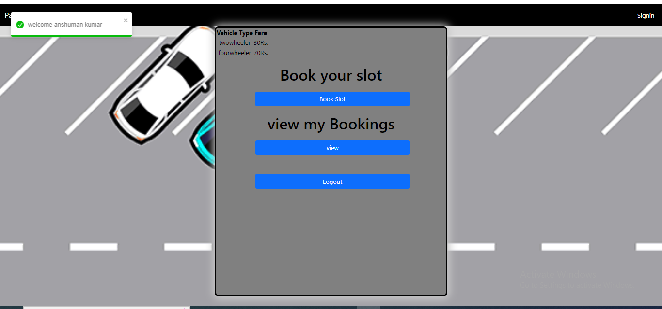
User Page

Slide 18
Conclusion
The proposed system provides better information for the users of this system easily they can see the available slots and book from anywhere without facing any difficulty.
The proposed system does not require any physical presence during booking.
The proposed system has good authentication so only authorized person can able to login and book it.

Slide 19
References
Mr. Saleel Bagde for MySql Database
Mrs. Harshita Maheshwari for HTML, CSS, ReactJs.
Mrs. Mayuri For Backend Java
https://www.projectideas.com
http://www.slideshare.net
A special Thanks to infoway management

Slide 20
THANK YOU

