Slide 1
AIRBOARD
an easier way to draw without external peripherals

Slide 2
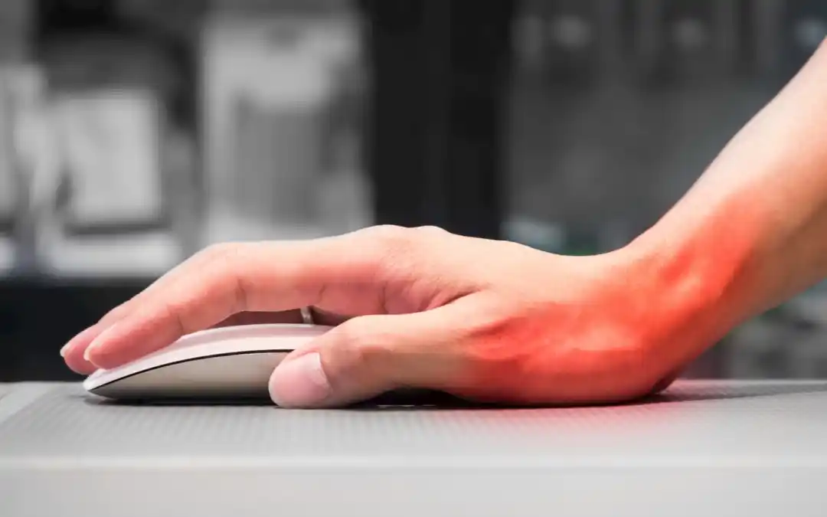
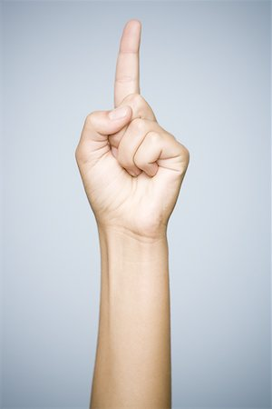
Why?
Using the mouse:
Difficult to understand where you are drawing
Sometimes too sensitive and so is easy to make mistakes
Using your hands:
It partially reproduces the feeling of writing on paper
Induces a more natural hand posture

Slide 3
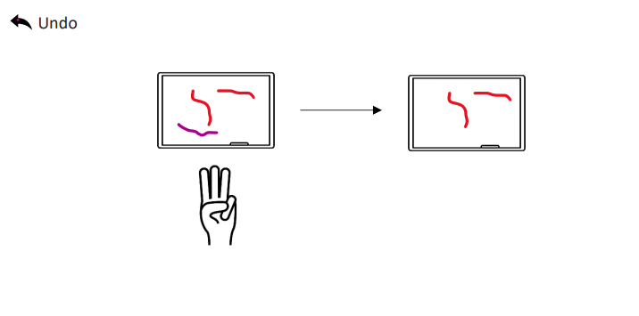
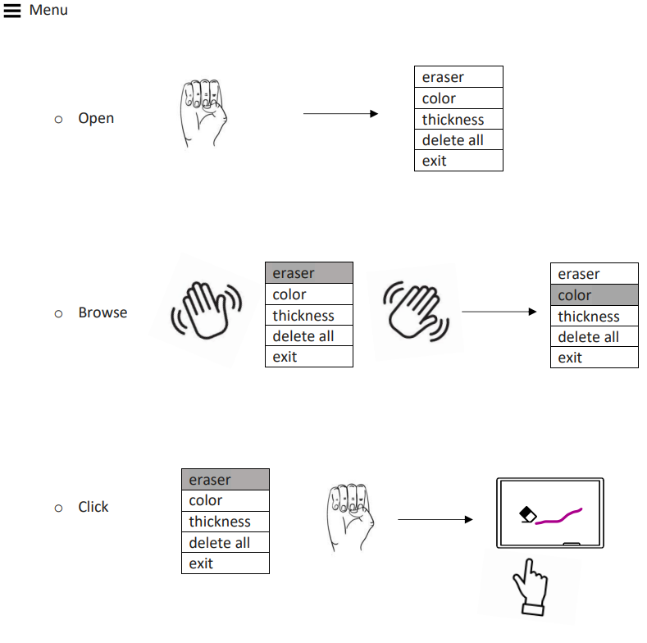
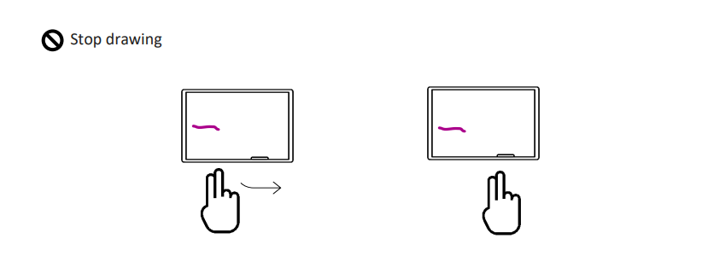
Is it actually accessible only with the use of the hands?
Yes
thanks to the set of gestures available

Slide 4
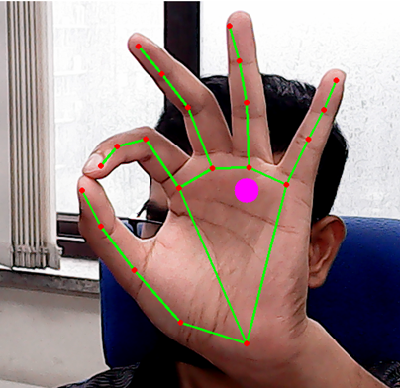
What make this possible? MediaPipe
MediaPipe Hands is a high-fidelity hand and finger tracking solution. It employs machine learning (ML) to infer 21 3D landmarks of a hand from just a single frame.
Using the positions of landmarks is possible to detect the gesture or follow the position of the index on the screen to draw

Slide 5
Other matiral used
PYQt5: to develop the interface
CV2: to take image inputs and convert them to different formats
Shapely: to work with geometric shapes
Pil: to work with images

Slide 6
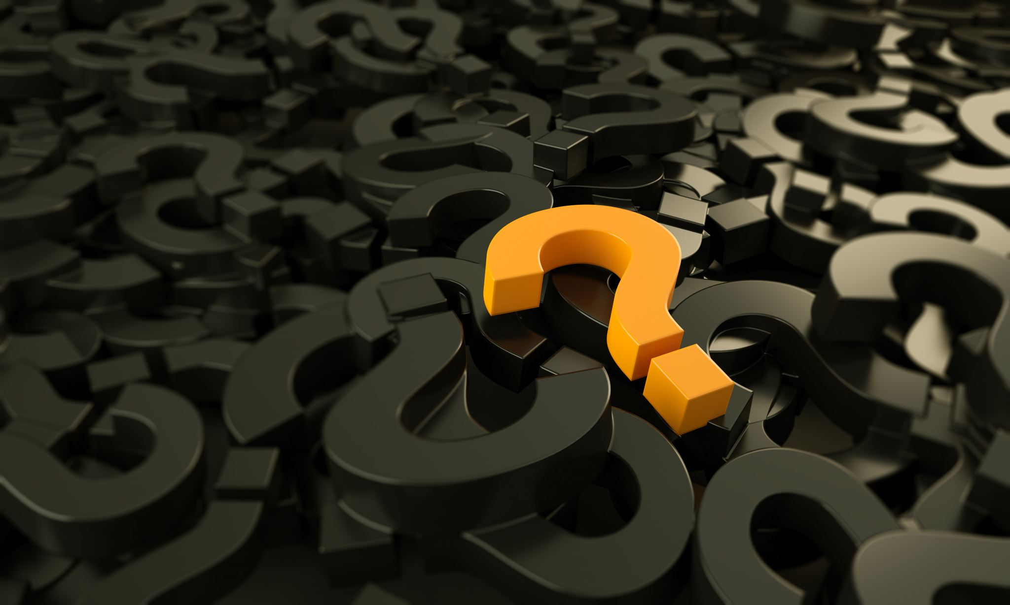
Questions?

