Slide 1
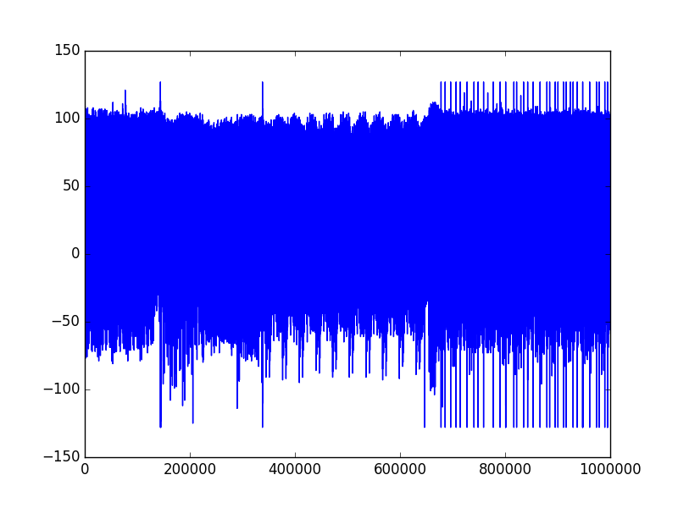
Pre-processing
AES rounds
Post-processing

