Slide 1

Supermarket System.
Possible databases in this systems in this area.
Inventory management System.
Sales & billing system.
Supplier management System.
Employee management System.
Customer Loyalty System.

Slide 2
Customer Loyalty System
Purpose
Register customers.
Track their purchases.
Award loyalty points.
Allow redemption of points.
Business case for the system
Users of the system.
Customers(earn & redeem points)
Cashiers(Record purchases)
Managers(analyze customer behavior and loyalty trends).

Slide 3
Reasons for choosing Customer loyalty System.
Helps supermarkets retain customers & increase repeat purchase.
Involves multiple entities(customers, transactions) making it good for database design.
Allows implementation of real world features like points, rewards & discounts.
Supports data analysis which improves decision making.
More interesting and slightly advanced compared to basic system.

Slide 4
Analysis of benefits
Tangible benefits
Intangible benefits
Increases sales due to repeated customers.
Better tracking of customer spending.
Improved marketing strategies based on data
Improved customer satisfaction
Strong customer loyalty to the supermarket.
Better brand reputation.

Slide 5
Analysis of costs
Tangible
Intangible
Cost of developing the database system.
Hardware(computers, servers)
Maintenance costs.
Training staff to build the system
Time required to implement the system
Possible resistance to change by employee.

Slide 6
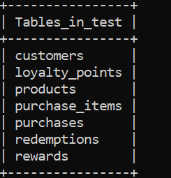
Entities.

Slide 7
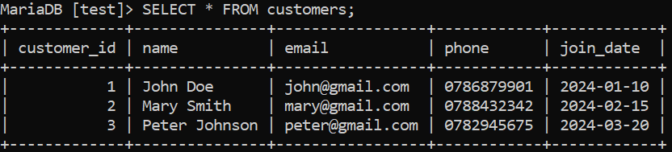
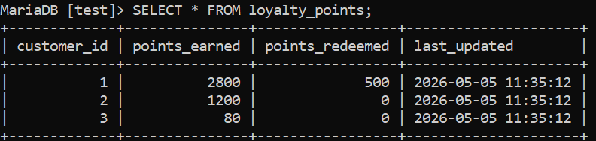
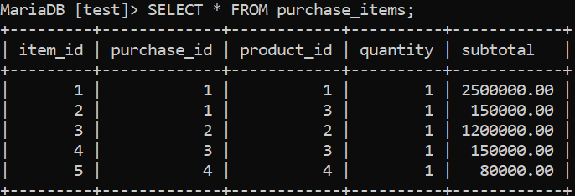
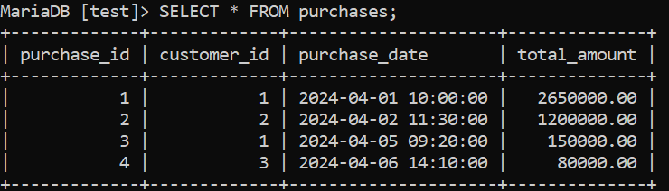
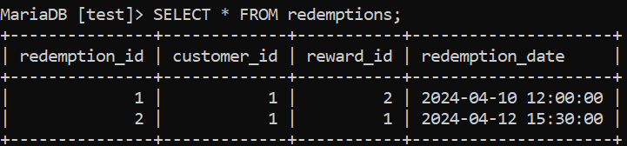
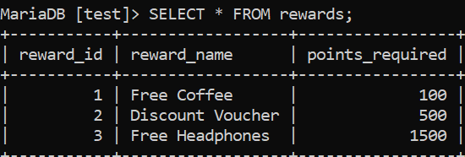
Tables.

Slide 8
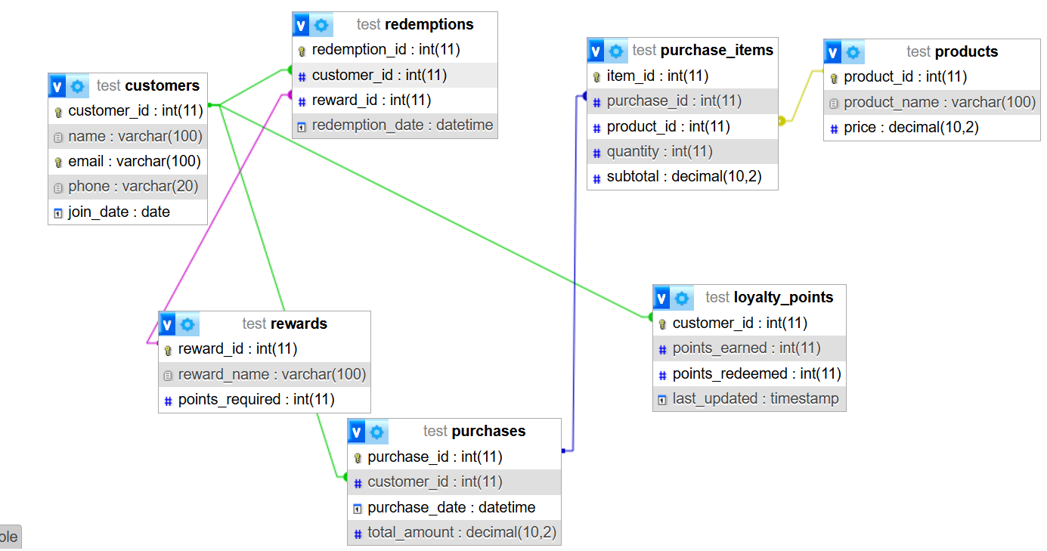
Entity Relationship Diagram.

Slide 9
Conclusion
The system of customer loyalty system is important in the supermarket project because it improves the system’s efficiency, boosts customer loyalty and supports business growth.

