Slide 1
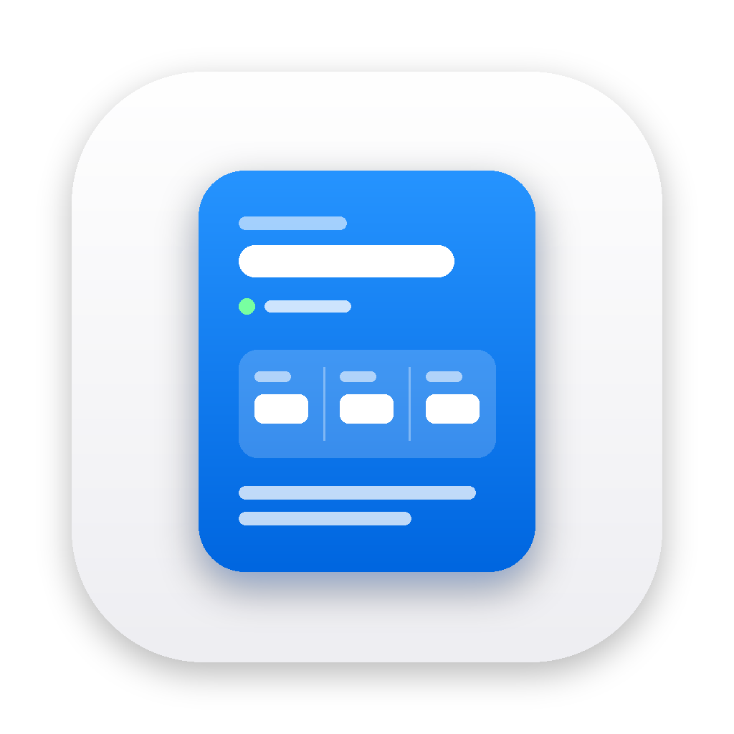
Reporting Builder
From raw notes to an accessible status card, in the tools your team already uses.
Tony Wen · Project Reporting Builder · Proof of concept
1
Notes:
Hello, I'm Tony. Thank you for your time. The brief asked for a tool that turns raw text, numbers and images into polished, accessible snippet cards you can share by email and chat. I built it as a native Mac app called Reporting Builder. I'll show it working first, then three design principles, how I handled accessibility and AI, the engineering, and what I would not claim yet.

Slide 2
THE PROBLEM
Every week, the same update, three times
1
2
3
Scattered inputs
Redone per channel
Accessibility last
Points in a notes app, numbers in a spreadsheet, a chart as a screenshot. Nothing is in one place or one format.
Mail wants rich text, Slack wants its own markup, the wiki wants Markdown. Each copy is made by hand.
Images without descriptions, status shown by colour alone, text trapped inside screenshots. Nobody checks.
The brief: ingest text, metrics and images; produce modular, polished, accessible cards; copy or export them instantly.
2
Notes:
Think of a program manager on a Thursday afternoon. The material for the weekly update is scattered: bullet points in a notes app, numbers in a spreadsheet, a chart as a screenshot. They assemble it for email, then again for Slack, then again for the wiki. And nothing ever asks: can a colleague with a screen reader read this? Does the status still make sense without red and green? Three problems: assembling, re-formatting, and accessibility arriving too late.

Slide 3
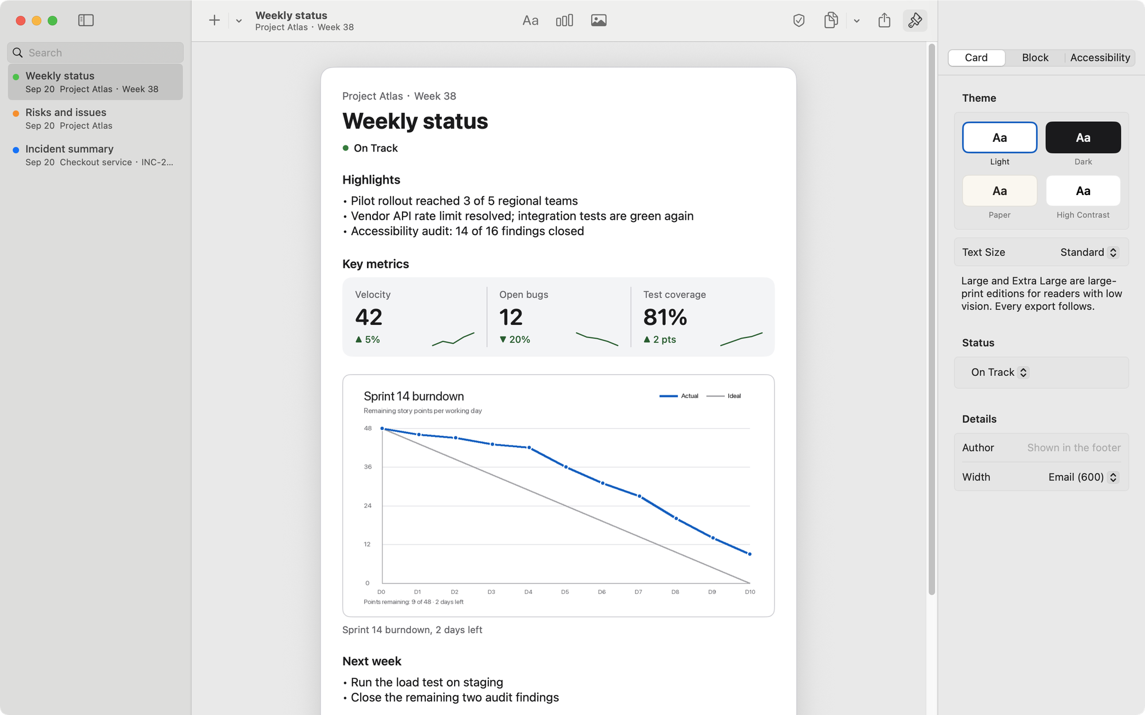
WHAT I BUILT
A Mac app where the card is the document
In
Type on the card, paste a spreadsheet range, drop files. Smart Paste picks the block type.
Card
Text, metrics and image blocks. Four themes, large print, fourteen accessibility checks as you type.
Out
One shortcut copies for Mail, Notes and Slack. PNG, tagged PDF, HTML, Markdown, print, share, drag out.
3
Notes:
This is Reporting Builder, a native Mac app in Swift and SwiftUI. On the left, your cards. In the middle, the card itself, and that is the editor: you click the title and type, as in Pages or Keynote. On the right, a Format inspector for what you cannot see on the card: theme, layout, image descriptions, and the accessibility check. Why native rather than web? Copy and share are the product, and the Mac pasteboard carries rich text, HTML and plain text at once. Accessibility is a platform feature here, not an add-on.

Slide 4
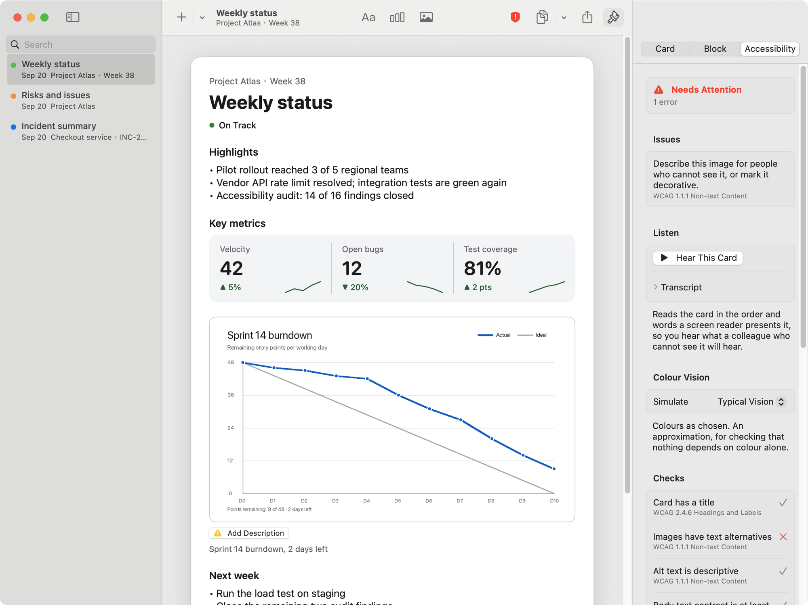
LIVE DEMO · 3 MINUTES
From scattered inputs to a shared card
1
New card from a template; type on the card
2
Paste a spreadsheet range: metrics with change arrows
3
Drop a screenshot: the shield turns red, “Add Description”
4
Hear This Card: “Image. No description.” Describe it; it clears
5
Colour Vision: still readable without red and green
6
⇧⌘C, paste into Mail, then into Slack
4
Notes:
Let me show you. I start a weekly status from a template and type straight onto the card. Now I copy a range from a spreadsheet and press Shift-Command-V. It recognises a table and offers metrics, with the change computed, and it knows that fewer open bugs is good news. I drop in a screenshot. The shield in the toolbar turns red, and the image asks for a description. Before I fix it, listen. [Play Hear This Card.] That's what a colleague with a screen reader gets: Image, no description. I describe it, and the check clears. Colour Vision shows the card as someone with red-green colour blindness sees it, and it still works, because every change has an arrow and words, not just colour. Finally Shift-Command-C. Paste into Mail: rich text, a real table, the image. Paste into Slack: the same copy, and Slack picks the flavour it understands. One copy, the right format in each place.

Slide 5
PRINCIPLE 1
One model, many renderers
Canvas, PNG, tagged PDF
Markdown, Slack
SwiftUI
chat and wiki
Email HTML, web page
SnippetCard
Plain text
inline styles, semantic
value type · Codable · Sendable
Messages, fallback
Rich text
Spoken narration
Mail, Notes
Hear This Card
Also on the same model: accessibility linter · templates · JSON import/export · reportcard CLI
5
Notes:
Three design principles. The first: one model, many renderers. A card is a plain value type with no UI dependencies, and every output is a pure function of it: the canvas you edit, the PNG and the PDF, inline-styled HTML for email, rich text for Mail, Markdown for Slack, plain text, even the spoken narration. That is why what you see is what you paste. It also makes a new destination cheap, and it lets the same code run without a window.

Slide 6
ARCHITECTURE
One package below, two consumers above
Reporting Builder.app
reportcard
SwiftUI + AppKit · Store · Workspace · Canvas · Inspector · Export · Assistant
a command-line tool · render · lint · site
↓ imports
↓ imports
ReportCore
a Swift package that imports only Foundation
Model · Ingestion · Rendering · Accessibility linter · Templates · Assistant prompts
Dependencies point one way
Testable without a window
One target away from iPad
ReportCore has never heard of SwiftUI, AppKit or the network, and nothing below it imports anything above.
Its ninety tests run in under a second, so the renderers and the linter stay cheap to change.
The package builds for iOS too. Only the views are specific to the Mac.
Swift 6 language mode throughout: a card is a Sendable value type, and the stores are main-actor observable objects.
6
Notes:
Here is the shape of it, because the shape is the argument. At the bottom is one Swift package, ReportCore, that imports nothing but Foundation: the model, the parsers, every renderer, the accessibility linter and the templates. Two things sit on top, and neither knows the other exists: the Mac app, and a command-line tool. Dependencies point one way, and that single rule buys three things. The package's ninety tests run in under a second, so the renderers and the linter stay cheap to change. The same code runs headless, which is how accessibility became a gate in the pipeline. And it already builds for iOS, so an iPad version is a target rather than a rewrite. Inside the app it is Swift 6 with strict concurrency: a card is a Sendable value type, the stores are main-actor observable objects, and the compiler checks it.

Slide 7
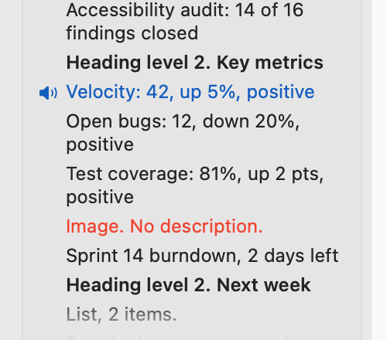
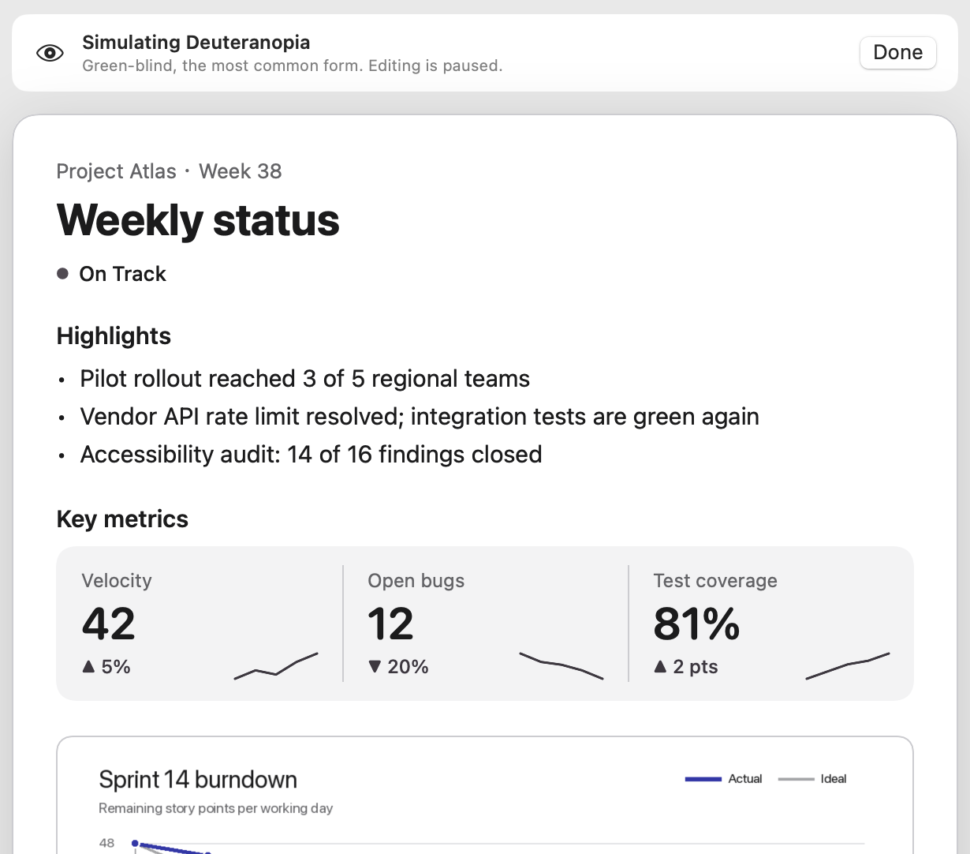
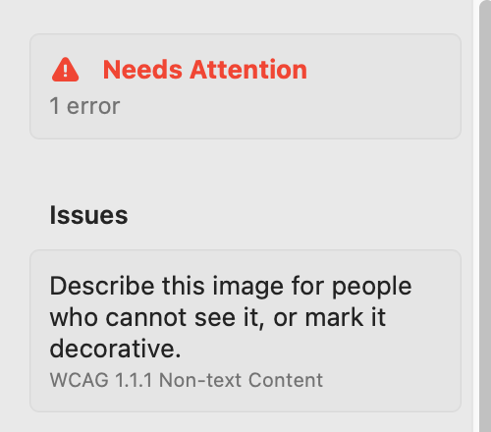
PRINCIPLE 3
Accessibility you can experience, not just pass
Hear This Card
Colour Vision
Fourteen checks, live
Spoken the way a screen reader presents it, block by block. A missing description is a silence you can hear.
Protanopia, deuteranopia, tritanopia, no colour. Status and changes still read, because they are shapes and words.
Contrast, alt text, labels, headings, and language: “the red items”, long capitals, images that are mostly text (on-device OCR).
7
Notes:
The third principle is the one I care most about. Passing a checklist is the floor. Most people who write status reports do not use a screen reader, so they cannot tell what their report is like for someone who does. So the app lets you experience it. Hear This Card reads the card in the order and words a screen reader uses: heading level one, list of three items, velocity forty-two, up five percent, positive. If an image has no description, you hear the gap. Colour Vision shows the card under the common colour-vision deficiencies. And the linter checks fourteen rules as you type, each mapped to a WCAG criterion, including ones about language: it flags “the items marked in red”.

Slide 8
ACCESSIBILITY, CONTINUED
For those who read it, and those who write it
For the reader
For VoiceOver and keyboard users
Large print
Audio Graph
Standard, Large, Extra Large. HTML, rich text, PNG and PDF all follow.
A metric's trend plays as pitch through AXChartDescriptor, as in Stocks and Health.
Tagged PDF
Rotor and actions
Real text, H1/H2, lists, figures with alt text, document metadata.
A Blocks rotor; Move Up, Move Down, Format, Delete on every block.
Semantic email HTML
System settings honoured
Headings, table header scopes, hidden words for ▲ and ▼, status never by colour alone.
Differentiate Without Colour, Increase Contrast, Reduce Transparency, Reduce Motion. Undo and Redo.
8
Notes:
Accessibility has two audiences. For people who receive a card: large print, which every export follows, and a tagged PDF with real text, headings and figure descriptions, so a screen reader treats it as a document rather than a picture. For people who use the app with VoiceOver: a metric's trend is an Audio Graph, so you hear the line as pitch; each block has move and delete actions, and a rotor jumps between blocks. The app honours the system's contrast, colour, transparency and motion settings.

Slide 9
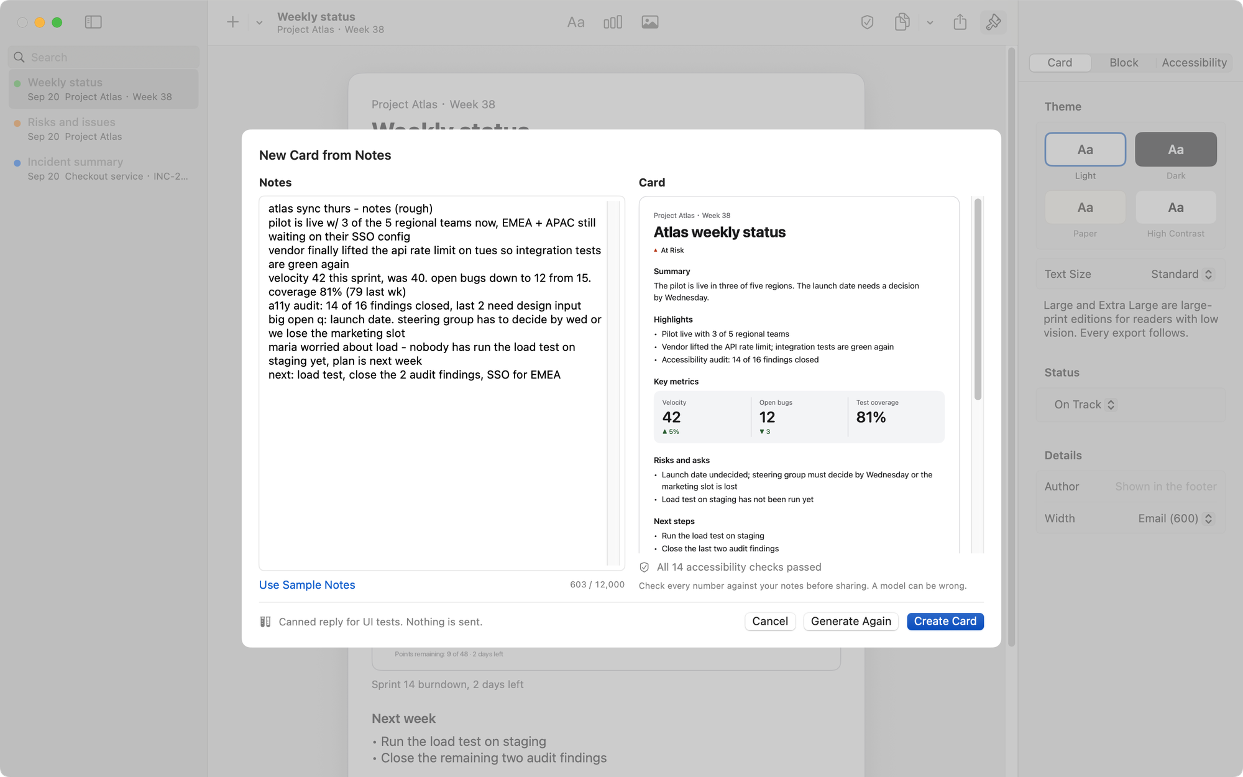
AI ASSISTANCE · OPT-IN
New Card from Notes: the brief's first sentence
Rough notes in; title, status, highlights, metrics, risks, next steps out
The reply is untrusted input: parsed, bounded, mapped, then linted
Nothing is saved until Create; “check every number”
Refine a text block: concise, formal, grammar. One undo step
Not rebuilt: the system's Writing Tools already work in every field
Provider-agnostic: on-device first
9
Notes:
I added one AI feature, because it answers the first sentence of the brief: quickly assemble and structure project progress. You paste rough notes, and the model returns a structured report: title, status, highlights, metrics, risks, next steps. What matters is what happens to the reply. It is treated as untrusted input: parsed defensively, every list bounded, the status mapped onto an enum, and then it goes through the same accessibility linter. The prompt forbids inventing numbers, nothing is saved until you press Create, and the sheet tells you to check every number. Refine does the same for one text block. I did not rebuild Writing Tools: with Apple Intelligence the system already provides them in every text field.

Slide 10
AI ASSISTANCE · DATA RISK
For this exercise only: not how I would ship it
Sending real project data to a public third-party model is not acceptable in a real business setting. The demo uses a public API only because my Mac (macOS 15) cannot run the on-device model.
Why it is a risk
What I would ship instead
Confidentiality: plans, names, financials, incidents leave the organisation
Provider's retention and training terms, provider's jurisdiction
No DPA, vendor security review, data residency or audit trail
Prompt injection via pasted notes; confident wrong numbers
A personal API key on a laptop is not an enterprise credential
On-device first: Apple Foundation Models, nothing leaves the Mac
Otherwise an approved internal gateway: auth, redaction/DLP, logging
Already built: endpoint and model are configuration, not code
Already built: off by default, consent per host, key in the Keychain, HTTPS only
Already built: one build flag removes the feature and the network entitlement
10
Notes:
Now the part I want to be very clear about. In this demo the model is a public API, DeepSeek. That is for this exercise only. I would not ship it, and I would not use it with real data. Status reports are business data. Sent to a public third-party model they leave the organisation's control: the provider's retention and training terms apply, in the provider's jurisdiction, with no data-processing agreement, no security review and no audit trail. Pasted notes can carry a prompt injection, and a model can state a wrong number confidently. So why is it here? My Mac runs macOS 15, which cannot run Apple's on-device model, and a demo needs a model that answers. But the design assumes the right answer. The provider sits behind a protocol. The first implementation is Apple's Foundation Models, on device, where nothing leaves the Mac. The second is any compatible endpoint, which in a company means an approved internal gateway with authentication, redaction and logging. The feature is off by default, asks consent per host, and one build flag removes it with the network entitlement.

Slide 11
TESTING
Fast where it is cheap, honest where it is not
90
47
12
2
core unit tests
app unit tests
UI tests
static checks
Parsers, renderers, contrast maths, the fourteen linter rules, the draft parser. Under one second.
Store and undo, persistence, every export including the tagged PDF, pasteboard types, smart paste.
Canvas, inspector, the undescribed image, Hear This Card, Colour Vision, drafting, and XCTest's accessibility audit.
SwiftLint and SwiftFormat, clean, on every push alongside the tests.
Kept deterministic
Not covered by a test, and said so
Never the real clipboard, network or files: named pasteboards, temporary directories, an in-memory store, a stubbed client
One exception, on purpose: the Copy for Email test uses the real pasteboard, because that is what it tests
Dates and locale are injected, so a footer never depends on the test machine
Launch arguments open the app in a known state: a seeded card, a missing description, a canned model
How Mail and Slack actually render a paste: each destination is marked verified or expected in the docs
The VoiceOver experience: the data is tested, the experience needs a person who uses it daily
PDF/UA conformance: the structure tree is checked, a validator is not run
Each of these sits in the documentation next to the feature it limits
11
Notes:
On testing, and the split is deliberate. Ninety tests in the package cover everything that is a pure function: parsers, renderers, contrast maths, the fourteen linter rules, and the parser that turns a model's reply into a card. They finish in under a second, so I run them constantly. Forty-seven app tests cover the store and undo, persistence, every export including the tagged PDF, and the assistant against a stubbed HTTP client. Twelve UI tests drive the real app, including XCTest's accessibility audit. Nothing touches your clipboard, your network or your files, with one deliberate exception: the Copy for Email test uses the real pasteboard, because the pasteboard is the thing under test. Three things I do not test, and say so instead: how Mail and Slack really render a paste, the VoiceOver experience, and PDF/UA conformance.

Slide 12
ENGINEERING
Built to be read and changed
0
12
4
1
third-party dependencies
architecture decision records
feature flags, set in xcconfig
YAML spec generates the Xcode project
Code
Configuration and delivery
Documented public API; comments say why, not what
Model replies are untrusted input: parsed, bounded, linted
One concern per type; the compiler lists every place a new block kind touches
Conventional commits, one change each, readable in order
Versions, flags and signing live in xcconfig, not buried in the project file
XcodeGen writes the .xcodeproj from YAML, so the build is reviewable
One flag removes writing assistance and its network entitlement
GitHub Actions on every push: tests, SwiftLint, SwiftFormat, CLI smoke test
12
Notes:
On the engineering around it. Configuration is not buried in the Xcode project: versions, feature flags and signing live in xcconfig files and reach the running app through one typed accessor. The project file is generated from a YAML spec, so a reviewer can read the build the way they read the code, and one flag removes writing assistance together with its network entitlement. There are no third-party dependencies. And twelve short decision records explain the choices someone might question, including the ones I reversed.

Slide 13
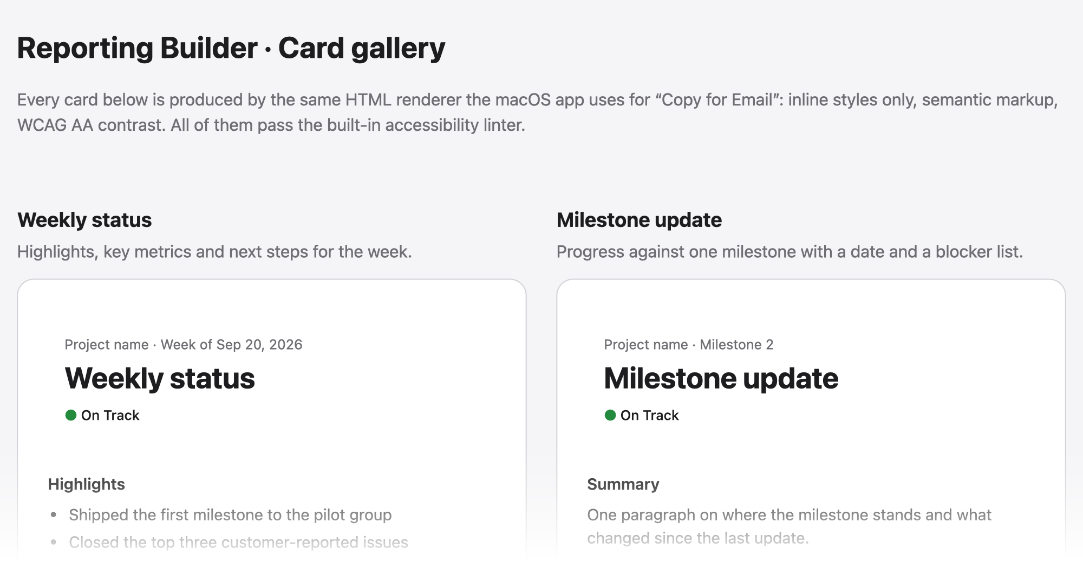
CLOUD AND DELIVERY
The cloud carries the software, not your data
git push
→
Tests + lint
→
reportcard lint
→
Pages gallery
every commit
GitHub Actions
accessibility gate
same HTML renderer
User data stays on the Mac by design
Release workflow on a version tag: zipped app and checksum
Headless CLI: render from JSON, lint in any pipeline
Enterprise path: notarise, then Apple Business Manager or MDM
Next: share links via CloudKit or an internal Swift service; the renderers do not change
13
Notes:
The brief mentions the cloud. A Mac app is distributed rather than hosted, and user data stays local on purpose, so what ships to the cloud is the software and its output. On every push, GitHub Actions runs the tests and lint. A push to main also renders a gallery of every template, with the same HTML renderer the app uses for email, and publishes it, but only if every card passes the linter in strict mode. Accessibility becomes a pipeline gate. A version tag is set up to build a release; I have not cut one yet. In an enterprise the same artifact would be notarised and distributed through Apple Business Manager or MDM.

Slide 14
TRADE-OFFS
What I would not claim yet
Not verified, and documented as such
Deliberate limits and next steps
On-device model: compiles with availability checks, not run (my Mac is on macOS 15)
Paste targets: “verified” and “expected” are kept apart in the docs
VoiceOver features: data is tested, the experience needs a human
Tagged PDF: structure tree present, not validated against PDF/UA
Ad-hoc signed; notarisation needs a Developer ID
Tiny text markup on purpose, so every renderer agrees
Rich text has no alt text: Mail gets the caption; HTML and PDF keep the description
Colour-vision matrices are an approximation, not a clinical tool
Next: iPad target on the same core, share links, localisation
Each of these is written down in the repository, next to the feature it limits: the paste matrix, the accessibility notes and the decision records.
14
Notes:
I want to be straightforward about what I cannot claim. The on-device model path compiles behind availability checks, but I could not run it on macOS 15. The paste matrix separates what I verified by hand, which is Copy for Email into Mail, Notes, Messages and Slack, from what I expect from each app's documentation. The VoiceOver features are tested for their data; the experience needs someone who uses VoiceOver every day. The tagged PDF has a structure tree, but I have not run a PDF/UA validator. Next would be an iPad target on the same core, share links, and localisation.

Slide 15
Three things to take away
1
One model, many renderers
What you see is what you paste, in every channel.
2
Accessibility you can hear and see
For the author, the reader, and the VoiceOver user.
3
Privacy is a design decision
Local by default, AI opt-in, and honest about what is a demo.
Thank you. Questions?
github.com/ANTI-Tony/apple_oa · anti-tony.github.io/apple_oa
15
Notes:
Three things to take away. One model, many renderers: what you see is what you paste. Accessibility you can hear and see, not only pass, for the author, the reader and the VoiceOver user. And privacy as a design decision: local by default, AI opt-in, and honest about which parts are a demonstration. Thank you. I'd be glad to go deeper into any part.

