Slide 1


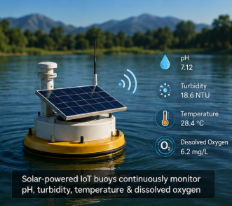
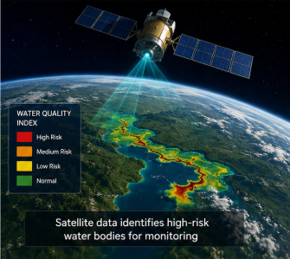
OSCode
DECODE SIH 2026
by communityX
AQUA-ETHIC
Real-Time, Tamper-Evident Water Quality Monitoring for Early Contamination Detection in Rural India
PRESENTED BY:
Bytyetalks

Slide 2
OSCode
by communityX
TEAM MEMBERS
Team Member 1 : Neeraj K J
Team Member 2 : Jerrin Anto
Team Member 3 : Thulasi G T
Team Member 4 : Sudeeksha

Slide 3


OSCode
PROBLEM STATEMENT
by communityX
Problem Title : Smart Water Intelligence System for water quality monitoring.
What does this Problem Aim to Solve?
->Delayed Detection Water contamination is detected only after 2–5 days.
-> Unreliable Records Water quality records can be altered or deleted.
-> No Instant Alerts Communities receive no timely warning about unsafe water.
-️> Limited Monitoring No smart way to prioritize high-risk water bodies.
️ Why did our Team Choose this?
-> Real-World Impact Clean water is a basic necessity for everyone.
-> Purposeful Technology IoT + AI + Blockchain + Cybersecurity work together to solve the problem.
-> Affordable & Scalable ₹10–15K prototype suitable for villages to cities.
-> Meaningful Outcome Real-time monitoring with transparent, trusted data.

Slide 4
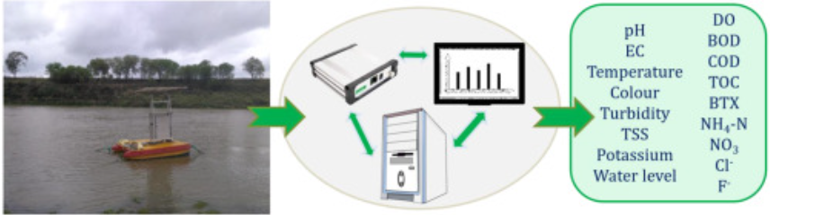
REAL-WORLD PROBLEM ALIGNMENT
OSCode
by communityX
Who faces this issue?
Communities depending on river water
Pollution Control Boards & Government Agencies
Farmers and Fishermen
Industries requiring continuous compliance monitoring
Environmental researchers and NGOs
What’s the current gap in the system?
Existing systems monitor only selected locations due to high deployment costs.
Water quality data is not fully transparent or tamper-proof.
No integrated platform combining satellite screening + IoT sensing + blockchain.
Limited real-time alerts and citizen access to verified water quality data.
Mention if it connects to any existing schemes.
Namami Gange Mission – Supports transparent river quality monitoring.
National Water Mission – Promotes sustainable water resource management.
Digital India – Enables digital governance through IoT and data transparency.
Smart Cities Mission – Encourages smart environmental monitoring solutions.
Swachh Bharat Mission – Contributes to cleaner rivers and healthier ecosystems.
How does your proposed solution fill that gap practically?
Uses satellite screening to identify high-risk water bodies before deployment.
Deploys low-cost IoT floating buoys for continuous water quality monitoring.
Stores sensor records on blockchain, ensuring immutable and verifiable data.
Provides real-time dashboard and alerts for both citizens and authorities.
Designed as a scalable, affordable prototype suitable from villages to cities.

Slide 5
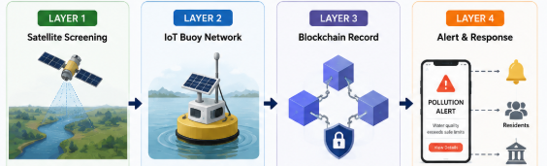
OSCode
PROPOSED SOLUTION
by communityX
What are you Building?
AQUA-ETHIC is a smart, low-cost water quality monitoring system that combines Satellite Imaging, IoT, Blockchain, and AI to detect river pollution in real time. Satellite data first identifies water bodies showing unusual changes. Low-cost solar-powered IoT buoys then continuously monitor pH, turbidity, temperature, and dissolved oxygen. Every sensor reading is securely stored on the Ethereum blockchain, making it transparent, tamper-proof, and independently verifiable. A live dashboard displays water quality updates, while instant alerts notify citizens and authorities whenever pollution crosses safe limits. Our goal is to make water quality monitoring faster, affordable, transparent, and scalable for communities across India.
What are the 3-4 Key Features?
Satellite-Based Screening
Detects high-risk water bodies for targeted monitoring.
Low-Cost IoT Buoys
Real-time monitoring of pH, turbidity, temperature & DO.
Blockchain Verification
Immutable, tamper-proof water quality records.
Live Dashboard & Alerts
Real-time updates and instant notifications to citizens & authorities.
What makes it different or innovative?
Integrates Satellite + IoT + Blockchain + AI into one platform.
Tamper-proof records ensure trust and transparency.
Affordable & scalable (~₹10–15K per buoy), suitable from villages to cities.
Goes beyond monitoring by enabling Detection → Verification → Alert → Action.

Slide 6
OSCode
by communityX
TECH STACK & ARCHITECTURE
Tech Stack (E.G., NextJS, Express, Hono, AWS, etc.)
APIs/Libraries
Deployment Plan
High-level Block Diagram OR Architecture

Slide 7
OSCode
ARCHITECTURE DIAGRAM
by communityX
Show the Technical Flow using a simple block diagram.
Mention Frontend/Backend/Tools/API connections.
Include Cloud/Database/ML Model (if applicable)

Slide 8
OSCode
by communityX
THANK YOU

Slide 9
OSCode
by communityX

