Slide 1

FINAL PROJECT
Name : ANUSHA M
College : Rohini College of Engineering and Technology
Stream : Computer Science and Engineering
Degree : BE
Email ID : anushamohanraj2003@gmail.com
NM ID : au963321104007

Slide 2
PROJECT TITLE
TEXT SUMMARIZATION USING LSTM-RNN

Slide 3
AGENDA
Problem Statement
Project Overview
Who Are The End Users?
Your Solution and its value proposition
The wow in your solution
Modelling
Results
Conclusion

Slide 4
PROBLEM STATEMENT
The project aims to implement a Long Short-Term Memory (LSTM) network for text summarization, specifically targeting Amazon food reviews dataset. The dataset comprises textual reviews of food products, and the goal is to develop a model capable of generating concise summaries of these reviews, capturing the key information and sentiments expressed by the reviewers.

Slide 5
PROJECT OVERVIEW
The project "Text Summarization using LSTM" aims to develop a system that automatically generates concise summaries of large text documents. This system utilizes Long Short-Term Memory (LSTM) neural networks, a type of recurrent neural network (RNN), to understand the sequential structure of text data and extract the most important information. The project involves preprocessing textual data, training the LSTM model on a dataset of text-summary pairs, and fine-tuning the model to optimize summarization accuracy. The end goal is to provide users with an efficient tool for quickly grasping the key points of lengthy texts, saving time and effort in information consumption.

Slide 6
WHO ARE THE END USERS?
The end users for a text summarization project using LSTM could be anyone who needs to quickly grasp the key points of a lengthy text, such as researchers, students, journalists, or professionals dealing with large volumes of textual data.

Slide 7
YOUR SOLUTION AND ITS VALUE PROPOSITION
The solution of text summarization using LSTM lies in its ability to mimic human comprehension and condense lengthy texts into concise summaries, effectively extracting the most important information. This technology streamlines information consumption, enabling users to quickly grasp key points without having to read through extensive documents.
The value proposition lies in saving time and effort by providing users with condensed and relevant information, enabling quicker understanding and decision-making.

Slide 8
THE WOW IN YOUR SOLUTION
Delving into the intricate world of text summarization with LSTM (Long Short-Term Memory) technology opens new vistas of efficiency and insight. LSTM, a specialized form of recurrent neural network (RNN), exhibits remarkable prowess in understanding and synthesizing textual data, making it a prime candidate for summarization tasks. By leveraging LSTM's ability to capture long-range dependencies and preserve essential context, text summarization reaches unprecedented levels of accuracy and coherence. Whether it's condensing lengthy articles, extracting key insights from documents, or generating concise summaries of vast datasets, LSTM-driven text summarization offers a transformative solution with the potential to revolutionize information processing across diverse domains.

Slide 9
MODELLING
Data Preparation:
Downloaded the Amazon fine food reviews dataset
Dataset Link : https://www.kaggle.com/datasets/snap/amazon-fine-food-reviews
To preprocess the dataset, there are several things that should be done. First, the data must be cleaned. All of the stopwords, symbols, etc should be removed and contraction mapping should be done. After this,split the data for tokenization. It will be tokenized and ready for the model's training.
Model Building and Training:
This project having a sequence as our input and a sequence for our output and because of that, Calling the model Seq2Seq (Sequence to Sequence) is done.
Implementing the seq2seq model using LSTM-RNN.First input should be defined. The input goes to the encoder. The state of the encoder gets to the decoder. Then the result of the decoder goes to a attention layer. This layer gets the main focus of the subject and adjust the weights and biases.

Slide 10
MODELLING
LSTM Architectural Design:
LSTM (Long Short-Term Memory) networks are a type of recurrent neural network (RNN) architecture designed to handle the vanishing gradient problem and capture long-term dependencies in sequential data.
Encoder: Construct an LSTM network to encode the input text into a fixed-length vector representation. Experiment with variations in LSTM layer sizes, the number of layers, and dropout rates to optimize performance.
Decoder: Implement another LSTM network as the decoder to generate the summary based on the encoded vector. Use techniques such as teacher forcing to train the decoder efficiently.
Attention Mechanism: Incorporate an attention mechanism to allow the model to focus on relevant parts of the input text during summarization.

Slide 11
MODELLING
Hyperparameters Tuning:
Conducted hyperparameter tuning experiments to optimize the model performance.
Explored variations in learning batch size, latent dimension,embedding dimension.
Selected the hyperparameters that lead to the best performance based on evaluation metrics.
Model Testing and Evaluation:
As the model is trained and ready to test and evaluate the model. To do this trained layers prepared for single prediction.
Then, Some functions should be defined that transform sequences to texts and texts to sequences.
At the end,define a function for single prediction.
Deployment:
The trained model and associated code are deployed into a GitHub repository.
Included instructions for setting up the environment and running the code.
Created documentation and README files explaining the project, algorithm RESULT instructions.

Slide 12
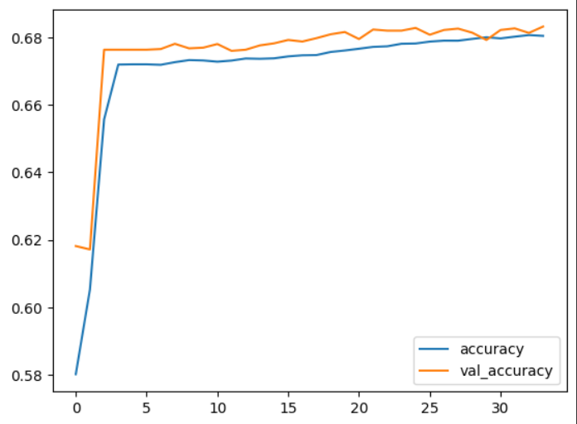
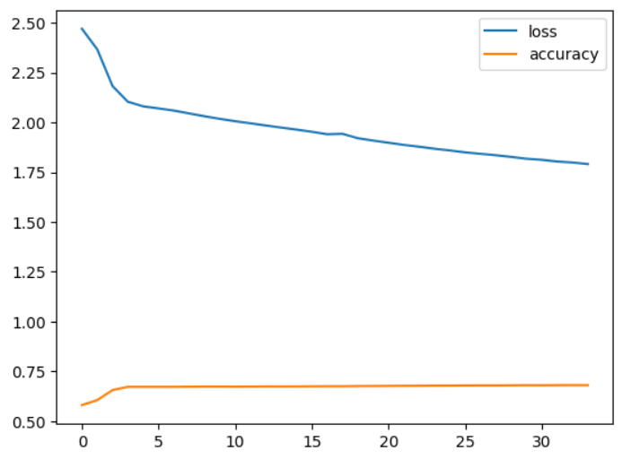
RESULTS
Demo link:
https://github.com/ANU-0011/TNSDC-Generative-AI-For-Engineering/blob/main/Text%20Summarization%20using%20LSTM%20in%20RNN.ipynb

Slide 13
CONCLUSION
This project demonstates the capabilities of LSTM networks in text summarization, highlighting their effectiveness in condensing large bodies of text into concise summaries. Moving forward, continued research and experimentation will undoubtedly enhance the performance and applicability of LSTM-based summarization techniques, opening up new avenues for efficient information processing and knowledge extraction.
Dataset Link : https://www.kaggle.com/datasets/snap/amazon-fine-food-reviews

