Slide 1

Car and bike rental

Slide 2

ABSTRACT:
The website is a full-stack web application which allows the clients to rent a car or bike.
The main goal of the website is to facilitate the process of renting a vehicle.
HTML,CSS and JavaScript involves in the client side.

Slide 3
PHP involves in the server side.
MySQL is used as the database.
The user can rent a vehicle by uploading his details which will be stored in the database for later use.
The agency can organize and deliver the vehicles according to the entries in the database.

Slide 4




TECHNOLOGY AND TOOLS:
HTML 5
CSS 3
JavaScript
PHP

Slide 5



XAMPP
Apache
phpMyAdmin

Slide 6
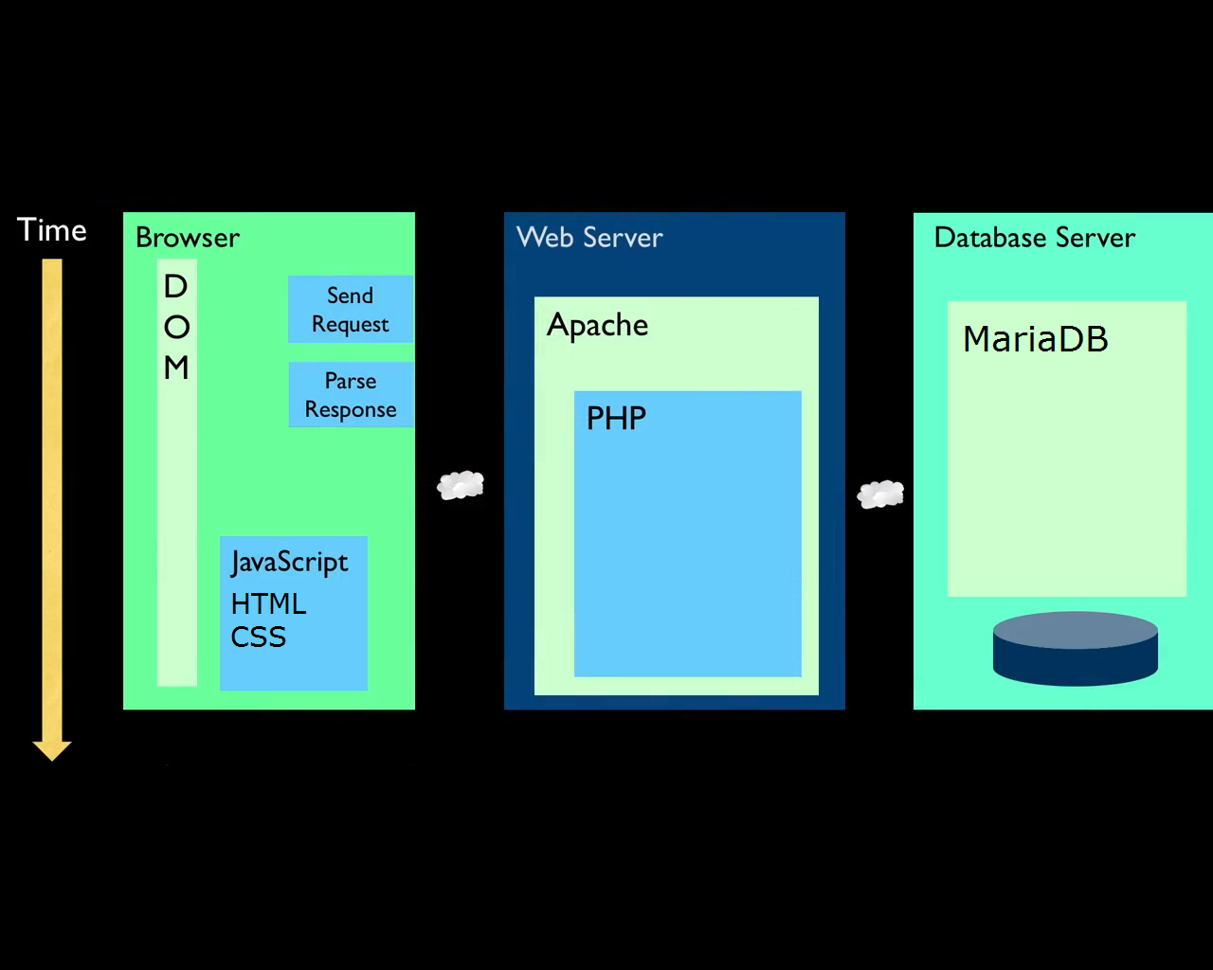
ARCHITECTURAL DIAGRAM:

Slide 7
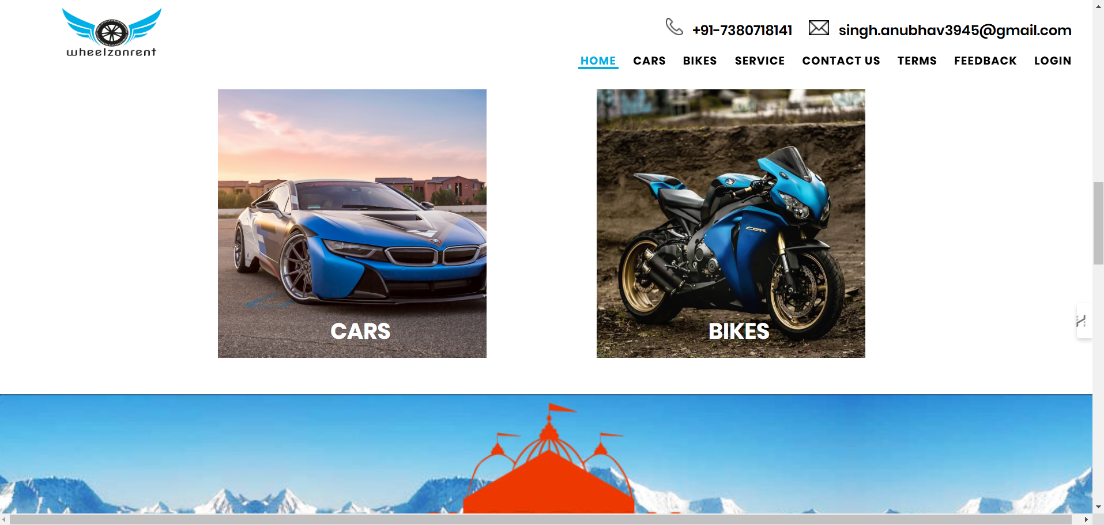
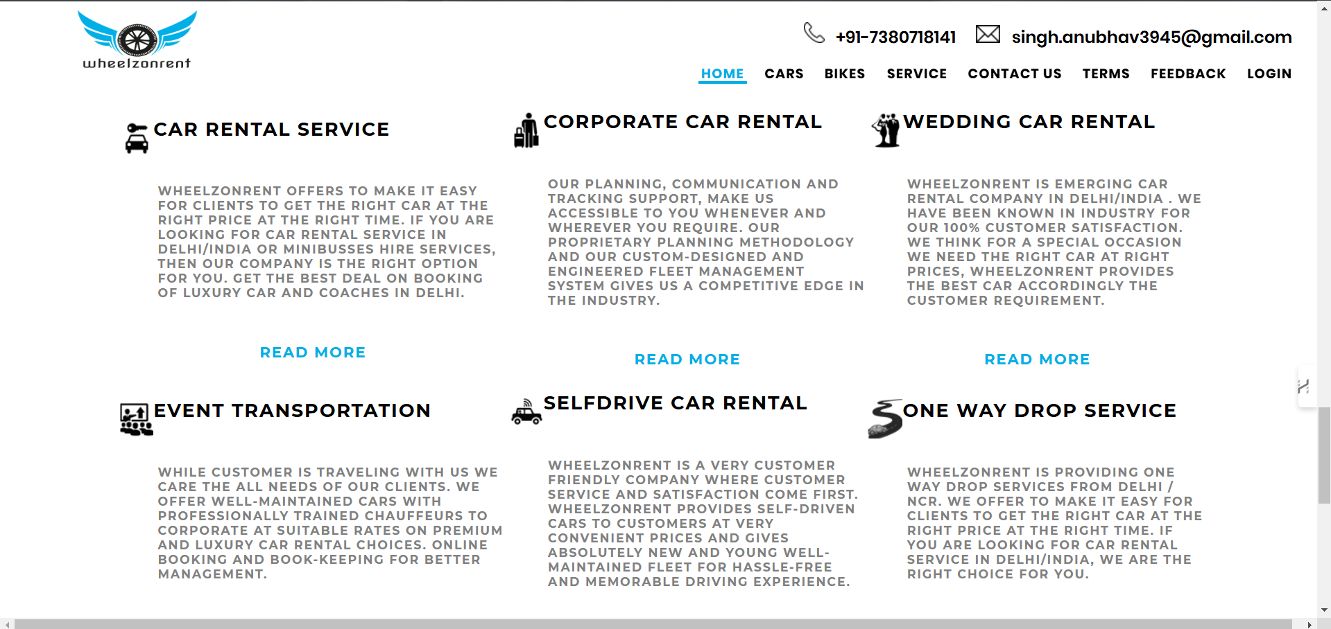

Slide 8
CONCLUSION:
Notepad++ was used as code editor.
XAMPP was used as an alternative for server and database(Apache and MySql).
The package consists of totally 16 items,13 php files,2 css font files and 1 script file including a folder for images.

Slide 9

Image SLide
REFERENCE
www.w3schools.com
www.stackoverflow.com
www.wheelzonrent.com

Slide 10
THANK YOU

